Slide 1
How Can an Na⁺ Channel Inhibitor Ameliorate Seizures in Lennox-Gastaut Syndrome?
ANNALS of Neurology 2021;00:1–15
Yun-Chu Lin, MS, Yi-Chen Lai, MS, Ping Chou, MS, Shu-Wei Hsueh, MS,
Tien-Hung Lin, BS, Chen-Syuan Huang, PhD, Ren-Wei Wang, MS,
Ya-Chin Yang, PhD , and Chung-Chin Kuo, MD, PhD
Speaker：Yun-Chu Lin M.S.
Date：2023.10.28

Slide 2
Introduction

Slide 3
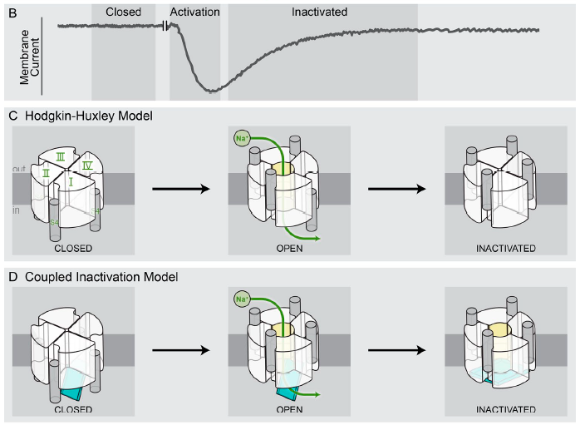
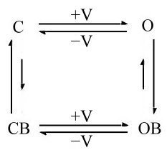
Activation and Inactivation of Sodium Channel
Hodgkin and Huxley(HH) model ： m³h
Kuo and Bean. Neuron. (1994)
Ahern et al. The Journal of General Physiology.(2015)

Slide 4
Results

Slide 5
Rufinamide Selectively Binds to Inactivated Na⁺ Channel
The apparent binding affinity of RFM
relative current = 1/(1+ [RFM]/Kapp)
-120 mV K_{app}: 242.2 mM. -70 mV K_{app}: 573.7 μM.

Slide 6
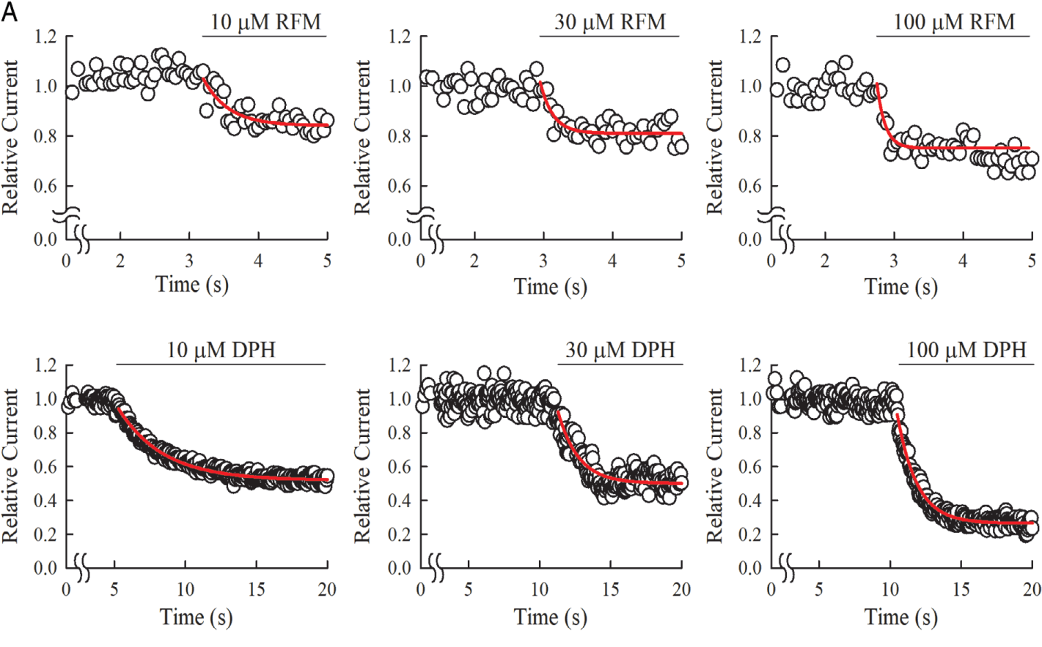
RFM Has Faster Binding Kinetics Than Classical Na⁺ Channel Inhibitors
DPH：
On-rate: 3.2×10³ M⁻¹s⁻¹
Off-rate: 0.41 s⁻¹
The binding kinetics of RFM and DPH to Na⁺ Channel At -70 mV
RFM：
On-rate: 3.4×10⁴ M⁻¹s⁻¹
Off-rate: 4.0 s⁻¹

Slide 7
RFM Has Faster Binding Kinetics Than Classical Na⁺ Channel Inhibitors
The stronger inhibitory effect of RFM at −60 than at −80mV V
RFM at -60 mV：
On-rate: 4.0×10⁴ M⁻¹s⁻¹ ~ 1.2×10⁵ M⁻¹s⁻¹
Off-rate: 43.0 s⁻¹ ~ 46.0 s⁻¹

Slide 8
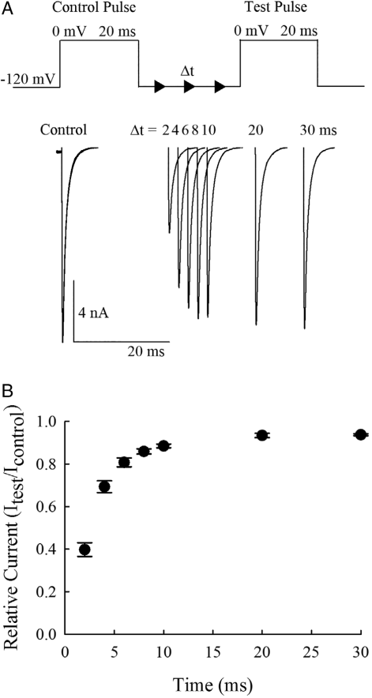
RFM Binds to Inactivated Na⁺ Channel with Ultrafast Rate of ~2.7×10⁵ M⁻¹ s⁻¹
In the presence of RFM, most of the channels not recovered are RFM-bound
On-rate: 2.7×10⁵ M⁻¹s⁻¹
Off-rate: 17.0 s⁻¹

Slide 9
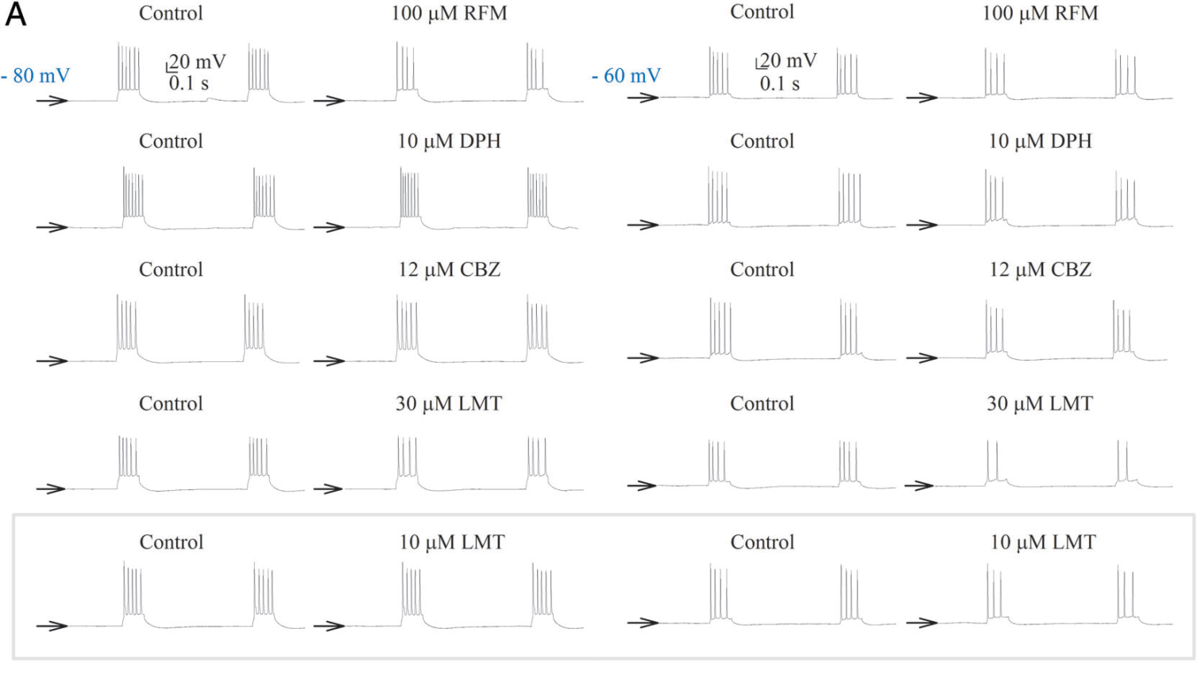
RFM Is Distinctively Effective against Short Burst Discharges with More Hyperpolarized Interburst Intervals
The stronger inhibitory effect of RFM than phenytoin (DPH),
carbamazepine (CBZ),
and lamotrigine (LMT)
on short burst discharges (~200 ms)

Slide 10
Rufinamide Is Distinctively Effective against SWDs In Vivo
Inhibition of pentylenetetrazol (PTZ)-induced absencelike seizure discharges and behaviors by RFM rather than DPH
(except for type A discharges)
There are significantly increased spontaneous excitatory postsynaptic potentials (EPSPs) in hippocampal neurons from PTZ-injected mice compared to normal mice or mice injected with both PTZ and RFM
Type A : very short isolated spikes (~20–80 ms). The animal could have myoclonic jerks,but the behavior is normal (Racine stage 0)
Type B: repetitive spikes intermixed with waves, and the animals in general show absencelike behavior (“behavioral arrest,” Racine stage 0.5).
Type C: advanced type B, oscillations of larger amplitude and higher frequency (2–7Hz). Behaviorally, the animal would be in Racine stage 1 to 5

Slide 11
Conclusion

Slide 12
Suppression of SWDs and Seizures in Lennox-Gastaut Syndrome: Requirement and Limitation of Fast Drug Binding
EEG of LGS: Consist of a spike (duration <70 ms) or a sharp wave (70–200 ms), followed first by a wave(350-400 ms). (Arzimanoglouet et al. The LANCET Neurology., 2009)
The depolarization of LGS is too short for slow-binding Na ⁺ channel inhibitors such as phenytoin.
Rufinamide at 100μM may therefore take on average only ~40 ms (in vitro data) to bind to the inactivated Na⁺ channel to suppress the burst discharges.
Rufinamide could be the drug of choice for repetitive short burst discharges rather than the classical Na ⁺ channel inhibitors.
Ultrashort bursts or depolarization could persist with myoclonic jerks in the presence of rufinamide, because the bursts could be “cut shorter” by rufinamide.

