Slide 1
Speaker: De-Fong Huang (黃得峰), M.Sc.
Advisor: Hsien-Sung Huang (黃憲松老師), Ph.D.
Date: 2023.10.28

Slide 2
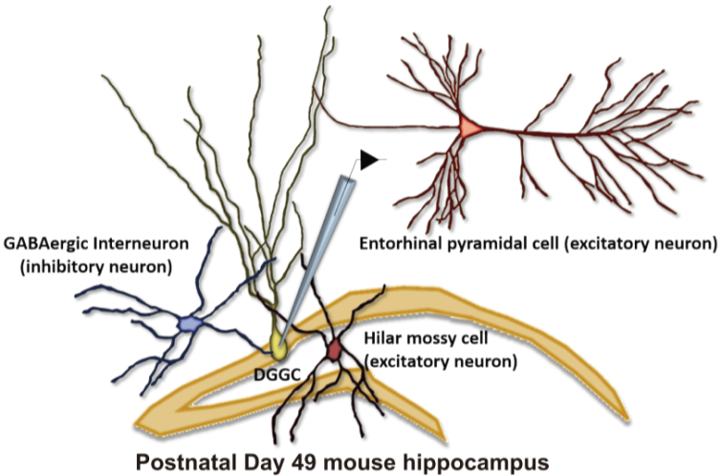
Cell-type-specific deletion of Rbfox3 in the hippocampal dentate gyrus
Mukherjee, A., & Nongthomba, U. (2023).
Wang HY, Hsieh PF, Huang DF, Chin PS, Chou CH, Tung CC, Chen SY, Lee LJ, Gau SS, Huang HS. (2015)
RBFOX3/NeuN is required for hippocampal circuit balance and function. Scientific Reports.
Lin YS, Wang HY, Huang DF, Hsieh PF, Lin MY, Chou CH, Wu IJ, Huang GJ, Gau SS, Huang HS. (2016)
Neuronal Splicing Regulator RBFOX3 (NeuN) Regulates Adult Hippocampal Neurogenesis and Synaptogenesis. PLOS ONE.

Slide 3
Selective deletion of Rbfox3 in GABAergic but not glutamatergic neurons causes spontaneous seizures and higher mortality in mice
Ctrl
KO

Slide 4
Increased evoked postsynaptic potential (ePSP) in hippocampal granule cells following selective deletion of Rbfox3 in GABAergic neurons

Slide 5
Selective deletion of Rbfox3 in GABAergic increased neuronal excitability but not intrinsic excitability in hippocampal granule cells
With neurotransmission
Without neurotransmission

Slide 6
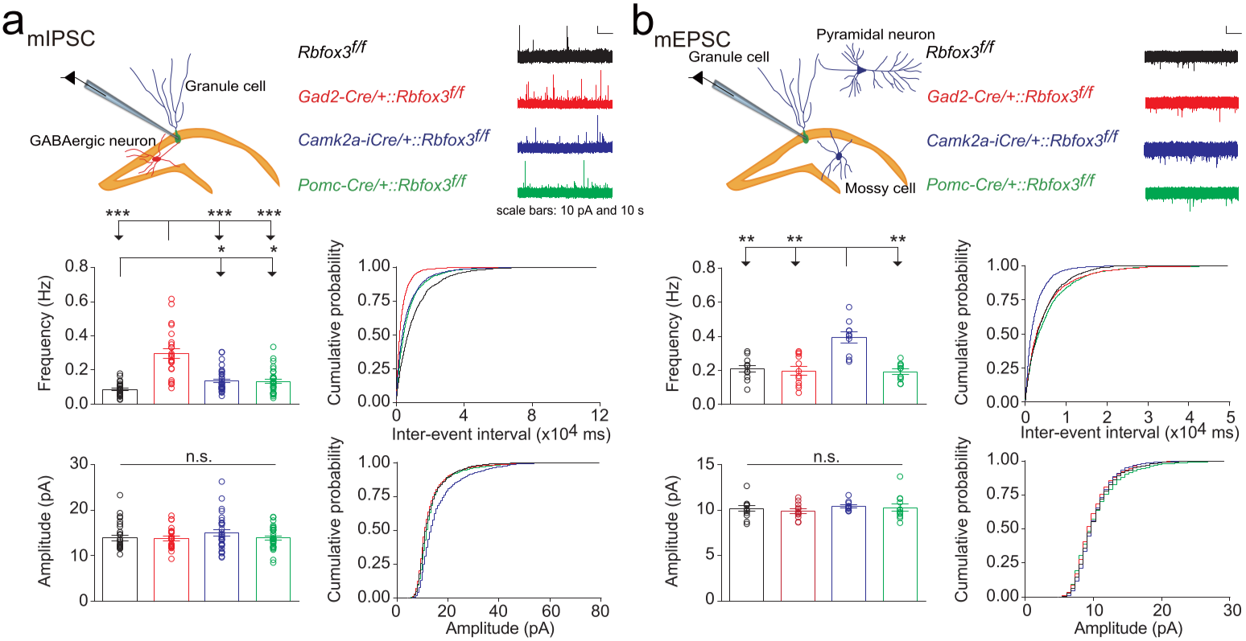
RBFOX3 mediates excitation/inhibition balance in a cell type–specific manner

Slide 7
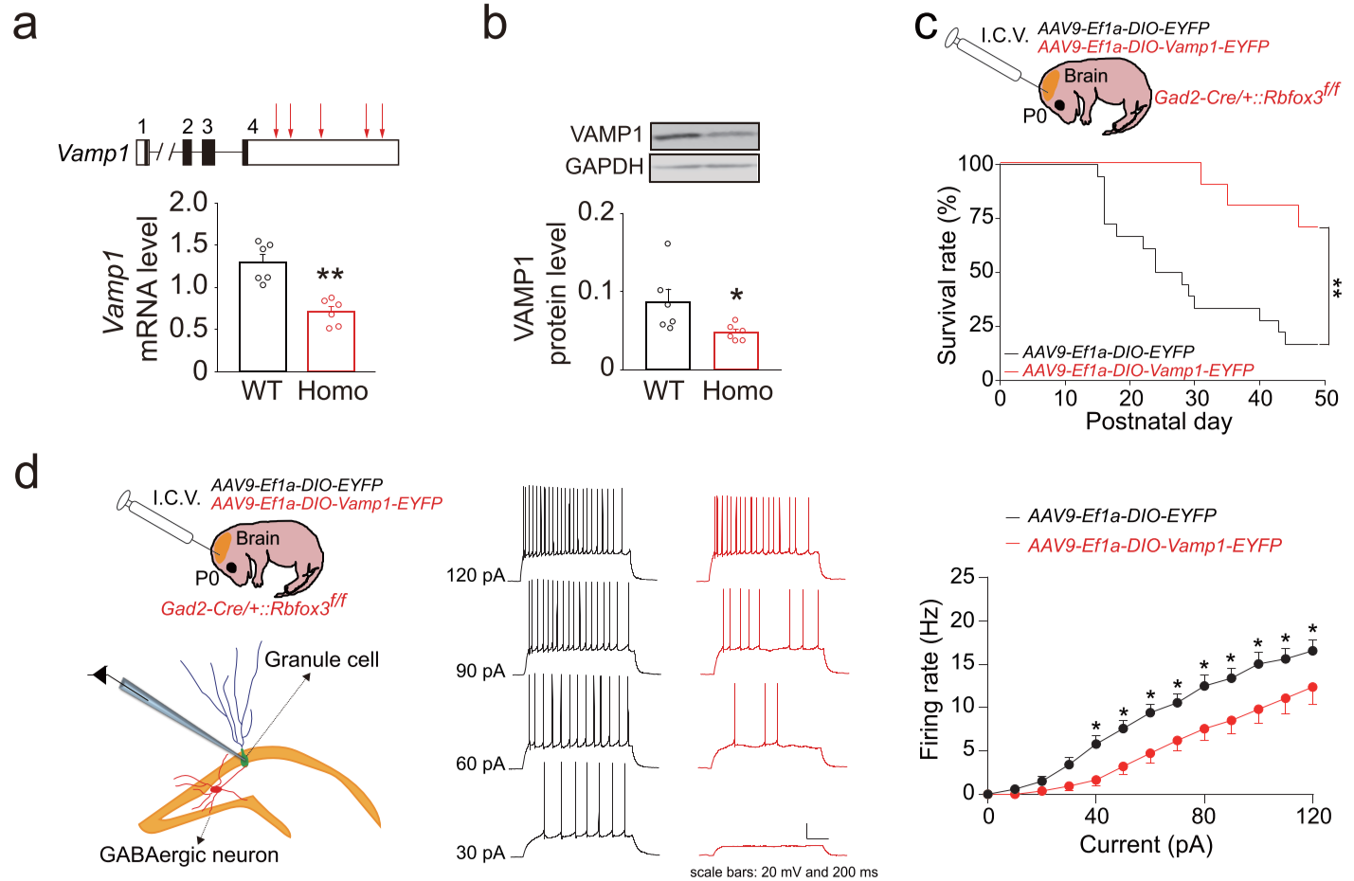
Premature mortality and neuronal excitability are rescued by postnatal restoration of VAMP1 in mice with Rbfox3 deletion in GABAergic neurons

Slide 8
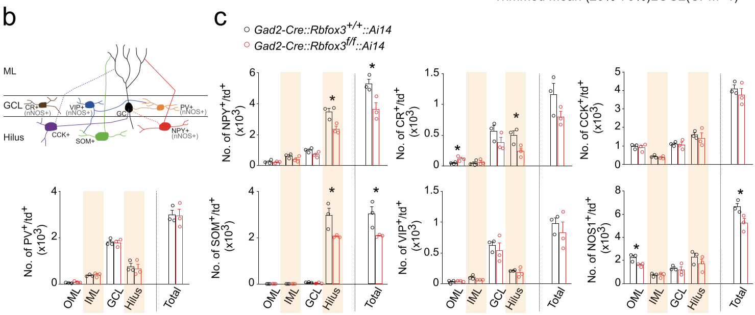
Alterations in the number of hippocampal GABAergic neurons with deletion of Rbfox3

Slide 9
The most severe seizures were exhibited by mice with selective deletion of Rbfox3 in NPY-expressing GABAergic neurons

Slide 10
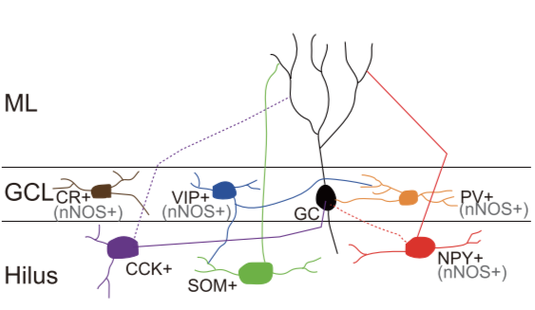
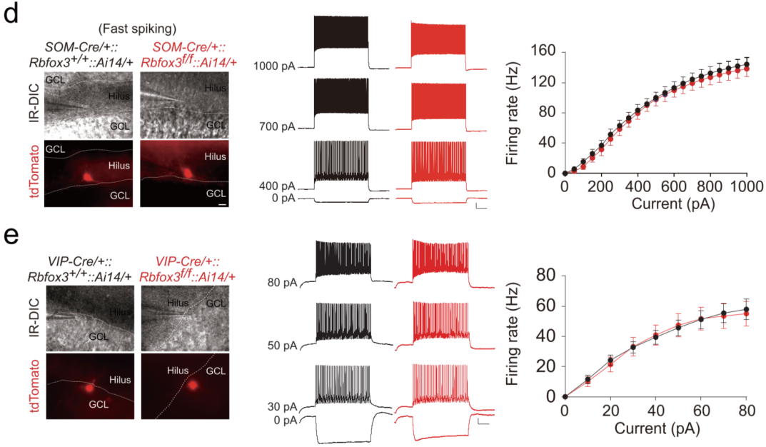
Selective loss of Rbfox3 in NPY-expressing GABAergic neurons decreases intrinsic excitability

Slide 11
Conclusion
excitability
Restoration of RBFOX3 or VAMP1
or
Bumetanide (FDA-approved drug)
( Figure adapted from Dr. Hsien-Sung Huang )

Slide 12
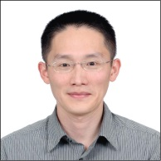
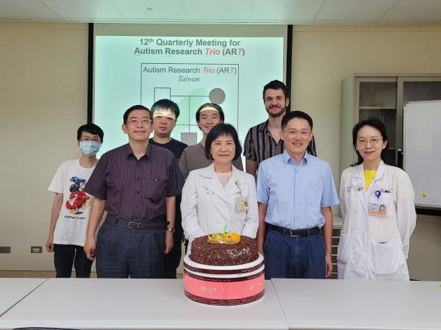
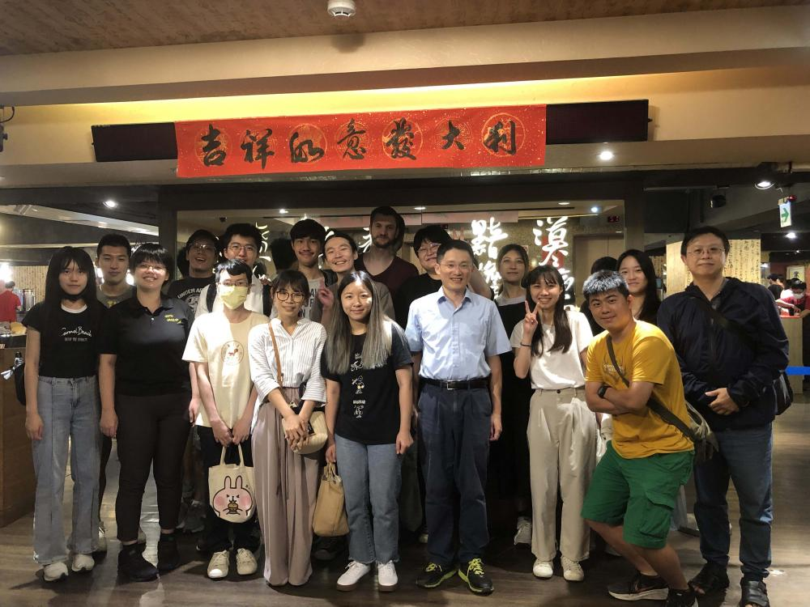
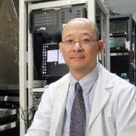
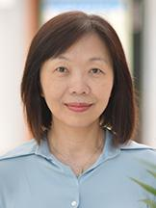
Acknowledgements
National Taiwan University:
Dr. Hsien-Sung Huang (黃憲松教授)
National Taiwan University:
Dr. Susan Shur-Fen Gau (高淑芬教授)
Dr. Hsiang-Po Huang (黃祥博副教授)
National Yang Ming Chiao Tung University:
Dr. Cheng-Chang Lien (連正章教授)
Academia Sinica:
Dr. Yi-Shuian Huang (黃怡萱研究員)

