Slide 1
The clinical relevance of anti-glutamic acid decarboxylase antibodies in children with encephalitis/encephalopathy
2023 全國兒童神經精神科學 勵翔獎 科學論壇
Anti-glutamic Acid Decarboxylase抗體在兒童腦炎/腦病變的臨床相關性及血中抗體濃度變化
侯如盈、林光麟、周怡君、洪伯誠、劉欣威、林建志、謝孟穎、郭政諺、劉懿萱、王煇雄 林口長庚兒童神經科 兒童重症加護科
2023/10/28

Slide 2
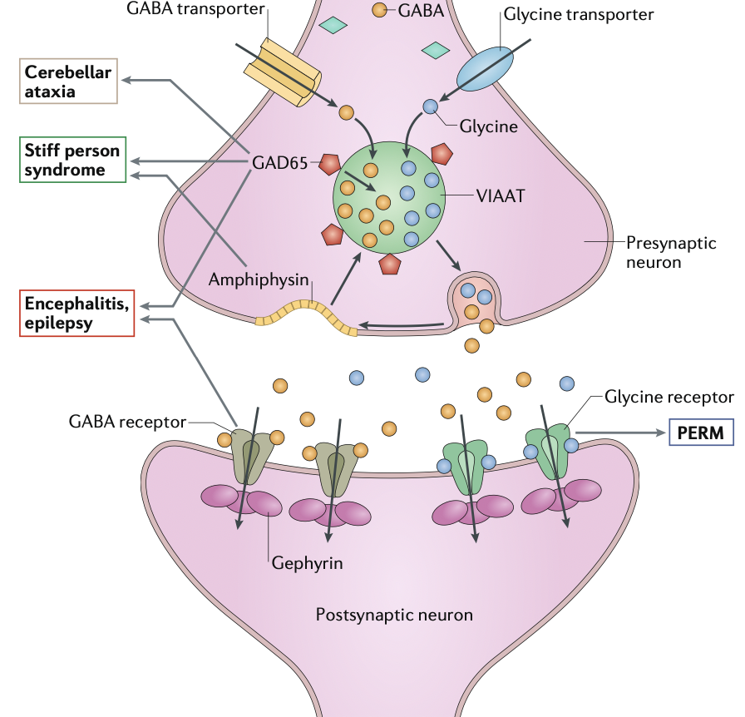
Background
Glutamic acid decarboxylase (GAD):
the rate-limiting enzyme in the synthesis of the inhibitory neurotransmitter
Anti-GAD antibody:
associated with a wide range of neurological conditions
The pathogenic role of anti-GAD Ab is still unclear
GABA
GAD
GABA
Autoimmune targets at the inhibitory synapse and the associated neurological disorders
Graus et al 2020
Notes:
GAD 是影響GABA合成的enzyme (glutamate轉成GABA)
Anti-GAD AB: stiff-person syndrome, cerebellar ataxia, epilepsy, and limbic encephalitis

Slide 3
Background
In children…
Anti-GAD Ab titers have been reported to be significantly higher in children with encephalitis and status epilepticus than in those of control children with therapy-resistant epilepsy
Presumed infectious etiologies may account for pediatric encephalitis with anti-GAD antibodies, suggesting a possible immune-mediated mechanism after a severe febrile infection.
However, few studies have investigated the association between anti-GAD antibody titers and clinical presentation in children with encephalitis/encephalopathy.
(Lin et al., 2012)
(Lin et al., 2014)

Slide 4
Aim of the study
To evaluate whether serum anti-GAD antibody titers were associated with
the initial symptoms
clinical severity
outcomes
of children with encephalitis/encephalopathy.
Notes:
建志那篇：高的腦炎>癲癇
0 high 2020 NNN Neurologic syndromes related to anti-GAD65 Clinical and serologic response to treatment：成人腦炎 ->放在discussion?

Slide 5
Methods
Single-center retrospective cohort study
From February 2010 to October 2021
Encephalopathy: signs of brain parenchyma dysfunction
Encephalitis: encephalopathy plus at least 2 findings:
(1) fever (body temperature > 38C)
(2) abnormal CSF examination
(3) abnormal EEG findings compatible with encephalitis
(4) abnormal results of neuroimaging
Eligible criteria:
Hospitalized children with encephalitis and/or encephalopathy
Positive anti-GAD antibodies in serum and/or CSF via ELISA
Negative for NMDA-R encephalitis
No pathogen detected in CSF
Enzyme-linked immunosorbent assay (ELISA)
(RSR Ltd., Cardiff, Wales, United Kingdom)
If available:
Radioimmunoassay (RIA) (RSR Ltd., Cardiff, Wales, United Kingdom)
Cell-based assay (CBA) (Euroimmun, Lübeck, Germany)
37 Eligible children
Anti-GAD Ab < 100 U/mL (n=20)
Anti-GAD Ab ≥ 100 U/mL (n=17)
Notes:
Hospitalized children with encephalitis and/or encephalopathy
Tested GAD positive
Excluded
Clinical data?
Clinical symptoms, CSF analysis (not compulsory), EEG, neuroimaging, treatment, and clinical outcomes
Pathogen survey
Other autoantibodies
GAD >100 <100

Slide 6
Results
 | Anti-GAD Ab <100 U/mL (n=20) | Anti-GAD Ab ≥100 U/mL (n=17) | p value
Sex |  |  | 1.000
Male (%) | 9 (45%) | 7 (41.2%)
Female (%) | 11 (55%) | 10 (58.8%)
Age at onset (years), median (IQR) | 6.3 (4.5-9.8) | 7.1 (2.9-11.9) | 1.000
Possible pathogen | 14 (70%) | 10 (58.8%) | 0.512
Mycoplasma | 4 (20%) | 4 (23.5%)
Influenza A, B | 6 (30%) | 2 (11.8%)
Herpetic simplex virus | 1 (5%) | 1 (5.9%)
Other pathogens | 3 (15%) | 3 (17.6%)
Seizure | 18 (90%) | 12 (70.6%) | 0.212
Initial symptoms
Language difficulty | 1 (5%) | 7 (41.2%) | 0.014 ª
Ataxia | 1 (5.3%) | 6 (35.3%) | 0.033 ª
Psychiatric symptoms | 2 (10%) | 5 (29.4%) | 0.212

Slide 7
 | Anti-GAD Ab <100 U/mL (n=20) | Anti-GAD Ab ≥100 U/mL (n=17) | p value
CSF abnormal findings | 8/14 (57.1%) | 4/8 (50%) | 1.000
CSF pleocytosis | 1/14 | 2/8
Elevated CSF protein | 5/14 | 2/8
Elevated CSF IgG index | 0/4 | 2/3
CSF oligoclonal band | 1/4 | 0/2
EEG abnormalities | 17/18 (94.4%) | 13/16 (81.3%) | 0.326
Cortical dysfunction | 16/18 (88.9%) | 8/16 (50%)
Epileptiform discharge | 9/18 (50%) | 8/16 (50%)
MRI abnormalities | 12/19 (63.2%) | 10/15 (66.7%) | 1.000
Other autoantibodies ^{d} | 3 | 3 | 1.000
Hospitalization days, median (IQR) | 21 (13-29) | 17.5 (13.75-31) | 0.402

Slide 8
 | Anti-GAD Ab <100 U/mL (n=20) | Anti-GAD Ab ≥100 U/mL (n=17) | p value
Clinical severity
CASE score, median (IQR) | 19 (5.5-23) | 9 (4-23) | 0.842
Initial GCS, median (IQR) | 7 (6-9.5) | 8 (6-12) | 0.333
<8 | 14 (70%) | 9 (52.9%) | 0.328
>8 | 6 (30%) | 8 (47.1%)
ICU stay | 19 (95%) | 15 (88.2%) | 0.584
ICU duration, days, median (IQR) | 9 (5-13.5) | 8 (5.5-9.5) | 0.383
Endotracheal tube | 13 (65%) | 6 (35.3%) | 0.103
Types of initial ASMs | 2.0 ± 1.7 | 1.3 ± 1.4 | 0.151
Treatment
Immunotherapy use | 18 (90%) | 16 (94.1%) | 1.000
IVMP only | 1 (5%) | 1 (5.9%)
IVIG only | 1 (5%) | 6 (35.3%)
IVMP + IVIG | 15 (75%) | 9 (52.9%)
IVMP, IVIG, and rituximab | 1 (5%) | 0
Outcome
mRS at follow-up |  |  | 0.462
Good functional status (mRS <2) | 14 (70%) | 14 (82.4%)
Poor functional status (mRS >3) | 6 (30%) | 3 (17.6%)

Slide 9
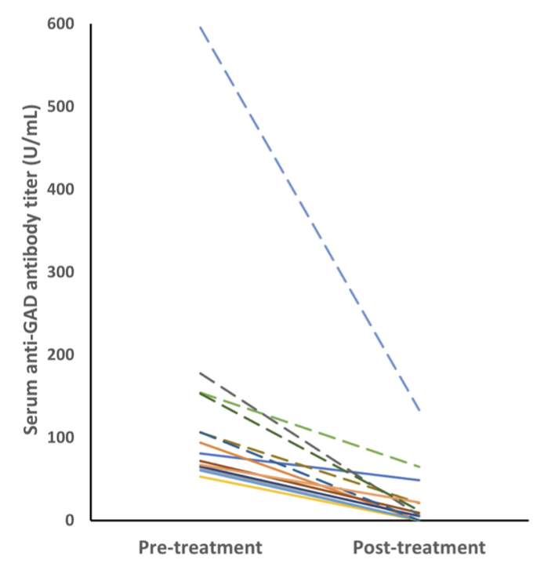
Pre- and post-treatment samples were available in 14 patients
High titer (n=6)
Median reduction 86%
Low titer (n=8)
Median reduction 95%
(50%, n=7) near-complete or complete response
(43%, n=6) partial response
(7%, n=1) died
Variable response to immunotherapy
Notes:
Pre- and post-treatment samples were available in 14 patients. All of them had decreased anti-GAD Ab after immunotherapy.
The anti-GAD antibody titers decreased after immunotherapy in 14 patients.
The dashed lines represents the high-titer group.
Serum anti-GAD antibodies in the high-titer group (n = 6) showed a median reduction of 86% (range 58–99%). The median titer reduction in the low-titer group (n = 8) was 95% (range 36–99%).
The response to immunotherapy was variable. Half of the patients (7/14) had a near-complete or complete response to immunotherapy, while 6 (43%) had a partial response with some neurologic sequelae, and 1 (7%) died.

Slide 10
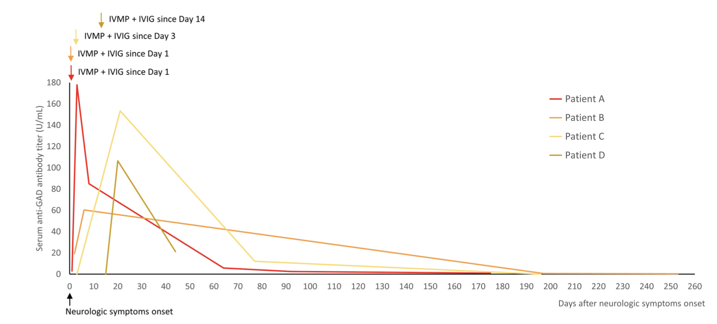
Serial anti-GAD Ab changes were available in 4 patients
The start of immunotherapy
Elevation in acute stage
Decreasing during follow up
No clinical worsening was observed during the transient elevation in titers.
Notes:
Serial changes in the titers of serum anti-GAD antibodies during immunotherapy were measured in four patients. The titers were transiently elevated during immunotherapy, and then decreased after immunotherapy during follow-up.
The arrows indicated the start of immunotherapy (IVMP and IVIG in all of them).
No clinical worsening was observed during the transient elevation in titers.

Slide 11
Summaries of our study
language difficulty
Initial symptoms of
ataxia
Statistically associated with
Not associated with
Severity or outcomes
Anti-GAD Ab titer
Elevation in acute stage

