Slide 1
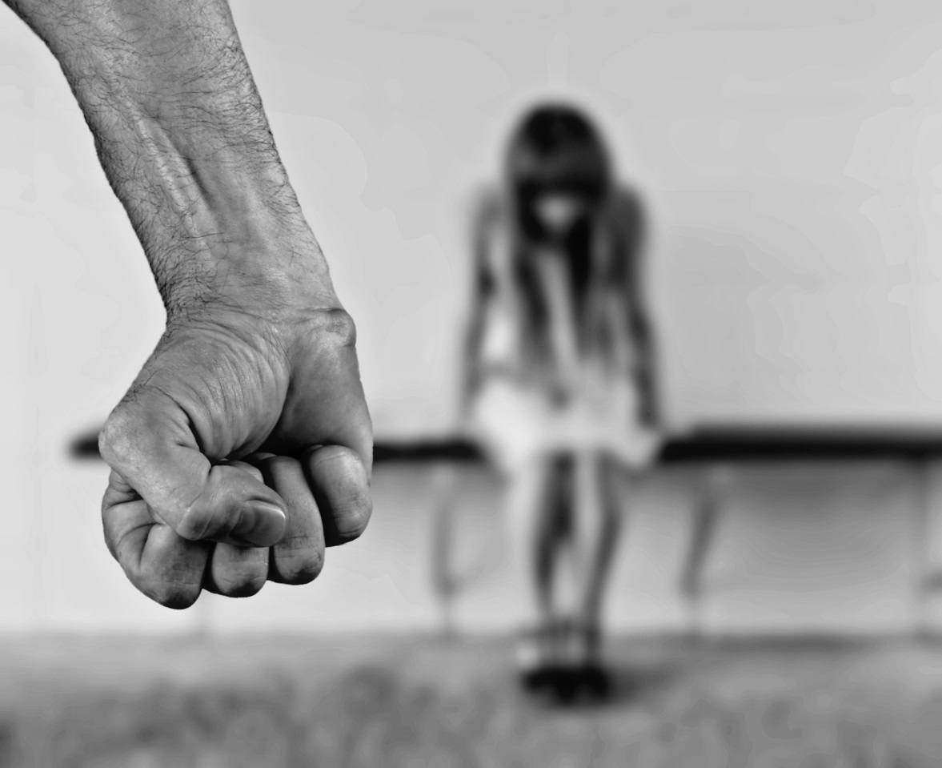
Childhood Trauma and Aggression
in Persons Convicted for Homicide:
An Exploratory Study Examines the Role of Plasma Oxytocin
兒時創傷與殺人犯罪者之暴力—探討血中催產素之角色
吳佳慶 助理教授
臺北市立萬芳醫院精神科、臺北醫學大學醫學系
盧孟良 教授
臺北市立萬芳醫院精神科、臺北醫學大學醫學系
周愫嫻 教授
國立臺北大學犯罪學研究所

Slide 2
Childhood trauma and Aggression
The adversities of childhood trauma may have prolonged into adulthood.
Individuals with childhood trauma have high risk for problematic behaviors such as smoking, heavy drinking, risky sexual behavior, and mental health adversities.
Highly association of childhood trauma with aggression was shown in various medical and forensic settings, especially high prevalence among the violent offenders.
Various brain circuits, including the amygdala and pre-frontal cortex, may be involved in aggression formulation. In addition to these anatomical findings, neurotransmitter activity, such as serotonin, dopamine, norepinephrine, and γ-aminobutyric acid, is proposed to be positively correlated with aggression.

Slide 3
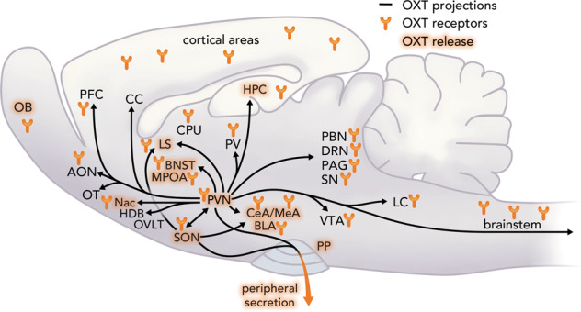
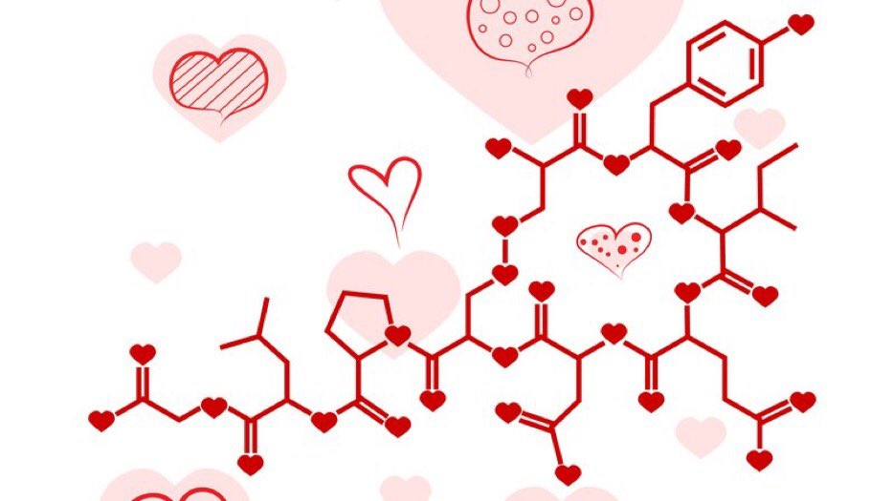
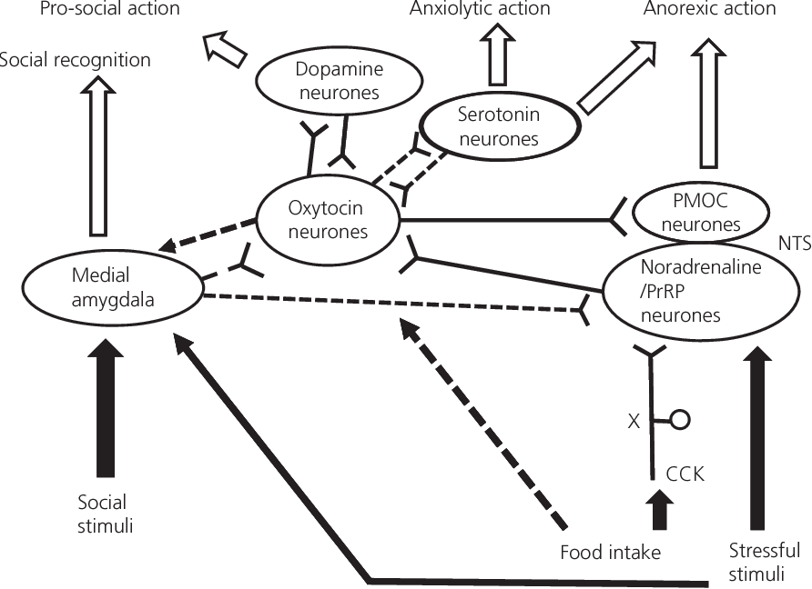
Impacts on Oxytocin
Decreased levels of oxytocin in adults exposed to early childhood maltreatment.
History of less severe forms of childhood physical abuse was associated with higher oxytocin concentration in healthy adults.
Downregulation of HPA axis through cortisol release by oxytocin proposed to mediate the reduction in hostility and situational aggression in the context of reduced stress reactivity
Grinevich, V., & Neumann, I. D. (2021). Brain oxytocin: how puzzle stones from animal studies translate into psychiatry. Molecular psychiatry, 26(1), 265-279.

Slide 4
Study Design
How oxytocin mediates the route to aggression from childhood trauma?
Participants
Offenders who committed Offences of Homicide (Criminal Code §271/272/273/274)
Healthy participants without history of criminal conviction, illicit drugs use, mental disorder
Measures
Basic demographic
  Age at index offense, length of sentences, and length of imprisonment.
Childhood trauma
  Childhood Trauma Questionnaire - Short Form (CTQ-SF)
Aggression
  Modified Overt Aggression Scale (MOAS) measuring verbal aggression, aggression against property, auto-aggression, and physical aggression.
Plasma oxytocin (detection range at 0–100 ng/ml)

Slide 5
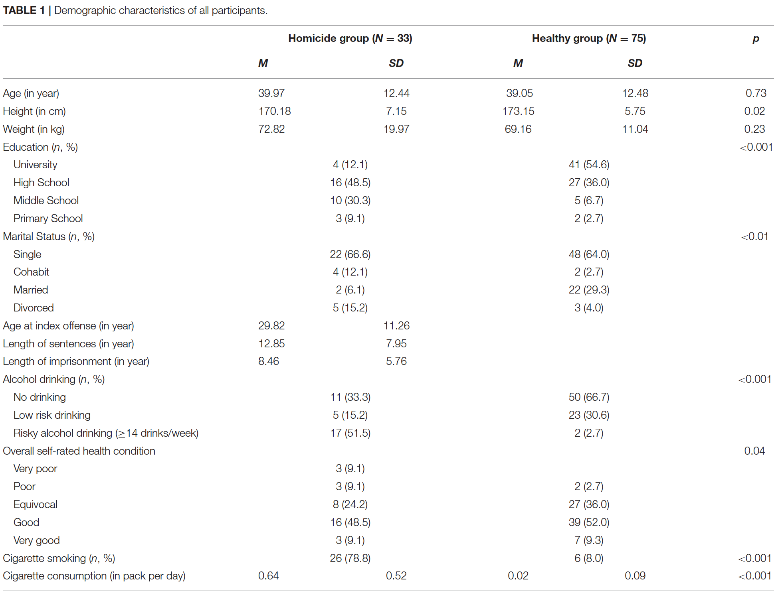

Slide 6
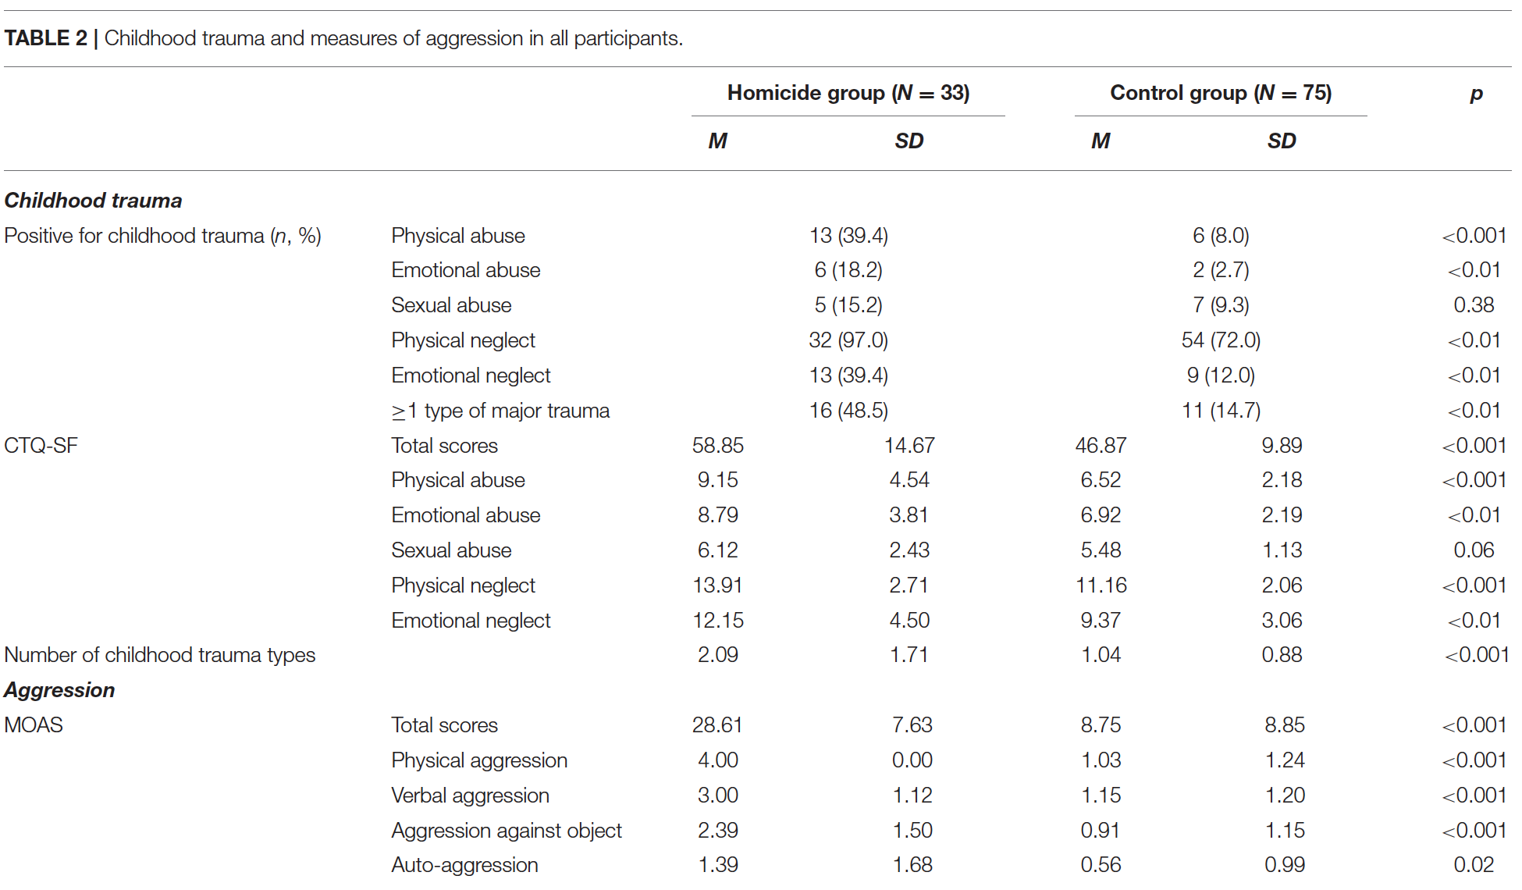

Slide 7
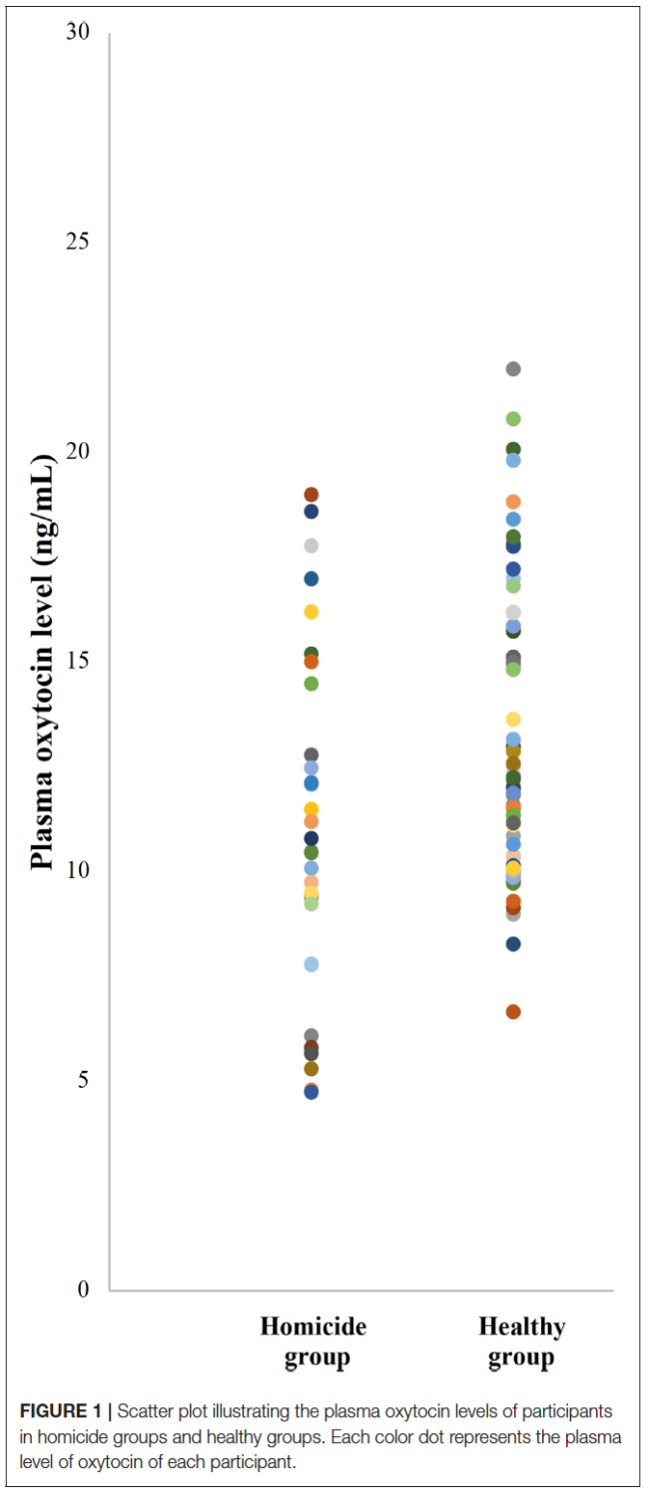

Slide 8
Limitations
Cross-sectional design
Validity of the constructs
  Validity and reliability of retrospective self-reporting on childhood trauma is debatable
  Lack of standardized quantifying measurements to validate the aggression measurements
Oxytocin
  Is determined not only by childhood trauma
  Using peripheral plasma oxytocin as a surrogate for central oxytocin function may yield the questions of accuracy of oxytocin measurement and its implications

Slide 9
Conclusion

