Slide 1
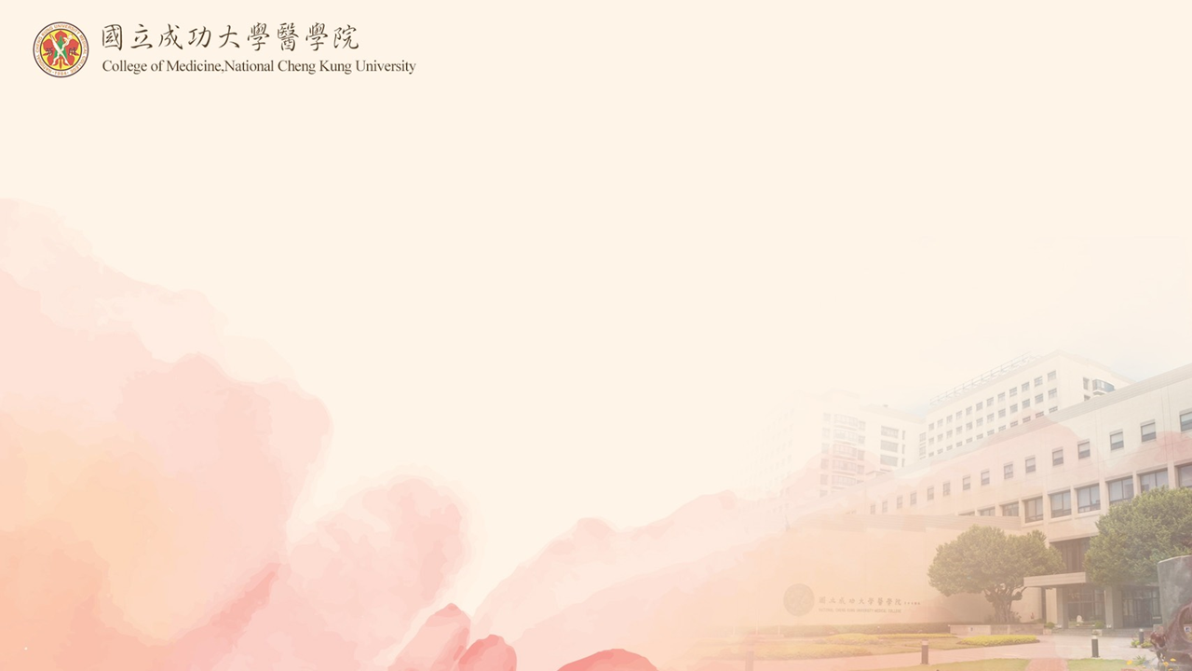
Association of Cystic Periventricular
Leukomalacia and Postnatal Epilepsy in
Very Preterm Infants
囊性腦白質軟化症與日後癲癇發生相關性
成大醫院 吳博銘

Slide 2
研究背景
白質軟化症為極端早產兒神經發展障礙的重要原因之一
可區分為囊性白質軟化症和非囊性白質軟化症
可影響 corticospinal tract, thalamocortical fibers, optic radiation, superior occipital fasciculus, and the superior longitudinal fasciculus

Slide 3

未竟之處
白質軟化如何形成未來的癲癇
直接影響或是因為共病症所造成
癲癇型態有無不同

Slide 4
研究目標
檢視囊性腦白質軟化症與日後(5歲)癲癇發生相關性

Slide 5
研究方法
前瞻性世代研究（prospective cohort study
調查對象:Jun 2003 -Dec 2015出生的極端早產兒
收集出生資訊和5歲時的癲癇問卷

Slide 6
囊性腦白質軟化症的危險因子

Slide 7
Univariate and multivariate analysis
NEC stage III, neonatal seizures, and IVH were independent risk comorbidities of cystic PVL.
發炎性傷害比缺氧影響大

Slide 8
Neurological consequence of cystic PVL
囊性腦白質軟化症是不良神經預後的獨立預測因子

Slide 9
Very preterm infants with postnatal epilepsy subdivided by cystic PVL
Commonly generalized and less intractable and had older age of onset

Slide 10
Uniqueness of immature brain
Birth
1-2yr
Front Pediatr. 2021 ; Nat Rev Neurosci 2002

Slide 11
Strengths and limitations
a large cohort of very preterm infants with 5-year follow-up assessments.
a relatively small number of cystic PVL or epilepsy, a wide range of GA, and no genetic survey of epilepsy in our patients.
our study detected cystic PVL using ultrasound examination instead of magnetic resonance neuroimaging.

