Slide 1
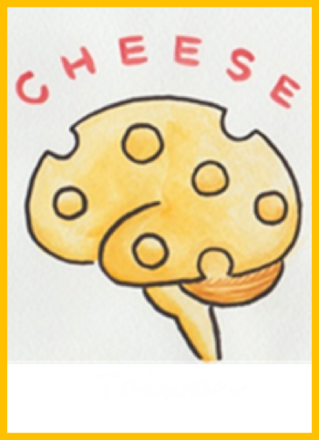
ADGRG1 mutation related
Bilateral Frontoparietal Polymicrogyria of
Three Siblings Receiving Callosotomy
Cheng-Yen Kuo M.D
Division of Pediatric Neurology, Chang Gung Children’s Hospital and Chang Gung Memorial Hospital, Taoyuan Taiwan
Children with Encephalitis/
Encephalopathy
Related Status Epilepticus and
Epilepsy
(CHEESE Study Group)
Intensive and Integrated Care for
Pediatric Central Nervous System
(iCNS Group)
Chang Gung Children’s
Hospital Taoyuan Taiwan

Slide 2
基因缺陷如何導致
大腦結構與功能異常
早期診斷 (臨床、腦波)、早期介入(藥物、生酮、手術)、基因功能
Identification and clinical characteristics of a novel missense ADGRG1 variant in bilateral Frontoparietal Polymicrogyria: The electroclinical change from infancy to adulthood after Callosotomy in three siblings, Epilepsia Open, 2022

Slide 3
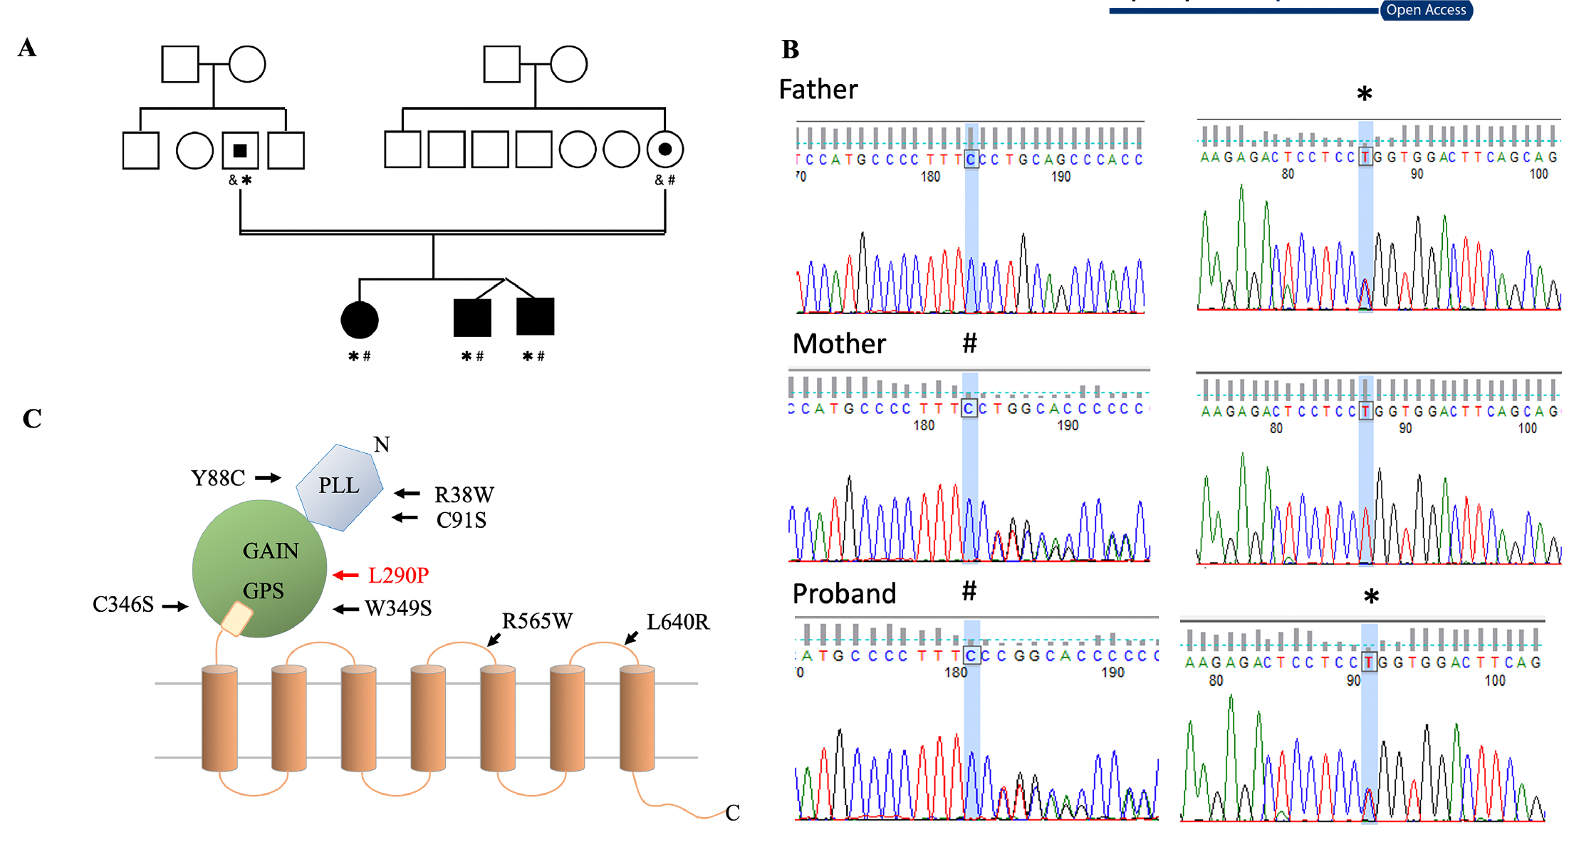
Identification of GPR56/ADGRG1 gene frameshift/missense mutations in a Taiwanese family
Chr 16: 57685260C >
exon 4: c.213delC:p.P72Lfs*40
Chr 16:57689411
exon7:c.T869C:p.L290P
Notes:
p.Leu290Pro
白胺酸, Leucine, Leu，脯胺酸 Proline

Slide 4
Pathology
Late in the stage of neuronal migration or
Early in the stage of cortical organization
Abnormal
localized
radial glial
endfeet
Defect pial
basement
membrane
Malpositioned
Cajal-Retzius
cells
Overmigrated
neurons
Shihong Li et al, The Journal of Neuroscience, May 28, 2008 • 28(22):5817–5826
Notes:
Late in the stage of neuronal migration or early in the stage of cortical organization
Defect pial basement membrane
Abnormal localized radial glial endfeet
Malpositioned Cajal-Retzius cells
Overmigrated neurons

Slide 5
 | Patient 1 | Patient 2 | Patient 3
Age | 22Y | 20Y | 20Y
Newborn
Infant hypotonia | No | No | No
Head circumference | Normal | Normal | Normal
Infant and childhood
Developmental delay
Walk alone | 1Y6M | 1Y4M | 1Y4M
Meaningful word | 2Y | 2Y | 2Y
Sleep problem | excessive night crying | No | No
Mental Retardation | severe | severe | severe
Cerebellar sign | Normal | Normal | Ataxia
Spasticity | diplegic | diplegic | diplegic
Oculomotor anomaly | Strabismus, Nystagmus | Nystagmus | Nystagmus
Epilepsy
Onset age | 9Y | 3Y | 1Y
Seizure type | head nodding*, Tonic, myoclonic, staring myoclonic, epileptic falling | head-nodding* tonic, myoclonic, staring myoclonic, staring, epileptic falling | head nodding*, GTCs, myoclonic, staring myoclonic, staring, epileptic falling

Slide 6
 | Patient 1 | Patient 2 | Patient 3
Refractory age | 11Y | 12Y | 8Y
Ever used AEDs | vigabatrin, clobazam, clonazepam, oxcarbazepine, zonisamide, perampanel, rufinamide, topiramate, lacosamide | valproic acid, vigabatrin, levetiracetam clobazam, phenobarbital zonisamide, | valproic acid, vigabatrin, levetiracetam, clobazam clonazepam, phenobarbital, topiramate, lamotrigine,
Free from epileptic falling duration After Callosotomy | 1Y | 1Y | >1.5Y⁺

Slide 7
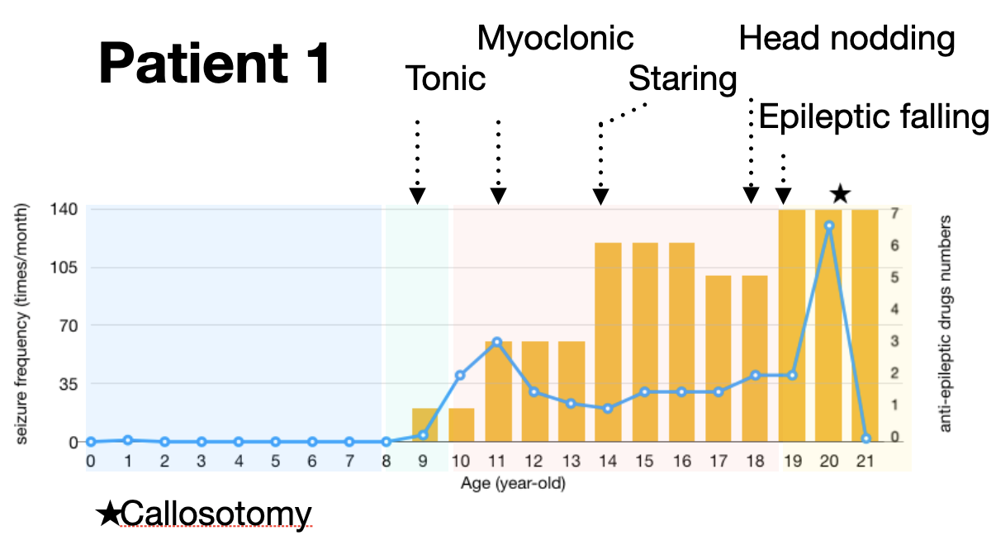
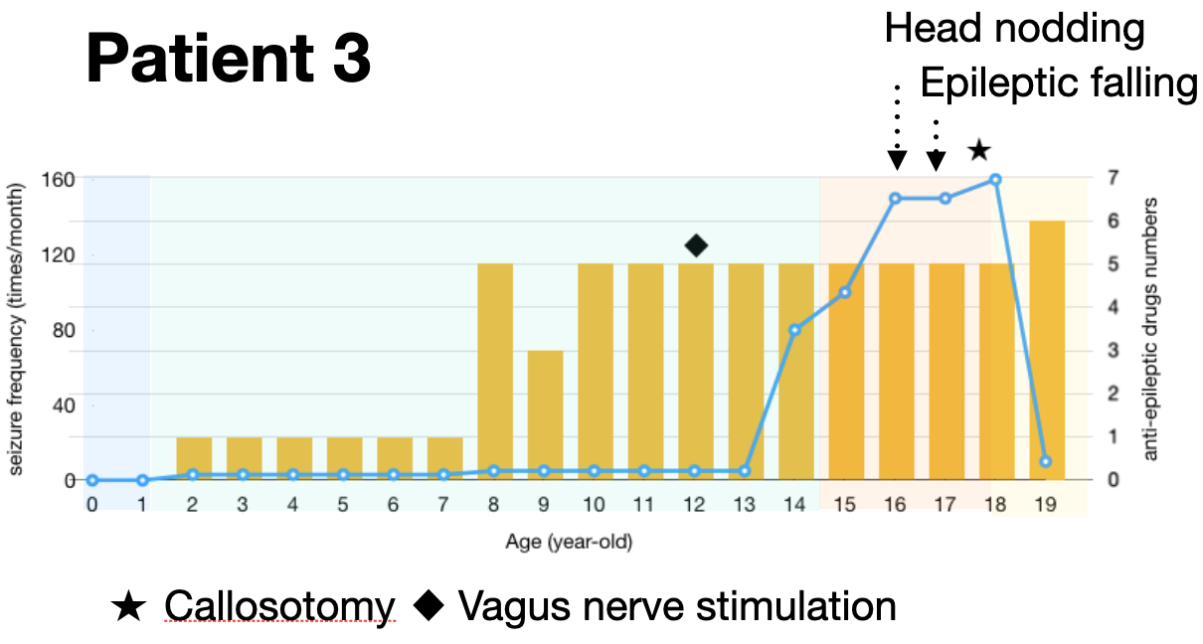
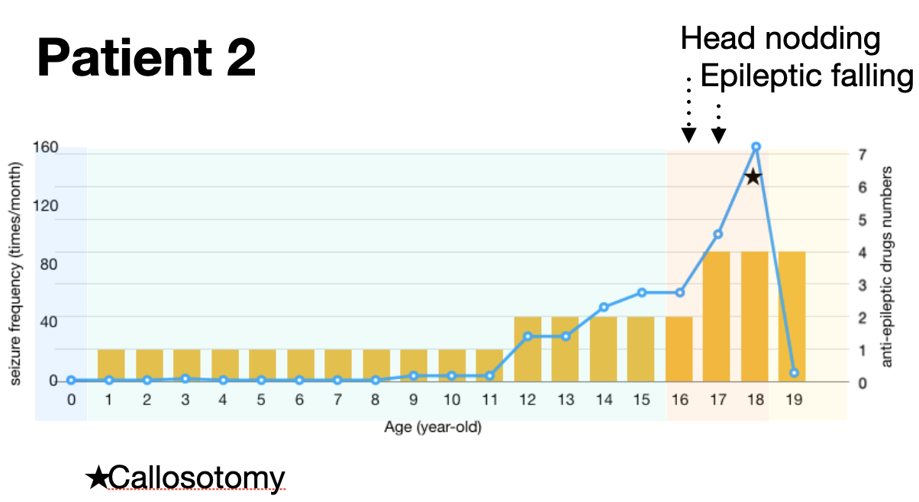
clinical course of epilepsy

Slide 8
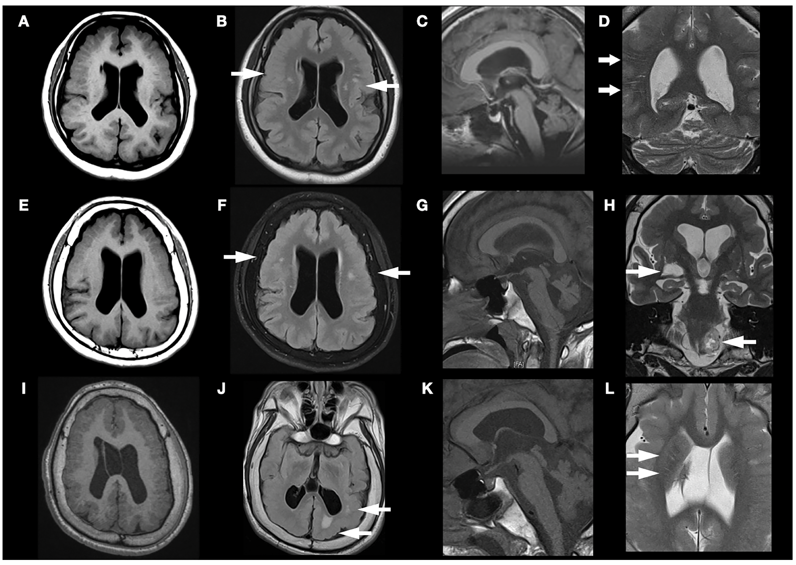

Slide 10
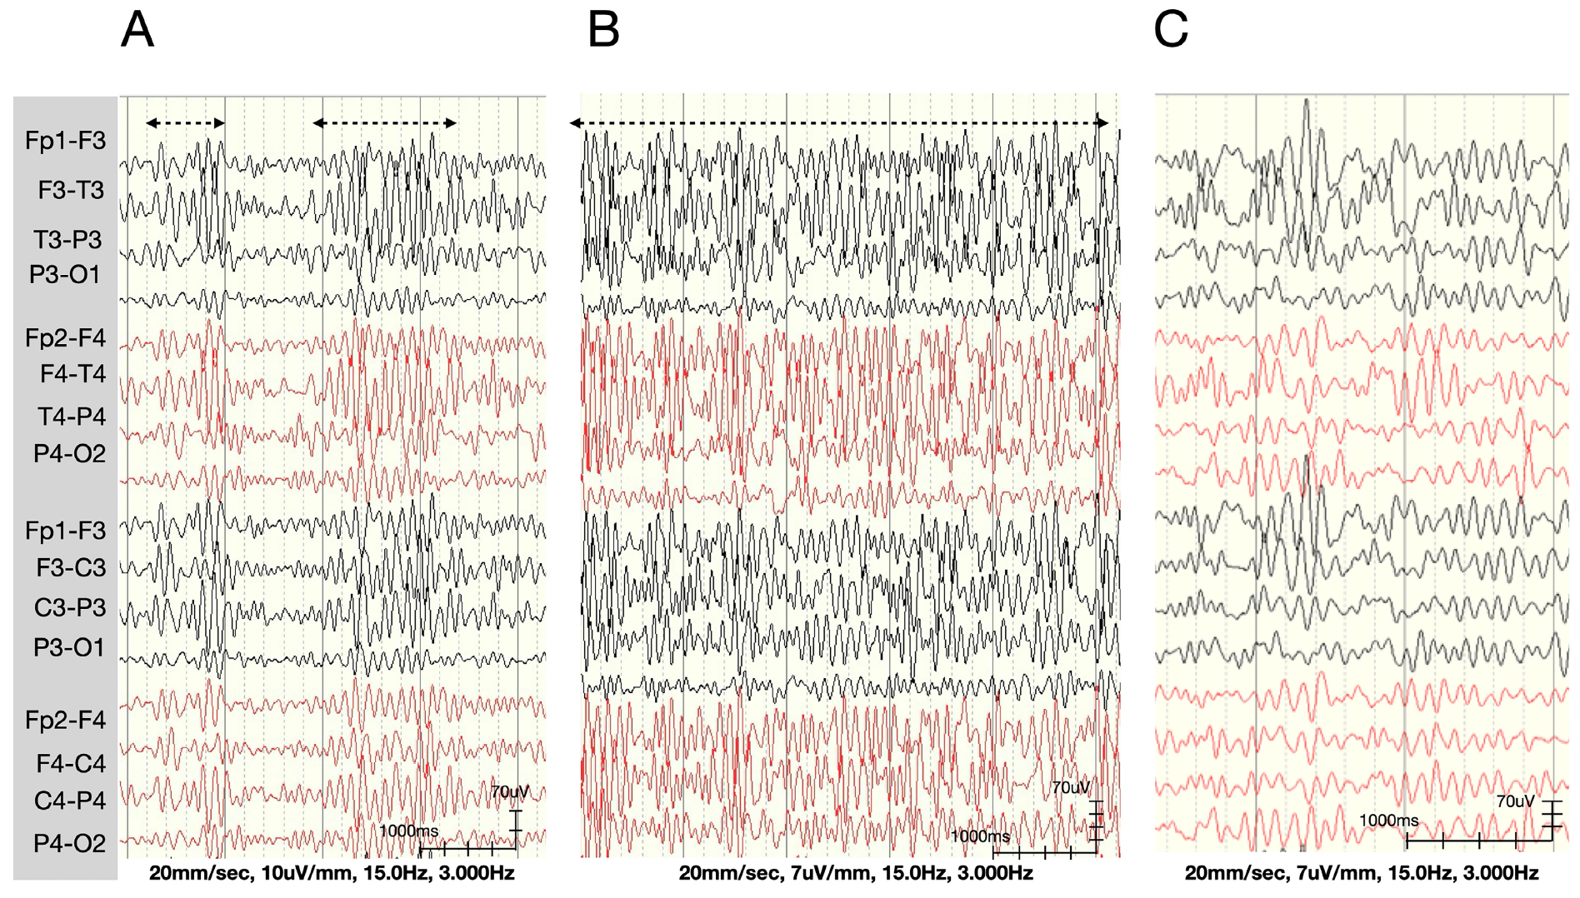
High-amplitude rhythmic activity
Sleep EEG of Patient 1 at 1, 5, and 9 y of age (A-C)

Slide 11
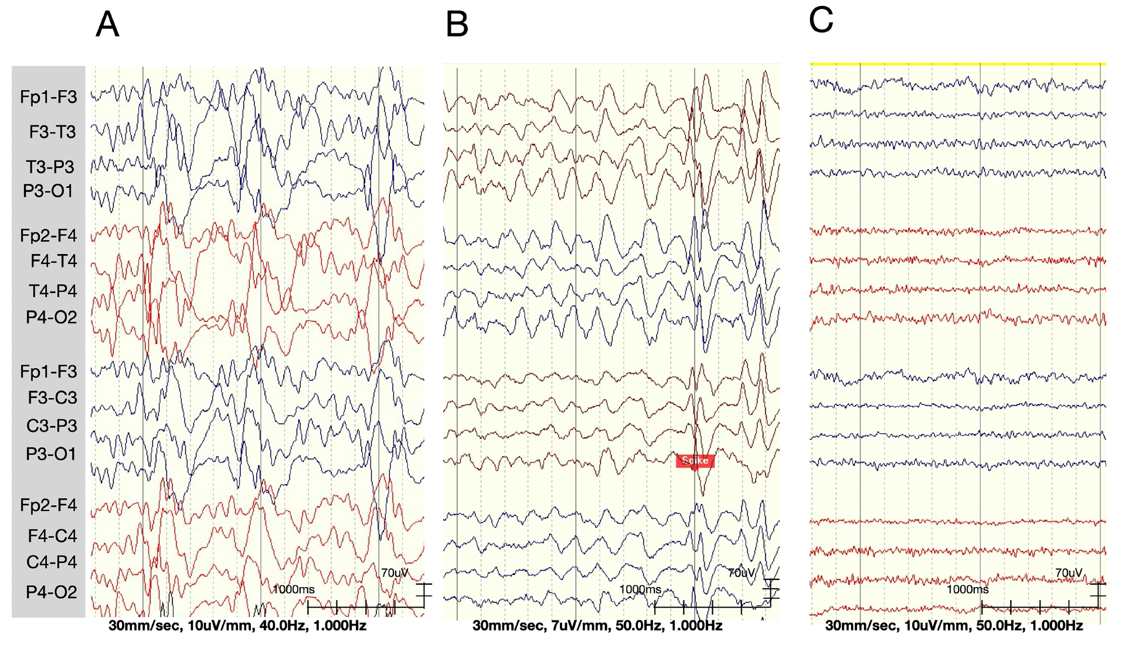
Epileptiform Discharge
Sleep EEG in Patient 2 at 10 y of age (A),
Awake EEG in Patient 2 at 18 y of age before and after callosotomy (B,C)

Slide 12
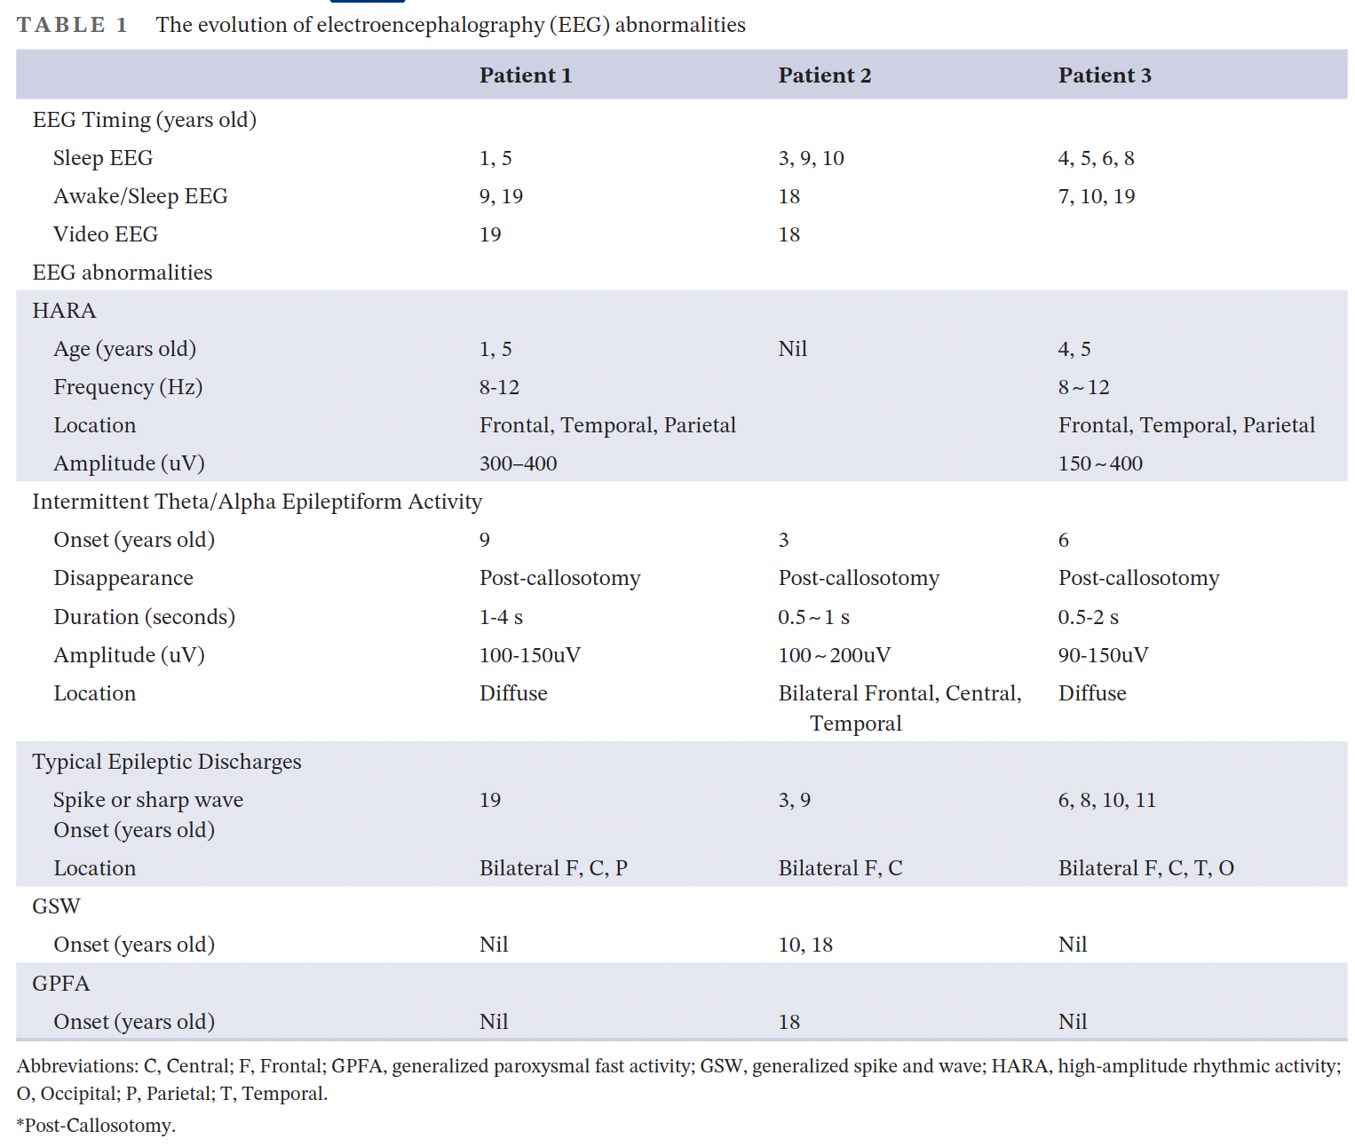

Slide 13
Structural prediction and molecular
analysis of the GPR56-L290P variant
Notes:
Regardless of the change, leucine (L) is still very similar to valine (V) biochemically, but a change in leucine (L) to structurally different proline ℗ is likely to cause significant alterations in intramolecular interactions among residues.

Slide 14
Structural prediction and molecular
analysis of the GPR56-L290P variant
Notes:
Regardless of the change, leucine (L) is still very similar to valine (V) biochemically, but a change in leucine (L) to structurally different proline ℗ is likely to cause significant alterations in intramolecular interactions among residues.
The results showed that the GPR56-L290P isoform, as with the GPR56-C91S
and -C346S variants, also displayed a decrease in stability (negative predicted ΔΔG) and increase in vibrational entropy (positive ΔΔSvib)

Slide 15
Structural prediction and molecular
analysis of the GPR56-L290P variant
Notes:
Highly similar to those of the GPR56-C91S,-C346S, and -R565W isoforms, a markedly reduced surface level of GPR56-L290P was detected in transiently
transfected HEK-293 T cells (Figure 5C). In contrast, the total cellular expression of GPR56-L290P was comparable with those of GPR56-WT and BFPP-associated mutants

Slide 16
Structural prediction and molecular
analysis of the GPR56-L290P variant
GPR56-L290P variant is a GPS proteolysis-deficient unstable receptor
Notes:
Furthermore, the Western blotting results revealed that the L290P isoform, as with the C346S isoform, was not processed by GPS proteolysis, as protein bands of
the same size were detected by two different Abs used to detect the extracellular fragment and transmembrane fragment, respectively

Slide 17
Conclusion
1. GPR56-L290P variant is a GPS proteolysis-deficient unstable receptor . This mutation may result in a congenital disorder called bilateral frontoparietal polymicrogyria.
2. Developmental delay, spasticity, HARA could be early sign of BFPP before seizure attack
3. Callosotomy may offer benefits for individuals with pharmacoresistant epilepsy and cognitive impairment. However, the optimal timing for this procedure remains uncertain.

