Slide 1
Effects of Acute Moderate-Intensity Exercise on Executive Function in Children with Preterm Birth: A Randomized Crossover Study
--------------------------------------------------------------------------
陳豐慈 助理教授
(Feng-Tzu Chen, Assistant Professor)
中國醫藥大學，運動醫學系
(Department of Sports Medicine, China Medical University)
2023/10/28 全國兒童神經精神科學科學論壇

Slide 2
Preterm Birth and Executive Function
Preterm birth (PB): 37 weeks of gestation
High incidence of neurodevelopmental impairment
40-50 % of PB survivors develop multiple cognitive deficits.
Executive function (EF): higher-order cognitive processes responsible for adaptive, goal-directed behavior
EF impairments for children with PB can persist into adulthood, negatively influencing academic achievement, social competence, and adaptive function.

Slide 3
Acute exercise and EF
Acute exercise improve EFs (i.e., inhibitory control, working memory, and cognitive flexibility) in children born full term.
EF benefits of acute exercise in overweight children or those with neurodevelopmental impairments such as autism spectrum disorder, learning disability, and attention deficit hyperactivity disorder.

Slide 4
Purpose
The study was to examine whether acute exercise impacts EF in children with PB
Notes:
Based on this evidence, it is possible that acute exercise can positively impact EF in children with PB.

Slide 5
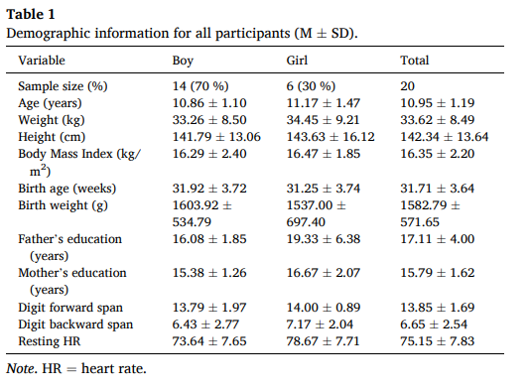
Method

Slide 6
Treatment sessions
Acute exercise session
30 min of aerobic exercise
5 min of warm-up
20 minutes of moderate intensity exercise (65-70% heart rate reserve)
5 min of cool-down
Control session
30 min of watching movies

Slide 7
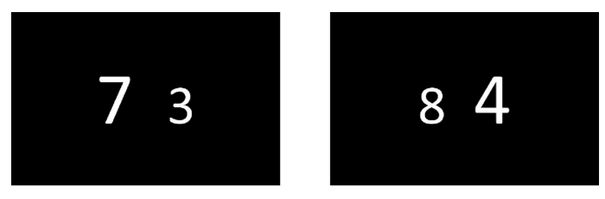
EF examination
Numeric Stroop Test
Congruent condition
Information processing speed
Incongruent condition
EF: inhibitory control

Slide 8
Procedure
First Day
Background, Digit Span test, resting heart rate determined
Second /Third Day
Acute exercise session
EF
Randomized and crossover design
Control session
EF

Slide 9
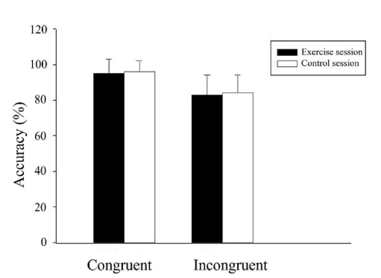
Results: Accuracy

Slide 10
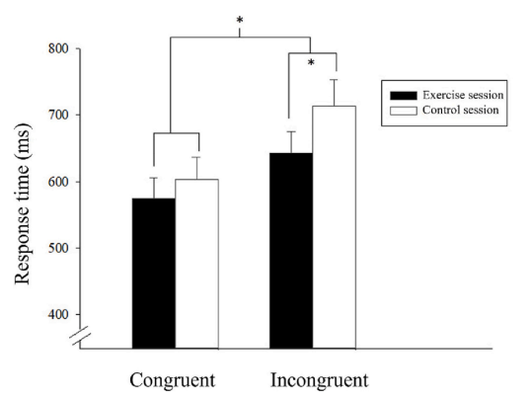
Results: Response time

Slide 11
Discussion and Conclusion
Discussion: possible mechanism
Arousal
Brain activation
Brain neurotrophic factors
Conclusion: acute exercise can facilitate EF in children with PB.
Moderate-intensity exercise
Faster RT on the Stroop’s incongruent
Inhibitory control

Slide 12
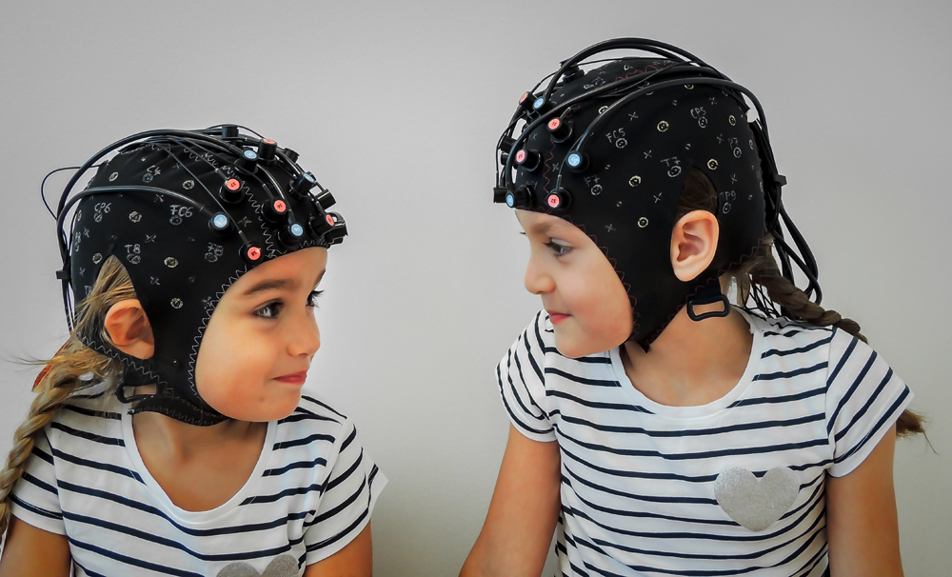
Limitation and Future Direction
Other category of EF, such as working memory, cognitive flexibility (Hsiang, Chen, & Chang, 2019)
Exercise mode, such as resistance exercise (Ren, … Chang, & Chen, in press)
Neuroelectric tools, such as EEG (Chen, …, Chang, ongoing)

