Slide 1

黎賢江 Le Hien Giang
Targeting of RRM2 suppresses DNA damage response and activates apoptosis in atypical teratoid rhabdoid tumor.
越南國立大學科學大學生物學碩士
臺北醫學大學 國際轉譯科學博士學位學程
張哲菖 副教授

Slide 2


Dissertation defense
Targeting of RRM2 suppresses DNA damage response
and activates apoptosis in atypical teratoid rhabdoid tumor
Student: Le Hien Giang（黎賢江）
Advisor: Che-Chang Chang (張哲菖）
International Ph.D. Program for Translational Science
College of Medical Science and Technology, Taipei Medical University
October, 2024

Slide 3
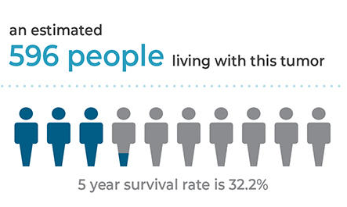
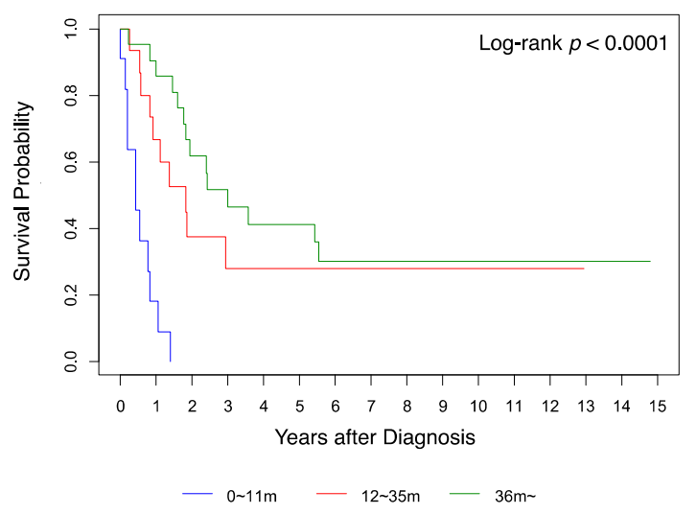
Atypical Teratoid Rhabdoid Tumor (ATRT)
USA
Taiwan
A rare, malignant tumor in the CNS (grade IV CNS embryonal tumor, classified by WHO in 2000).^{[1]}
The most common malignant brain tumor in children < 1 year.
Express extraordinarily fast-growing and lethal characteristics.
Very poor prognosis, patients usually die between 0.5 and 1 year from diagnosis and survival is especially poor (~ 20%) for patients with metastasis
- Currently, there is still no standardized treatment for ATRT.^{[2]}
→ The importance and necessity of developing highly efficacious, targeted therapies for this disease.
1. Kleihues et al., 2002
2. Liu, Y.N, et.al, 2022

Slide 4
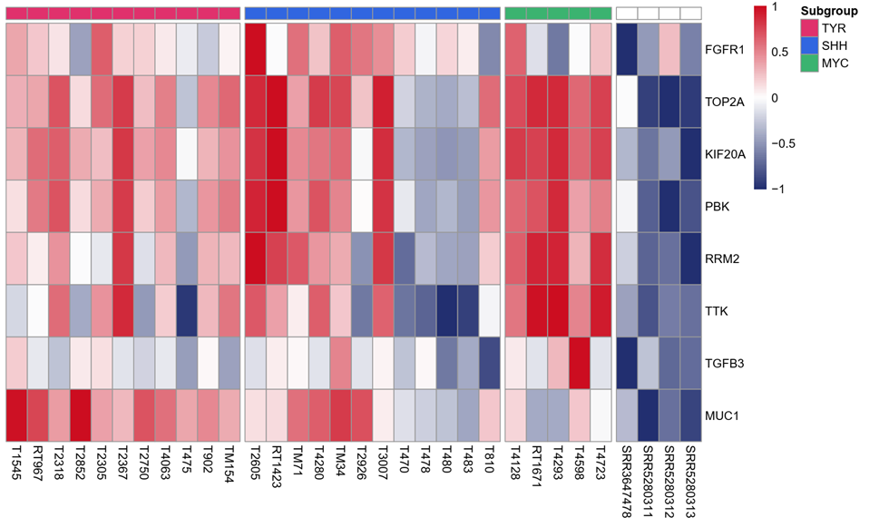
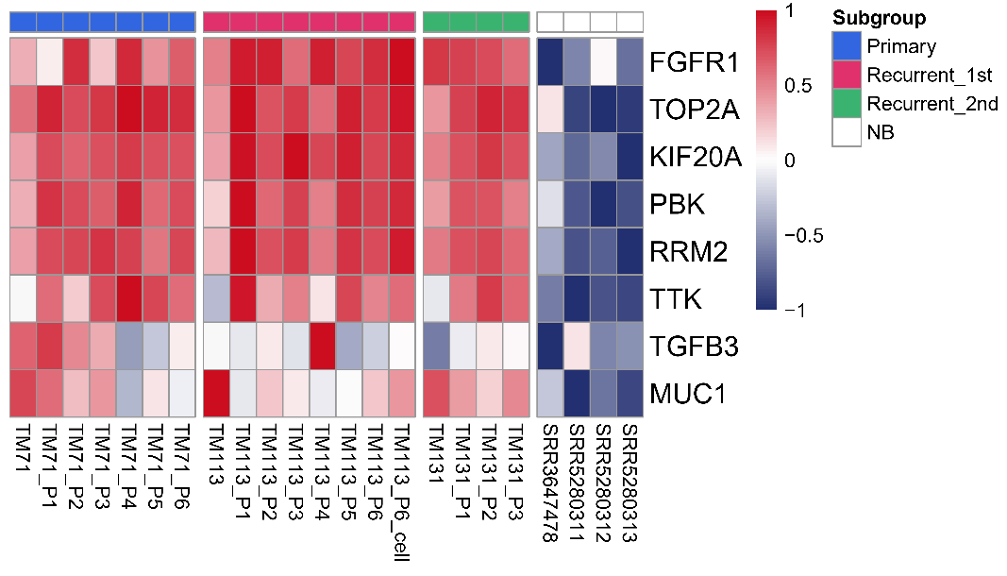
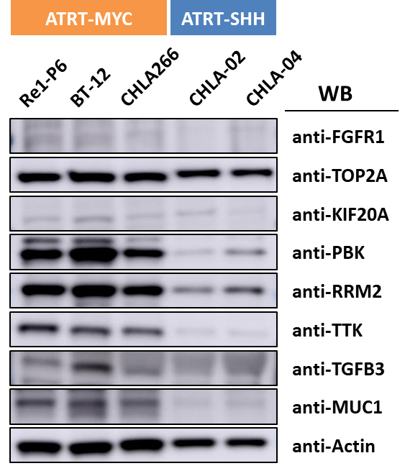
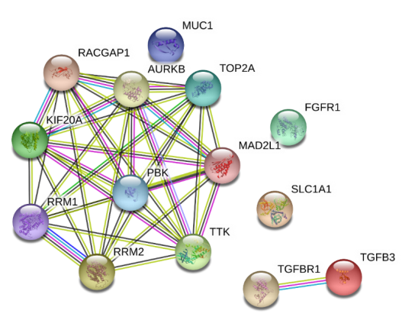
Differential expression analysis of potential therapeutic targets in established ATRT patients, PDX mouse tissues and cell lines
Rationale
Developing targeted therapies by combining laboratory and bioinformatics expertise underscores the potential for ATRT-specific treatments.
In our preliminary research, we found that RRM2 is overexpressed in ATRT and high level of RRM2 correlated with poor out come of patient.
COH29, a novel RRM2 inhibitor, might be a new therapeutic strategy therapy against ATRT.
A
B
ATRT-PDX vs NB
B
C
STRING network analysis
We hypothesize that inhibiting RRM2 by COH29 can substantially decrease the growth and survival of ATRT, offering a promising therapeutic approach for treating this disease.
RRM2

Slide 5


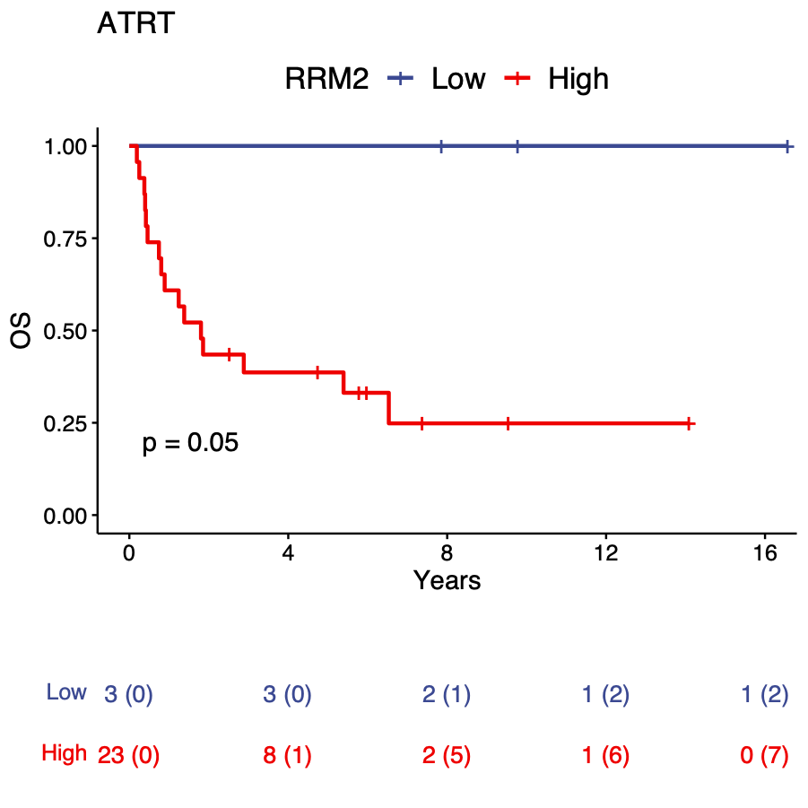
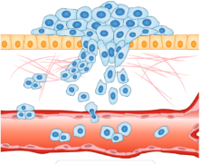

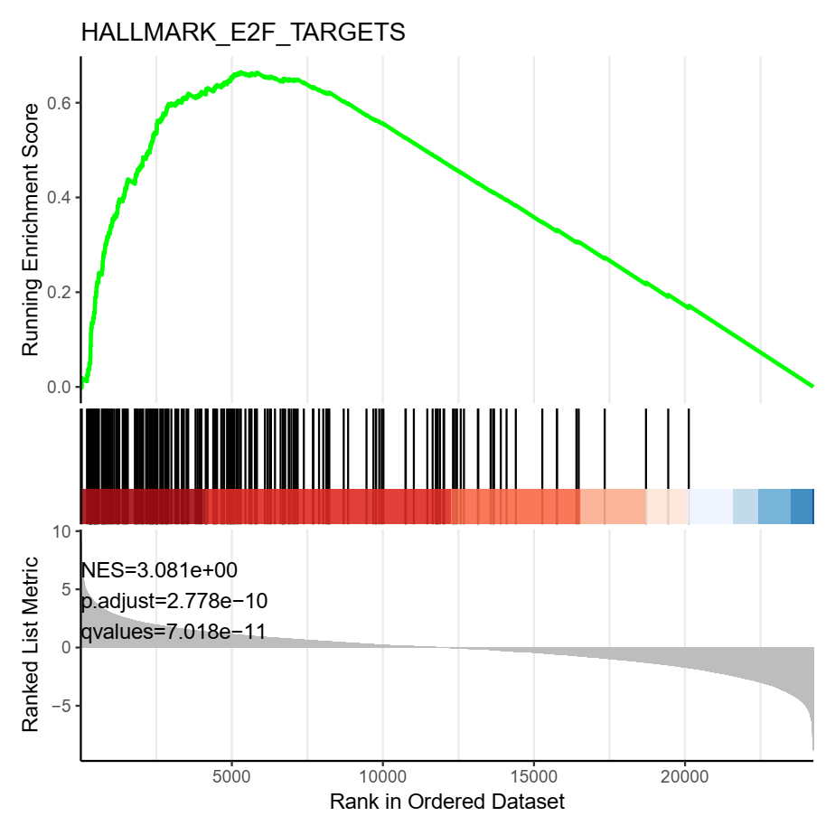
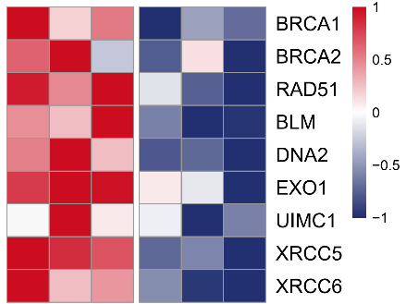
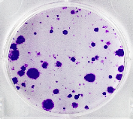
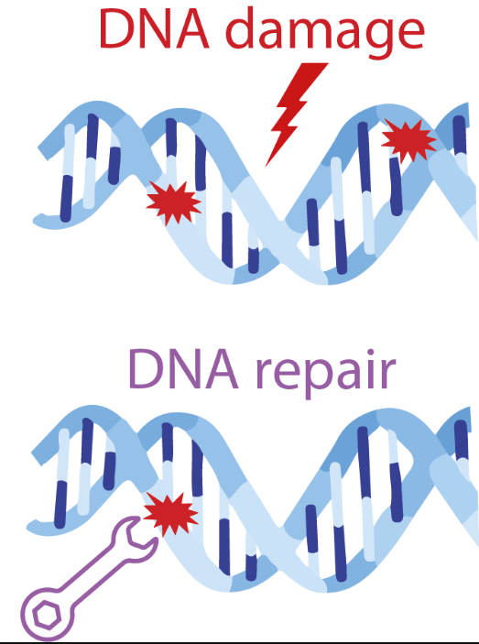
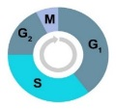

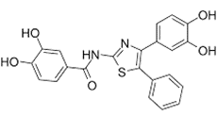
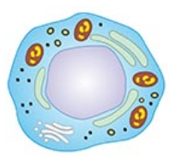
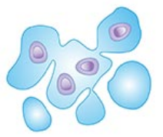
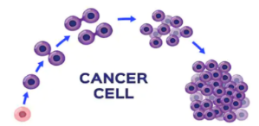
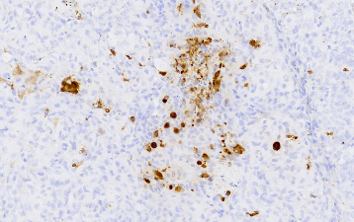
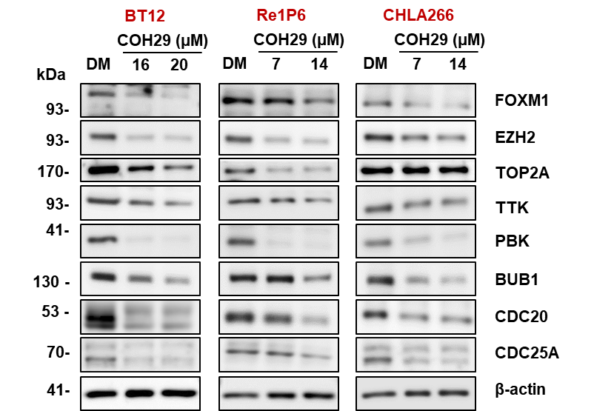

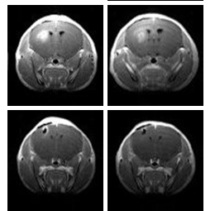
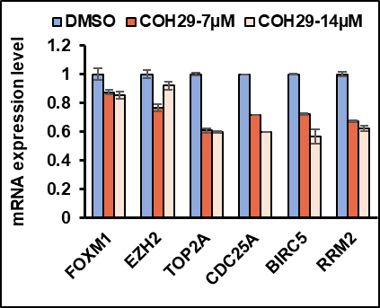
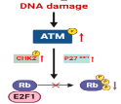
Specific aims
Screening
Cell functional assays
4
Mechanism
To examine the expression and explore the role of RRM2 in ATRT
To determine the inhibitory effects of RRM2 inhibition on ATRT cell lines in vitro.
To evaluate the therapeutic potential of COH29 in animal models of ATRT
To investigate the molecular mechanisms underlying the effects of COH29 on ATRT cells
1
1
Migration
Bioinformatics
2
RRM2
shRRM2
2
2
COH29
Colony formation
3
Propose mechanism
Cell proliferation
3
Animal model
4
Validation

Slide 6
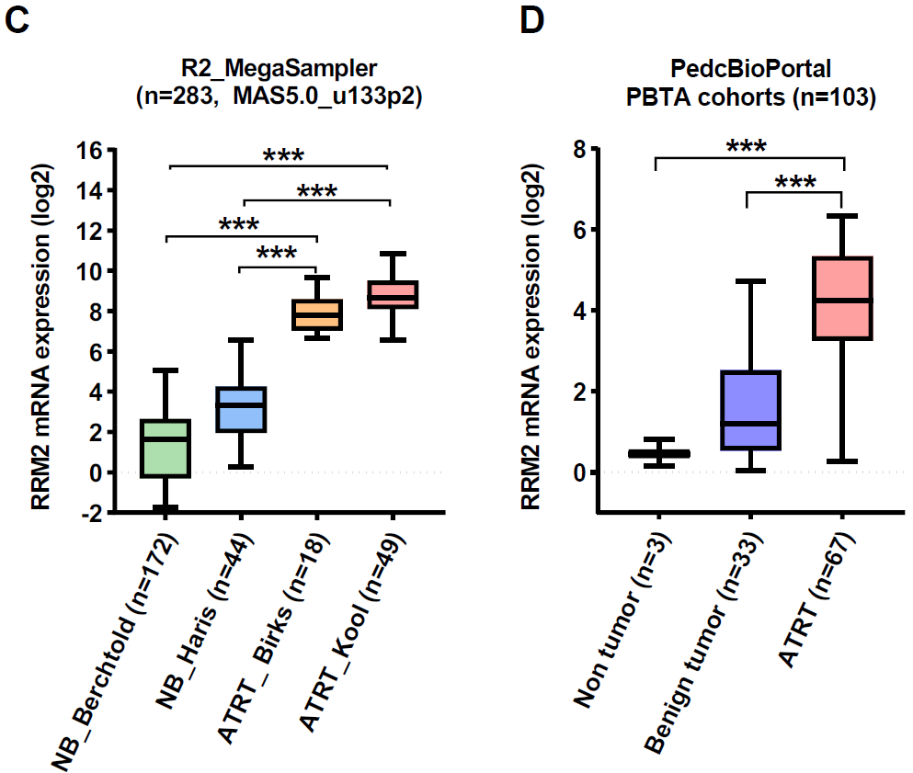
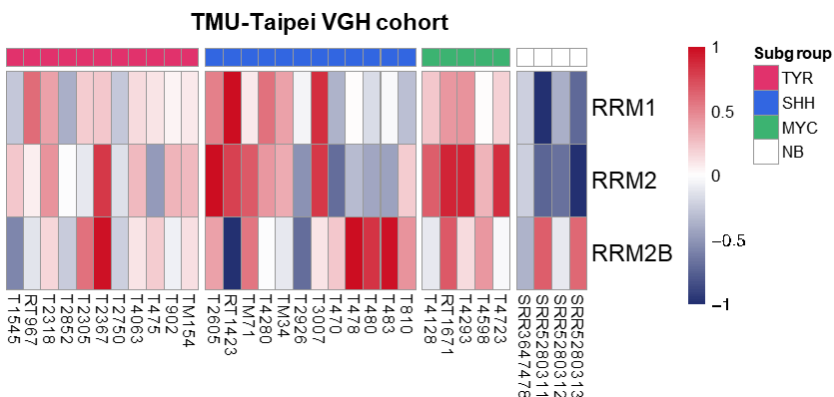
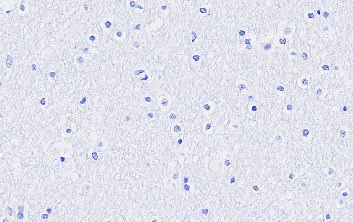
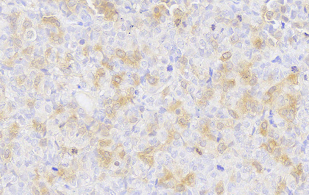
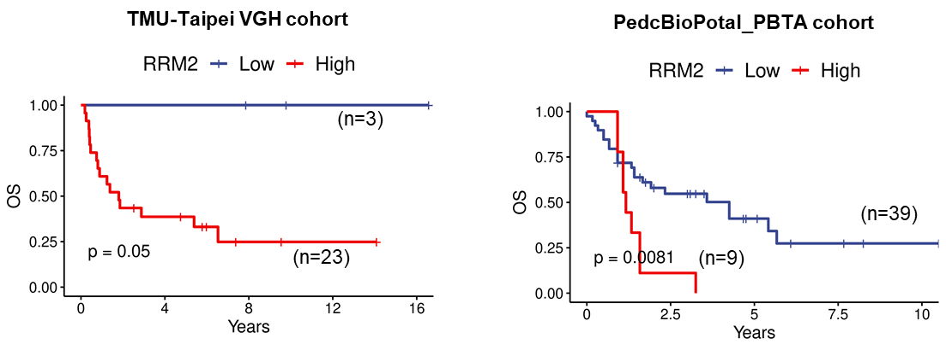
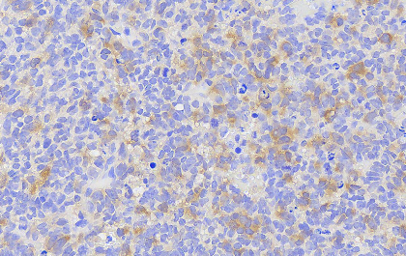
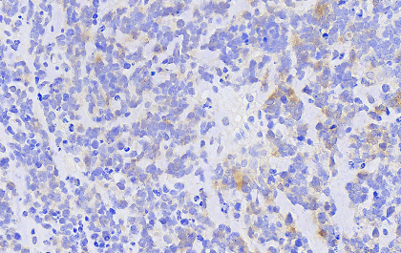
1
RRM2 functions as an oncogene in ATRT
Protein: Ribonucleotide Reductase Regulatory Subunit M2
Functions: Provides the precursors necessary for DNA synthesis. Catalyzes the biosynthesis of deoxyribonucleotides from the corresponding ribonucleotides. Inhibits Wnt signaling.
Main location: Cytosol
Anticancer Drugs: FDA-approved drugs; Gemcitabine, Hydroxyurea, Clofarabine
Research on brain tumor: GBM
A
B
C
D
Normal brain
ATRT-PDX
ATRT- patient samples
Giang et al. J Exp Clin Cancer Res (2023) 42:346

Slide 7
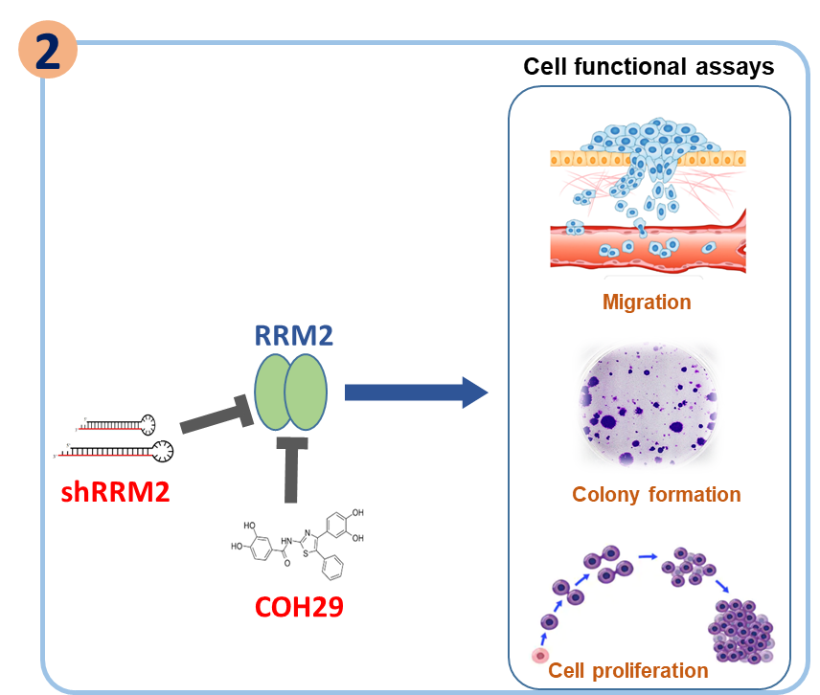
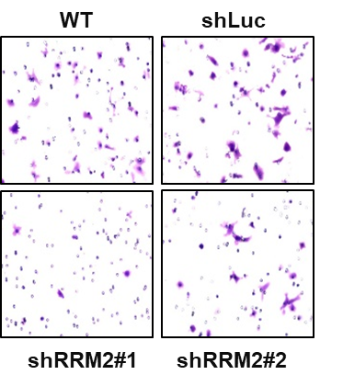
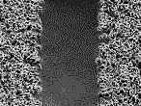

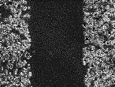
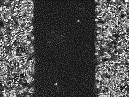
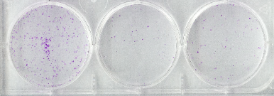
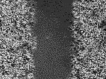
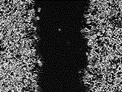
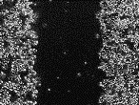
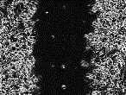
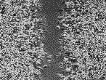
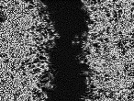
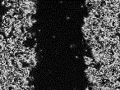
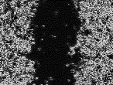
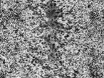
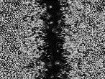
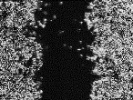
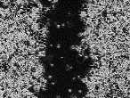
Knockdown of RRM2 decreases the growth and migration of ATRT cells
2
C
B
BT12
BT12
shRRM2
shRRM2
WT
shLuc
#1
#2
shLuc
#1
#2
D0
D1
D2
D3
A
Giang et al. J Exp Clin Cancer Res (2023) 42:346

Slide 8
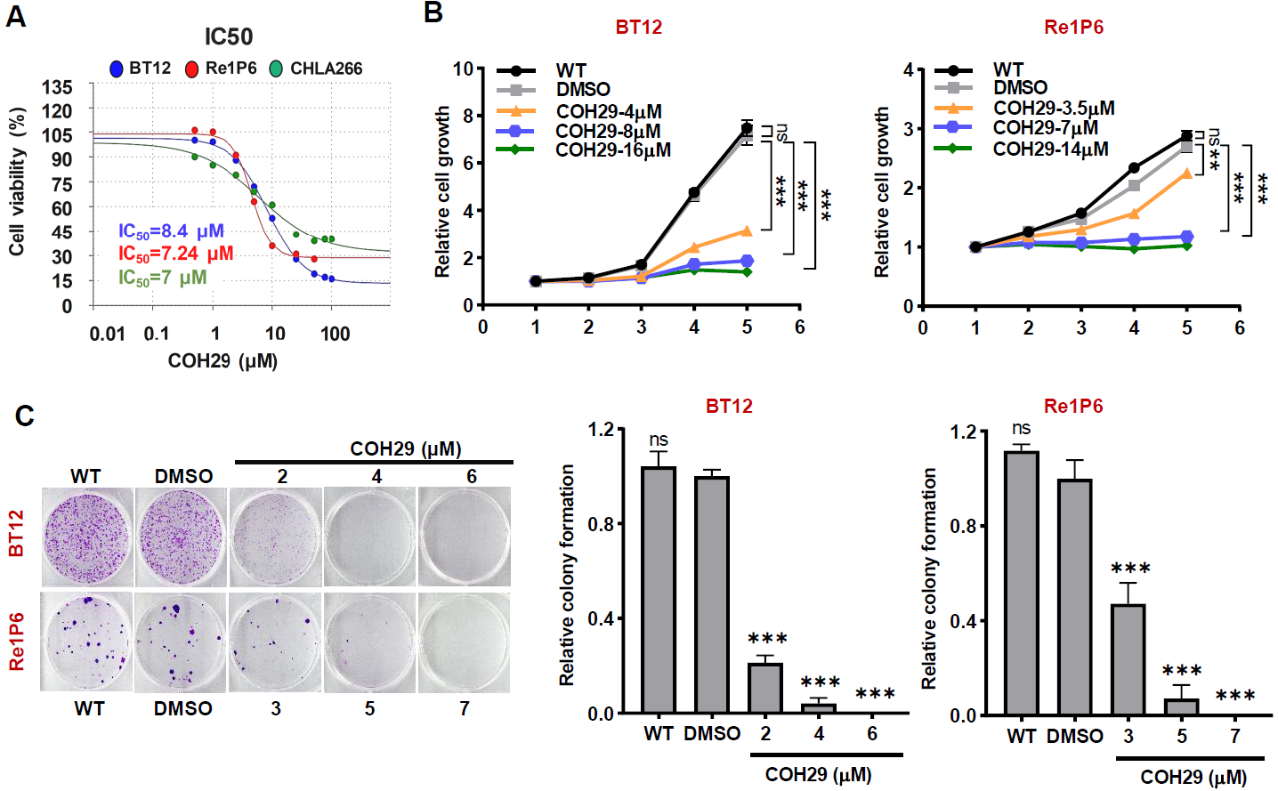
COH29 showed an anticancer effect on ATRT cells
2
D
Giang et al. J Exp Clin Cancer Res (2023) 42:346

Slide 9
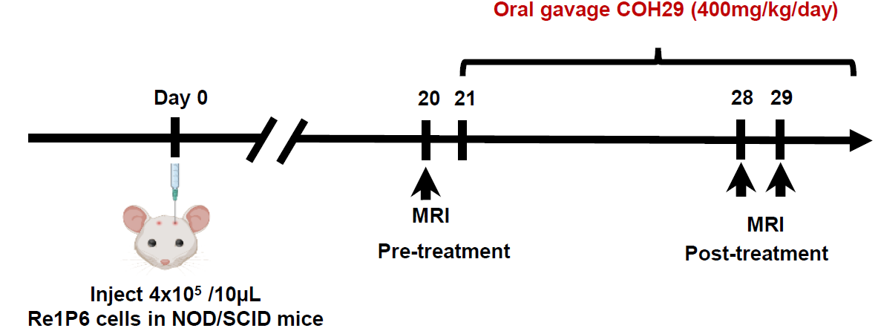
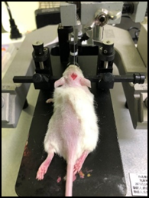



COH29 suppressed tumor growth and prolonged survival of ATRT mice in vivo
3
A
B
C
D
E
Giang et al. J Exp Clin Cancer Res (2023) 42:346

Slide 10







COH29 treatment induced DNA damage and suppress the HR pathway
4
Mechanism
DMSO
COH29-14 µM
COH29-25 µM
COH29-50 µM
A
Re1P6
Bioinformatics
B
D
Propose mechanism
C
E
Validation
Giang et al. J Exp Clin Cancer Res (2023) 42:346

Slide 11

RRM2 inhibition alters the pro-apoptotic and anti-apoptotic signaling pathway
4
Mechanism
Bioinformatics
Propose mechanism
Validation
Giang et al. J Exp Clin Cancer Res (2023) 42:346

Slide 12

Proposed mechanisms of RRM2 inhibition by COH29 in ATRT cells via DNA damage induction and apoptosis activation
By targeting RRM2, COH29 is proposed as a promising candidate for the development of novel therapeutic strategies aimed at combating ATRT
Giang et al. J Exp Clin Cancer Res (2023) 42:346

Slide 13



THANK YOU

