Slide 1
吳欣蔚
MRI features of pediatric atypical teratoid rhabdoid tumors and medulloblastomas of the posterior fossa
台北榮民總醫院 放射線部 主治醫師
張豐基 教授

Slide 2
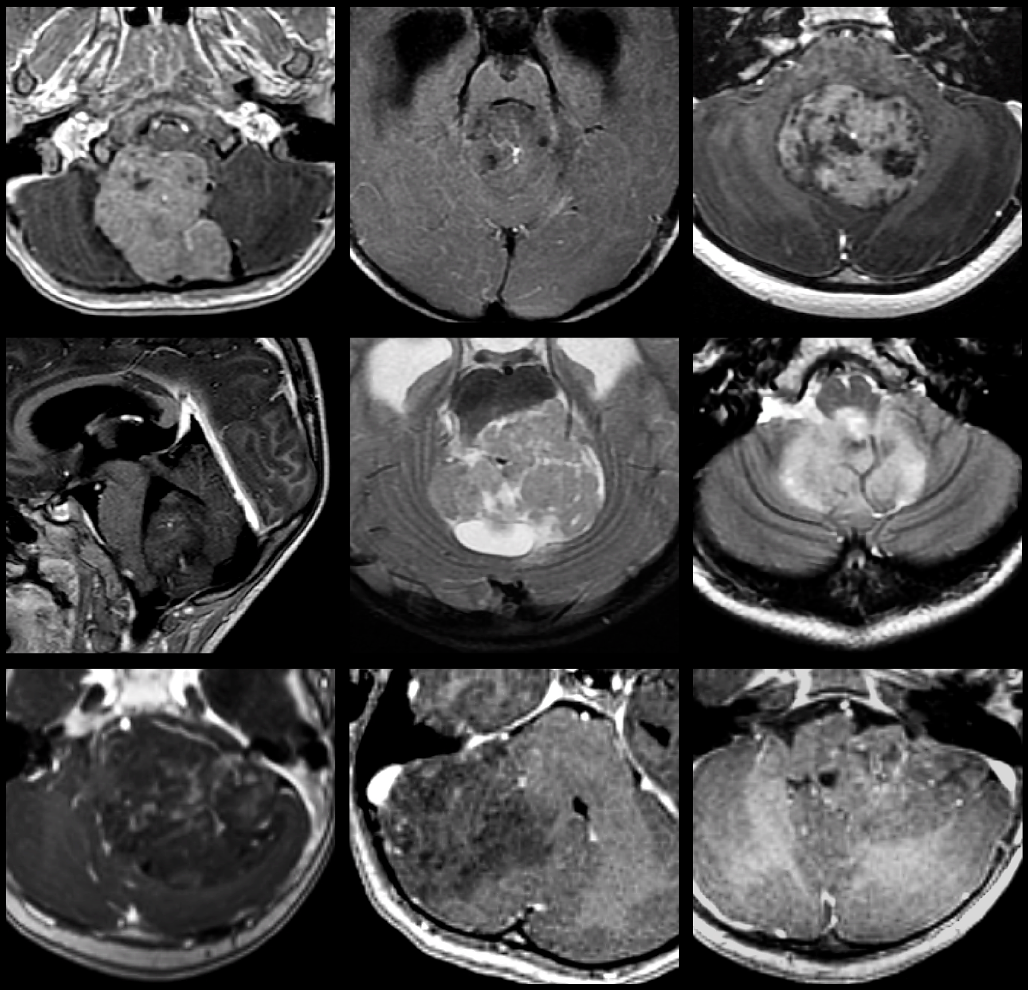
MRI Features of Pediatric Atypical Teratoid Rhabdoid Tumors and Medulloblastomas of the Posterior Fossa
Hsin-Wei Wu, MD
Department of Radiology,
Taipei Veterans General Hospital
19 Oct 2024

Slide 3
Background
Louis DN. Neuro-Oncology. (2021)
Fossey M. J Neuro-Oncol. (2017)
Lau CS. Cancer manag res. (2015)
Reddy AT. J Clin Oncol. (2020)
Gajjar A. J Clin Oncol. (2021)
AT/RT
Medulloblastoma
1-2% pediatric CNS tumors | 20% pediatric CNS tumors
Younger (85% ≤ 3 Y/O) | Older
Extremely poor prognosis (4-year-survival: 43%) | Fair prognosis (5-year-survival: 82.3%)

Slide 4
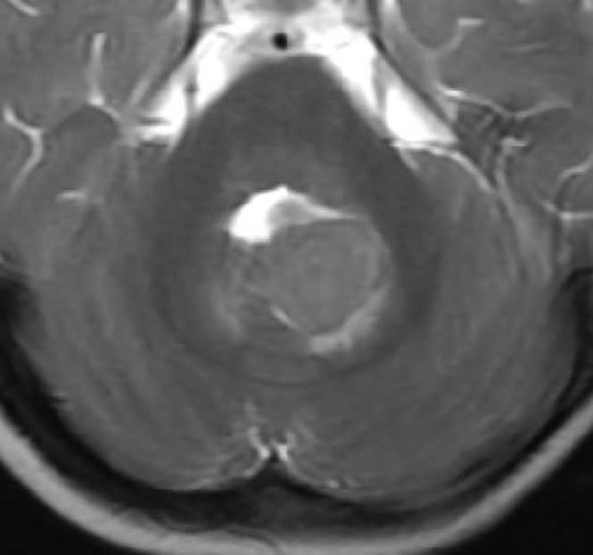
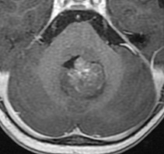
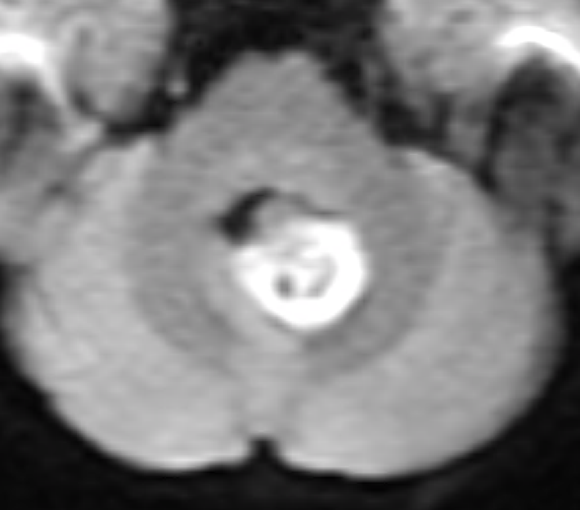
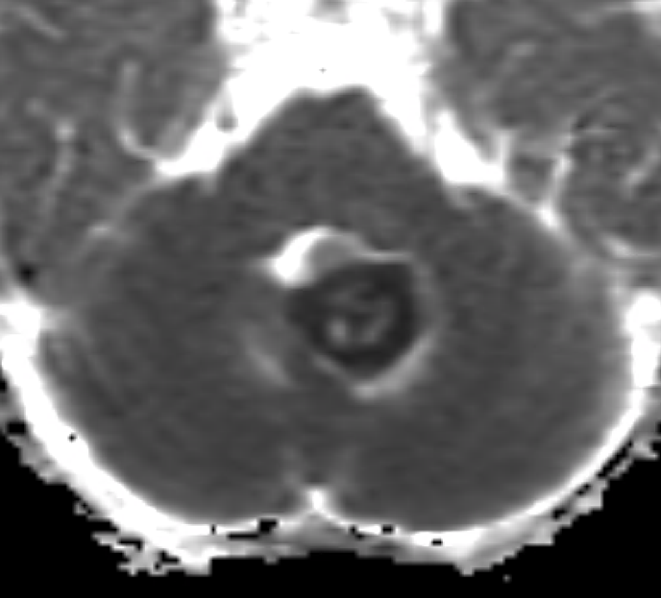
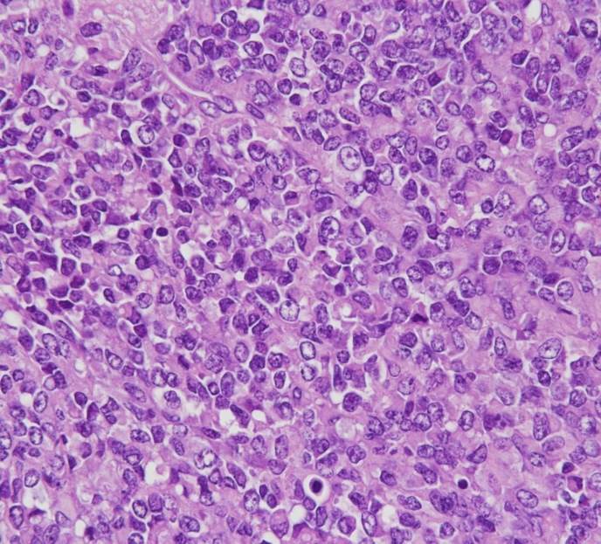
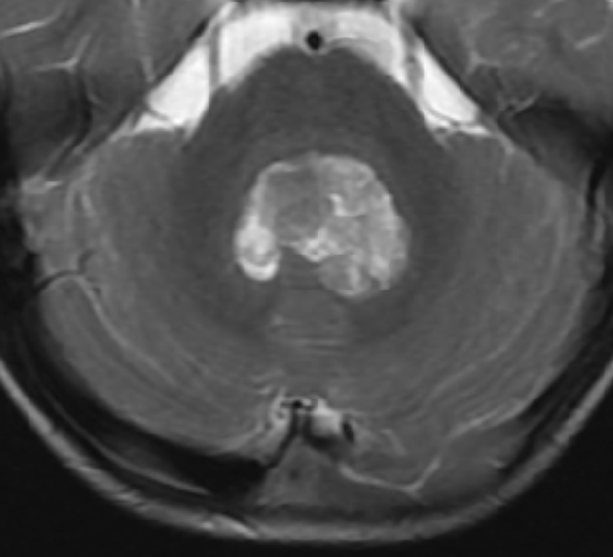
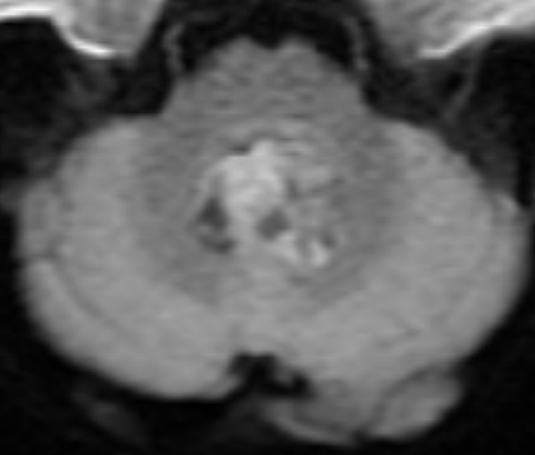
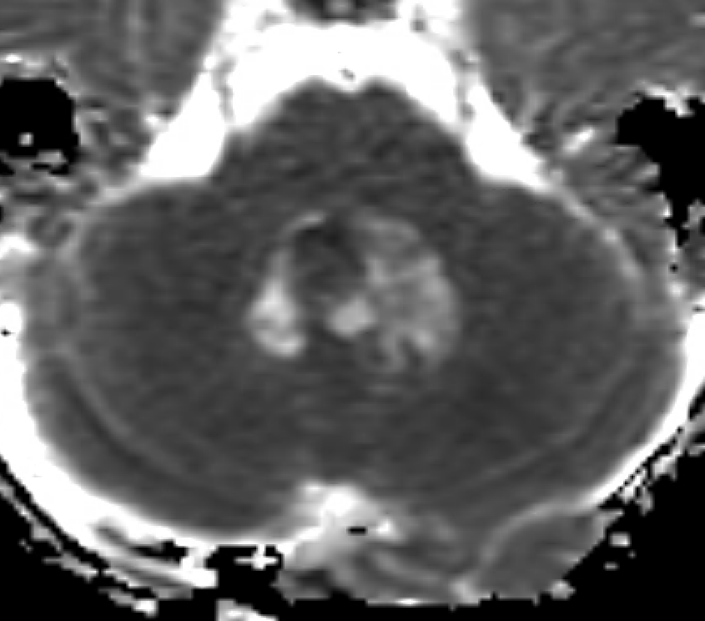
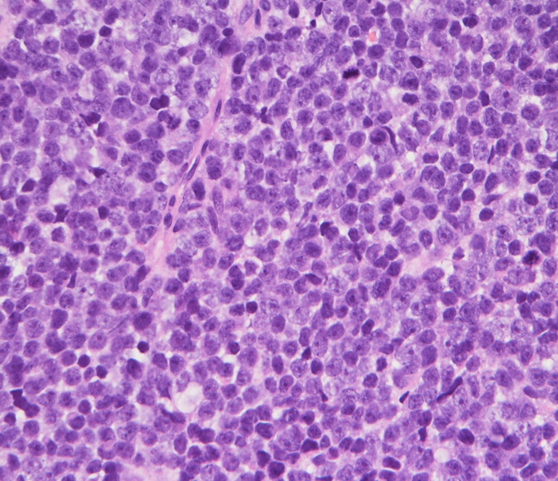
Louis DN. Neuro-Oncology. (2021)
Reddy AT. J Clin Oncol. (2020)
Gajjar A. J Clin Oncol. (2021)
Lau CS. Cancer manag res. (2015)
Jin B. Pediatric Radiology. (2013)
Rumboldt Z. Am J Neuroradiol. (2006)
Koral K. Am J Roentogenol. (2008)
Paker RJ. J Pediatric Hematol. (2002)
AT/RT and medulloblastoma have similar image features and are generally indistinguishable on neuroimaging
T2
T1C
DWI
ADC
AT/RT
1/F
T2
T1C
DWI
ADC
Medulloblastoma
3/M

Slide 5
Materials and Methods
From 2005-2021, retrospectively enrolled:
16 pediatrics with AT/RT
57 pediatrics with medulloblastoma

Slide 6
Materials and Methods
MRI characteristics
Then, we evaluated the 73 patients’
Lesion size
Signal signals on T1WI, T2WI, T1FS C+, DWI (b=0 & 1,000 s/mm²), ADC, SWI, T2*GRE
Intratumoral morphology (central/peripheral tumor drainage veins, necrosis, cysts, hemorrhage, calcification)
Peritumoral brain involvement (brainstem, middle cerebellar peduncle)
Distant involvement (brain edema, tumor seeding, hydrocephalus)
Clinical features
Age, gender
Surgical records (Gross total / nearly total / subtotal / partial removal)
Adjuvant cancer treatments (Chemotherapy, radiotherapy)

Slide 7
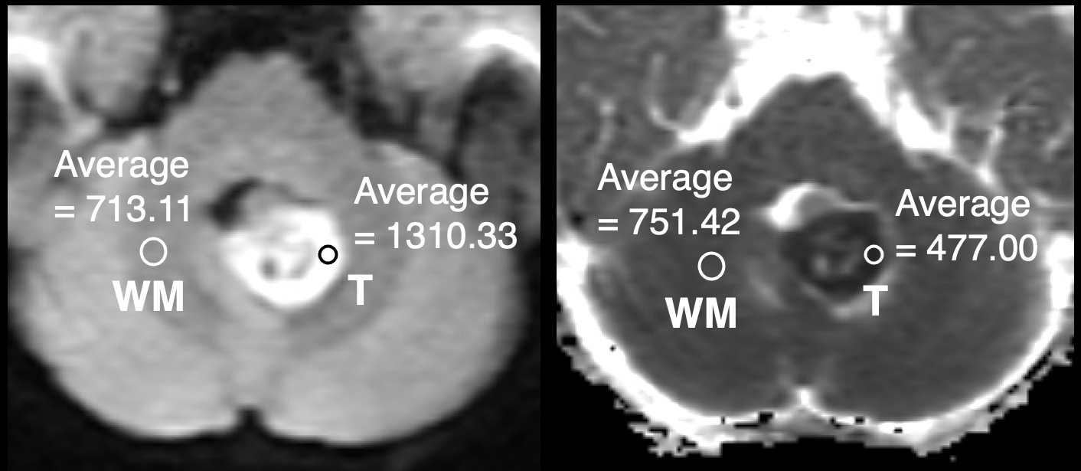
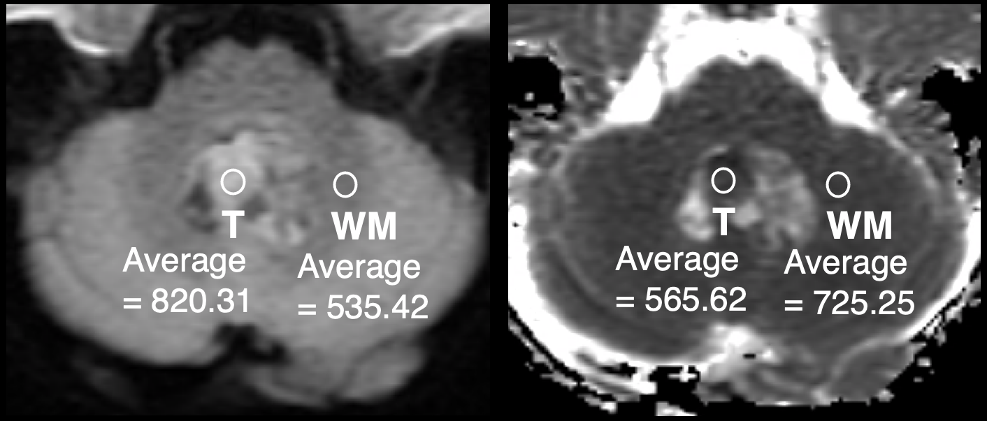
Materials and Methods
ADC_{min}, ADC ratio and DWI ratio
Place ROIs (10-50 mm²) at the tumors’ solid portion, with lowest ADC / highest DWI value
Avoid cyst, necrosis, edema, Ca⁺⁺, hemorrhage
In a single image sequence, 3 ROIs were positioned in various sections, and their average was subsequently calculated
ADC (or DWI) ratio = solid tumor ÷ contralateral white matter
1/F, AT/RT
3/M, medulloblastoma

Slide 8
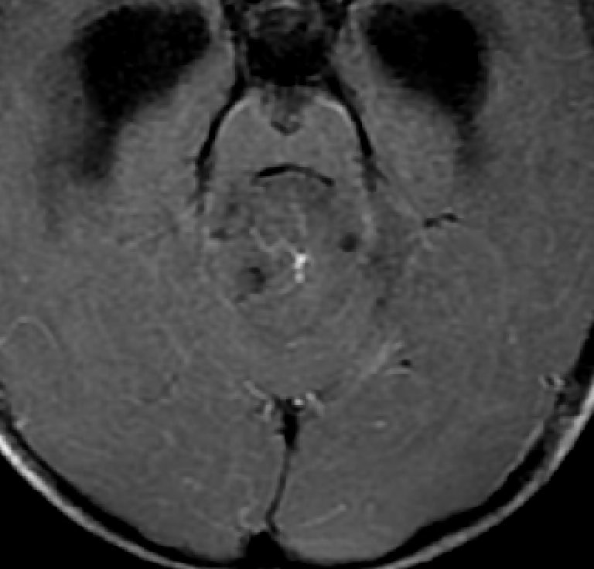
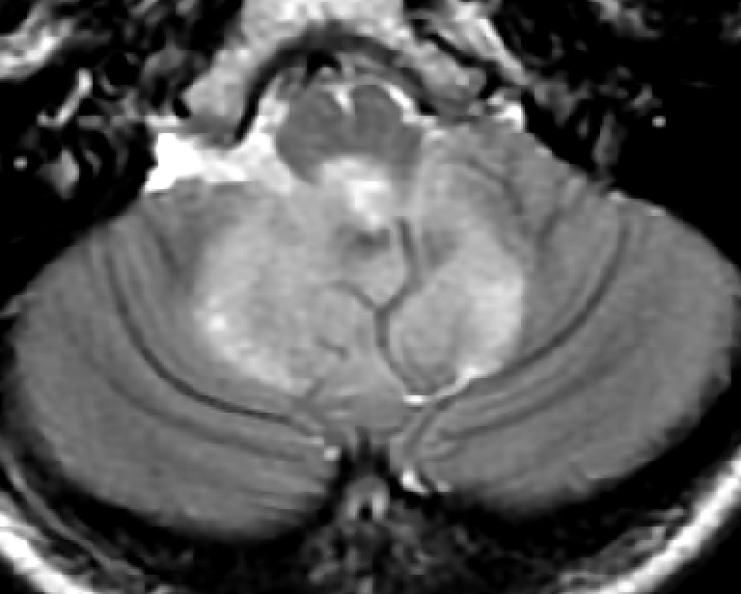
Materials and Methods
Tumor central vein sign
A single, dominant central intratumoral drainage vein
Visible on T1FS C+ or T2WI
May either appear as a thin line or dot
Statistical assessment performed with IBM® SPSS® software

Slide 9
Results
Demographic features
 | AT/RT (N=16) | Medulloblastoma (N=57) | P value
Age at diagnosis – years | 2.8 ± 4.9 (0-17) | 6.5 ± 4.0 (0-18) | <.001
Follow-up tumor status |  |  | .003
Recurrence or progression – no. (%) | 13 (81.3) | 20 (35.1)
Stationary disease – no. (%) | 0 (0) | 2 (3.5)
Disease regression – no. (%) | 3 (18.8) | 35 (61.4)
Surgery to progression– month | 8.5 ± 10.6 (1-33) | 32.0 ± 40.9 (3-137) | .004
Follow up period – month | 30.5 ± 47.4 (1-191) | 76.8 ± 55.2 (2-187) | <.001
Survival |  |  | .005
Alive – no. (%) | 3 (21.4) | 35 (66.0)
Deceased – no. (%) | 11 (78.6) | 18 (34.0)
Survival time – month | 45.5 ± 17.7 (3-191) | 128.4 ± 10.8 (10-187) | <.001

Slide 10
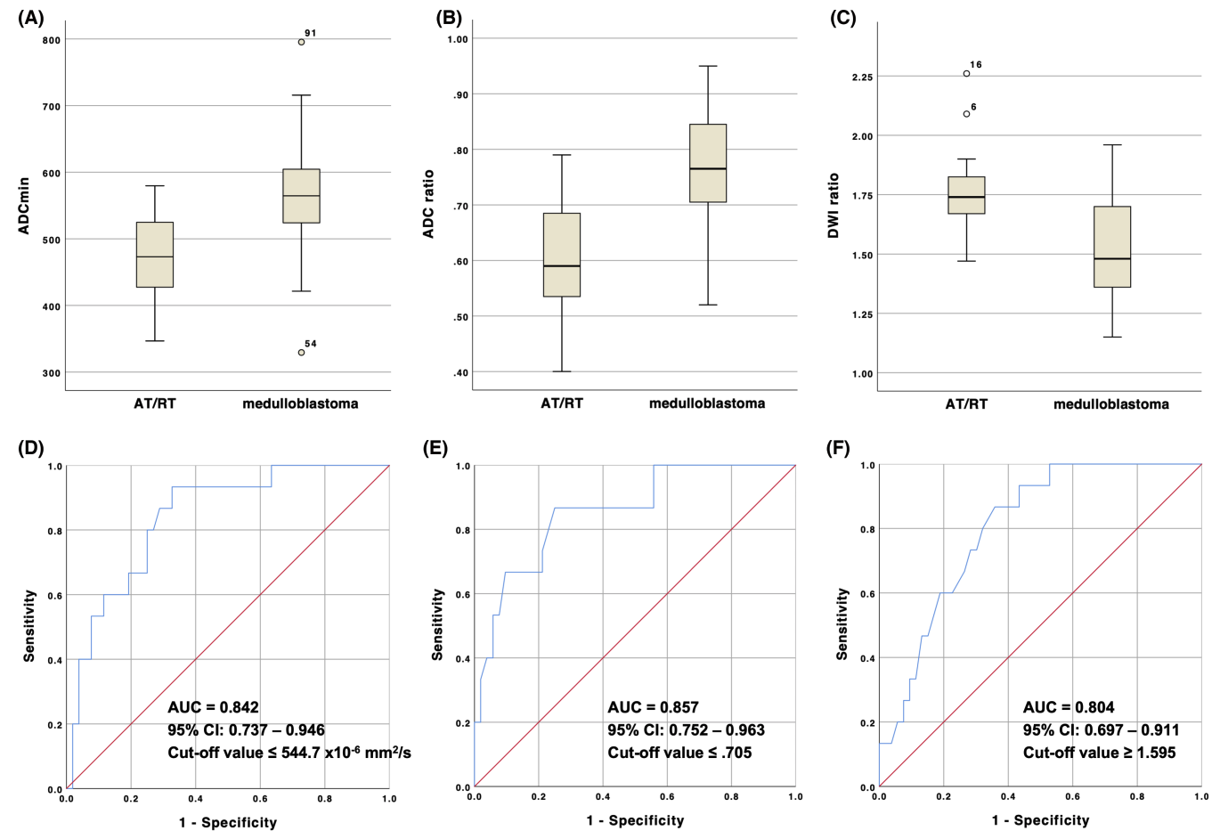
Results
AT/RT
MRI features (1)
ADC_{min}
ADC ratio
DWI ratio
DWI ratio = 1.84
ADC ratio = 0.63
Medulloblastoma
(P<.001)
(P<.001)
(P<.001)
DWI ratio = 1.53
ADC ratio = 0.80

Slide 11
Results
AT/RT
MRI features (2)
Intratumoral morphology
 | AT/RT (N=16) | Medullo-blastoma (N=57) | P value
Tumor central vein sign | 1 (6.3) | 24 (42.1) | .007
Necrosis – no. (%) | 13 (81.3) | 33 (57.9) | .14
Cysts – no. (%) | 15 (93.8) | 51 (89.5) | 1.00
Hemorrhage– no. (%) | 6 (37.5) | 8 (14.0) | .066
Calcification– no. (%) | 7 (43.8) | 11 (19.3) | .056
WITHOUT “tumor central vein sign”
Medulloblastoma
WITH “tumor central vein sign”

Slide 12
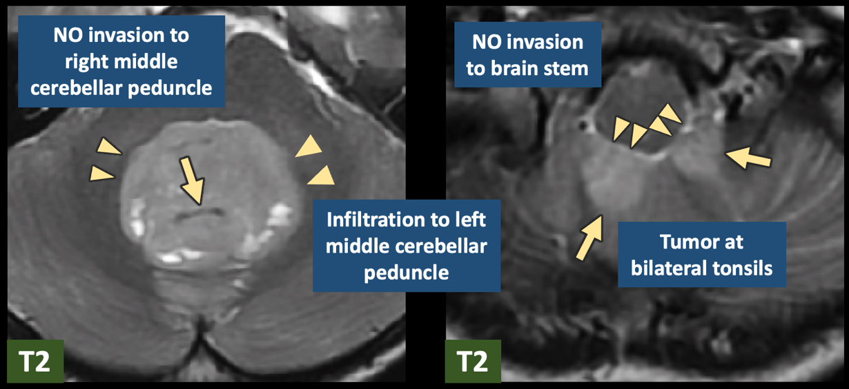
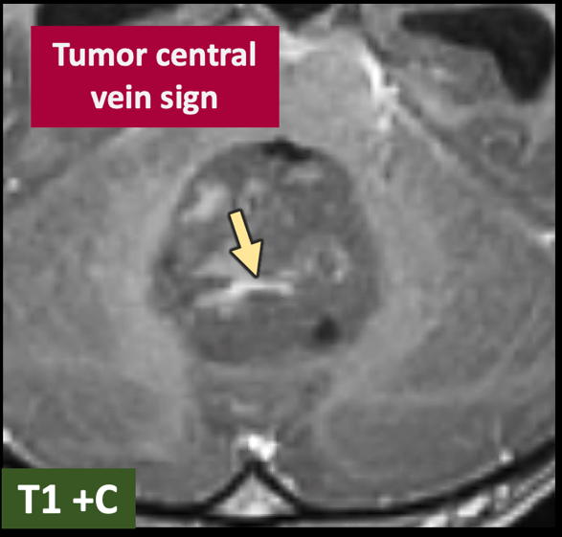
Results
AT/RT
MRI features (3)
Peritumoral and distant involvement
 | AT/RT (N=16) | Medullo-blastoma (N=57) | P value
Peritumor brain invasion
Brainstem – no. (%) | 12 (75.0) | 10 (17.5) | <.001
Mid. cerebellar peduncle | 15 (93.8) | 16 (28.1) | <.001
Peritumoral brain edema | 4 (25.0) | 28 (49.1) | .10
Downward transforminal extension – no. (%) | 4 (25.0) | 17 (29.8) | 1.00
Medulloblastoma

Slide 13
Conclusion
AT/RT and medulloblastoma were reported to be indistinguishable on neuroimaging, but we discovered that they have different clinical and MRI features:
AT/RT
Medulloblastoma
Higher progression/recurrence rate
Lower ADC_{min} and ADC ratio
Higher DWI ratio
More peritumoral invasion
Tumor central vein sign

Slide 14
Special thanks to Prof. Feng-Chi Chang.
All illustrated pictures without references were generated by AI image creators.
THANK YOU
@
E-mail Address
wu.lucas@gmail.com

