Slide 1
林姿吟
Therapeutic Drug Monitoring of Perampanel: Clinical Utility and Impact of Co-medication on Pharmacokinetic Variability
林口長庚醫院腦功能暨癲癇科 醫師
樂誠診所醫師
林秀娜 教授

Slide 2
Therapeutic drug monitoring of perampanel: Clinical utility and impact of co-medication on pharmacokinetic variability
2024全國兒童神經精神科學勵翔獎
林口長庚 腦功能暨癲癇科
樂誠診所
林姿吟 醫師
19th,Oct., 2024

Slide 3
Background-1
Perampanel (PER) is a newly developed ASM, acting as a non-competitive AMPA receptor on postsynaptic neurons.
Primarily metabolized through cytochrome P450 CYP3A4/5 hepatic oxidation.
Influenced by sex; unaffected by age and race.
Notes:
1. adjunctive treatment for focal-onset seizures with or without evolution to bilateral tonic-clonic seizures and for generalized-onset
tonic-clonic seizures in patients aged 12 years and higher
2. PER clearance was increased significantly by CYP3A4 enzyme-inducing ASMs

Slide 4
Background-2
Correlation between PER plasma concentration, reduction in seizure frequency, and AE? ☑ phase III study ❓post-marketing study
Aim: to determine the utilization of TDM for PER in a real-world clinical setting and investigate the influence of concomitant use of ASMs on the plasma concentration profile of PER.
Notes:
TDM of older generation ASMs has been widely accepted, whereas its benefits for the newer generations of ASMs, including
PER, is controversial

Slide 5
Method-1
All PER plasma level measurement requests from Electronic medical records and Chang Gung Research Database of CGMH
Medication prescribed and dose, epilepsy syndrome and seizure types, age at onset of epilepsy, body weight, monthly seizure frequency before and after TDM, AEs, co-medications, and laboratory test
Exclusion: renal impairment, hepatic dysfunction or pregnancy
Main outcomes: PER plasma concentration, ratio of concentration to the weight-adjusted dose (C/D)

Slide 6
Method-2
Subgroups according to indications for requesting PER TDM
Understanding baseline or dose optimization
Uncontrolled seizures despite an apparently adequate dose
Suspected toxicity
Drug-drug interactions
Status epilepticus
Elderly age

Slide 7
Method-3
Subgroups according to the concomitantly administered ASM
Group A: PER monotherapy
Group B: co-medication with enzyme-inducing ASMs
Group C: co-medication with enzyme-inhibiting ASMs
Group D: comedication with both enzyme-inducing and enzyme-inhibiting ASMs.
I

Slide 8
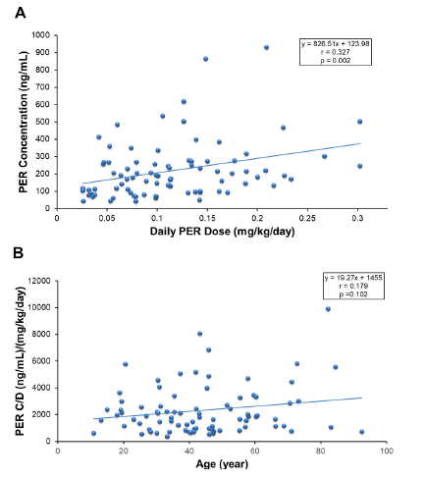
Result-1 PER concentration v.s. dosage
P=0.002
PER concentration exhibited dose linearity
Notes:
PER concentration exhibited dose linearity

Slide 9
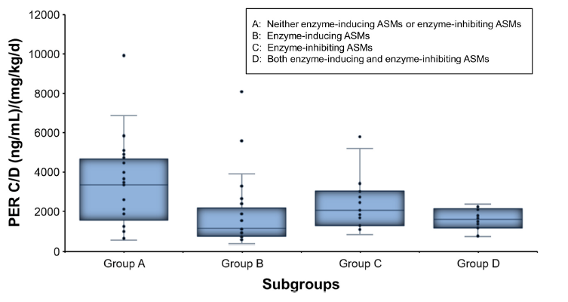
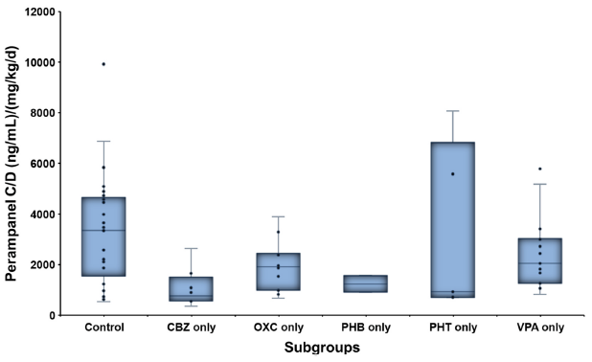
Result-2 PER concentration, C/D ratio v.s. concomitant ASM
The mean PER C/D ratio were significantly different among the four groups
P<0.05
The mean PER C/D ratio were no significantly
different among the six groups
Notes:
The mean PER C/D ratio were significantly different among the four groups (one-way ANOVA)
Compared with those who were not prescribed enzyme-inducing or enzyme-inhibiting ASMs (group A), the mean PER C/D ratio in
patients co-medicated with enzyme-inducing ASMs (group B) were significantly lower (p < 0.05)
the mean PER C/ D ratio in those co-medicated with VPA, a known CYP-enzyme inhibitor (group C), were not significantly different from those in the patients who were not co-medicated with enzyme-inducing or enzyme-inhibiting ASMs (group A).
However, patients co-medicated with CBZ had the lowest PER plasma concentration, and the mean PER C/D ratio in these patients was significantly lower than that in the patients who were not prescribed enzyme-inducing or enzyme-inhibiting ASMs (control, i.e., group A)

Slide 10
Result-2 PER concentration, C/D ratio v.s. concomitant ASM
P<0.05
The mean PER C/D ratio were significantly different among the four groups
The mean PER C/D ratio were no significantly
different among the six groups
Notes:
The mean PER C/D ratio were significantly different among the four groups (one-way ANOVA)
Compared with those who were not prescribed enzyme-inducing or enzyme-inhibiting ASMs (group A), the mean PER C/D ratio in
patients co-medicated with enzyme-inducing ASMs (group B) were significantly lower (p < 0.05)
the mean PER C/ D ratio in those co-medicated with VPA, a known CYP-enzyme inhibitor (group C), were not significantly different from those in the patients who were not co-medicated with enzyme-inducing or enzyme-inhibiting ASMs (group A).
However, patients co-medicated with CBZ had the lowest PER plasma concentration, and the mean PER C/D ratio in these patients was significantly lower than that in the patients who were not prescribed enzyme-inducing or enzyme-inhibiting ASMs (control, i.e., group A)

Slide 11
Result-2 PER concentration, C/D ratio v.s. concomitant ASM
P=0.0639
The mean PER C/D ratio were significantly different among the four groups
The mean PER C/D ratio were no significantly
different among the six groups
Notes:
The mean PER C/D ratio were significantly different among the four groups (one-way ANOVA)
Compared with those who were not prescribed enzyme-inducing or enzyme-inhibiting ASMs (group A), the mean PER C/D ratio in
patients co-medicated with enzyme-inducing ASMs (group B) were significantly lower (p < 0.05)
the mean PER C/ D ratio in those co-medicated with VPA, a known CYP-enzyme inhibitor (group C), were not significantly different from those in the patients who were not co-medicated with enzyme-inducing or enzyme-inhibiting ASMs (group A).
However, patients co-medicated with CBZ had the lowest PER plasma concentration, and the mean PER C/D ratio in these patients was significantly lower than that in the patients who were not prescribed enzyme-inducing or enzyme-inhibiting ASMs (control, i.e., group A)

Slide 12
Result-2 PER concentration, C/D ratio v.s. concomitant ASM
The mean PER C/D ratio were significantly different among the four groups
The mean PER C/D ratio were no significantly
different among the six groups
P=0.052
Notes:
The mean PER C/D ratio were significantly different among the four groups (one-way ANOVA)
Compared with those who were not prescribed enzyme-inducing or enzyme-inhibiting ASMs (group A), the mean PER C/D ratio in
patients co-medicated with enzyme-inducing ASMs (group B) were significantly lower (p < 0.05)
the mean PER C/ D ratio in those co-medicated with VPA, a known CYP-enzyme inhibitor (group C), were not significantly different from those in the patients who were not co-medicated with enzyme-inducing or enzyme-inhibiting ASMs (group A).
However, patients co-medicated with CBZ had the lowest PER plasma concentration, and the mean PER C/D ratio in these patients was significantly lower than that in the patients who were not prescribed enzyme-inducing or enzyme-inhibiting ASMs (control, i.e., group A)

Slide 13
Result-2 PER concentration, C/D ratio v.s. concomitant ASM
The mean PER C/D ratio were significantly different among the four groups
P<0.05
The mean PER C/D ratio were no significantly
different among the six groups
Notes:
The mean PER C/D ratio were significantly different among the four groups (one-way ANOVA)
Compared with those who were not prescribed enzyme-inducing or enzyme-inhibiting ASMs (group A), the mean PER C/D ratio in
patients co-medicated with enzyme-inducing ASMs (group B) were significantly lower (p < 0.05)
the mean PER C/ D ratio in those co-medicated with VPA, a known CYP-enzyme inhibitor (group C), were not significantly different from those in the patients who were not co-medicated with enzyme-inducing or enzyme-inhibiting ASMs (group A).
However, patients co-medicated with CBZ had the lowest PER plasma concentration, and the mean PER C/D ratio in these patients was significantly lower than that in the patients who were not prescribed enzyme-inducing or enzyme-inhibiting ASMs (control, i.e., group A)

Slide 14
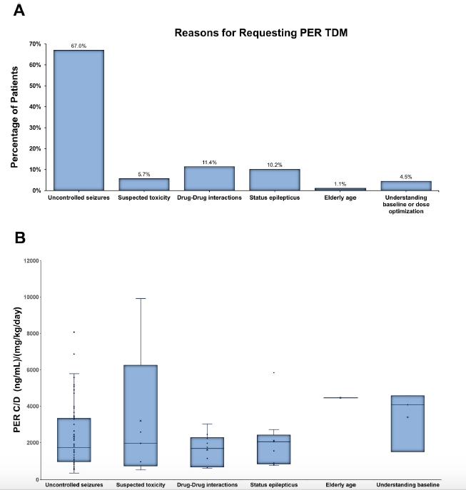
Result-3 PER concentration, C/D ratio v.s. Indications of TDM
Most of the p’ts received PER TDM owing to poorly controlled seizures
67%. + 10.2% = 77.2%
Trend toward a higher C/D ratio in those suspected of having
PER toxicity owing to AE than in those with poorly controlled seizures
Notes:
Most of the patients (n = 68, 77.3 %) received PER TDM owing to poorly controlled seizures, including nine patients with status
epilepticus

Slide 15
Conclusion
Linear regression relationship between PER concentration and PER dosage
PER plasma concentration is highly susceptible to interactions with enzyme-inducing ASMs
TDM with clear indication could be helpful in determining the influence of co-medication with ASMs on PER concentrations.

