Slide 1
林莞茜
A lissencephaly-associated BAIAP2 variant causes defects in neuronal migration during brain development
國立陽明交通大學 腦科學研究所 碩士
臺北榮民總醫院 實習醫師
蔡金吾 教授

Slide 2
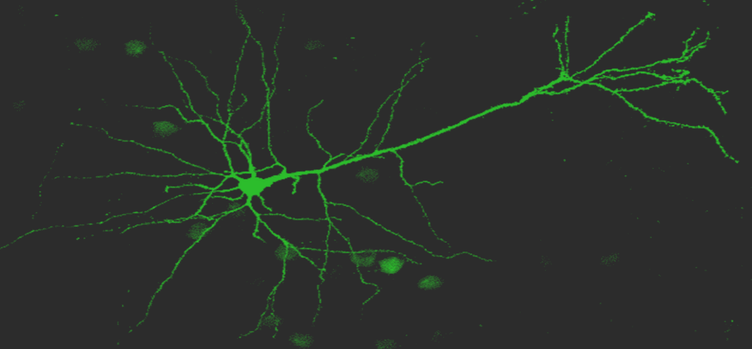
2024年中華民國神經精神科學 勵翔獎
Speaker: Wan-Cian Lin 林莞茜
(陽明交通大學 腦科所碩士)
Advisor: Dr. Jin-Wu Tsai 蔡金吾 教授
(陽明交通大學 腦科所教授/研發長)
Date: 2024.10.19

Slide 3
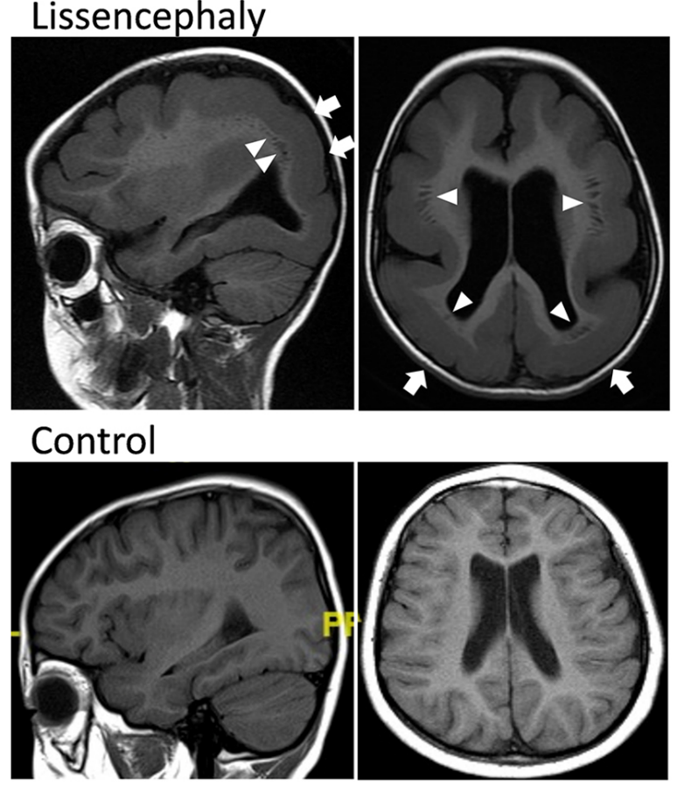
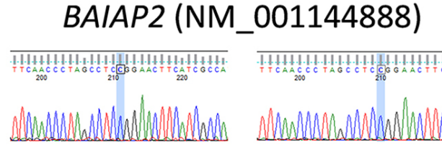
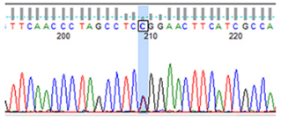
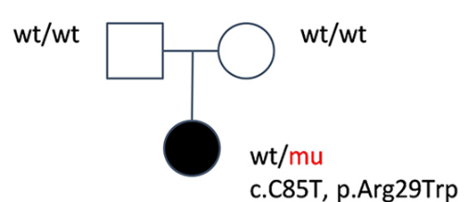
Novel BAIAP2 variant in a lissencephaly patient
6 y/o
Manifestation
Hypotonia
Feeding difficulties
Global developmental delay
Seizures
Average age: 1-2 decades
Contributed genes
(>80% cases)
LIS1 (PAFAH1B1)
DCX
TUBA1A
DYNC1H1
CEP85L
> BAIAP2 ???
Treatment - Supportive
BAIAP2
Notes:
P(severe)>A
Pt info!!!!!

Slide 4
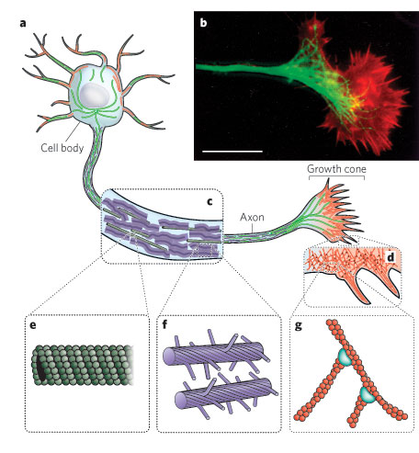
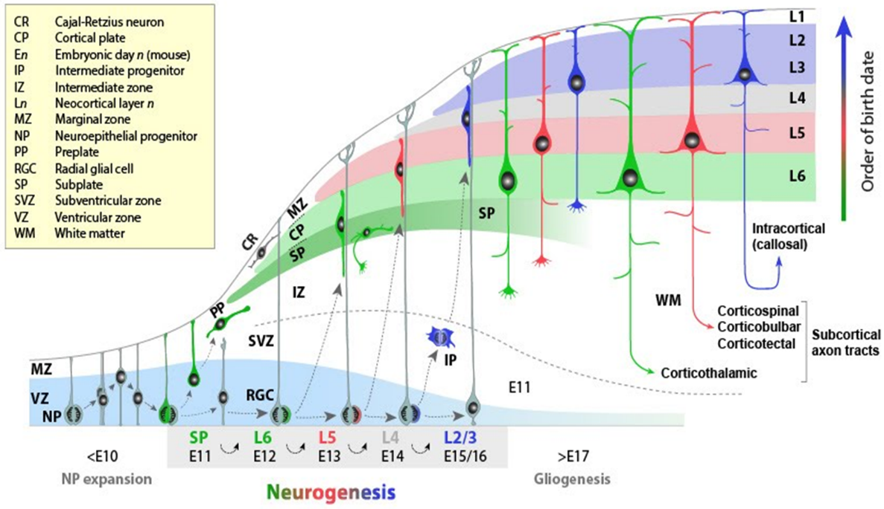
Cortical development and cytoskeletons in neuron

Slide 5
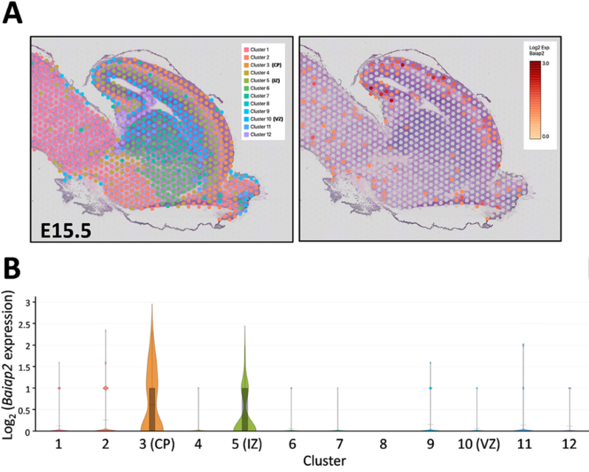
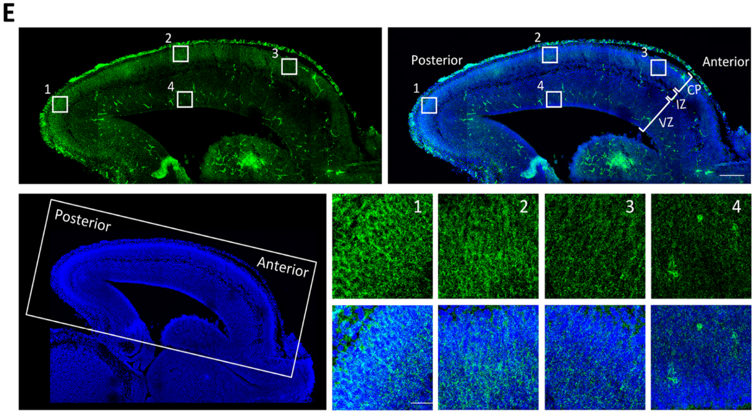
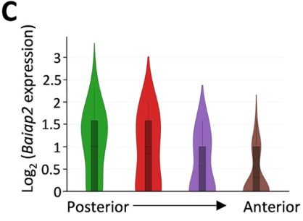
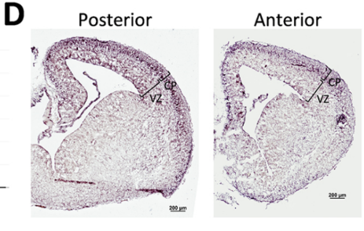
BAIAP2 expressed in an anterior-low to posterior-high gradient
200um
25um
Notes:
E 200um, 1234 25um
gene expression compatible to phenotype -> more probably an pathogenic gene

Slide 6
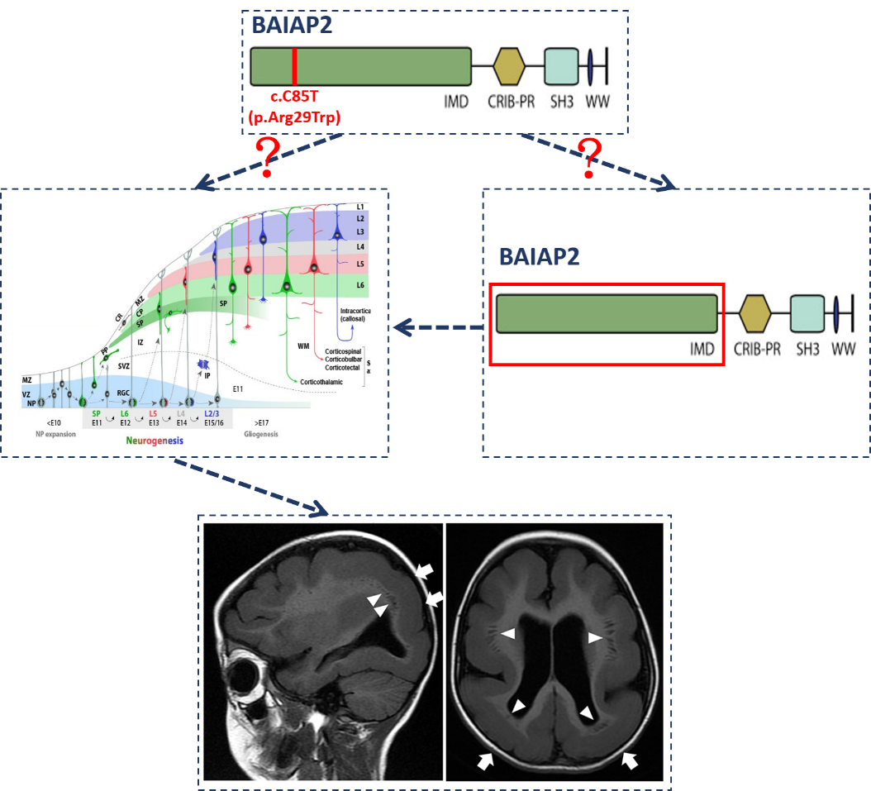
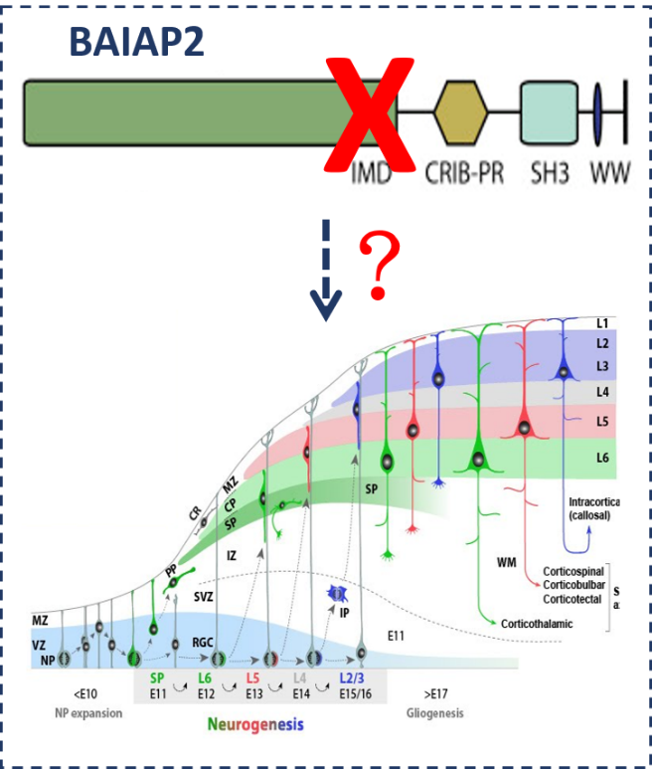
Experimental designs
2
1
1

Slide 7
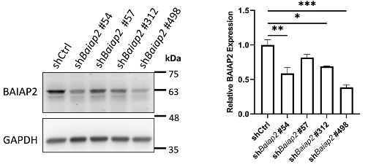
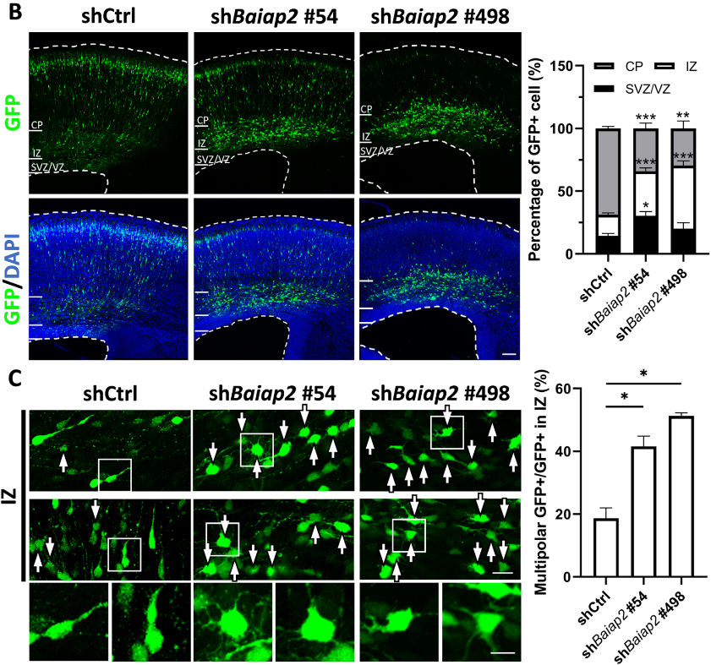
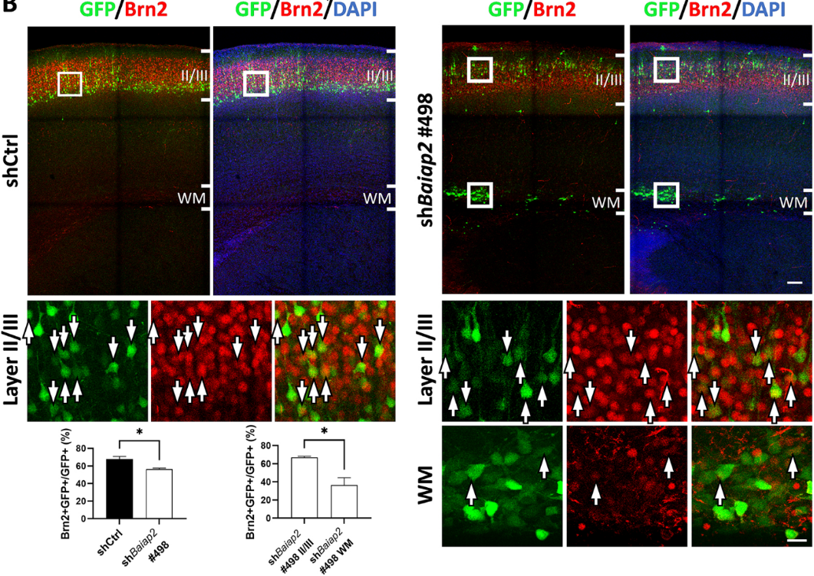
KD Baiap2 -> migration/morphology/differentiation defects
⬅ Neuro-2a cells
Brn2
layer II.III.(V) marker
100um
10um
100/20um
Notes:
Lt: 100/20/10, Rt: 100/20

Slide 8
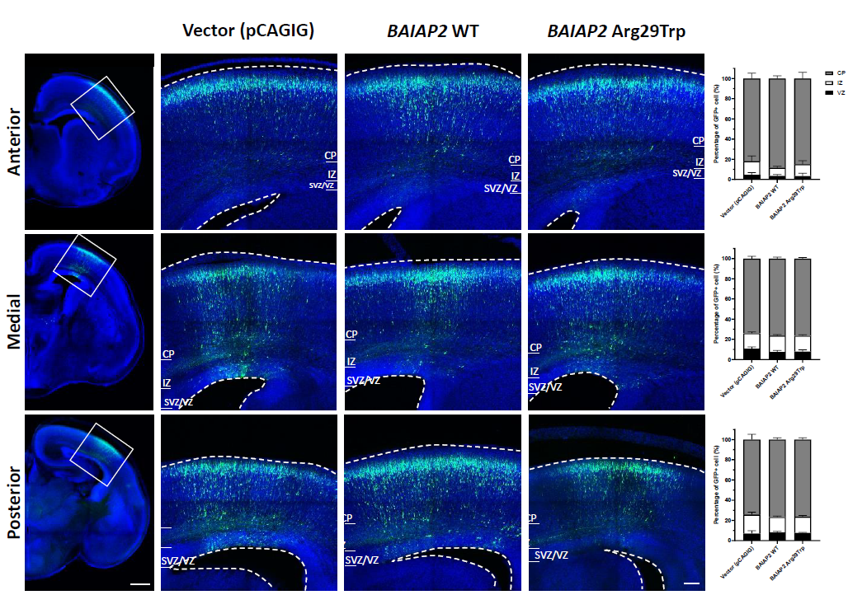
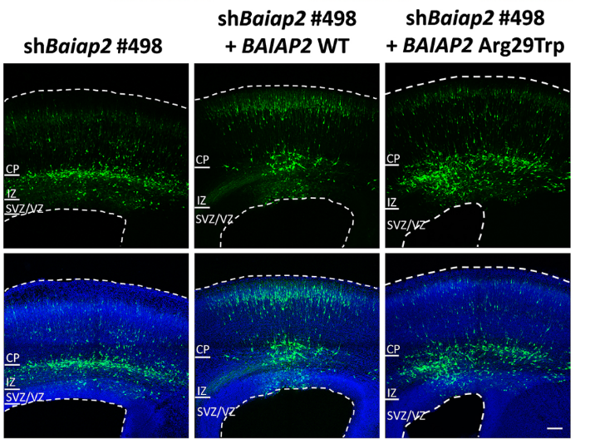
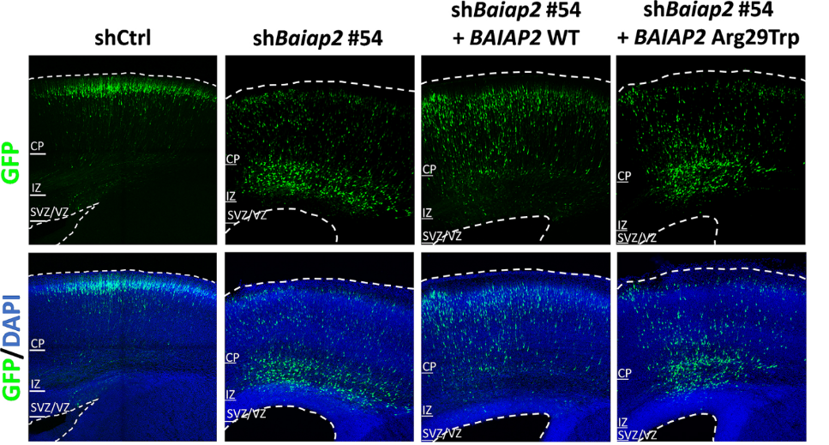
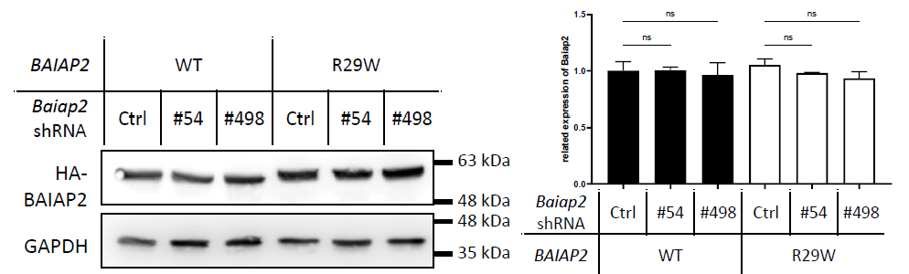
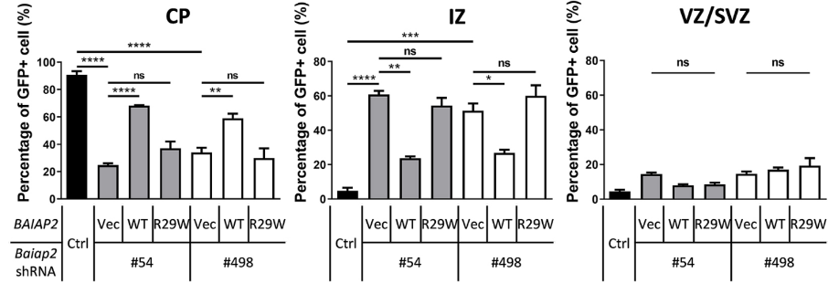
OE var. BAIAP2 -> no dominant-negative or rescue effect
Neuro-2a cells
100um
Notes:
100um

Slide 9
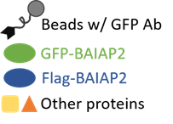
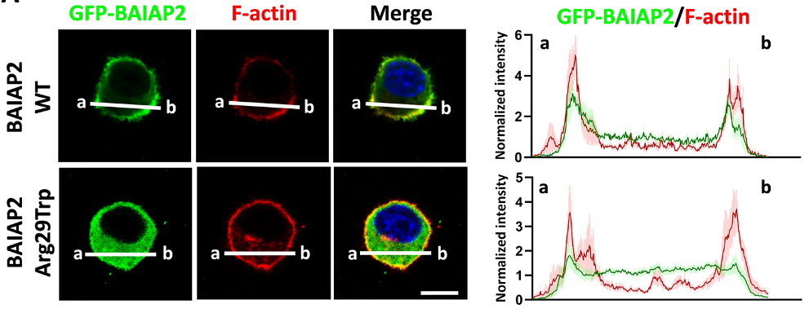
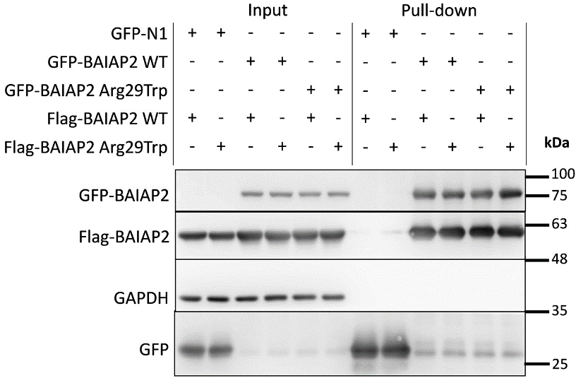
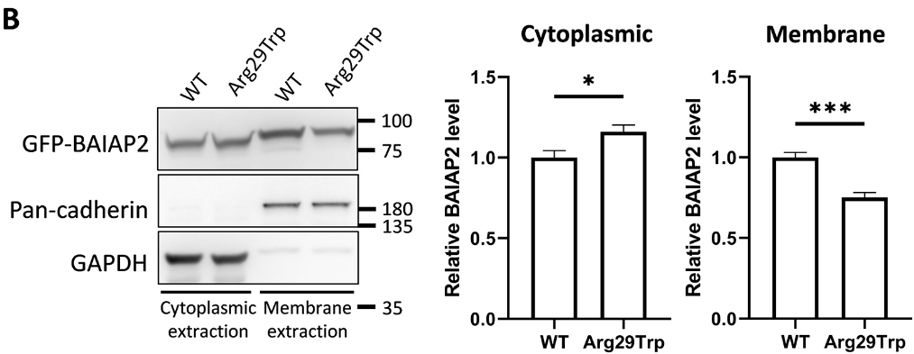
Var. BAIAP2 -> dimerization(+), but membrane targeting (-)
Neuro-2a cells
Phalloidin: F-actin stain
10um
Notes:
10um

Slide 10
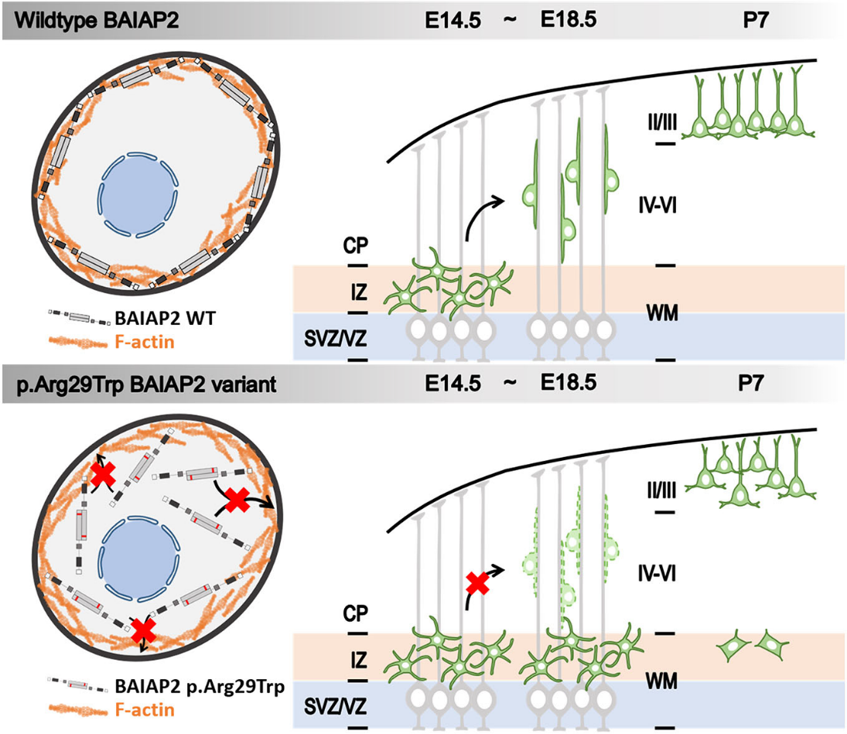
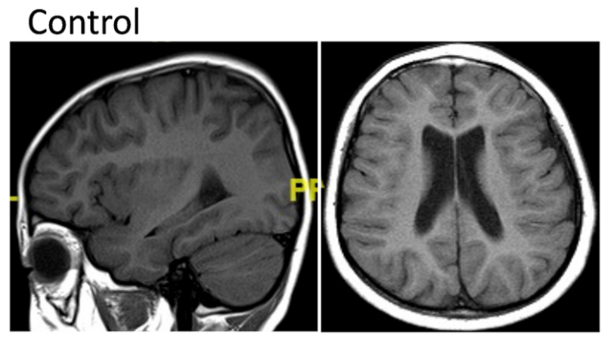
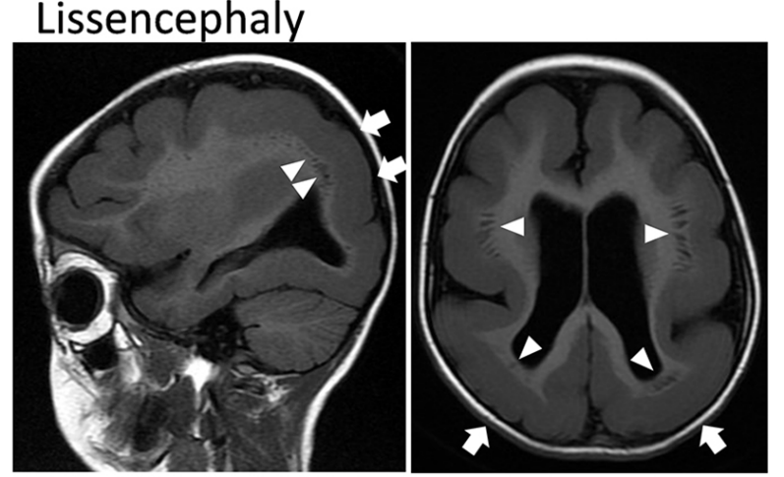
BAIAP2 plays important role in cortical development and lissencephaly pathogenesis
Notes:
10um

Slide 11
Acknowledgement
Jin-Wu Tsai 蔡金吾 教授 LAB
Meng-Han Tsai 蔡孟翰 醫師 團隊
(高雄長庚醫院 神內醫師/醫研部主任)
Pei-Shan Hou 侯佩珊 助理教授 LAB
(陽明交通大學 解剖所 助理教授)
Genomic and Proteomic Core Laboratory, Kaohsiung Chang Gung Memorial Hospital
cDNA library construction and the Genomics Center for Clinical and Biotechnological Applications of the National Core Facility for Biopharmaceuticals,Taiwan (NSTC 112-2740-B-A49-001)
The National Core Facility for Biopharmaceuticals (NCFB) and the National Science and Technology Council
Thank you for your attention!
Q & A

Slide 12
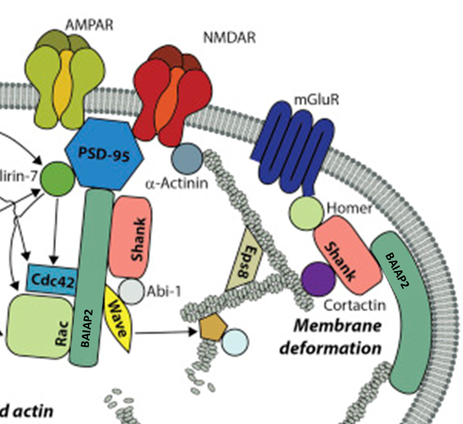
BAIAP2 biological functions
Notes:
10um

Slide 13
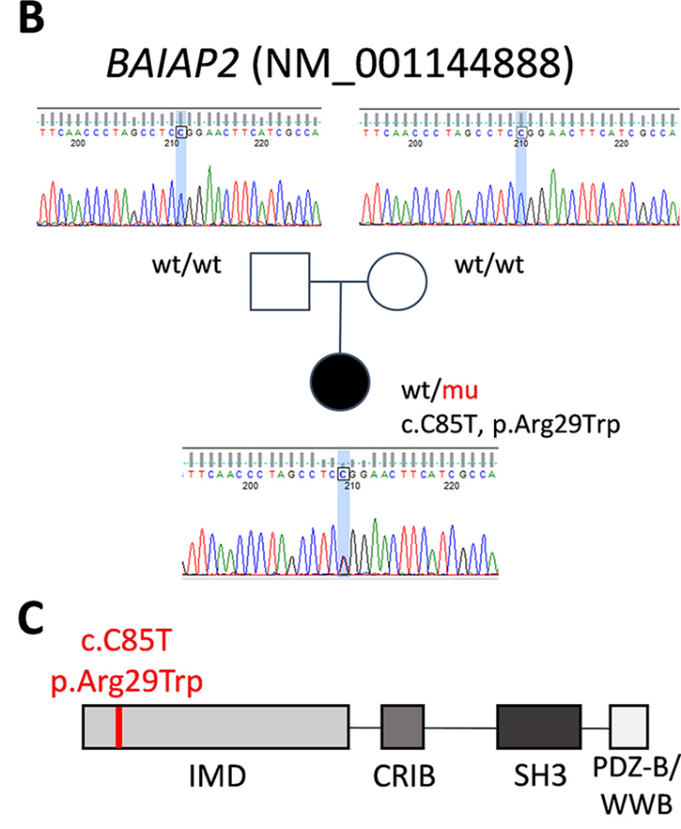
de novo missense BAIAP2 variant in 6y/o lissencephaly patient
Notes:
10um

Slide 14
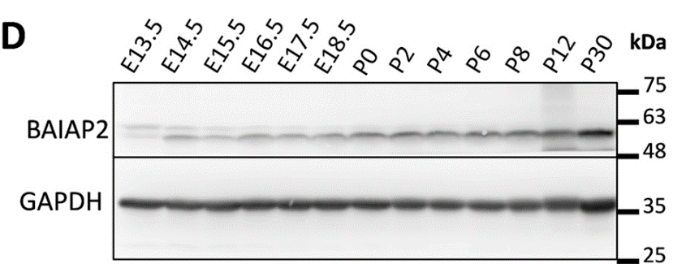
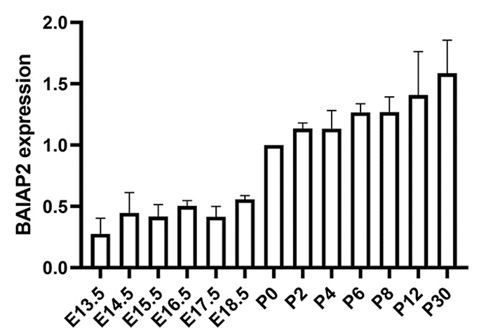
Expression of BAIAP2 in developing mouse cortex
Notes:
10um

Slide 15
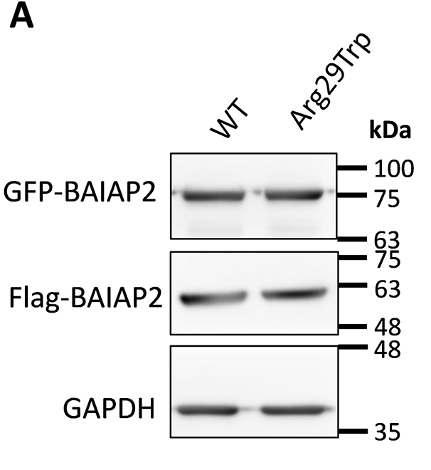
Similar expression of WT and variant BAIAP2 in cultured cells
Notes:
10um

Slide 16
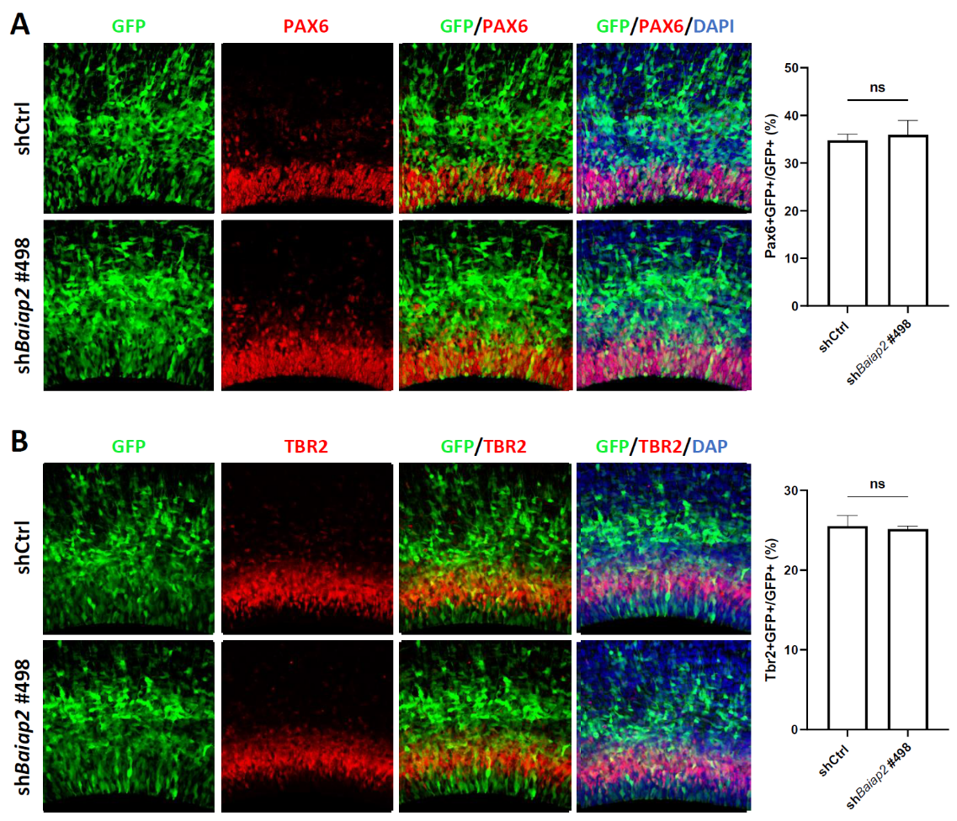
KD Baiap2 -> no change in progenitor cell ratio
Pax6. Tbr2
Progenitor cell markers
Notes:
10um

Slide 17
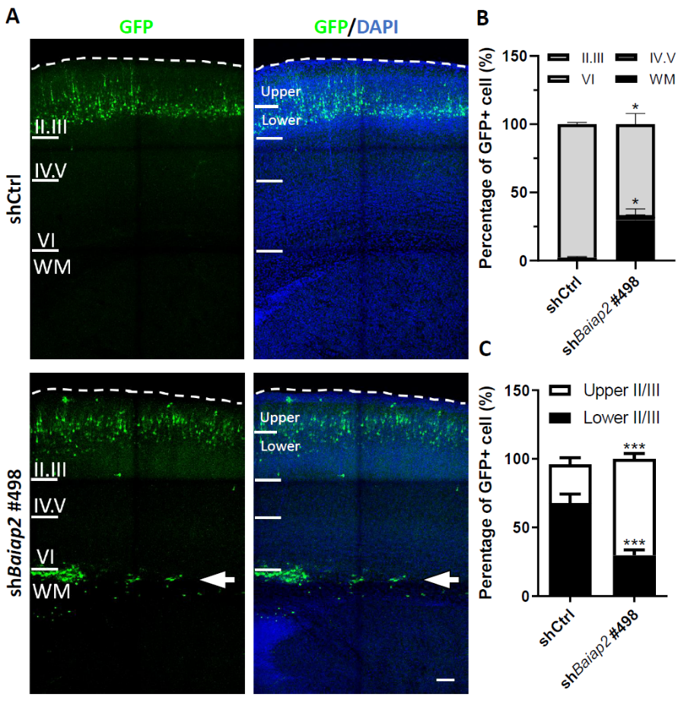
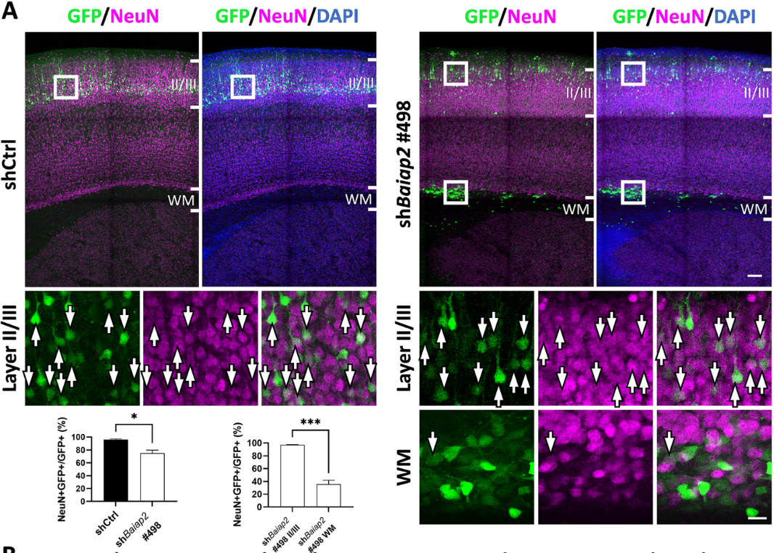
KD Baiap2 -> delayed migration, less NeuN+ neurons at P7
Notes:
10um

Slide 18
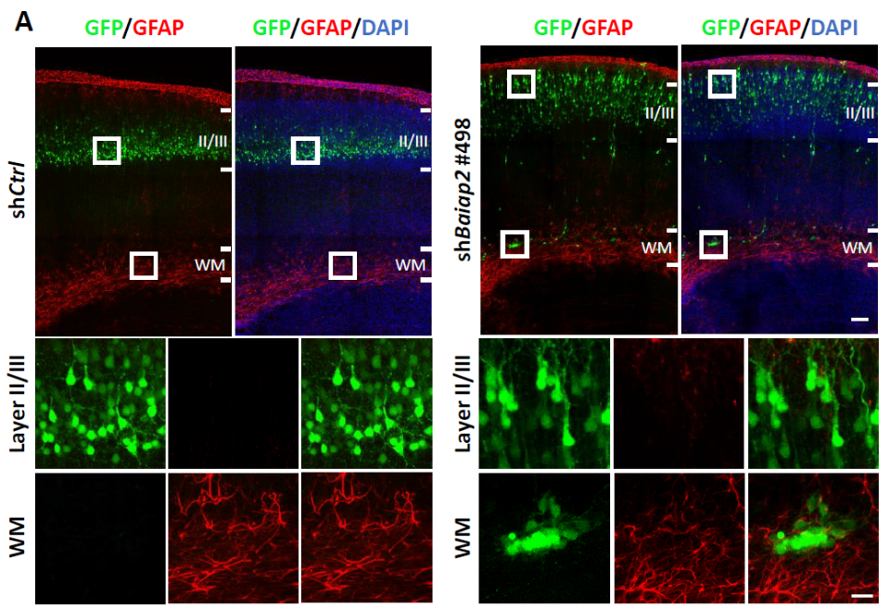
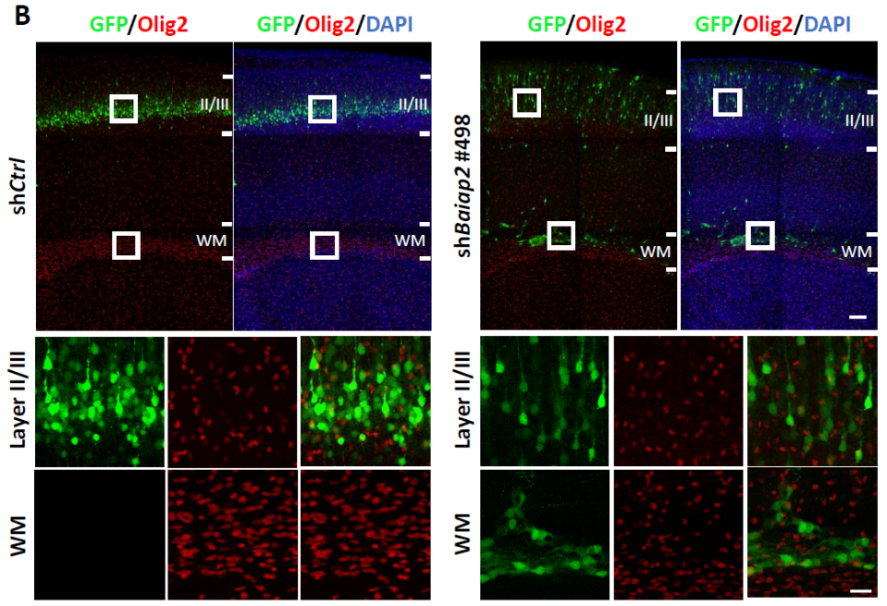
KD Baiap2 -> no astrocyte/oligodendrocyte fate adoption at P7
GFAP
Astrocyte marker
Olig2
Oligodendrocyte marker
Notes:
10um

Slide 19
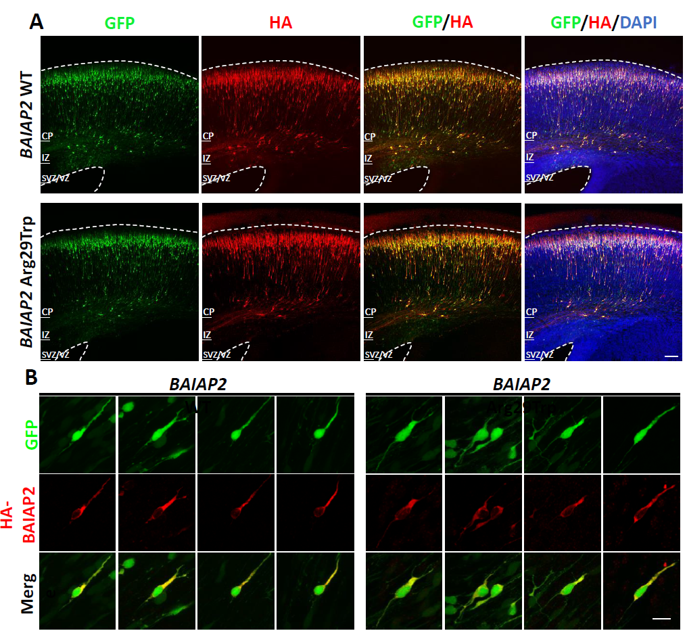
OE BAIAP2 in mice brains-> validation by HA-tag staining
Notes:
10um

Slide 20
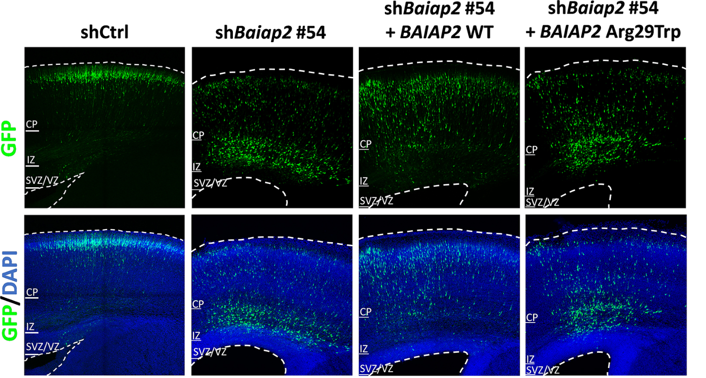
OE var BAIAP2 -> no rescue effect (shRNA #54)
Notes:
10um

