Slide 1
羅偉倫
Reprogramming of arachidonate metabolism confers temozolomide resistance to glioblastoma through enhancing mitochondrial activity in fatty acid oxidation
臺北醫學大學神經再生博士學位學程 博士
衛生福利部雙和醫院神經外科 醫師
臺北醫學大學醫學系 助理教授
徐宗溢 副教授

Slide 2
Reprogramming of Arachidonate Metabolism Confers Temozolomide Resistance to Glioblastoma
花生四烯酸之重編程可賦予膠質母細胞瘤對於帝盟多之抗藥性
蔡禹庭、羅偉倫、徐宗溢
臺北醫學大學、衛生福利部雙和醫院

Slide 3
Glioblastoma Multiforme (GBM)
GBM is an aggressive brain tumor with worst prognosis in all cancers.
Standard treatment includes CCRT following temozolomide (TMZ).
Resistance to TMZ is a critical challenge in GBM treatment.

Slide 4
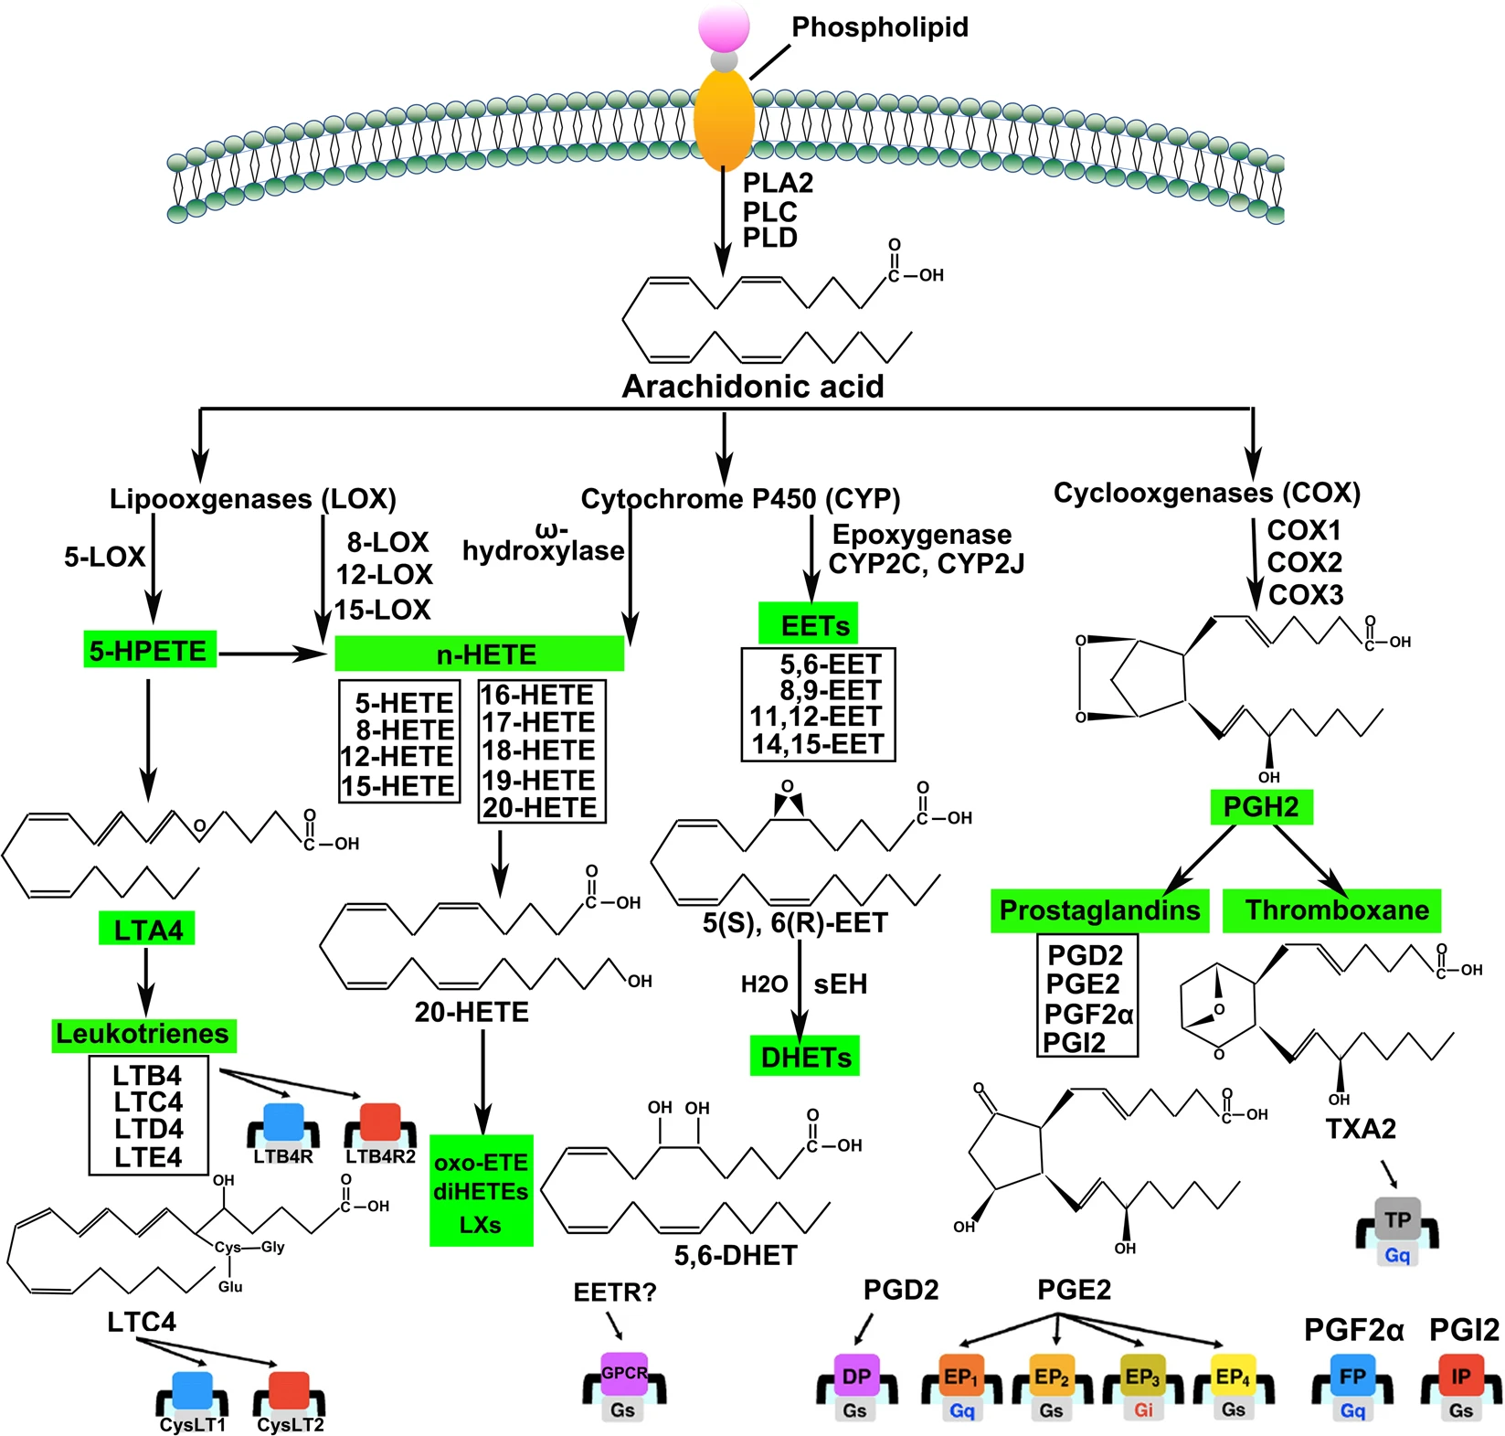
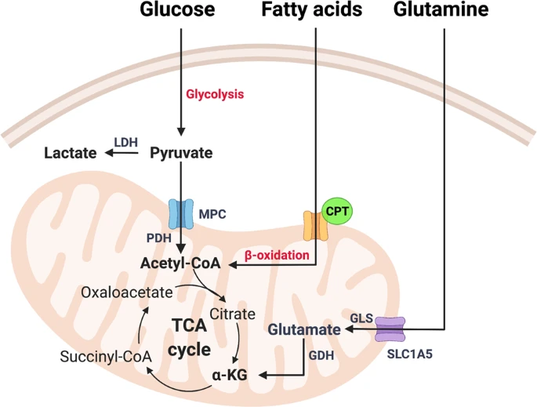
Objective
Investigate how specificity protein 1 (Sp1) reprograms arachidonate metabolism in GBM.
Explore how this metabolic shift leads to TMZ resistance by enhancing mitochondrial activity.
Signal Transduct Target Ther. 2021 Feb 26;6(1):94.
Nat Chem Biol. 2015 Jan; 11(1): 9–15.

Slide 5
Methods Overview
RNA sequencing and mass spectrometry to analyze gene expression and metabolites.
Seahorse XF Mito Stress Test for mitochondrial function.
Therapeutic targeting of PGE2 in resistant GBM.

Slide 6
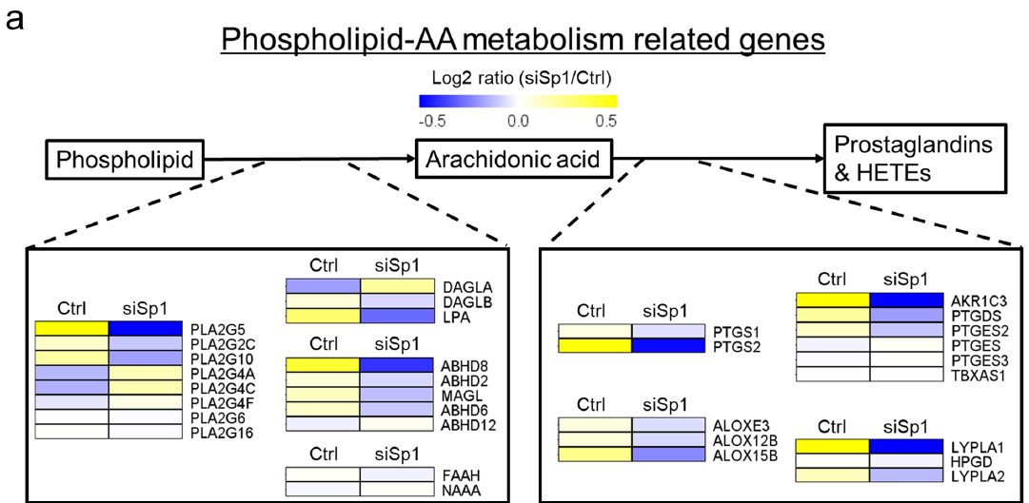
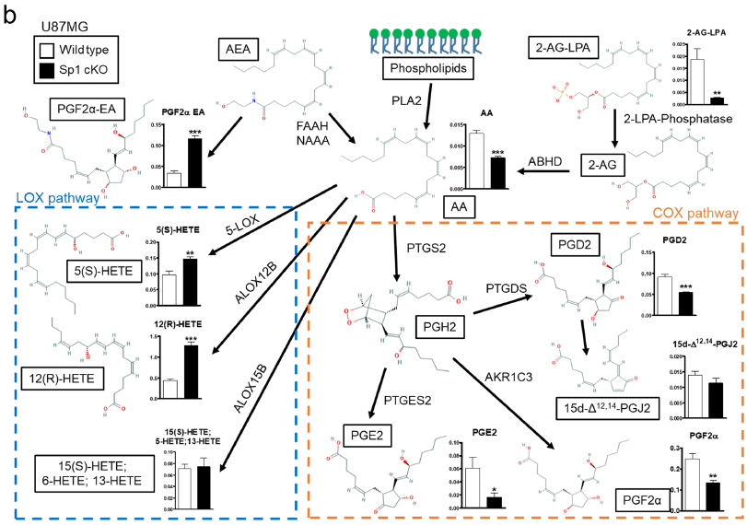
Sp1 and Prostaglandin Synthesis
Sp1 upregulates prostaglandin-endoperoxide synthase 2 (PTGS2), leading to increased PGE2 production.

Slide 7
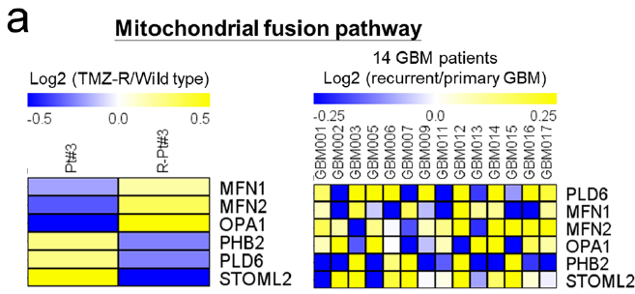
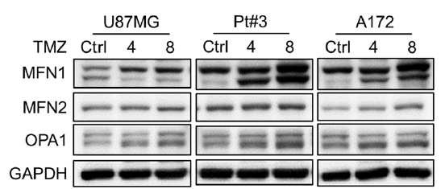
Mitochondrial Function
Enhanced mitochondrial activity via FAO and TCA cycle in TMZ-resistant GBM.
PGE2 rescues mitochondrial function impaired by TMZ.
Seahorse XF Mito Stress Test: OCR(Oxygen Consumption Rate)

Slide 8
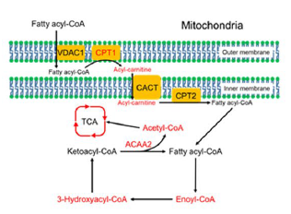
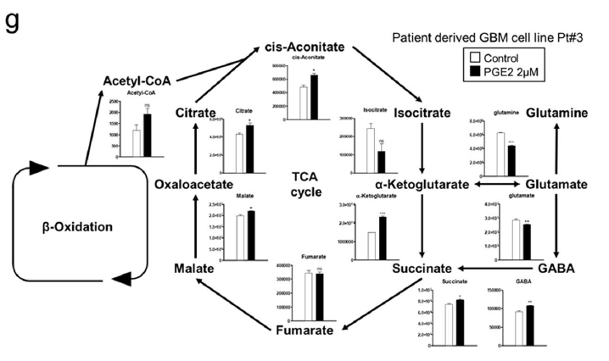
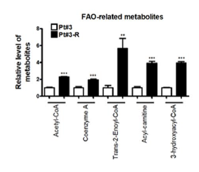
Role of Fatty Acid Oxidation (FAO)
FAO plays a crucial role in bioenergy generation for TMZ-resistant GBM cells.
PGE2 enhances FAO and TCA cycle progression to increase ATP production.

Slide 9
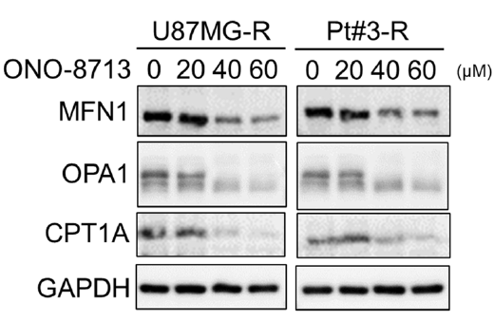
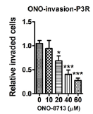
Clinical Implications
Blocking the PGE2 pathway with EP1 antagonists may reverse TMZ resistance, attenuate migration, attenuate invasiveness.

Slide 10
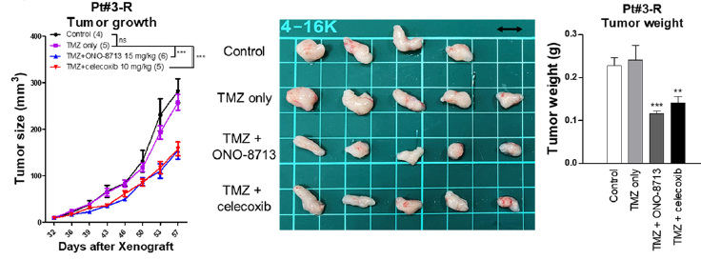
Experimental Validation
In vitro and in vivo experiments show effectiveness of ONO-8713 in suppressing TMZ-resistant GBM tumor growth.

Slide 11
Conclusion
Sp1-driven reprogramming of arachidonate metabolism promotes TMZ resistance in GBM.
Targeting the PGE2 pathway offers a promising strategy for overcoming drug resistance.

Slide 12
Acknowledgments
Funding: Ministry of Science and Technology of Taiwan, Taipei Medical University-Shuang Ho Hospital, and Chang Gung Memorial Hospital.

