Slide 1
董欣
Morphological and metabolic asymmetries of the thalamic subregions in temporal lobe epilepsy predict cognitive functions
陽明交通大學臨床醫學研究所 博士
臺中榮總神經醫學中心 助理教授
彭徐鈞 副教授

Slide 2
Epilepsy and the deep cortex
臺中榮總 神經醫學中心
董欣

Slide 3
Seizure is thought as abnormal electrical signals produced by damaged, which were thought to be related to cortical lesions.
Questions
What is the role of neurons in the deep gray matter in epilepsy ?
What and why do they alter during the course of epilepsy structurally, functionally, and electrophsiologically?

Slide 4
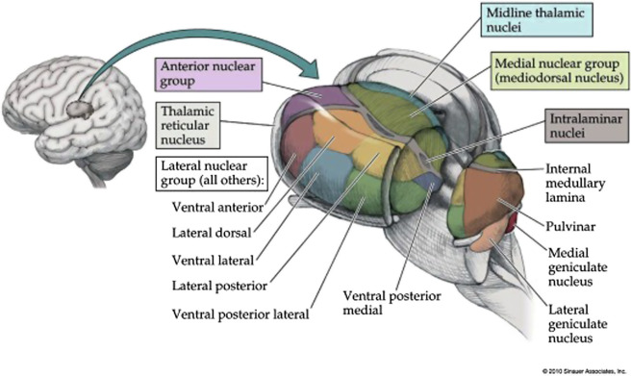

Slide 5
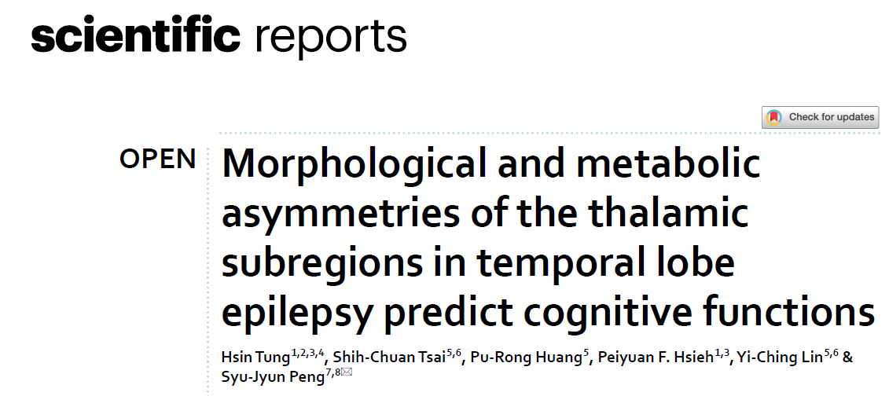

Slide 6
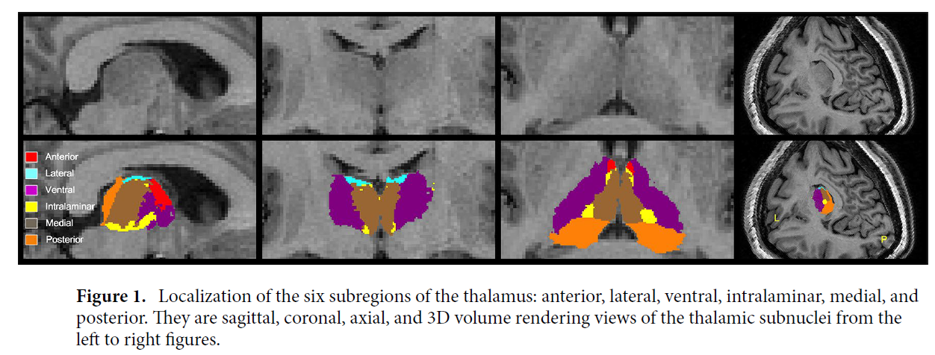
Structural
Metabolic
MRI
PET

Slide 7
Asymmetrical index = 2x [(L − R)/(L + R)].

Slide 8
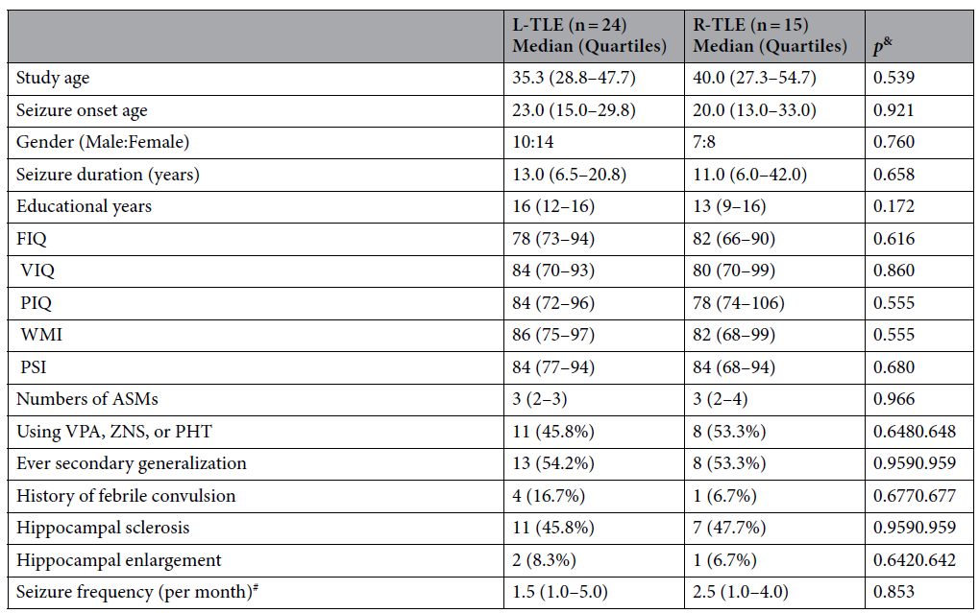
Table 1. Demographic characteristics of left-TLE and right-TLE cases.
August, 2019 to September, 2020 at Taichung Veterans General Hospital (TCVGH).

Slide 9
Table 2. Comparison of volumes and SUVR of six thalamic subnuclei of the ipsilateral and contralateral sides in patients with L-TLE.
Table 3.Comparison of volumes and SUVR of six thalamic subnuclei of the ipsilateral and contralateral sides in patients with R-TLE.

Slide 10
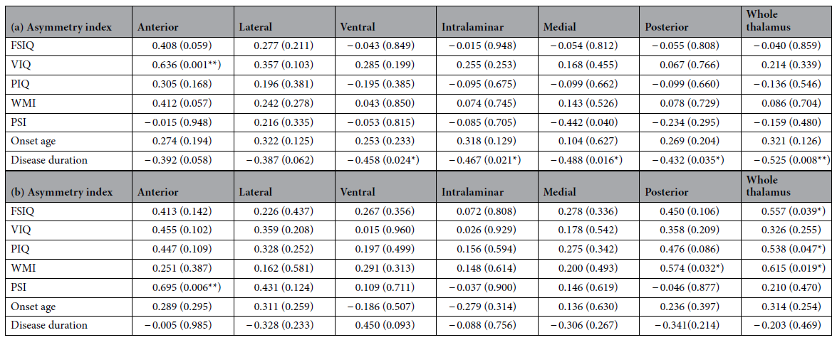
Table 4. Relationship between the asymmetry index of thalamic subnuclei volume and neurocognitive scores in patients with (a) left-TLE and (b) right-TLE

Slide 11
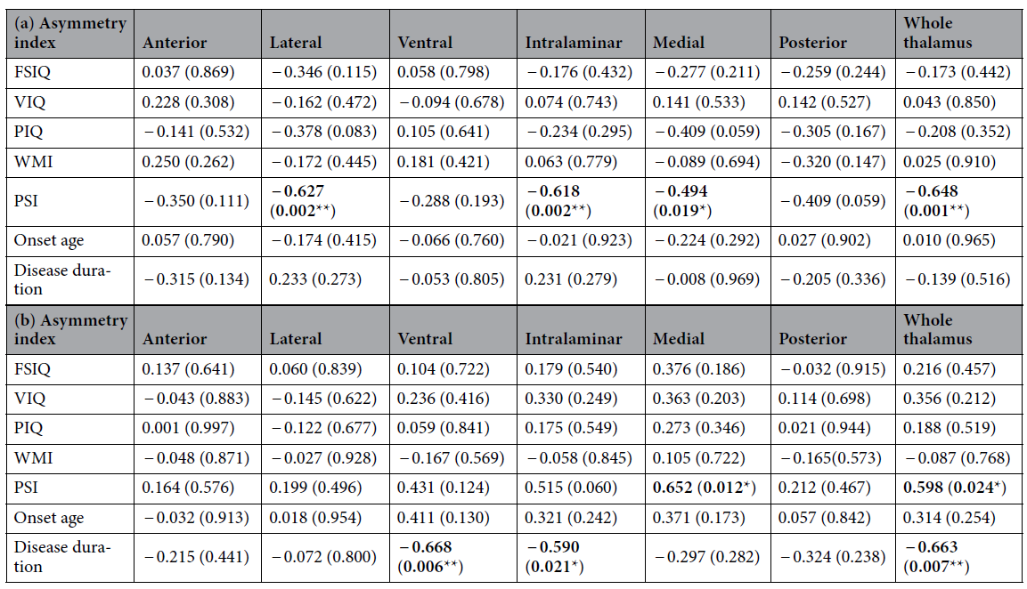
Table 5. Relationship between the asymmetry index of thalamic subnuclei SUVR and neurocognitive scores in patients with (a) left-TLE and (b) right-TLE

Slide 12
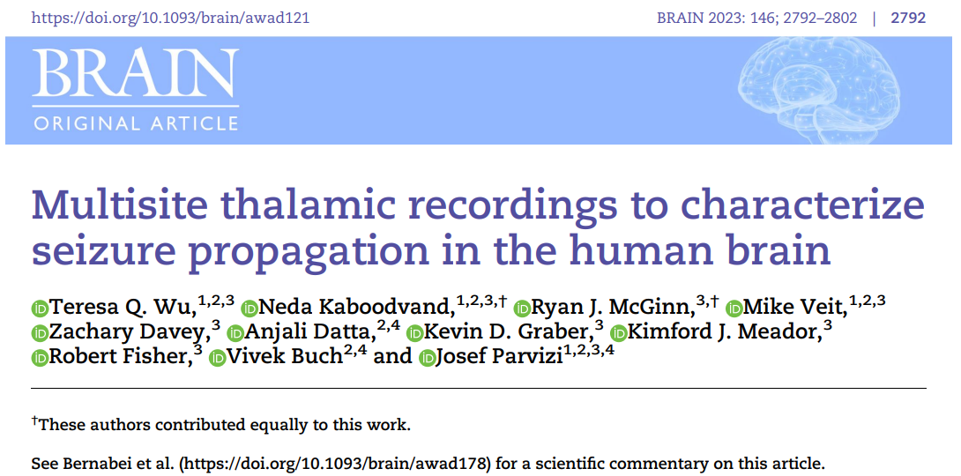
Electrophysiological
SEEG

Slide 13
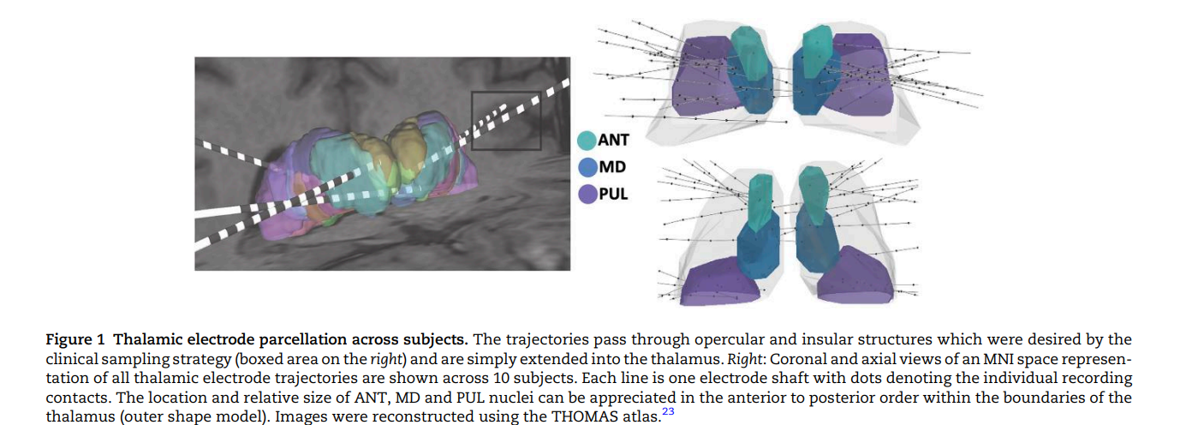

Slide 14
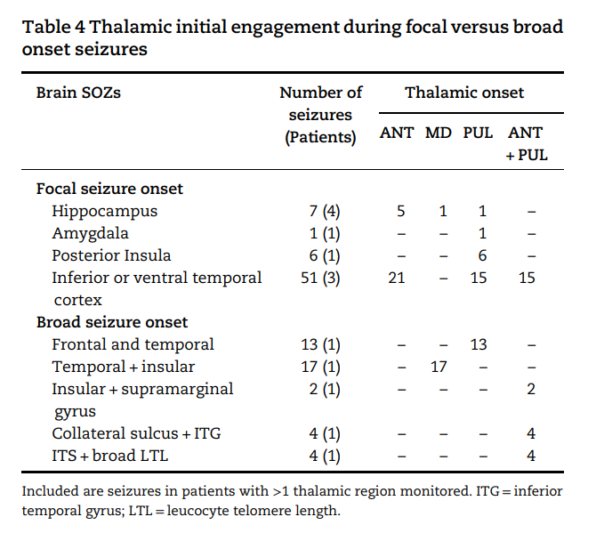

Slide 15
Take Home message(1)
The roles of the thalamus in TLE:
- Patients with L-TLE and those with R-TLE exhibited a differential morphological and metabolic vulnerability in their thalamic subregions.
- Metabolic asymmetry was more prominent than the volume differences, and the posterior and medial subnuclei presented persistently hypometabolism in both TLE groups.
- - R-TLE had relatively preserved volume of the ipsilateral thalamic volume, while L-TLE had relatively decline of volume and metabolism in posterior subnucleus.
- Longer epilepsy duration was associated with a prominent atrophy of most ipsilateral thalamic volume in L-TLE, but with a relative left thalamic hypometabolism in R-TLE.

Slide 16
Take Home message(2)
Thalamic subnuclei participated in cognitive functions.
- Processing speed presented most relevant to asymmetrical metabolic changes of thalamic subregions in TLE.
- Preserved metabolic activity of contralateral thalamic subregions is the key to maintain the processing speed in both TLEs.

