Slide 1
蘇佑安
NME3 binds to phosphatidic acid and mediates PLD6-induced mitochondrial tethering
國立臺灣大學分子醫學研究所博士
劉雅雯 教授

Slide 2
Speaker: You-An Su 蘇佑安
Advisor: Ya-Wen Liu, PhD
Institute of Molecular Medicine, National Taiwan University
Date: 2024.10.19

Slide 3
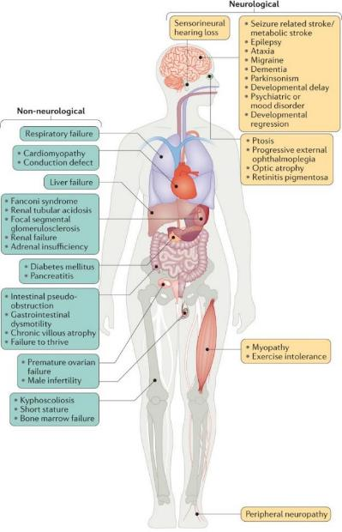
Introduction
Mitochondrial diseases are complicated by a diverse phenotype
Mitochondrial functions
Energy production
Transport metabolites and ions
Oxidation-reduction reactions
Inflammatory responses
Gorman, G., Chinnery, P., DiMauro, S. et al. Nat Rev Dis Primers (2016).

Slide 4
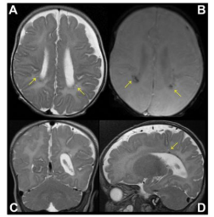
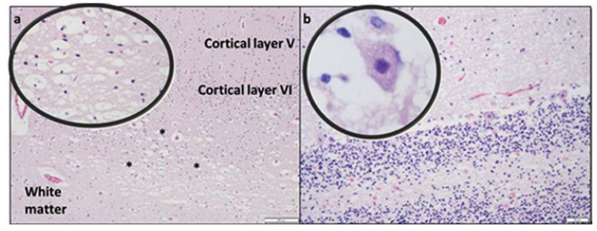
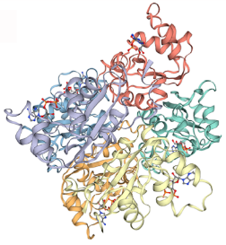
Introduction
The deficiency of NME3 leads to congenital hypotonia, hypoventilation, and cerebellar histopathological alterations
NME3
Nucleoside diphosphate kinase (NME family)
Chen, C.W., Wang, H.L., Huang, C.W., et al. Proc Natl Acad Sci USA (2019).

Slide 5
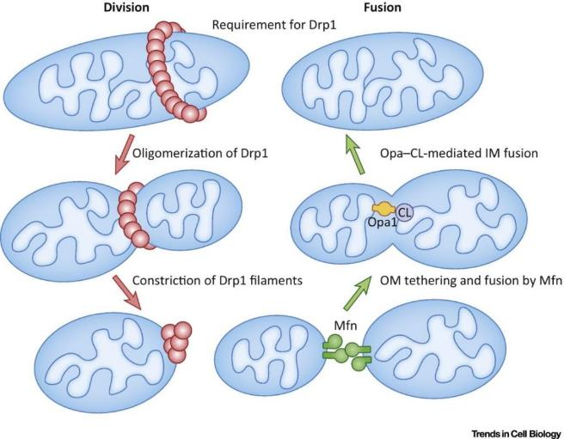
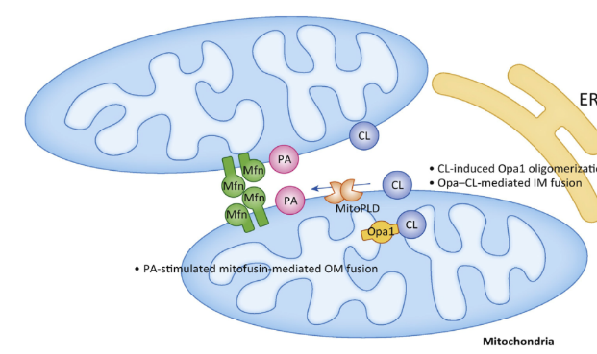
Introduction
Mitochondria are dynamic organelles regulated by fission and fusion
Fission
PLD6
Kameoka S. et al. 2018 Trends Cell Biol

Slide 6
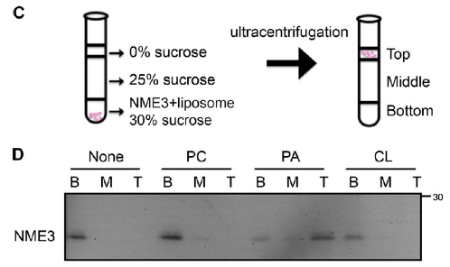
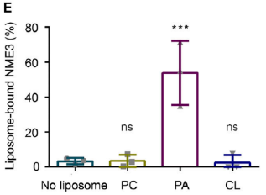
Result
NME3 preferentially binds to PA liposomes
Liposome flotation assay
Amphipathic helix
PC: Phosphatidylcholine
PA: Phosphatidic acid
CL: Cardiolipin
Hydrophilic face
Hydrophobic face
PC
PA
Lipid packing defects

Slide 7
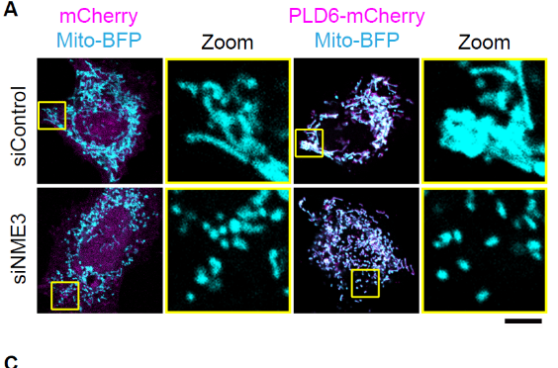
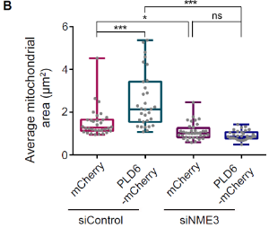
Result
NME3 is required for the mitochondrial clustering effect induced by PLD6-mCherry overexpression
F741 patient fibroblast
- NME3
Chen, C.W., Wang, H.L., Huang, C.W., et al. Proc Natl Acad Sci USA (2019).
Hypothesis:
NME3 functions as a PLD6 downstream effector to promote mitochondrial fusion

Slide 8
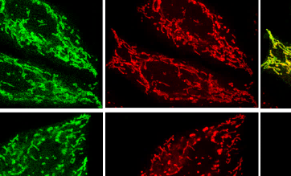
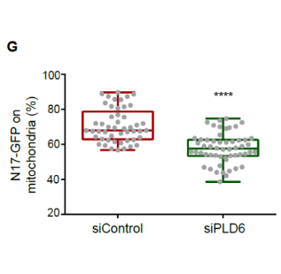
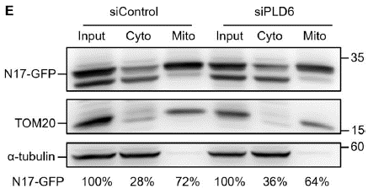
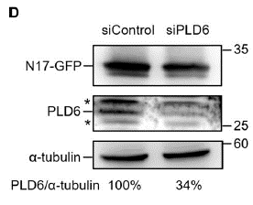
Result
PLD6 depletion reduces N17-GFP binding to mitochondria
Mitochondrial fractionation

Slide 9
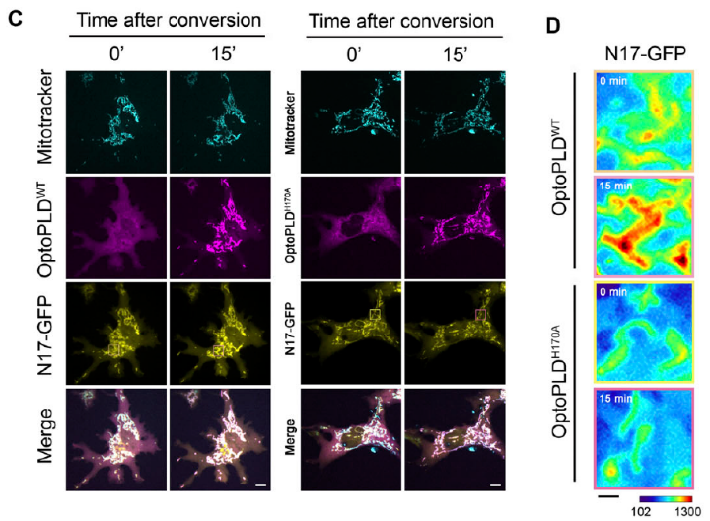
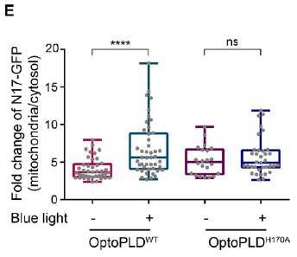
Result
A significant increase of N17-GFP targeting to mitochondria upon activation of optoPLD^{WT}
488 nm
OMM
PC
PLD_{PMF}
PA
PLD_{PMF}
Summary:
The N17 of NME3 binds to PLD6-generated PA on OMM
NME3 functions as a PLD6 downstream effector

Slide 10
Result
The enrichment of NME3-GFP at mito-mito contact interface is significantly reduced by PLD6 depletion

Slide 11
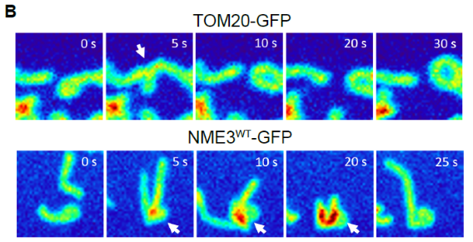
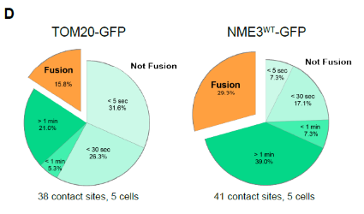
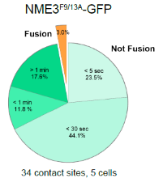
Result
The PA binding defective mutant shows significantly lower enrichment at the mitochondrial contact interface
Summary:
PLD6-generated PA drives a spatial control of NME3 enrichment at the mitochondrial contact interface

Slide 12
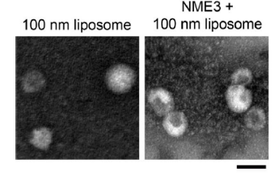
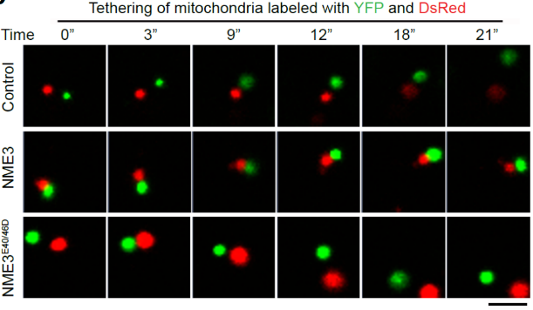
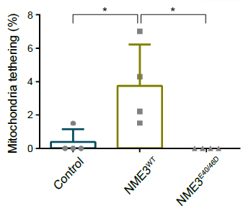
Result
The presence of NME3 significantly increased mitochondrial stable tethering
In vitro mitochondrial tethering assay

Slide 13
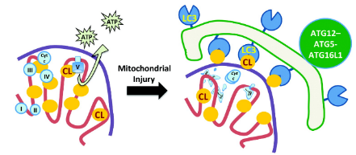
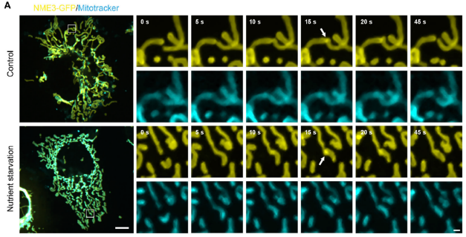
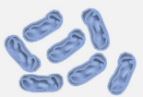
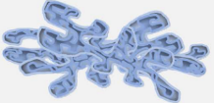
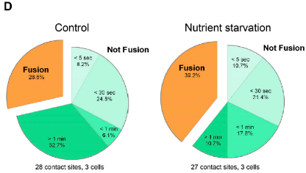
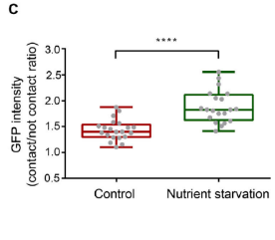
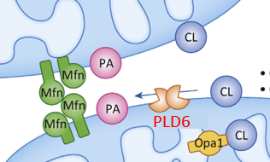
Result
NME3-GFP intensity in the mitochondrial contact interface is significantly increased under nutrient starvation
Normal dynamic mitochondria
Hyperfused mitochondria
Chu, C. T., Bayır, H. & Kagan, V. E. Autophagy (2014). Das, R. & Chakrabarti, O. Biochemical Society Transactions (2020). Kameoka S. et al. 2018 Trends Cell Biol

Slide 14
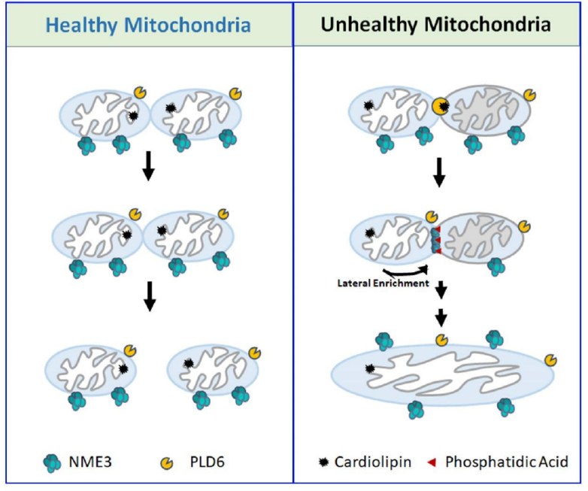
Hypothetical model
Notes:
Selective tethering factor for quality control of damaged mitochondria

Slide 15
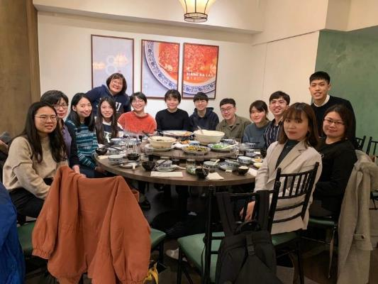
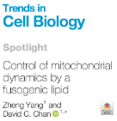
Acknowledgments
YWL lab
Advisor:
Dr. Ya-Wen Liu
Collaborators:
Dr. Zee-Fen Chang
Dr. Yu-Chun Lin
Dr. Jeremy M. Baskin
The first core labs, NTU: biomedical resource core and imaging core

