Slide 1
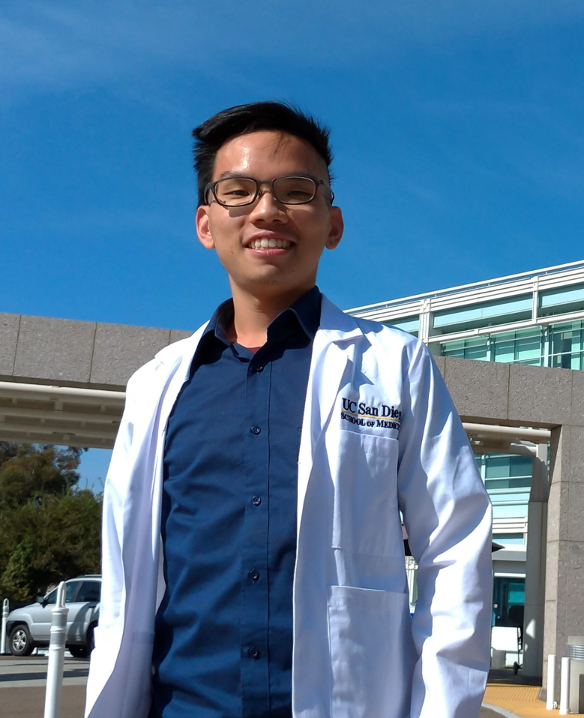
陳碩甫
Synergistically Enhancing Immunotherapy Efficacy in Glioblastoma with Gold-Core Silica-Shell Nanoparticles and Radiation
臺北榮民總醫院 重粒子及放射腫瘤部 總醫師
劉澤英教授

Slide 2
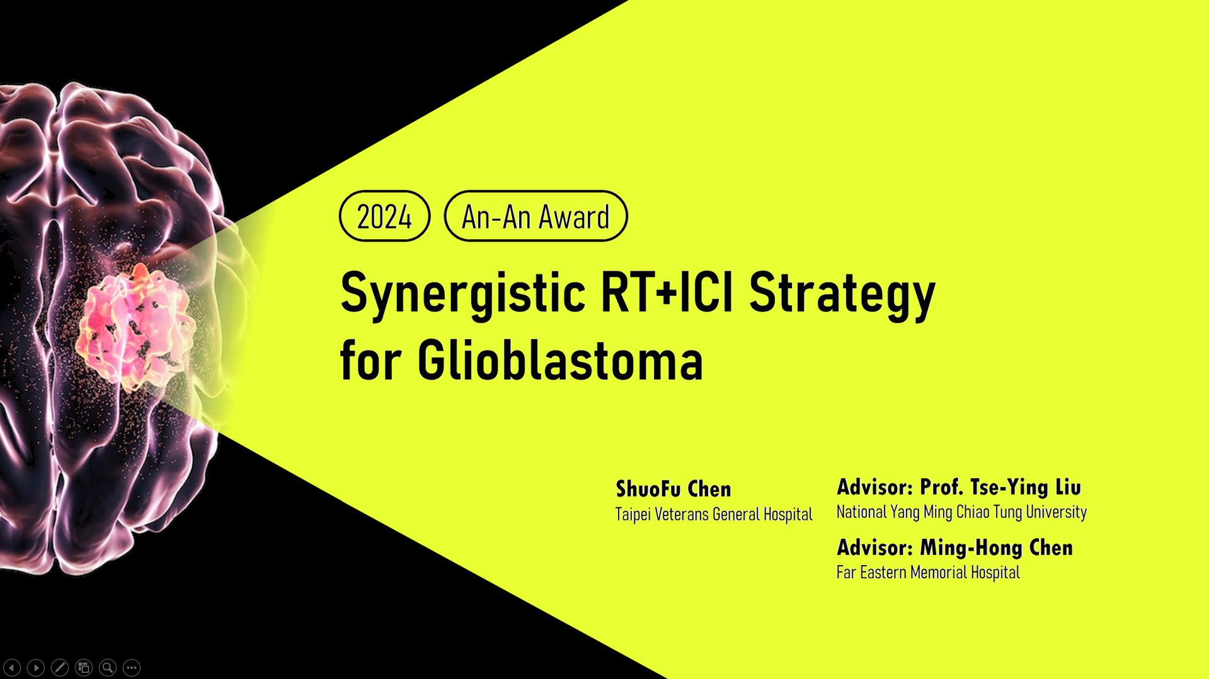

Slide 3
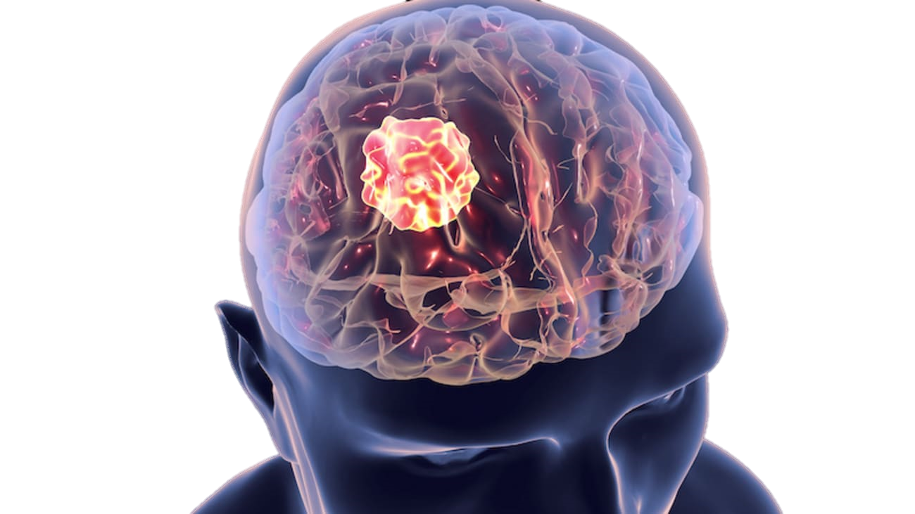

Glioblastoma
First-line Treatment
OP + Adjuvant CCRT
Notes:
GBM immunotherapy: disappointing initial clinical results of monotherapies

Slide 4
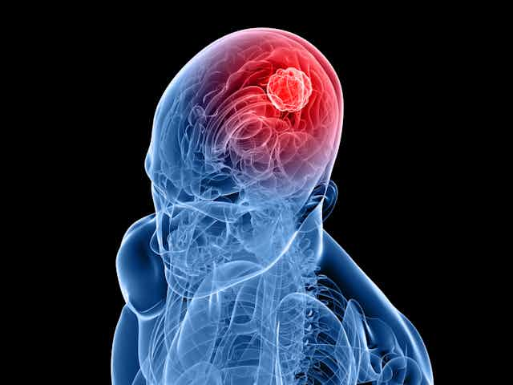
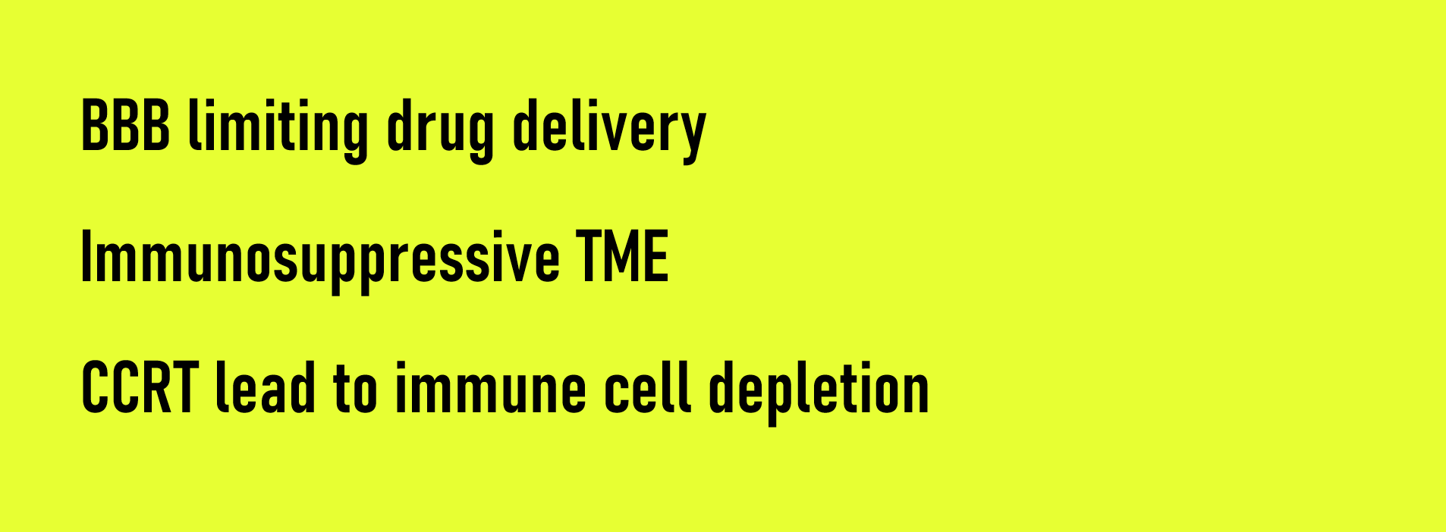
Checkmate 143
Checkmate 498
Checkmate 548
Why ARE IMMUNE CHECKPOINT INHIBITORS
disappointed so far

Slide 5
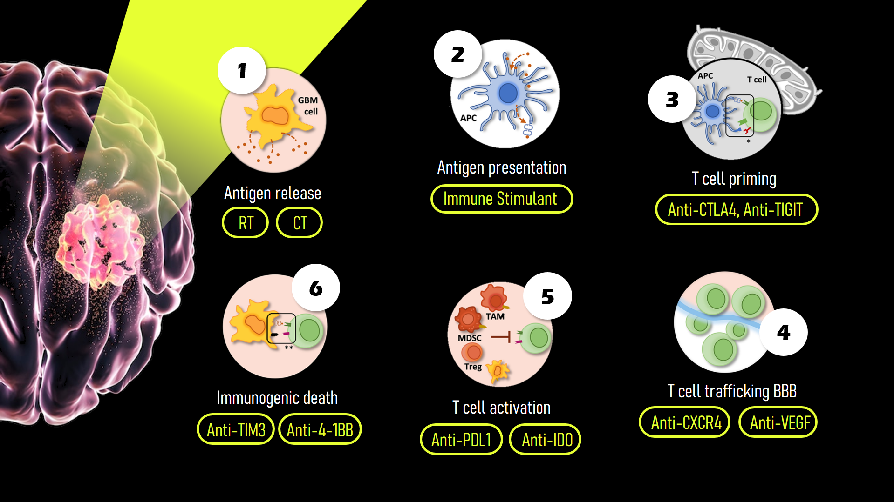

Slide 6
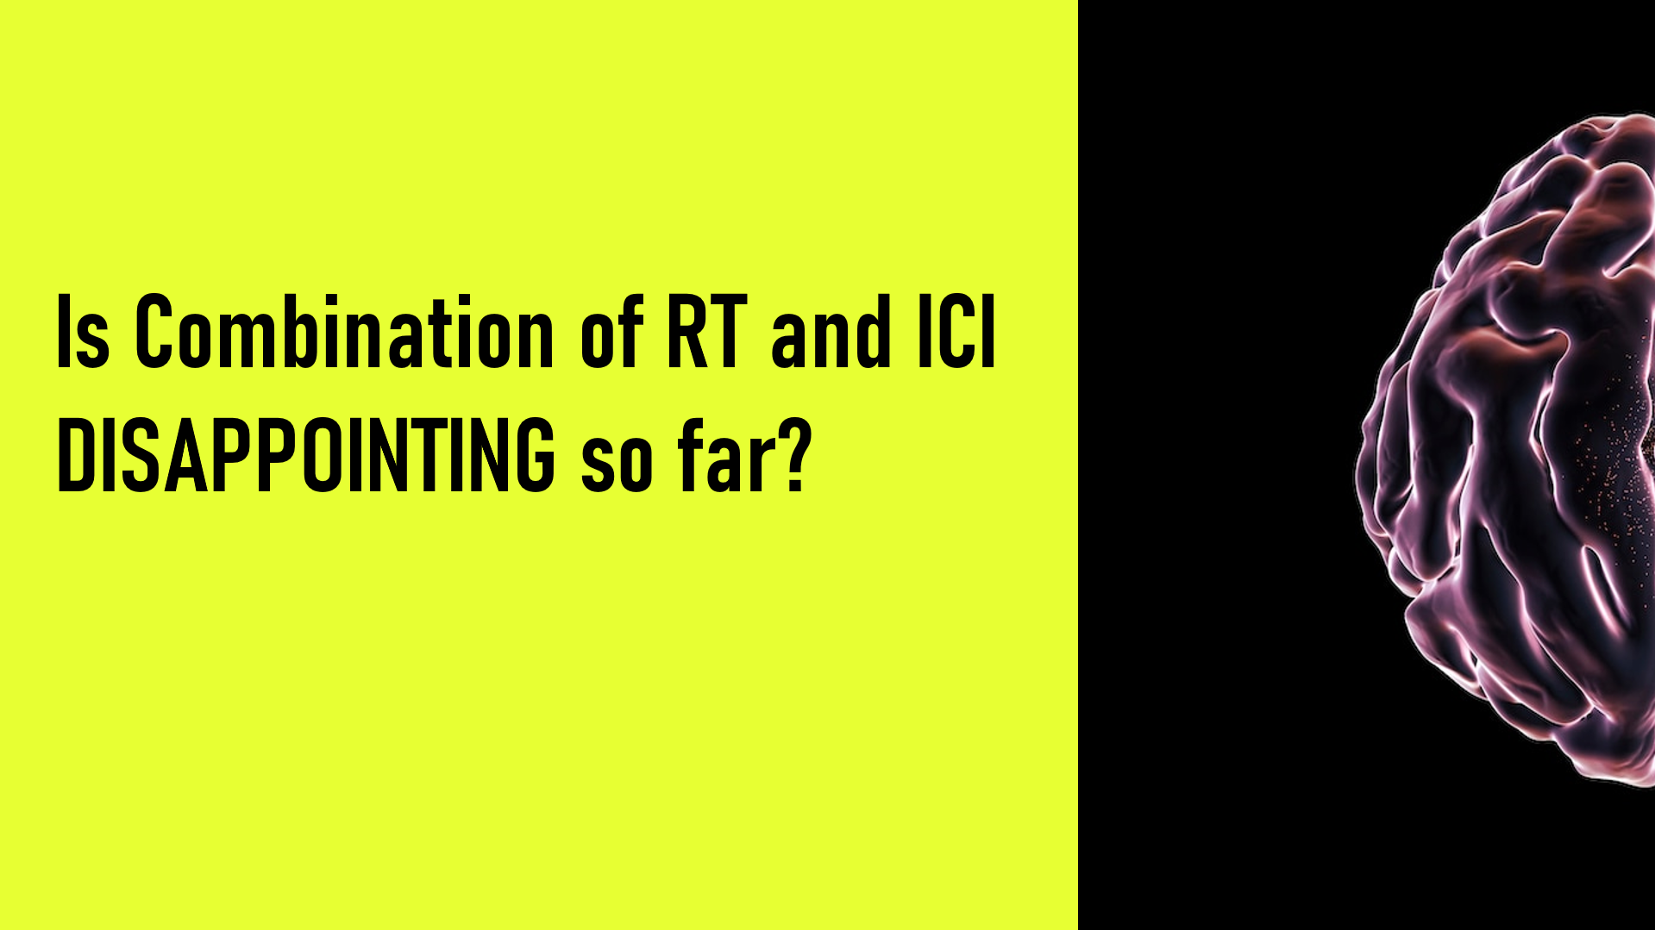
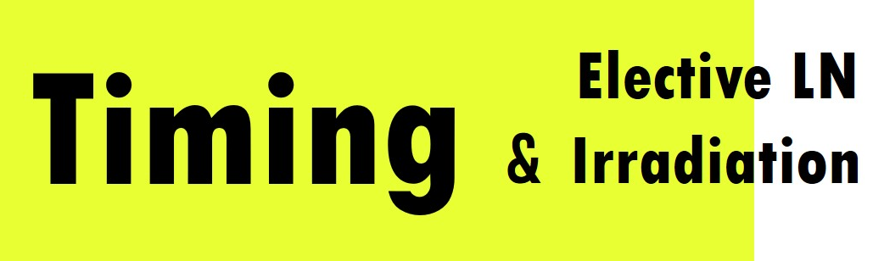
JAVELIN
PembroRad
KEYNOTE412
Checkmate 498
PACIFIC
CHECKMATE 577

Slide 7
Dose
Immune
exhausted
Timing
Not feasible for
Large tumor size
Pediatric cases
Cytotoxic to immune cells
Previous preclinical model
High dose 10Gy/fx

Slide 8
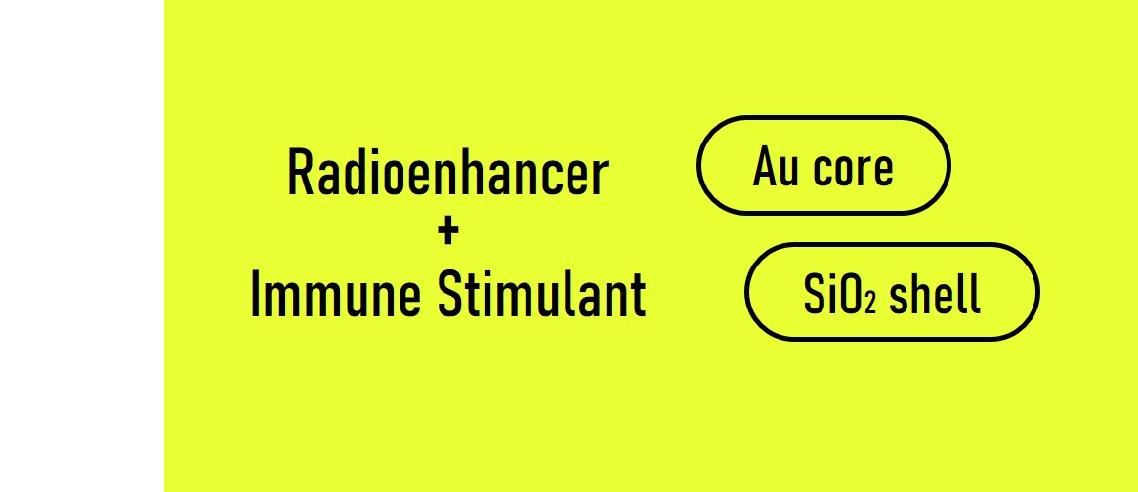

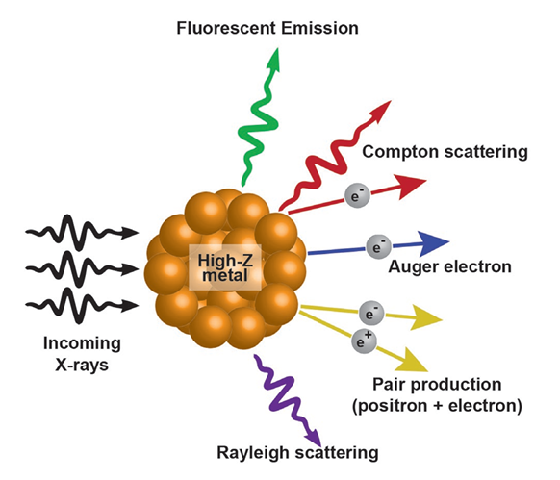

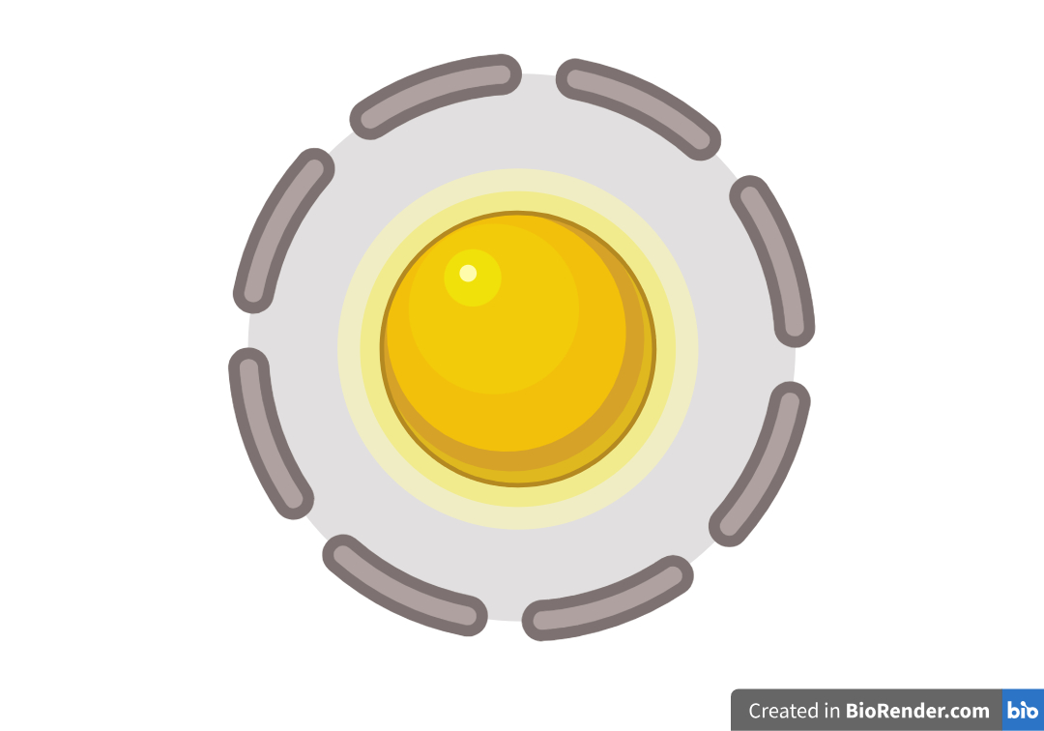
Low-dose RT

Slide 9
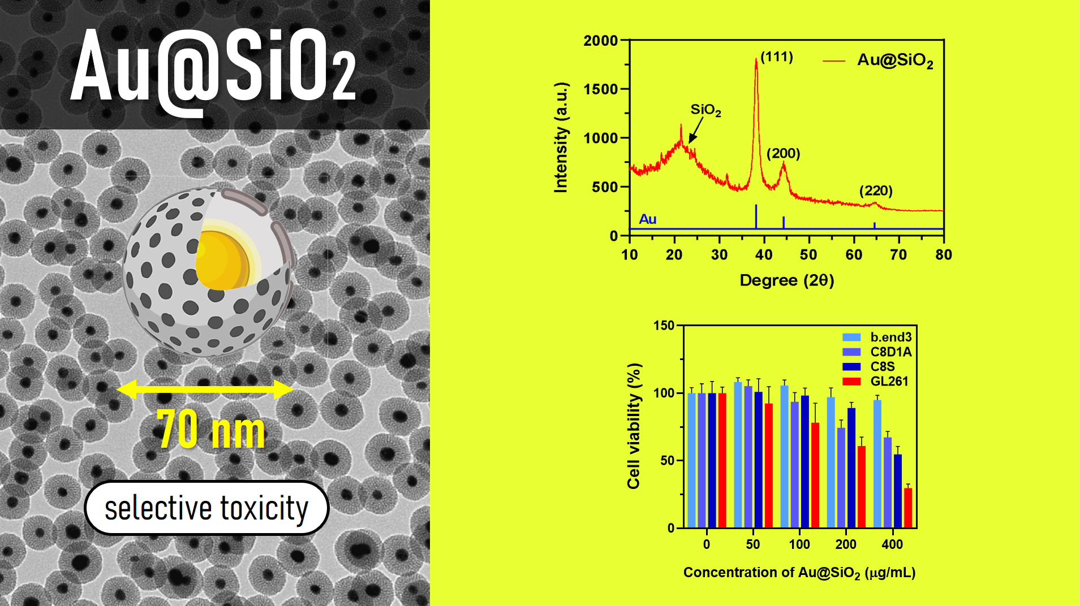
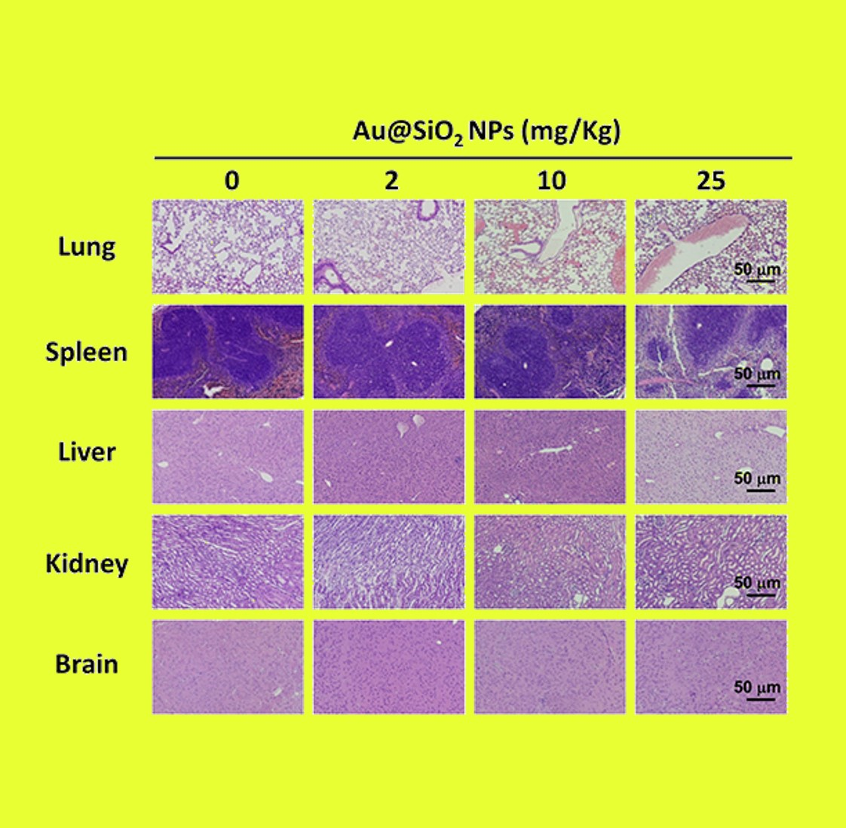

Slide 10
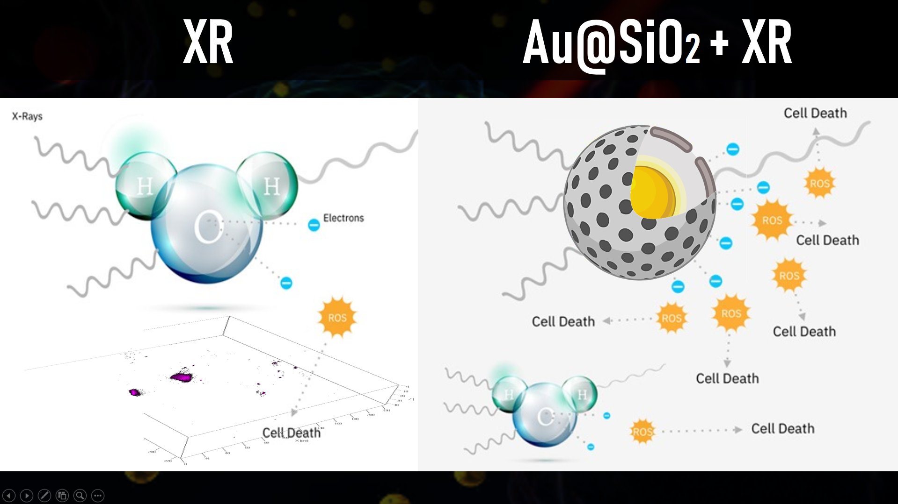
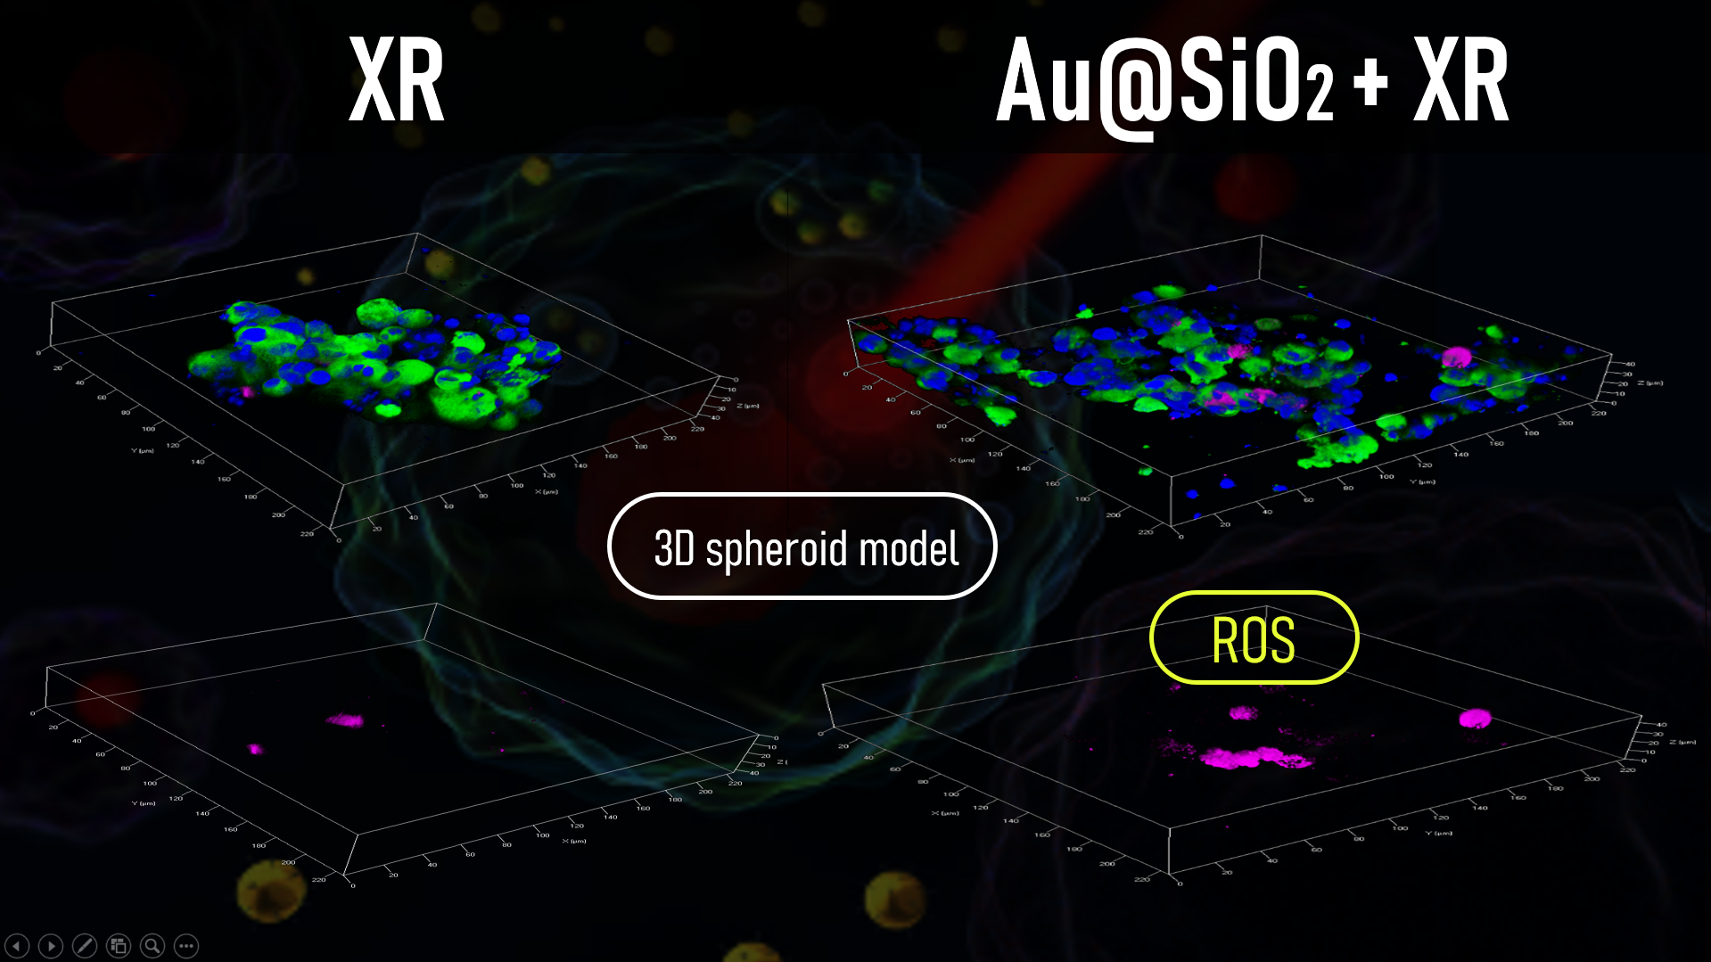

Slide 11
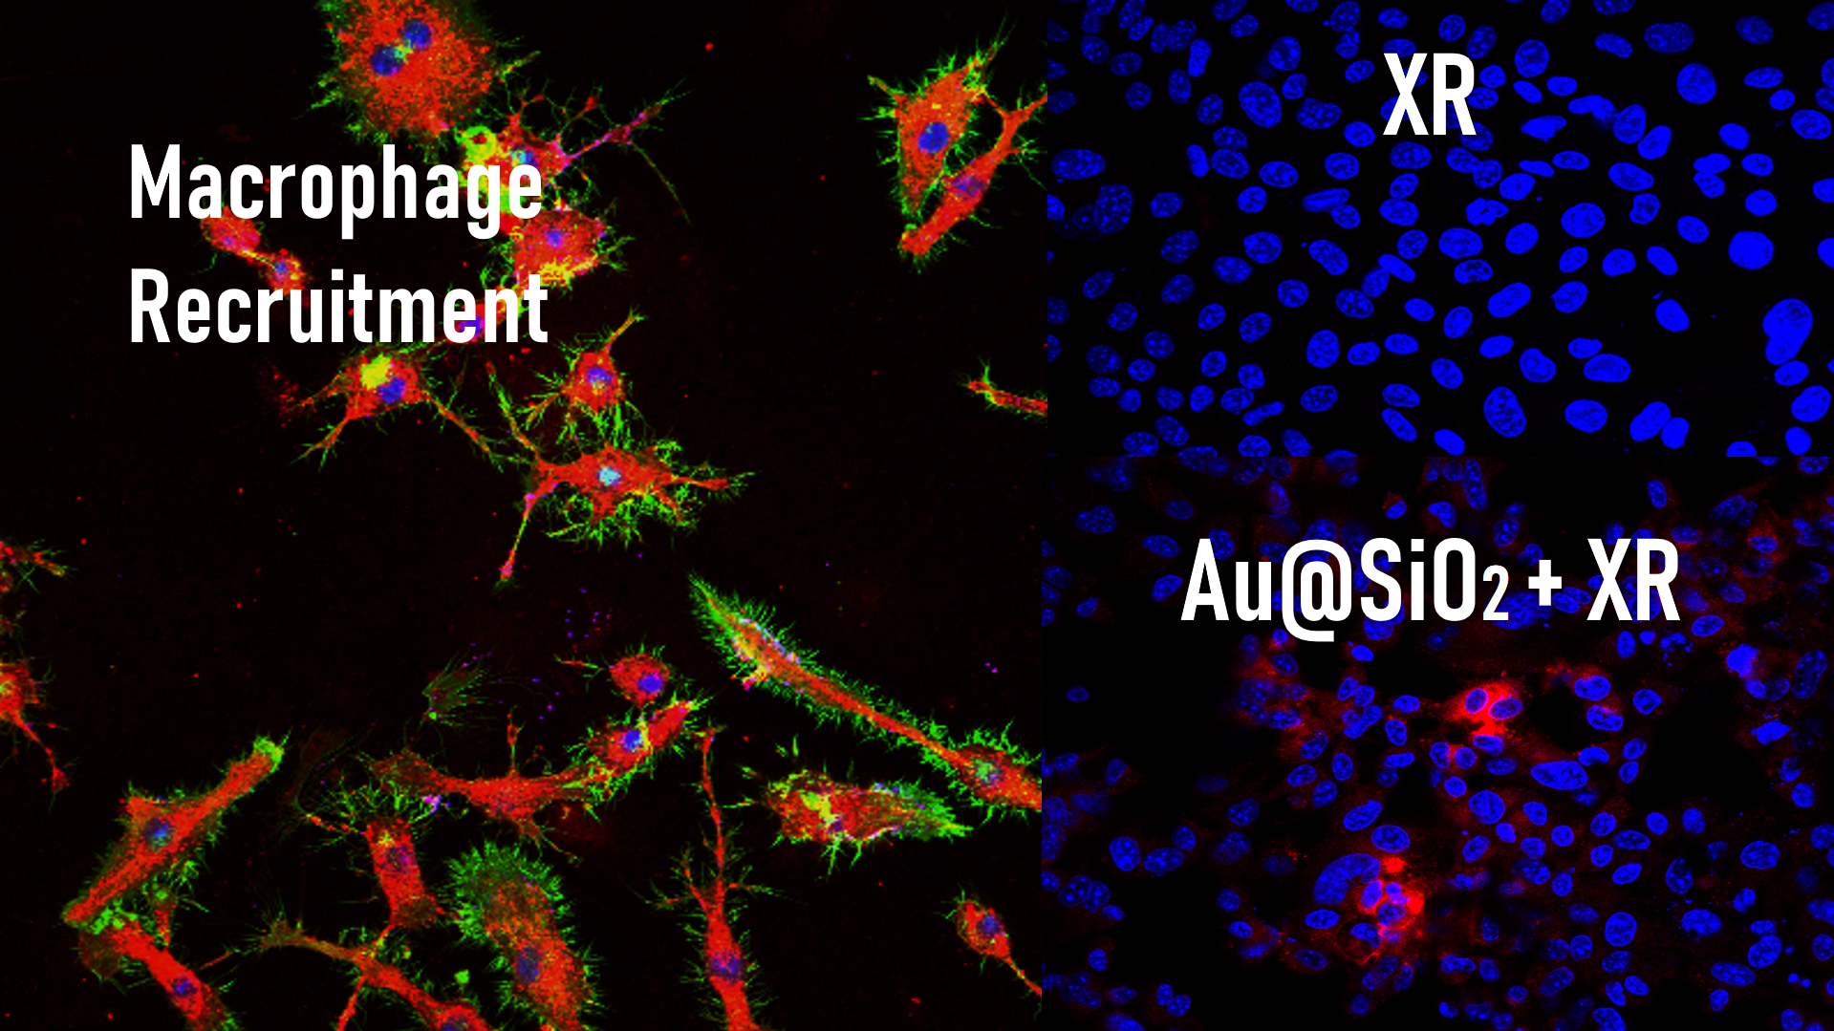
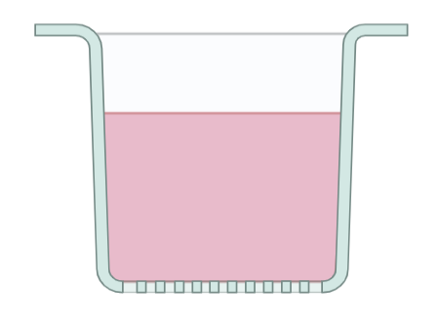
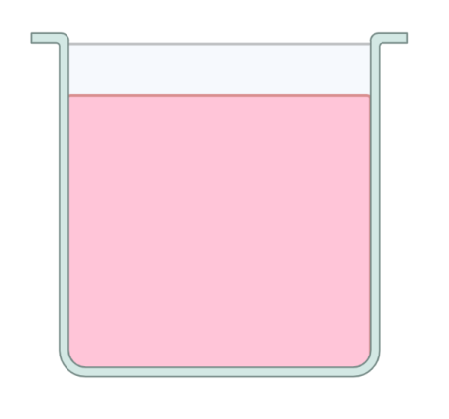
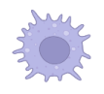
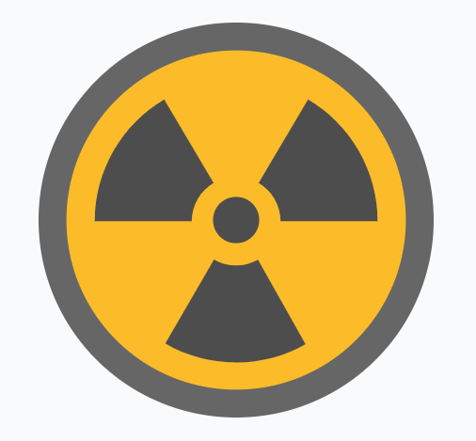


Slide 12
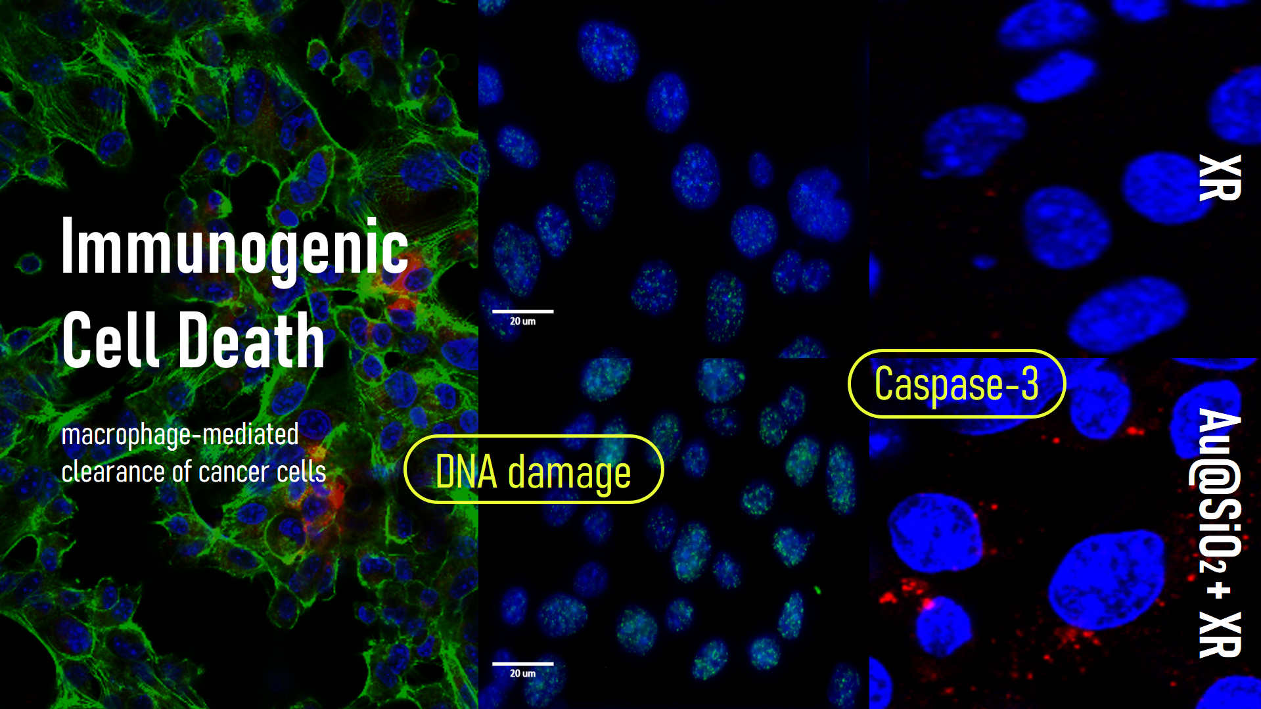
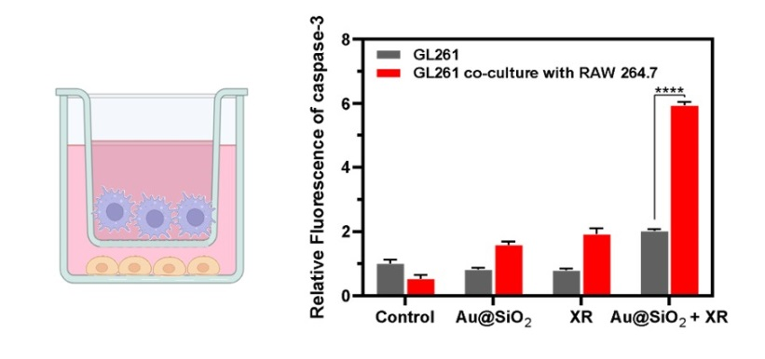

Slide 13
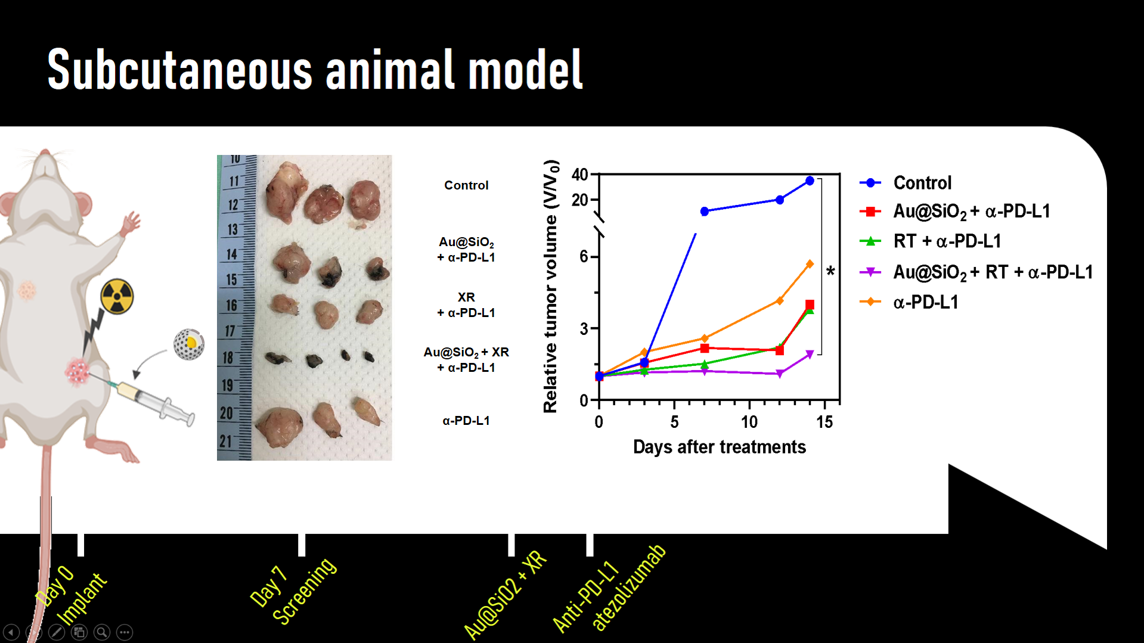

Slide 14
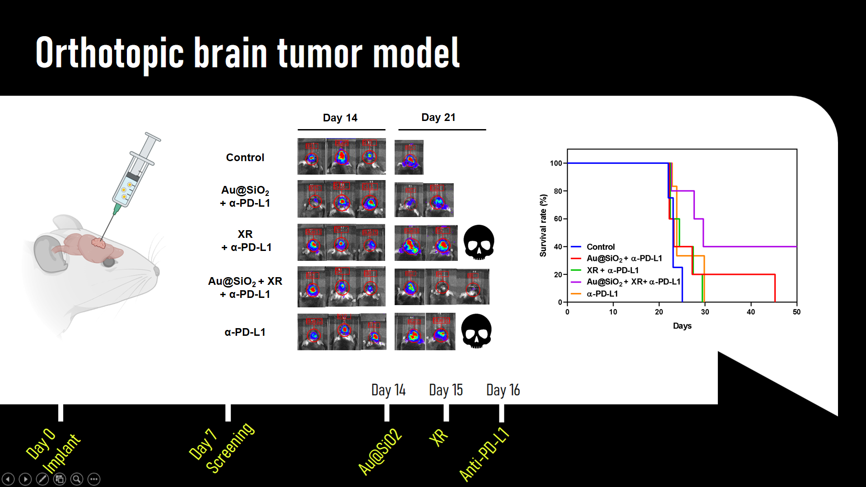

Slide 15
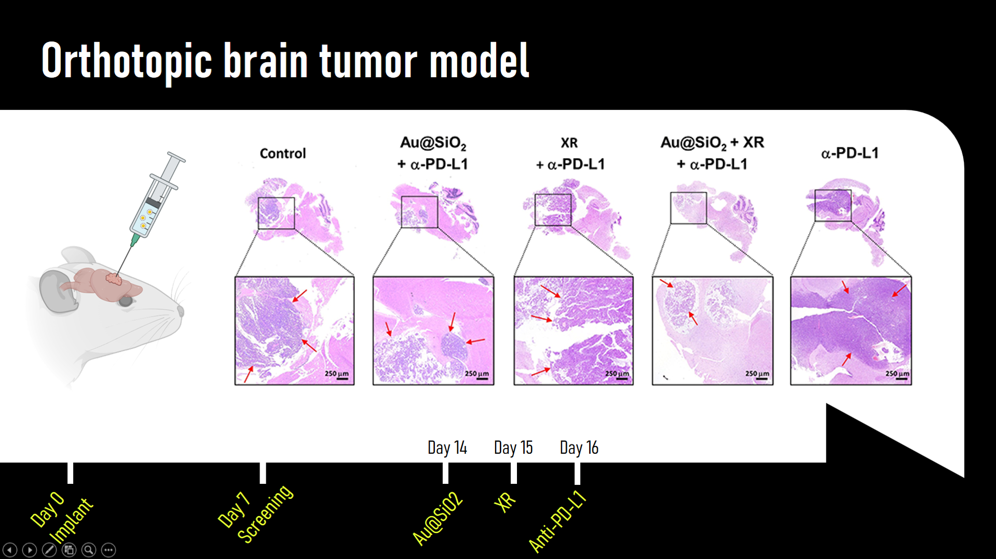

Slide 16
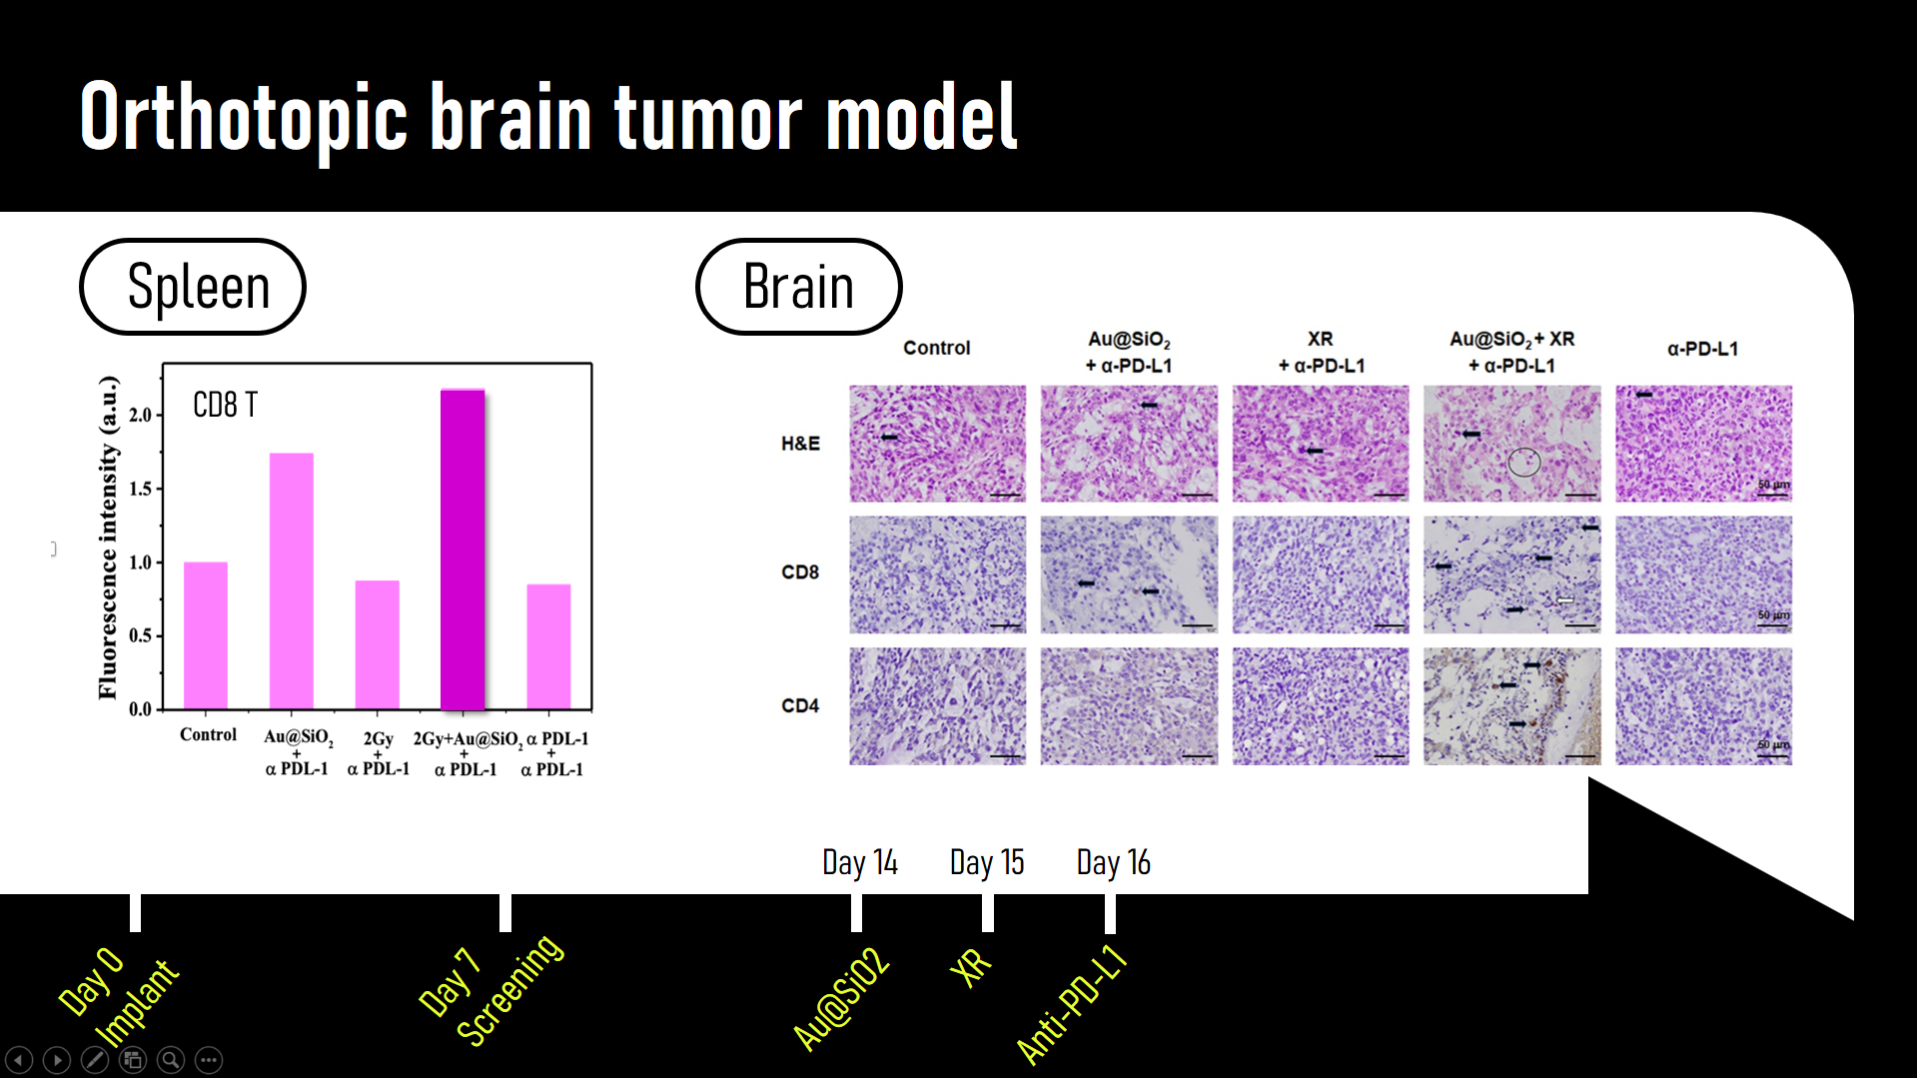

Slide 17
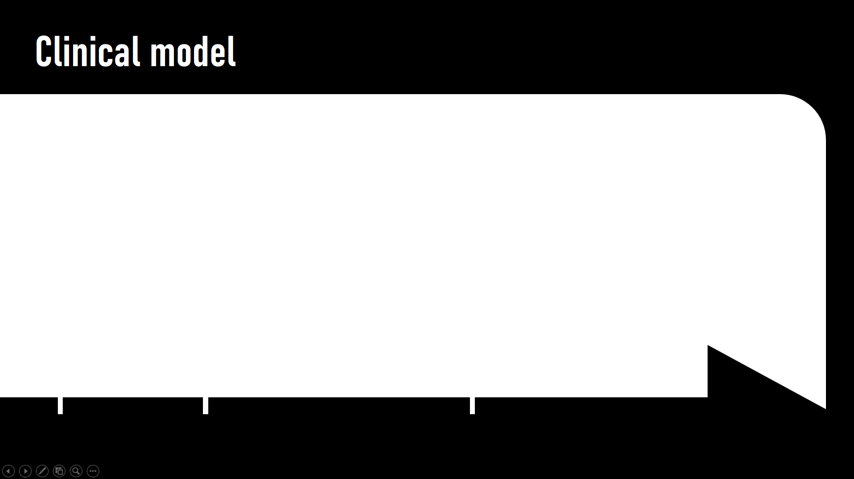
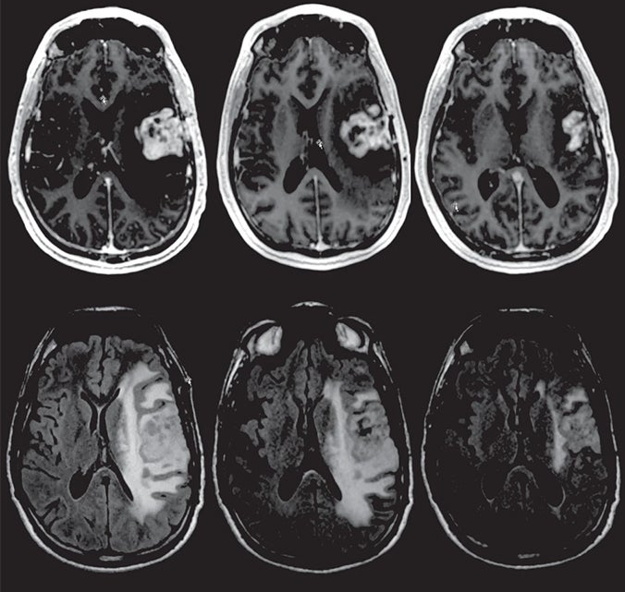
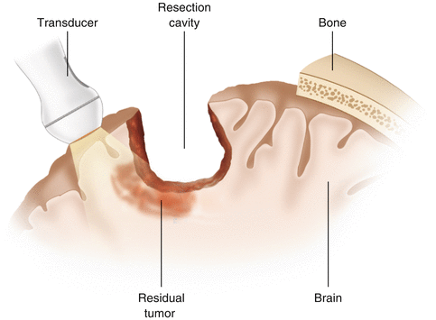
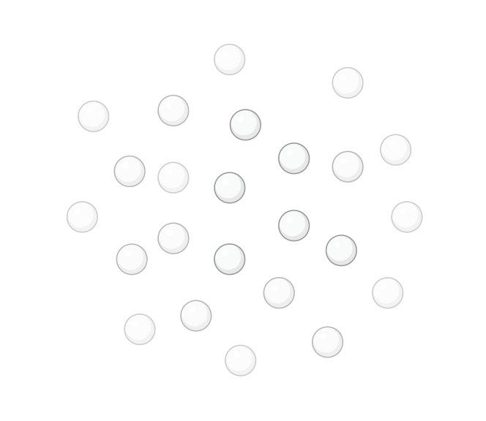
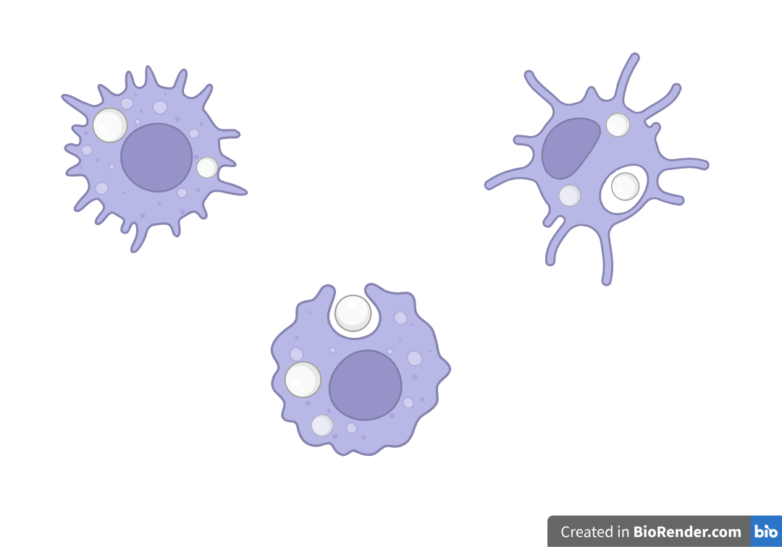
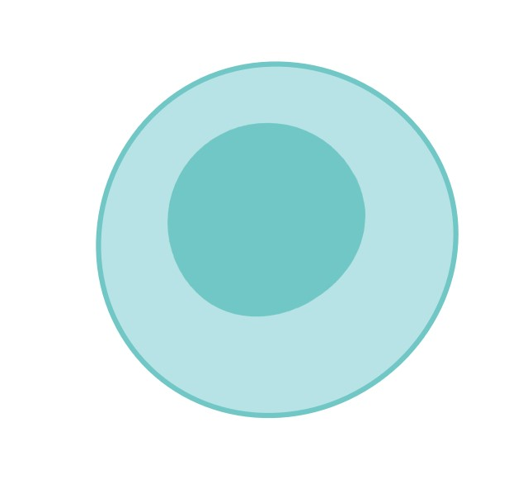
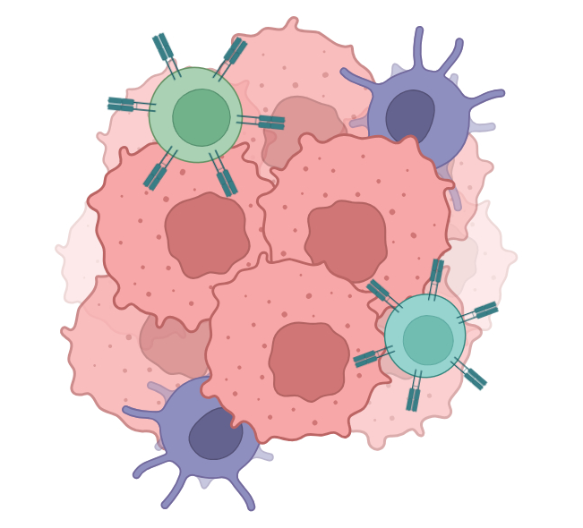


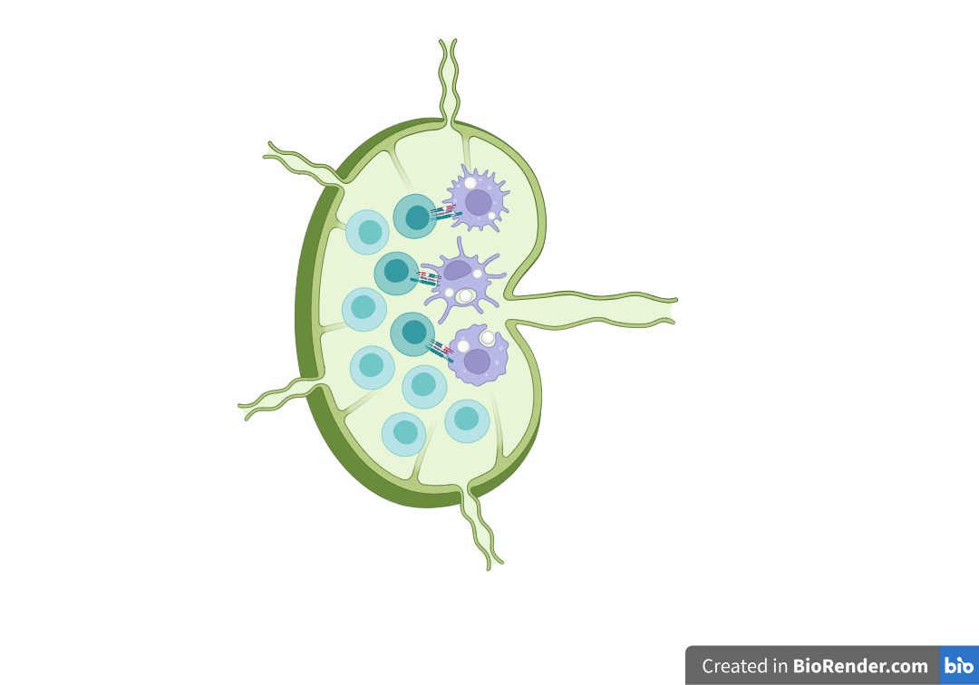
3. Systemic immune activation
Easily incorporated into current clinical practice
4. anti-PD-L1
1. Enhanced ROS
Tumor antigens release
2. Antigen presentation
Intratumoral injection
to surgical bed
OP
Adjuvant CCRT
+ ICI

Slide 18
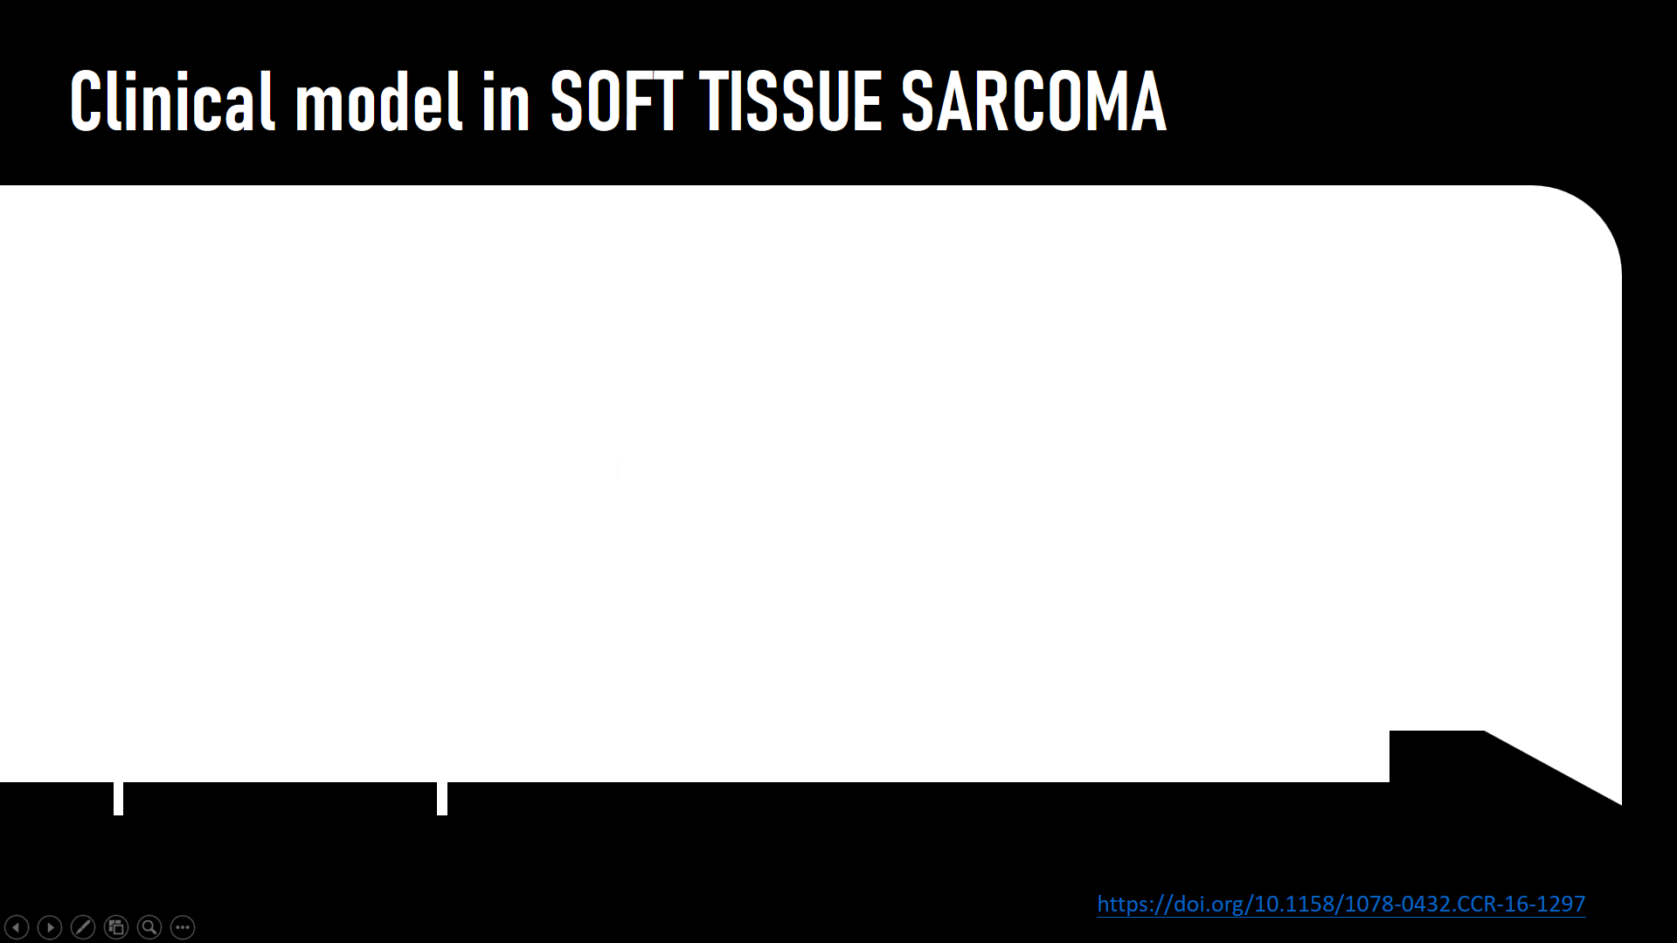
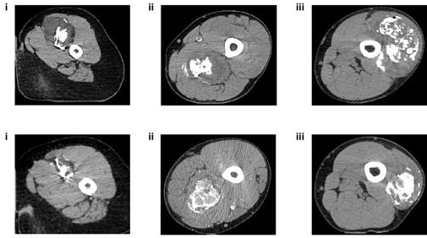
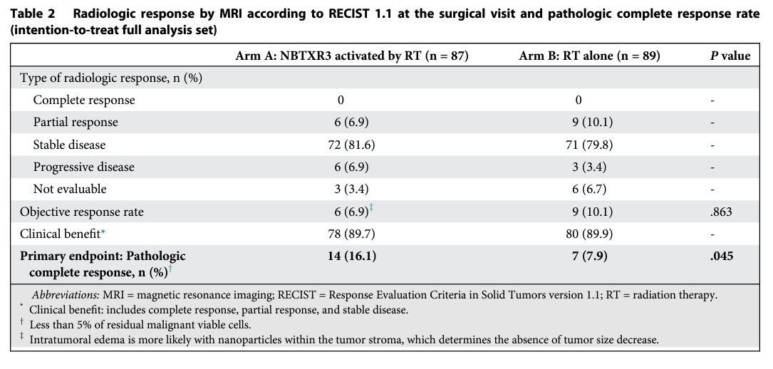
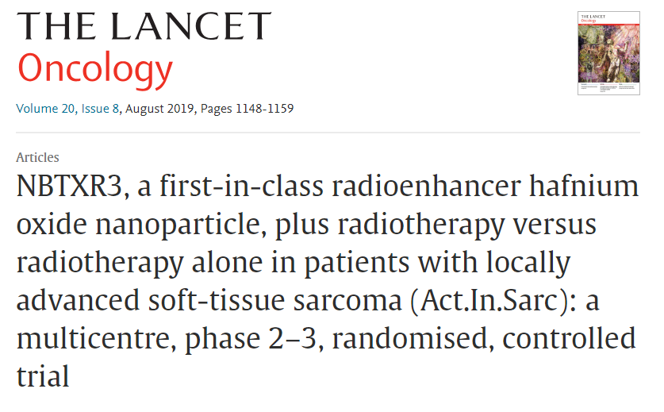
NBTXR3
HfO2 nanoparticle
RT
OP

Slide 19
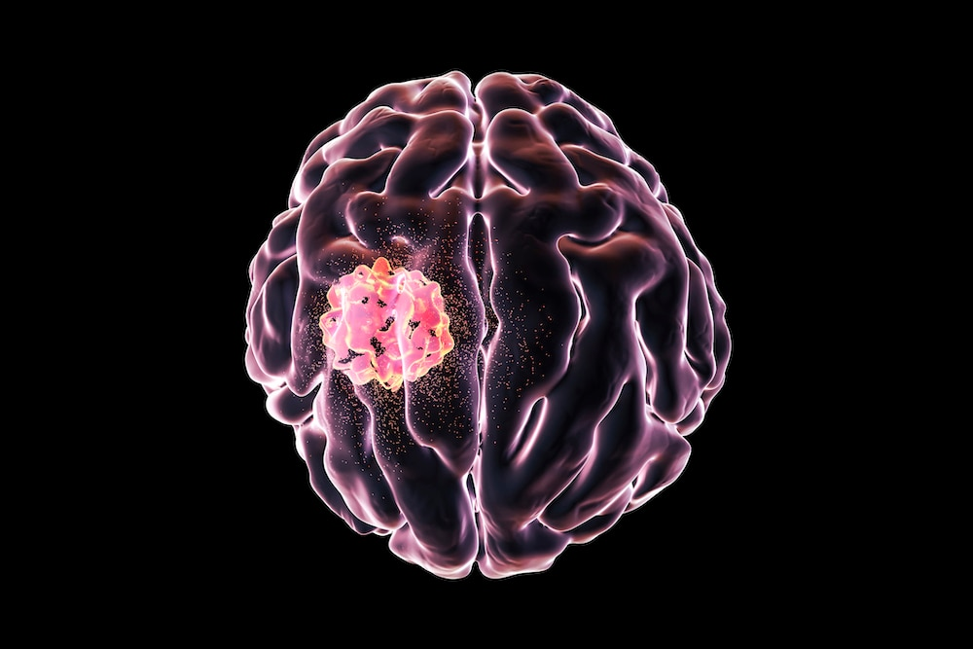
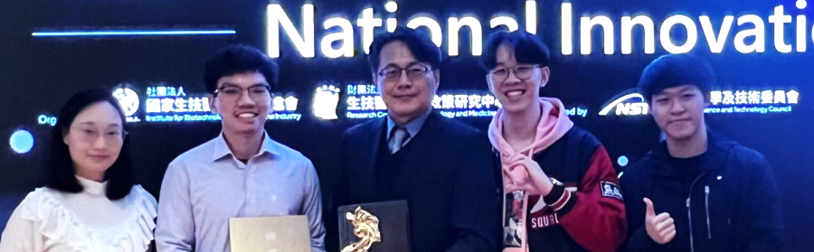





Thanks for your listening
王毓琦博士
劉澤英教授
高敏

