Slide 1
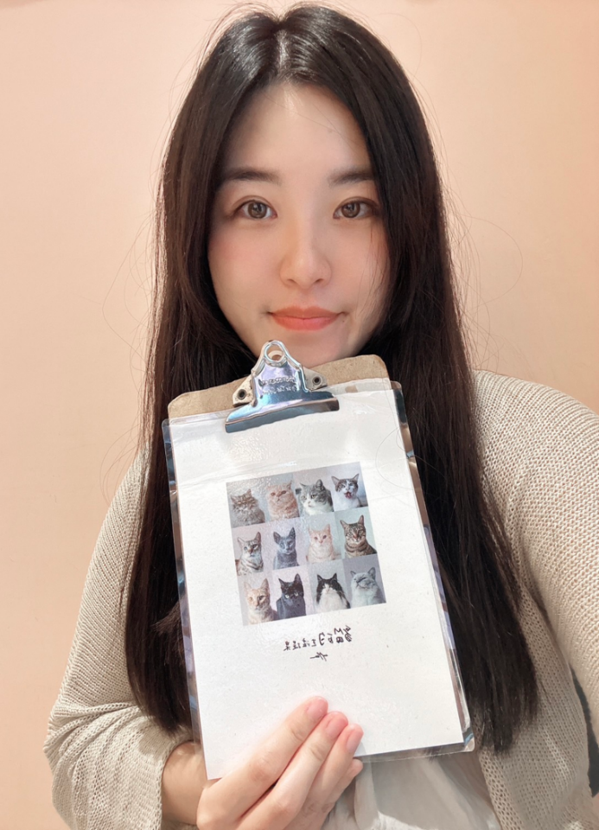
雷琬婁
All Biodisintegratable Hydrogel Biohybrid Neural Interfaces with Synergistic Performances of Microelectrode Array Technologies, Tissue Scaffolding, and Cell Therapy
國立陽明交通大學電機工程學系 博士
黃薇蓁 副教授

Slide 2



All Biodisintegratable Hydrogel Biohybrid Neural Interfaces with Synergistic Performances of Microelectrode Array Technologies, Tissue Scaffolding, and Cell Therapy
Wan-Lou Lei
Professor: Wei-Chen Huang
Department of Electrical and Computer Engineering, National Yang Ming Chiao Tung University
Oct. 19 , 2024, Yilan, Taiwan

Slide 3

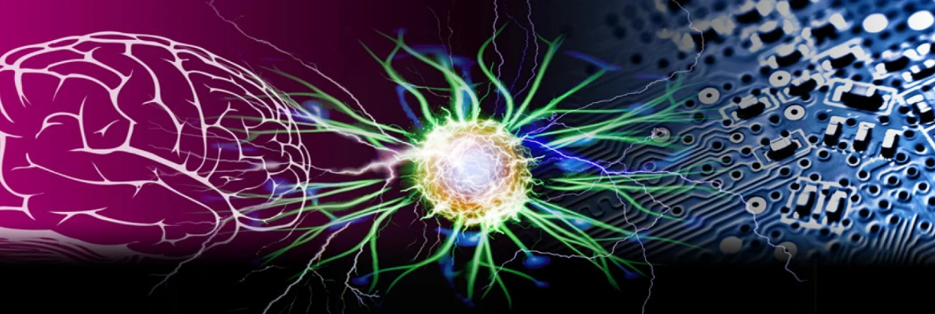
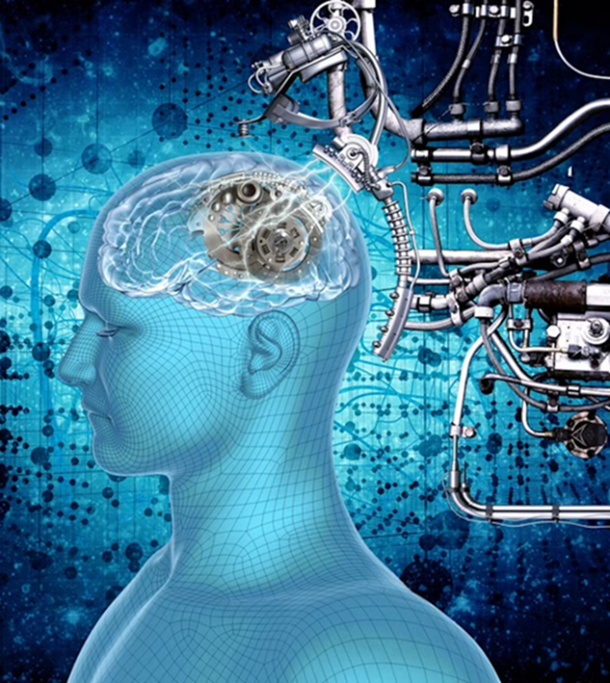
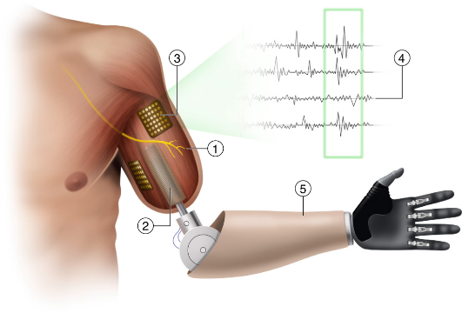
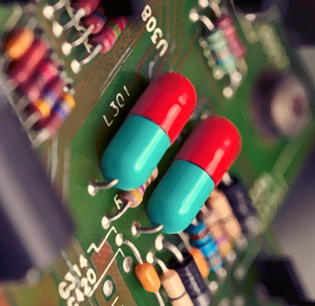
Implantable electronic device applications
Neuroscientific Research
Brain-Computer Interface (BCI)
Therapeutic Applications
Assessing the efficacy and safety of drugs
Toward higher-performance bionic limbs for wider clinical use, nature biomedical engineering, 7, 473–485, 2023
Notes:
目前腦機介面技術應用在醫學是極具有潛力，尤其是在治療神經疾病方面。而腦機介面顧名思義即是一種大腦與機器結合的介面可以利用放電來控制生物體內的免疫系統、新陳代謝，進一步對慢性病發揮療效。目前腦機介面還有許多不同技術應用：治療神經疾病、控制假肢或外骨骼、恢復感覺功能、藥物釋放，進一步對慢性病發揮療效。

Slide 4
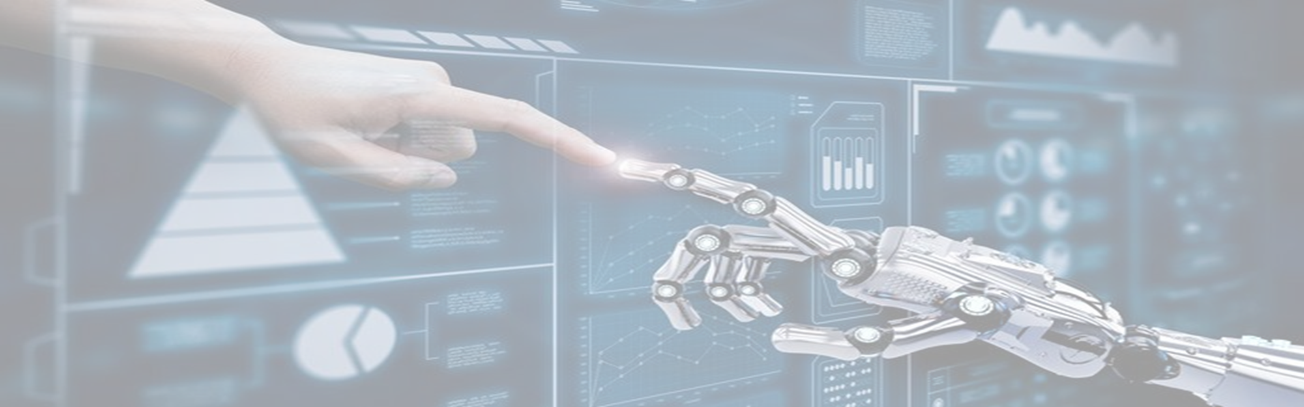
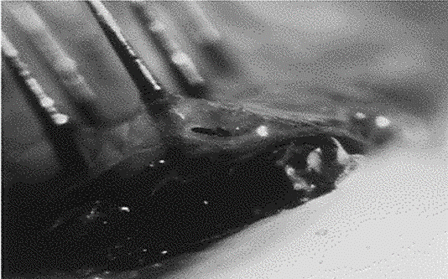
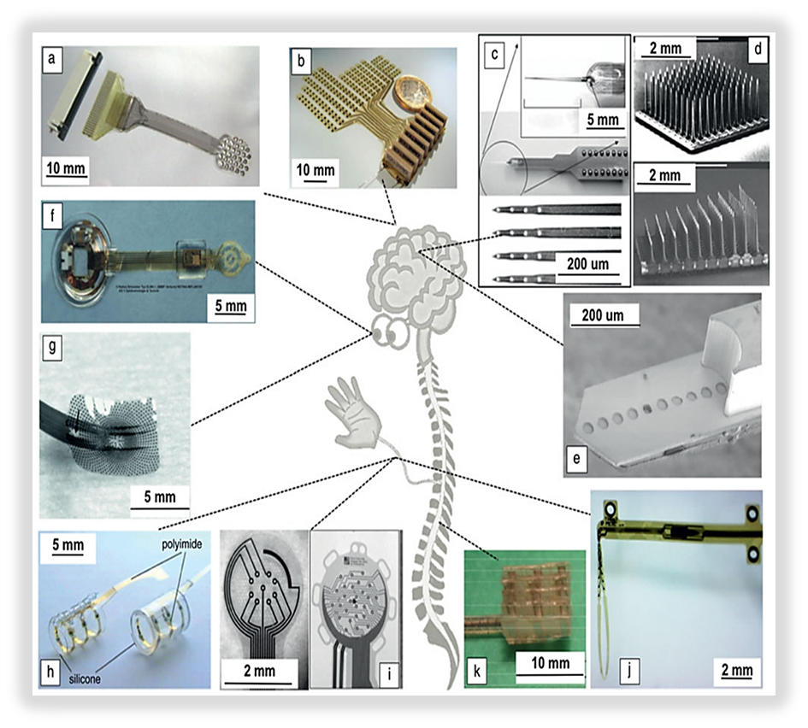
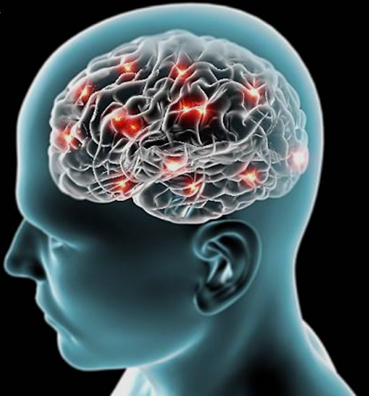
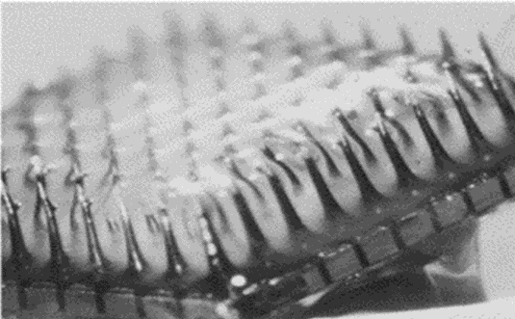
Current Limitations of Neural Implant Chips
Rigid electrode
Inflammatory reaction causes electrodes to become sticky
Inflammatory reaction causes electrodes to become sticky
Mechanical friction and inflammation caused by long-term implantation.
It is challenging to conform to the curved contour of soft tissues with lacerations.
Notes:
微電極陣列（MEAs）的發展源於我們渴望探索大腦產生、傳遞和處理信息的機制。希望能直接地收集電信號、記錄大腦所傳遞的訊號，希望同時探測和記錄更多的神經信號。下方為植入式鋼性的（MEAs）應用治愈受傷的神經
左圖為可植入生物體內的微電極陣列，雖然皆是能提供電刺激與提供引導神經有方向性生長。但致命的缺點是為剛性裝置與軟生物組織接觸，會發生很大的機械力失配，其彈性模數遠大於神經且不具生物相容性，容易引起生物體嚴重的免疫反應及神經受損。

Slide 5
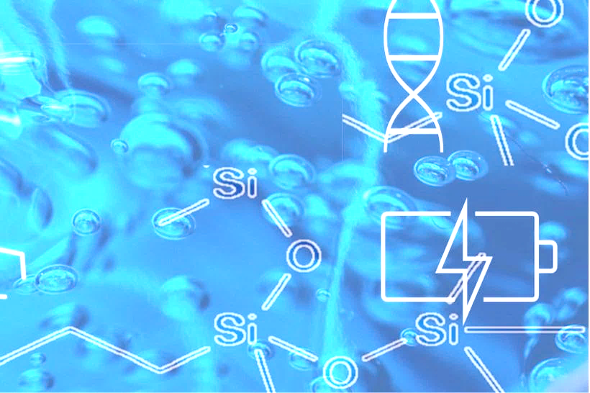
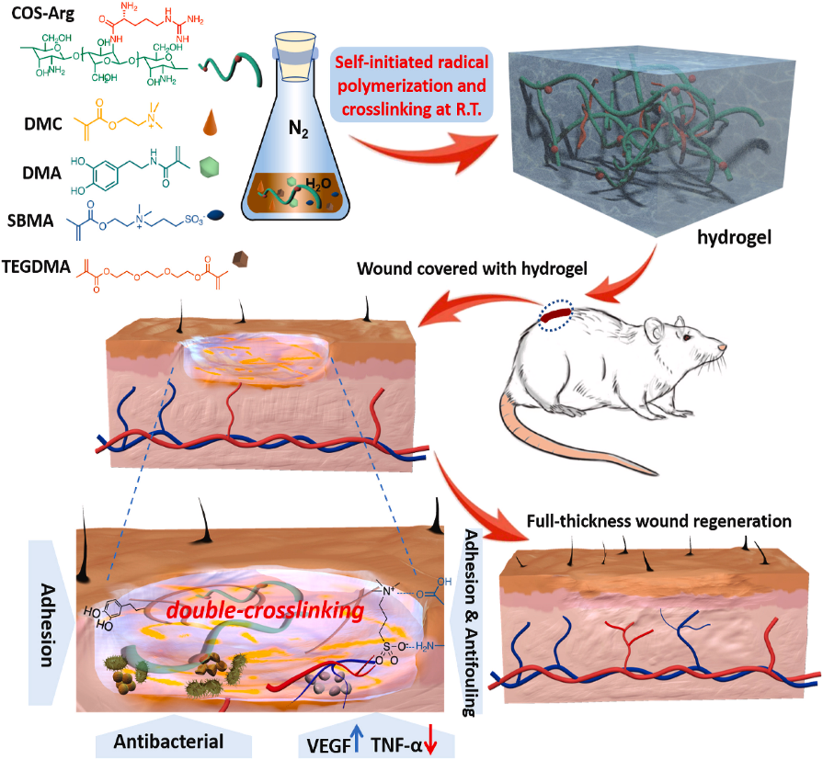
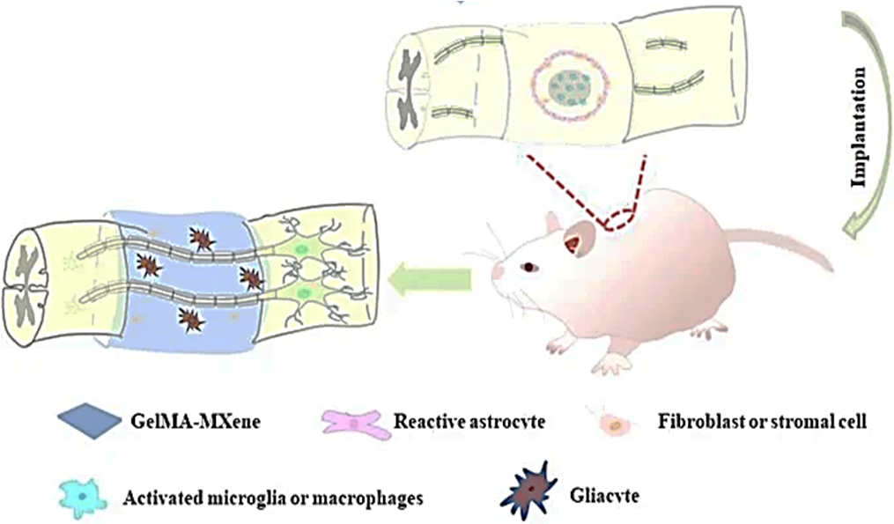
Limitations of tissue engineering treatments
Hydrogel dressing application
Hydrogel conduit treatment
Inflammatory reaction causes electrodes to become sticky
Non-precise and specific treatment.
Materials used cannot be used for simultaneous diagnosis and Poor performance.
Notes:
由於上述提到目前許多MEA是利用金屬及不可讓神經貼附的材料，所以後續的研究致力於研發一個模擬生物體內環境的元件，
左圖，為水膠敷料，雖然可以創造一個具有生物相容性及透過材料選擇可以產生抗菌之敷料，但皆是屬於大範圍的治療不具專一性。
右圖，應用於神經導管是一種有前景的再生醫學。神經導管可以在病變組織中創建一個新的微環境能引導神經成長的方向性，但水膠導管的治療方法是沒有專一性，並沒辦法針對特定損傷位置進行治療，只能大面積的治療。

Slide 6


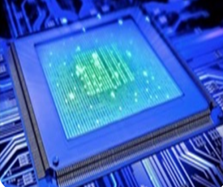
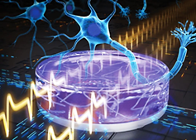
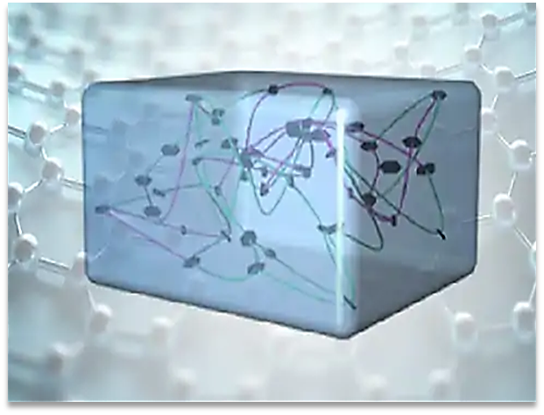
Analysis of the importance of problem solving
Biology
Environmentally
friendly
Electronics
Challenges
Inflammatory reaction causes electrodes to become sticky
Hydrogel
Unstable adhesion of swollen hydrogel- electrode interfaces.
The degree of compatibility between conductive materials and living organisms.
The relationship between electronic components and neural compliance.
The balance between the manufacturing process and environmental friendliness.
Notes:
由於上述的介紹，我們的研究著重於開發一個不僅具有黏彈性、專一性、導電性、生物相容性，且能讓神經細胞生長的導電水膠微電極陣列。
但開發一個上述的微電極陣列，將面臨多種的挑戰，如水膠材料與導電線路的介面結合、導電材料與生物的相容程度多寡、電子元件與神經順應的相互關係

Slide 7
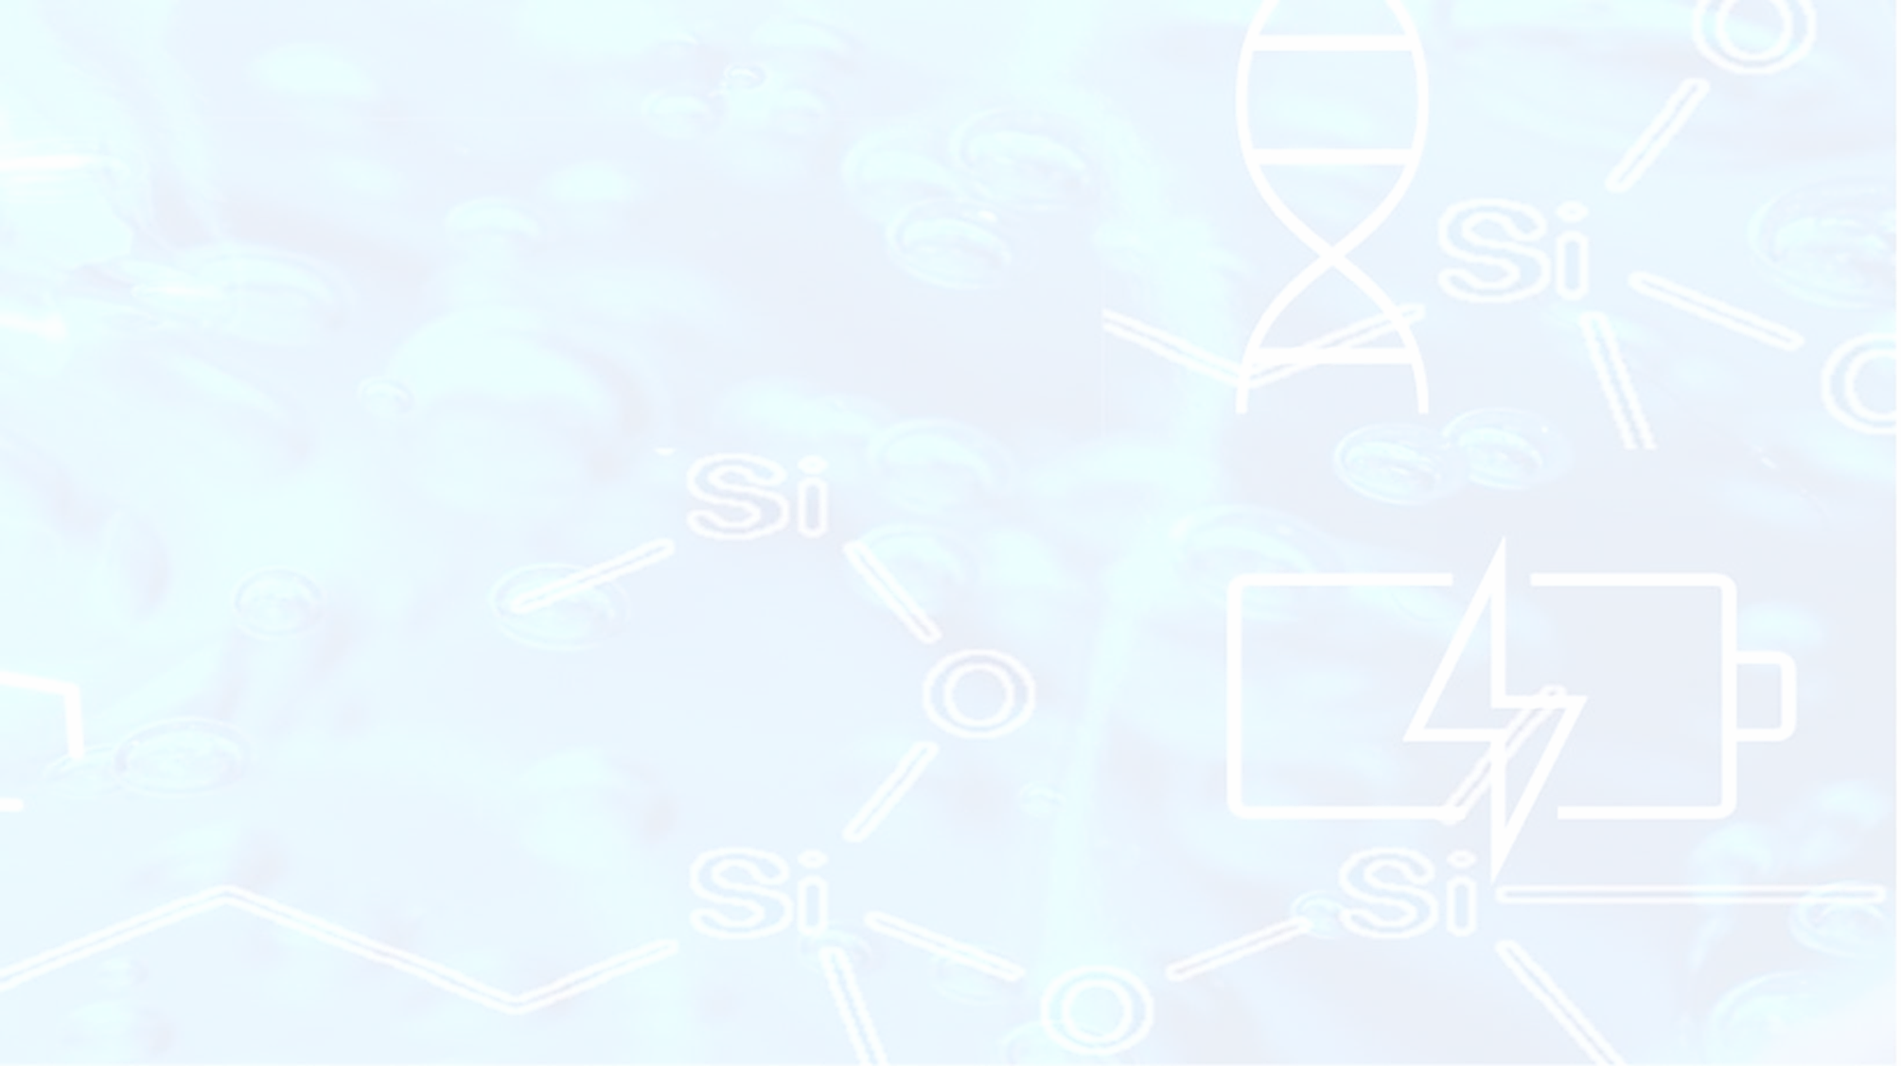
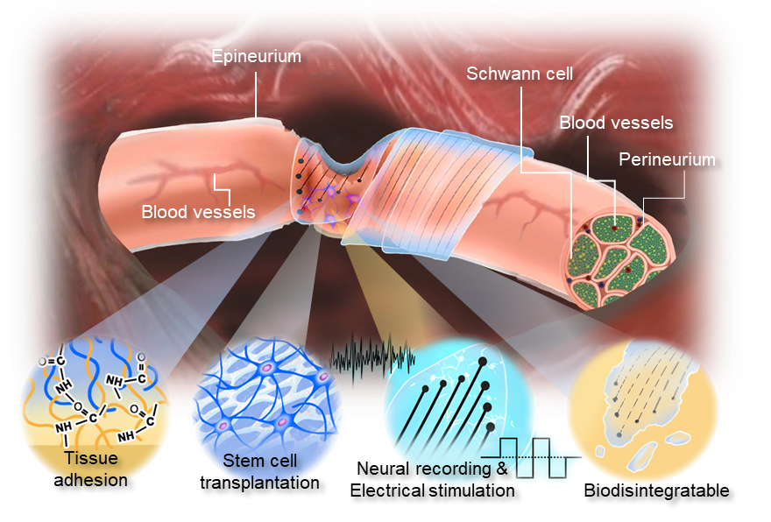
The Function of Hydrogel Microelectrode Array
Features:
All hydrogel can adhere to electronics.
An environmentally non-polluting, low-cost, and mass-producible manufacturing process.
Collaborative Treatment with Tissue Engineering and Neural Electrical Modulation.
Biodegradable and requires no secondary surgery after implantation.
Inflammatory reaction causes electrodes to become sticky
Notes:
因結合上述那些隱憂，之所以我們的研究主要是開發一個能讓具有微環境可讓神經細胞貼附、可自行被生物體分解、具導電且能專一性調控的可植入微電極陣列。

Slide 8

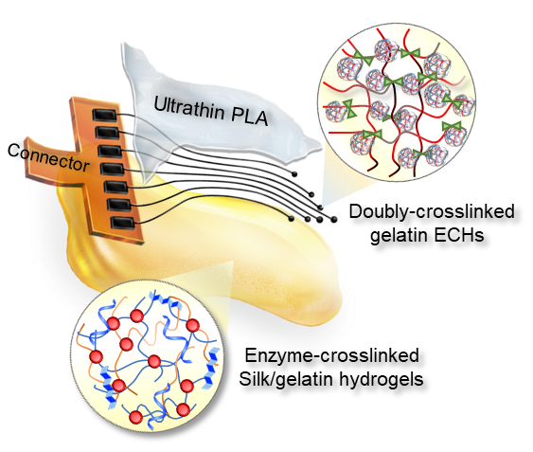
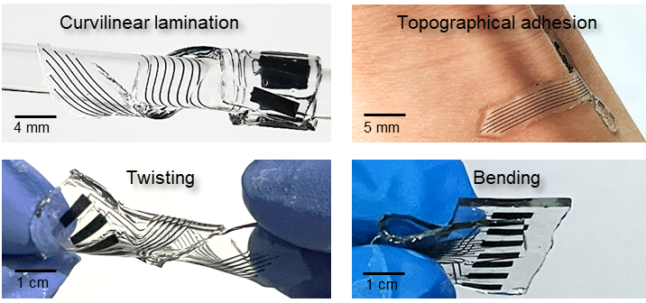
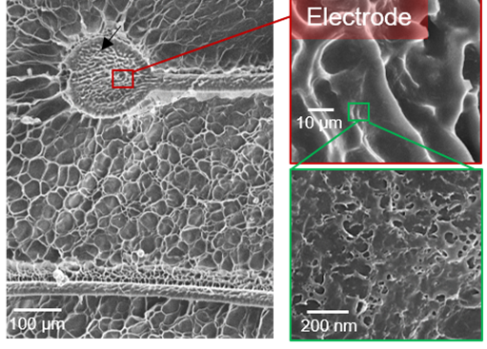
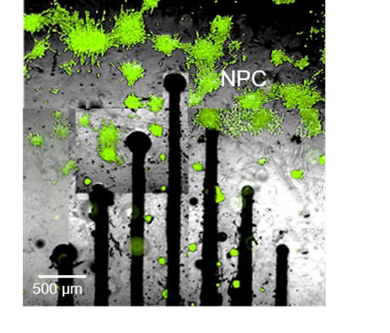
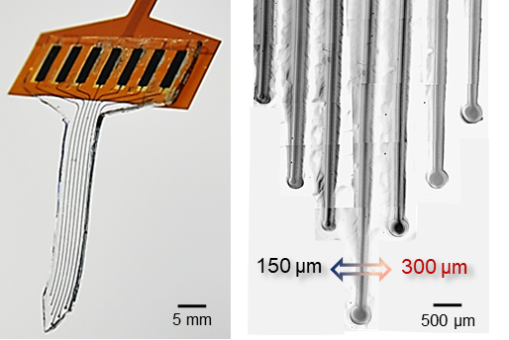
All-hydrogel can adhere to bionic electronics
All hydrogel electronics
Multiple deformation and bionics
Inflammatory reaction causes electrodes to become sticky

Slide 9
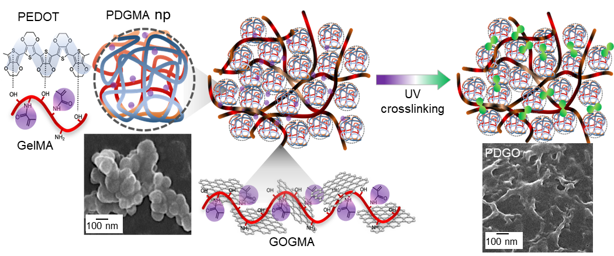
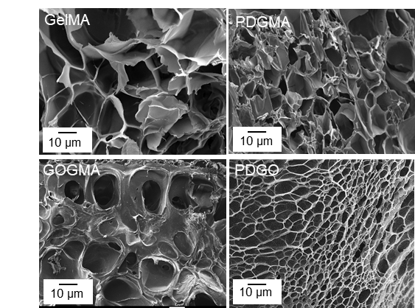
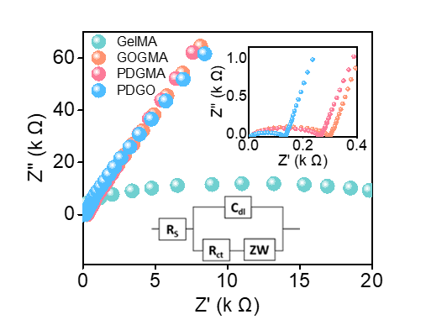
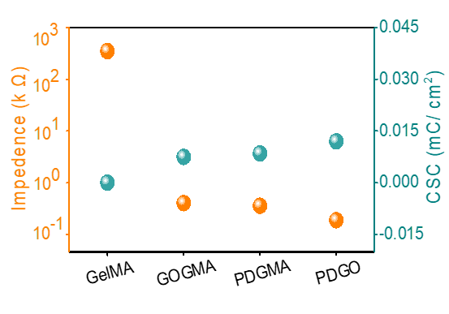
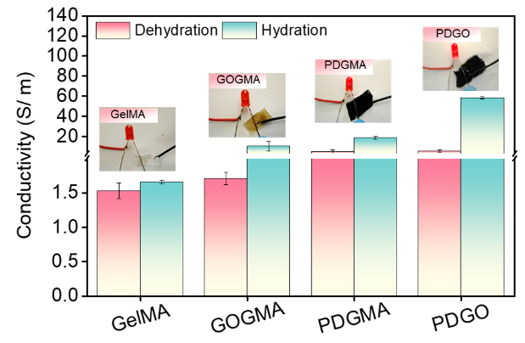
Characteristics of PDGO electroconductive hydrogels
SEM image
Nyquist plot
Impedance vs CSC
Conductivity Analysis
Inflammatory reaction causes electrodes to become sticky

Slide 10
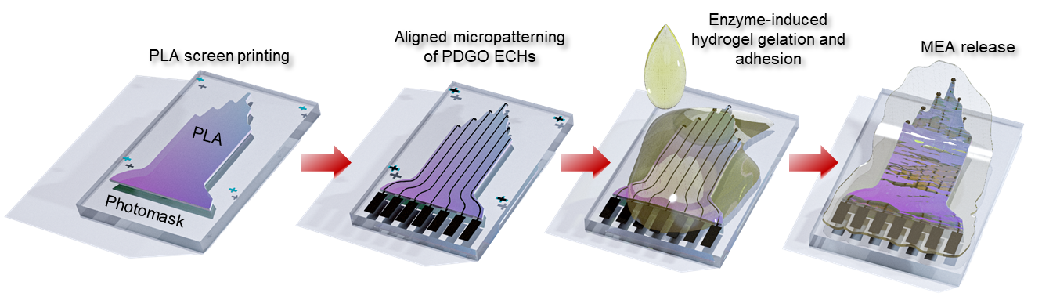
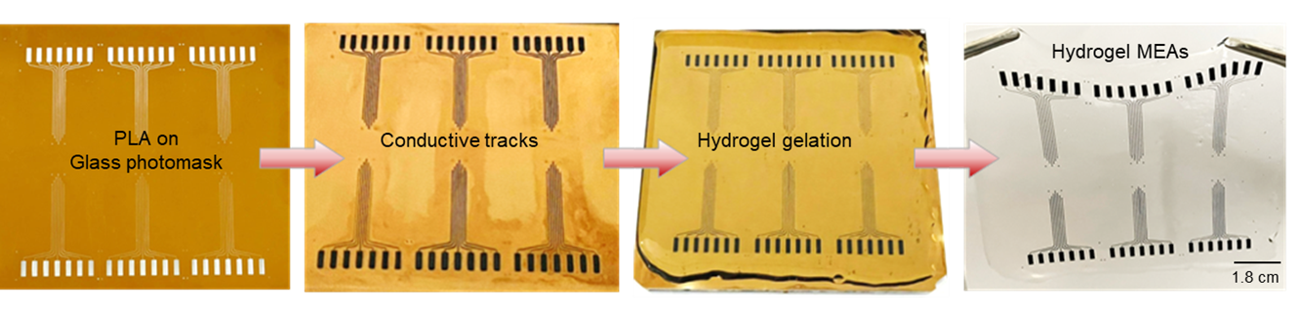
Non-environmentally polluting, low-cost, mass-produced process
Notes:
接著上圖為我們的製作過程，首先會先在光罩上塗上一層PLA絕緣層，接著會將導電材料鋪上光罩，後鋪上Gelatin參雜蠶絲及食用級酵素來轉印此微電極陣列。
在此我們的製程是一個新穎的製程，我們製作的過程簡單且不需要像一般製成需要進入偽影實驗室，
中間左圖可以看到mTG是透過與Gelatin上的Glutamine和Lysine反應，透過兩者間的交聯進而去提供黏彈性，而使此微電極陣列可被轉印起來，在我們得研究研發了一個不需要犧牲層且近乎全水膠的水交微電極陣列。右圖為我們透過實驗去找到最適合的mTG含量及轉印的時間，為此水膠微電極陣列找到一個良好的製程參數。
下圖為實際的製造過程，透過mTG來轉印的製程，我們能穩定且大量的製作元件。

Slide 11
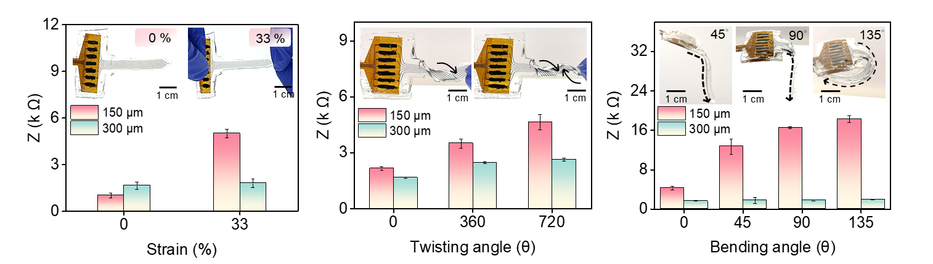
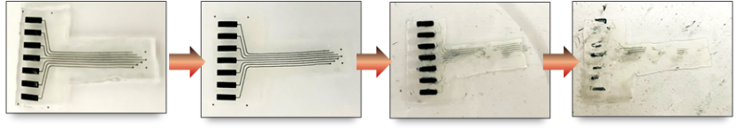


Structural and electrical stability of the hydrogel MEA
T= 14 d
T= 35 d
T= 56 d
T= 70 d
Impedance
CSC
Notes:
為了確定植入後電極的穩定性，我們將其做了多重變形發現CV雖會降低IMP有些微提高，但並沒有非常顯著的差異，證實了我們元件的穩定性。
進而透過在室溫下浸泡PBS 中 56 天后，隨時間測​​量CV及IMP，發現CV的電容儲存量變小而阻抗僅會有些微的變大，以此證實我們的原件是會隨著時間而自行分解的。

Slide 12
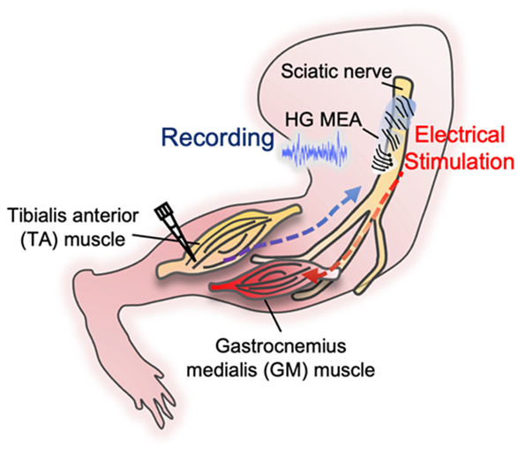
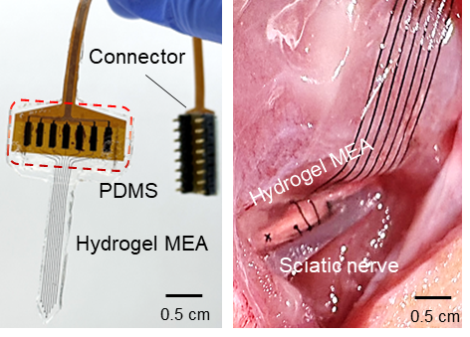
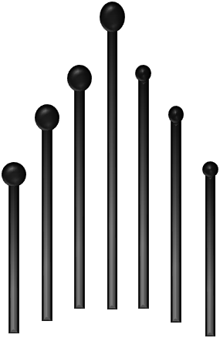
Neural Signal Recording and Electrical Stimulation
Recording between different electrodes
Electrical Stimulation
D1= 3 mm D2= 2 mm D3= 1 mm
D1
D2
D3
Notes:
接著我要為大家介紹in vivo，電極貼附於神經上供給電流2.3mA，神經被電刺激，所以會觸使肌肉運動，進而可以量測到肌肉電位。在記錄神經訊號的過程中，刺激坐骨神經，從而在肌肉組織上紀錄到電訊號。

Slide 13
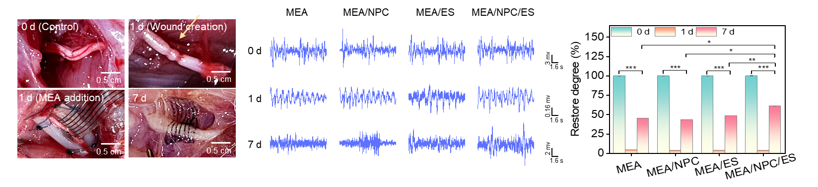
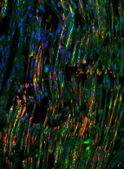
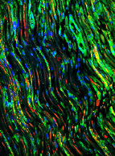
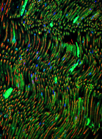
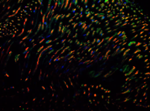
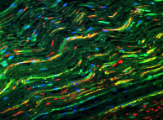
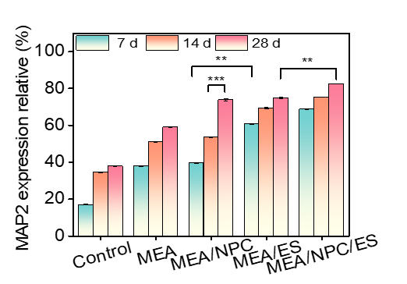
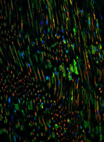
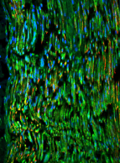
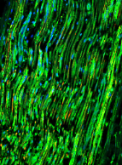
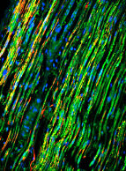
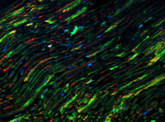
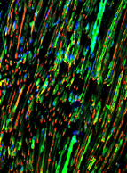
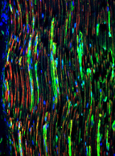
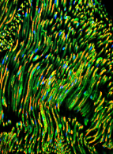


Hydrogel MEA Technologies and Tissue Engineering
for Nerve Injury
Control
MEA
MEA/NPC
MEA/ES
MEA/NPC/ES
7 d
50 µm
50 µm
50 µm
50 µm
50 µm
14 d
50 µm
50 µm
50 µm
50 µm
50 µm
28 d
50 µm
50 µm
50 µm
50 µm
50 µm
MAP2 Tuj1 DAPI

Slide 14


Hydrogel MEA Technologies and Tissue Engineering
for Nerve Injury

Slide 15




Future Prospects
Prospects 01
Prospects 03
Neurodegenerative disease: Alzheimer, Parkinson
01
03
Converting brain activity into controllable command signals: individuals regain motor function
Prospects 02
Prospects 04
02
04
Monitoring physiological signals: heart disease, brain and peripheral nerve reactions, and diabetes
Assessing the efficacy and safety of drugs

Slide 16






