Slide 1
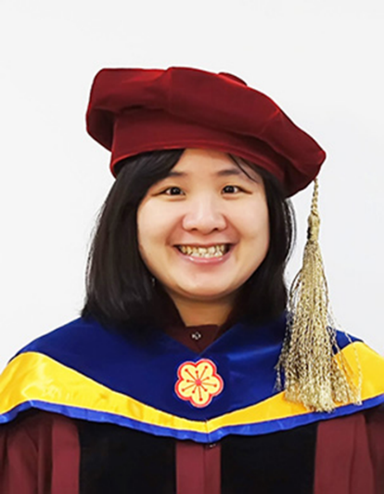
顏資儷
Sex bias in social deficits, neuronal circuits and nutrient demand in Cttnbp2 autism model
中央研究院 分子生物研究所
博士後研究員
薛一蘋

Slide 2




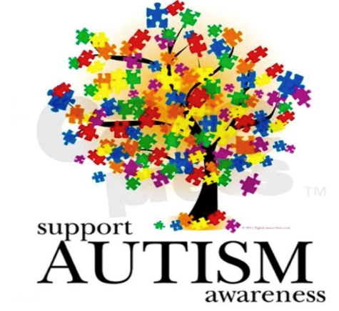

Sex bias in social deficits, neural circuits and nutrient demand in Cttnbp2 autism models
2024
Academia Sinica IMB
Tzu-Li Yen, PhD
Mentor: Dr. Yi-Ping Hsueh
Date: Oct 19, 2024
Notes:
Good afternoon, everyone, My name is Tzu-Li, yen from yi…
I am so glad to be here to present my work.
Before I start.
What comes to your mind, when you hear the word “Autism”
Do you think autism has sex difference?
What are you going to do, if one of your family members has it?
Why did I ask you thesis questions, because today I will be presenting about…

Slide 3

Autism Spectrum Disorders (ASDs)
Pervasive developmental disorders (PDD)
- Asperger disorder, Autism, Rett’s syndrome
Early onset neurodevelopmental disease – before 3 years old
1:44
1:36
autism
increased
317%
1:54
1:69
1:59
1:68
Prevalence has
1:88
1:110
1:125
Since 2000
1:150
CDC Prevalence
per ADDM*
1:500
1:1000
1:10,000
1970 1995 1999 2000 2002 2004 2006 2008 2010 2012 2014 2016 2018 2020
Surveilance Year
US
*ADDM (Autism and Development Disabilities Monitoring Network)
www.tacanow.org
Notes:
ASD is a PDD, and can be diagnosed before 3 years old.
Based on CDC report, Since 2000,
this is 317% increase in the prevalence rate released by CDC report.

Slide 4
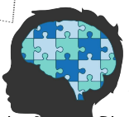
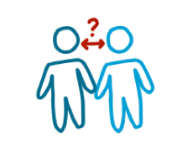

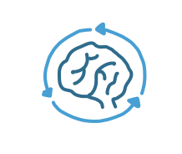

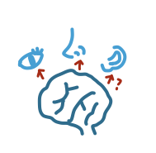
Autism Spectrum Disorders (ASDs)
Symptoms
a. Social
impediment
b. Difficulties in
communication
ASDs
v
c. Repetitive
Behavior
d. Restricted
Behavior
e. Sensitivity to change and stimulation
(Masini et al., 2020)
Notes:
What are the symptoms of ASD?
Autism pateints have problem with social communication and interaction.
Also, have repetitive and restricted behavior.
And some of them have shown that hyper or hypo sensitivity to a wide range of stimuli.

Slide 5
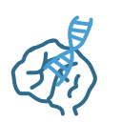




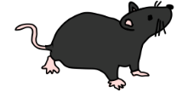

Autism Spectrum Disorders (ASDs)
Causes
Genetic factors
De novo mutations
Ex.Cttnbp2
Copy number variants
Environmental factors
Nutrition status
Microbiome
Gut inflammation
ASDs
v
Biological mechanism of Sex bias in ASDs?
Sex factors
Female protective effect
ASD mouse genetic models
(Cttnbp2^{M120I/+})
Notes:
What causes the Autism?
Genetic factor has powerful influence on ASD.
Around 80% ASD are associated with genetic variation, including synaptic function.
Human sequencing data have indicated that the de novo mutations and copy number variants can be found in autism patients
Another factor is environmental factors. Such as…
Significantly, Autism sows strong male bias, the report indicated that 4 time more often in boys than in girls
In this study, we want to investigate the biomechanism,
sex bias for autism using autism mouse models.
De novo mutations, by definition, are present in the affected individual but absent from both biological parents' genomes. These mutations can occur in any cell of the offspring

Slide 6
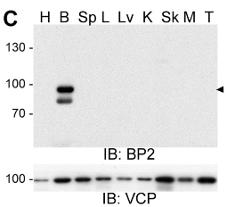
CTTNBP2
Cortactin binding protein 2
ASD mutation
A112T
P353A
M120I
R342R
R533*
D570Y
R42W
N
CC
Mid
P-rich
C
1
118
258
523
630
Pre-synapse
Neuron-specific cytoskeleton regulator
Strong autism candidate gene (SFARI)
NMDAR
PSD95
SHANK2
CTTNBP2
Post-synapse
Zinc binding
(Chen et al., 2012; Chen and Hsueh, 2012; Shih et al., 2014, Shih et al., 2022)
Notes:
As you can see, there are several patient mutation sites.
In previous paper shows that the M120I mutant mice exhibit
impairement of almost all examined functions such as apine morphology and behavior,
So we think the M120I mutant mice is an interesting model to study.
Cortactin, actin-binding protein
Given that the M120I mutation in mice
impairs almost all examined functions of CTTNBP2—including
the N- and C-terminal interaction, cortactin binding, biological condensate
formation, dendritic spine retention, dendritic spine formation,
and social interaction

Slide 7
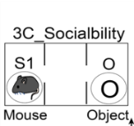
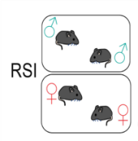
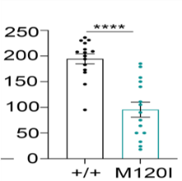
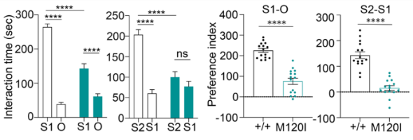
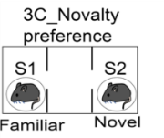

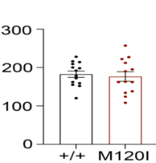
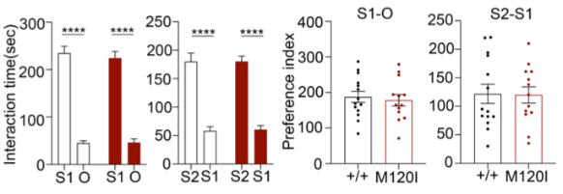
Cttnbp2 M120I mutant mice show sex-biased social deficits
3C: Three chamber test
RSI: Reciprocal social interaction
To identify the brain regions displaying sex-dependent differences.
Notes:
At first, I used two social behavioral tasks to investigate that the male mutant mice show lower sociability and social novelty in 3C task. Interestingly, the female social behavior of female mutant mice comparable to wildtype mice.
And the result of reciprocal social interaction shows the same phenotype as the 3C.

Slide 8
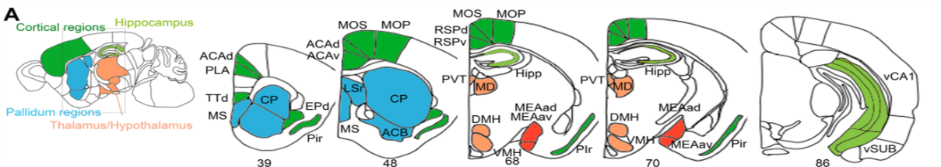
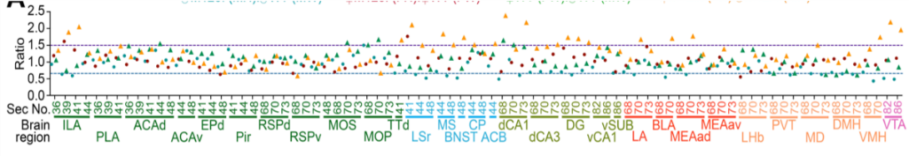
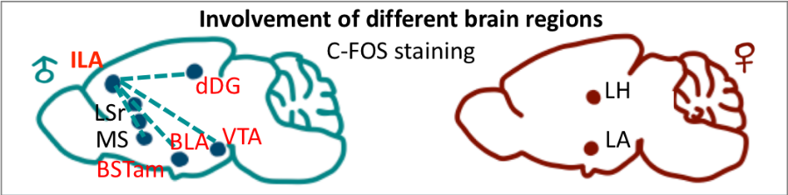
To determine the neural activity of brain regions is critical for sex-biased social deficits
31 brain regions are associated with sex dimorphism and social-related
Global comparison of neuronal activity
LSr
MS
dDG
BLA
VTA
ILA
LA
LH
mean value of CFOS density
Cortical regions
Pallidum regions
Thalamus/Hypothalamus regions
Hippocampus regions
Cttnbp2 deficiency may alter neuronal responses in some brain regions in a sex-biased manner.
Notes:
After searching the literatures, choosing 31 regions brain regions ……
Atlas is from Allen brain.
Here is the sagittal sections. Cortical regions…Here is the coronal sections, from rostral to caudal..
We did the global comparison,
The blue dots indicated M120I compare to wildtype in male, (the genotype effect in male)
and genotype effect in female,
Female compare to male in wildtype and in M120I mice
The sex effect in wildtype and M120I in orange.
The purple and blue dotted line indicated the above 50% change.
Mainly above 50% change are M1 compare to wildtype in male group,
and female compare male in M120I group.
So according to this data, we demonstrate that…
I further shows the statistic results for some brain regions.
First, we compared the mean values of
C-FOS+ cell density to determine the following ratios:
statistical analysis for each brain region
Here is the mean value, so I further show the statistic results in each brain regions.
0.66

Slide 9

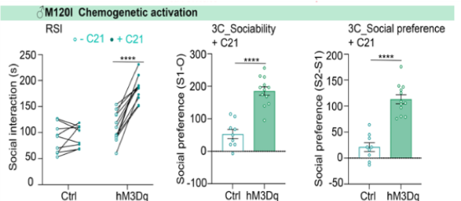


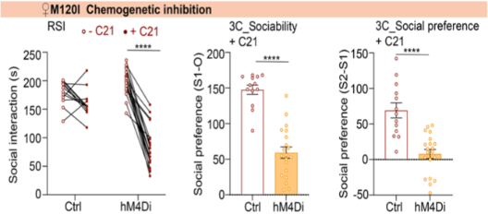
Chemogenetic manipulation at ILA region modulates social interaction of M120I mutant mice
ILA - infralimbic cortex
♂M120I
Control AAV
AAV-CaMKII-hM3Dq-mCherry
Control AAV
AAV-CaMKII-hM4Di-mCherry
♂ WT
♂ M120I/+
♀ WT
♀ M120I/+
C21
Human M3 muscarinic receptor
Human M4 muscarinic receptor
Compound 21
DREADD agonist
♀M120I
Enhanced ILA neuronal activity ameliorates the social deficits of male M120I mice.
DREADD: Designer receptors exclusively activated by designer drugs
(Wess et al., 2016)
Notes:
In male mice, we performed the hM3Dq virus injection to. ILA,
In female mice, we injected the hM4Di virus into ILA.
After IP injection C21 compound which is a DREADD agonist,
And in hM3dq would lead to neuron excitation
In hM4Di lead to neuron silencing
DREADD agonist esigner Receptors Exclusively Activated by Designer Drugs

Slide 10
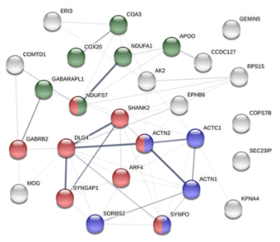
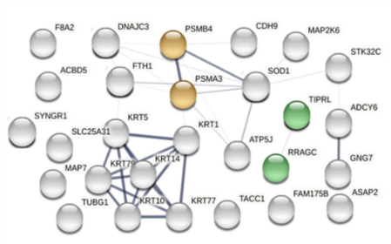
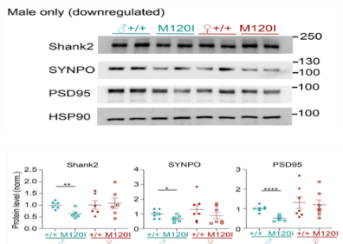
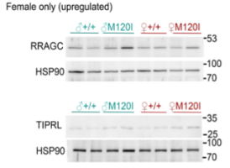
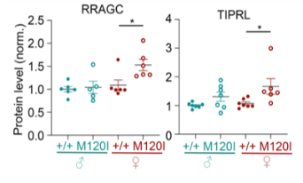
Dissection of synaptic components using proteomic approaches
Male downregulated
Female upregulated
Actin cytoskeleton
Mitochondria organization
Proteasome core complex
Synapse
mTOR related pathway
Whether increasing the mtor-regulated protein synthesis through BCAA supplementation can rescue the social deficits in male mice.

Slide 11
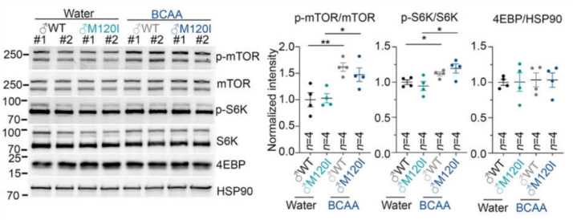
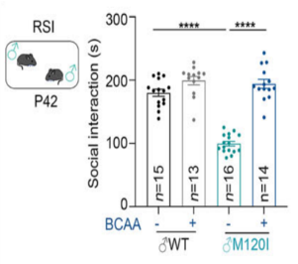
BCAA treatment increases mTOR activity of the mouse cerebral cortex
BCAA: Branched-chain amino acid:
Isoleucine, Leucine, Valine
Ras-related GTP-binding protein C
- Amino acid sensor
TOR signaling pathway
regulator-like
Feeding for 2 week
Amelioration of the social deficits of male M120I mice via BCAA supplementation.
(Luan et al., 2020 ; Yang et al., 2019)

Slide 12
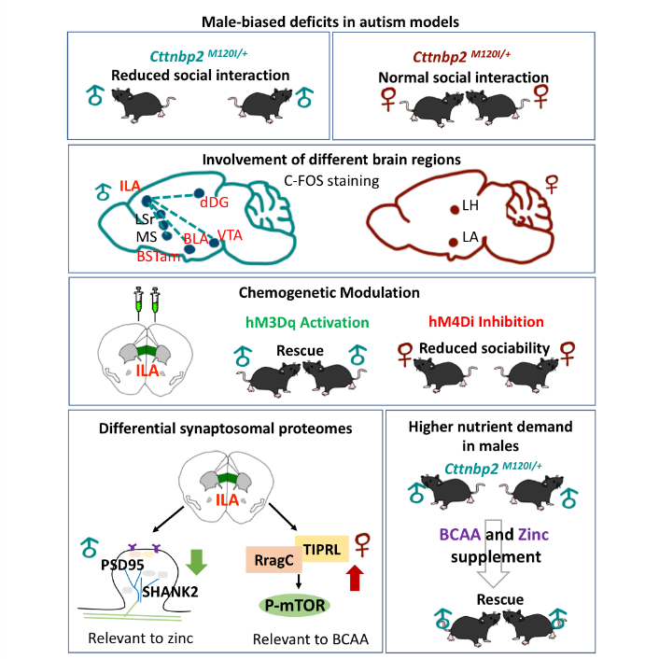


Slide 13
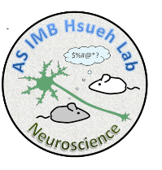





Acknowledgement
IMB N514
sMRI
IMB animal facility
Prof. Jason Lerch
Dr. Jacob Ellegood
Prof. Yi-Ping Hsueh
Dr. Tzyy-Nan Huang
Dr. Tsan-Ting Hsu
Mr. Bing-Yuan Hsieh
Dr. Ming-Hsuan Lu
Miss Fang-Ming Wu
Miss Si-Cih Lin
Dr. Yun-Feng Hong
Mr. Yu-Lun Fang
N514 lab members…
Proteomic
Proteomic Mass
Spectrumetry
Dr. Shu-Yu Lin
Thank you
Notes:
At first I have to thank the Dr. YI-ping Hseuh.
She gave me tons of useful suggestions and great advice.
She always has passion and
curiosity to do research.
She is a really nice advisor,
I am so glad to join her lab and complete my PhD degree.

