Slide 1
龐浩翰
Bioengineered Bacteriophage-Like Nanoparticles as RNAi Therapeutics to Enhance Radiotherapy against Glioblastomas
Nationwide Children’s Hospital, Center for Childhood Cancer 博士後研究員
楊閎蔚 教授

Slide 2
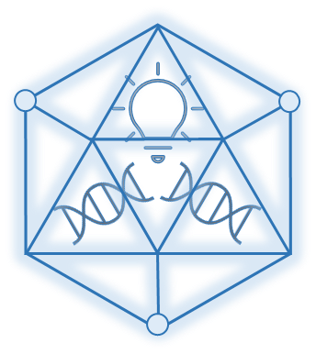
Bioengineered Bacteriophage-Like Nanoparticles as RNAi Therapeutics to Enhance Radiotherapy against Glioblastomas
Hao-Han Pang, Chiung-Yin Huang, Pin-Yuan Chen, Nan-Si Li, Ying-Pei Hsu, Jan-Kai Wu, Hsiu-Fang Fan,
Kuo-Chen Wei*, Hung-Wei Yang*
2024/10/19
Presenter: Hao-Han Pang, PhD
Postdoctoral researcher
Nationwide Children’s Hospital, Columbus, OH, USA

Slide 3
Personal Information
08/2017 – 07/2021 PhD in Biomedical Sciences
Institute of Biomedical Sciences, NSYSU, Taiwan, R.O.C
08/2015 – 07/2017 M.S. in Medical Science and Technology
Institute of Medical Sciences and technology, NSYSU, Taiwan, R.O.C
08/2011 – 07/2015 B.S. in Chemistry
Department of Chemistry NSYSU, Taiwan, R.O.C
08/2021 – 07/2023 Postdoctoral Researcher (Taiwan)
Lab of Nano Biomaterials Applications, prof. Hung-Wei Yang
Department of Biomedical Engineering, NCKU, Taiwan (since 08/2022)
Institute of Medical Sciences and technology, NSYSU, Taiwan
09/2023 – current Postdoctoral Researcher (USA)
Center for Childhood Cancer Research (CCCR)
Nationwide Children’s Hospital, Columbus, OH, USA.
Notes:
惡性腫瘤常居國人十大死因之首，其中又以腦癌最為惡劣，五年存活率不及一成。 腦部惡性腫瘤占中樞神經系統腫瘤超過90%，而在腦部惡性腫瘤中又以神經膠母細胞瘤 (glioblastoma) 為大宗，不論性別均占超過40%之腦瘤發生率。 據美國癌症協會 (American Cancer Society) 報導，2019年估計全美將有23,820人罹患中樞神經相關惡性腫瘤，其中有17,760人將死於腦腫瘤。

Slide 4
Outline
Introduction
Target tumor: GBM
Challenges of GBM therapy
Goal of this study
Method
Design of multifunctional RNA scaffold
Method scheme
Results and discussion
Conclusion
Current stage and future scope

Slide 5
Introduction: Target tumor GBM
Tumor occurs in CNS
Main therapy method
Glioblastoma (GBM) is the most lethal among all astroglial tumors .
Surgery is the most common therapy method for GMB.
However, the recurrence rate still high.
Extreme poor survival
Adjuvant therapy methods
Median survival of GBM patients is less than 15 months, and less than 5% of patients with GBM survive longer than 3 years.
Chemotherapy and radiotherapy are most common. Gene therapy could also be an option.

Slide 6
Introduction: Challenges of GBM therapy
Biological barrier
Tumor cell
Delivery challenge
Blood-Brain
Barrier
Resistance
RNAi therapy
Cause low chemo- and radio- therapy efficiency
Special RNAi scaffold with carrier packaging
Poor drug penetration
Delivery carriers need to be developed
Specific gene target for reducing resistance and gene therapy
Resistance
downregulation
Gliadel
Focus ultrasound
Ratio sensitizer side effect and delivery
High-cost detection
Carrier selection
RNA synthesis and stability

Slide 7
Introduction: Goal of this study
Q1:
Is it possible to deliver siRNAs or RNA fragments with specific function simultaneously and is traceable in vitro or in vivo?
Q2:
A gene therapy cocktail that can down regulate more than one gene and reduce the tumor progression and resistance.

Slide 8
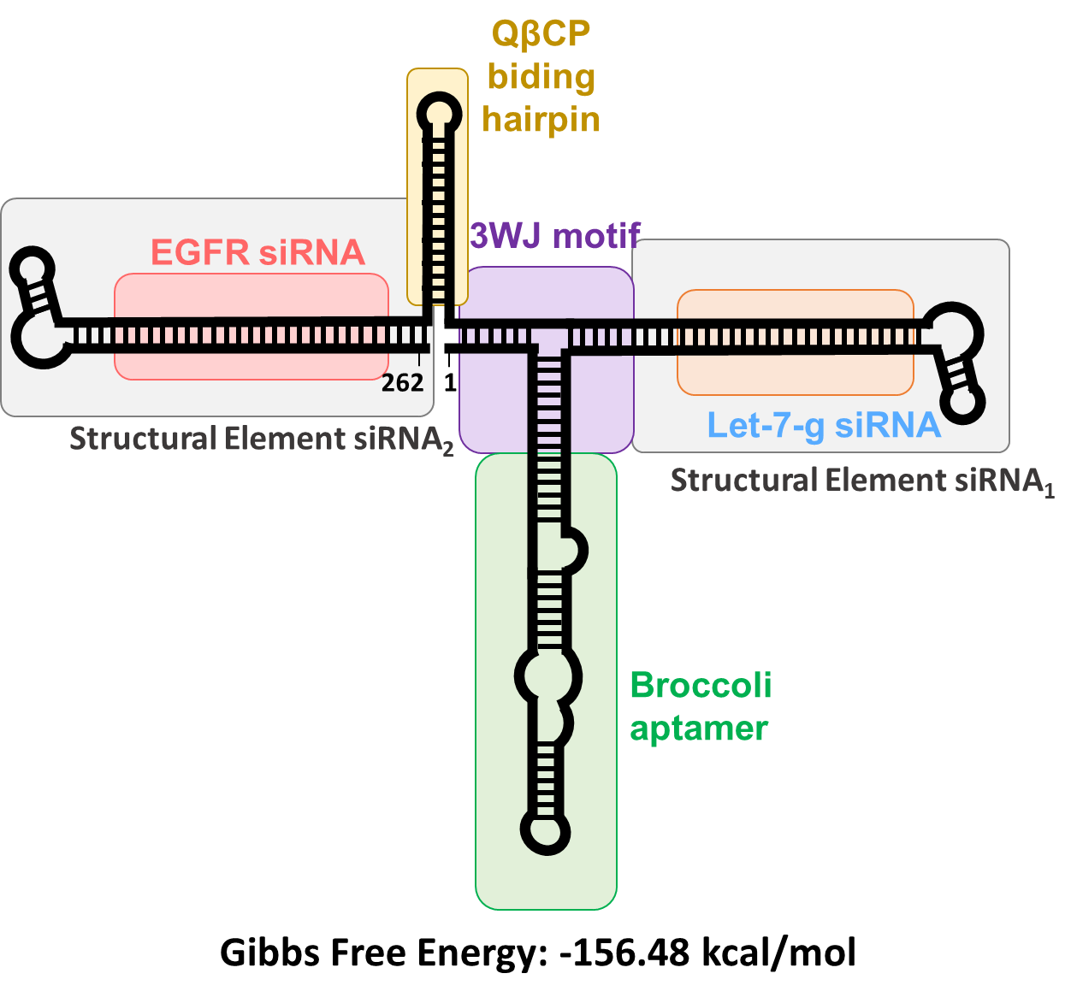
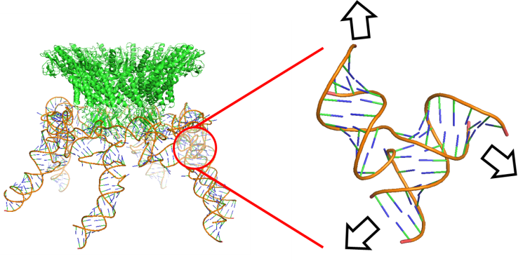
Method: Design of multifunctional- RNA scaffolds
Stage 1: RNAi scaffold traceable version
Stage 2: RNAi scaffold therapy version
The three-way junction domain from Phi-29 pRNA

Slide 9
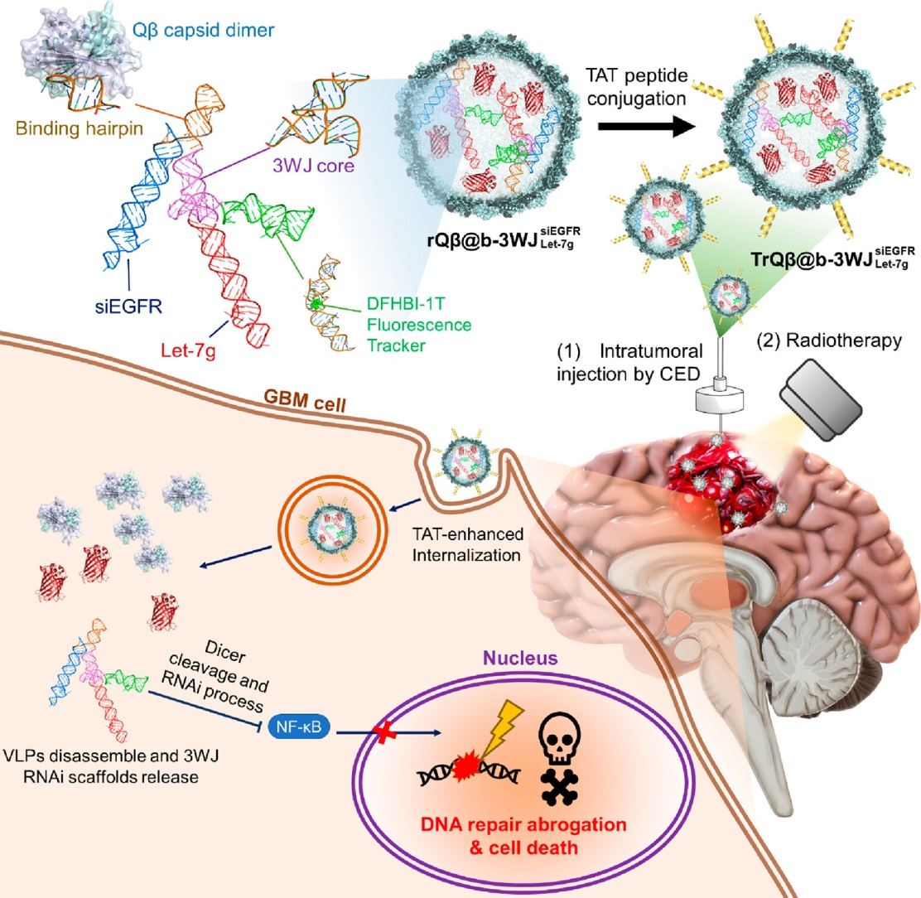
Method

Slide 10
RNA Scaffold for real-time fluorescence tracing
Stage 1: RNAi scaffold traceable version
Goal:
Dual-fluorescence aptamer for folding check
Real-time RNA tracing.

Slide 11
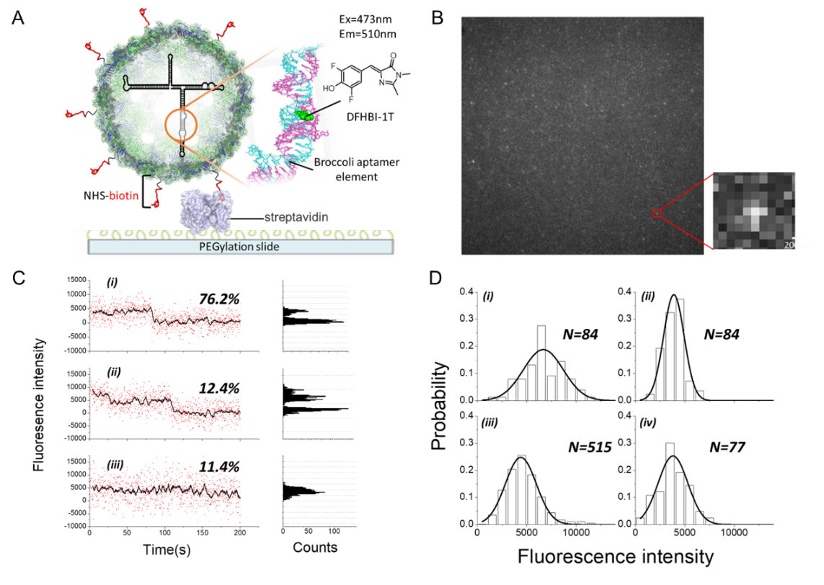
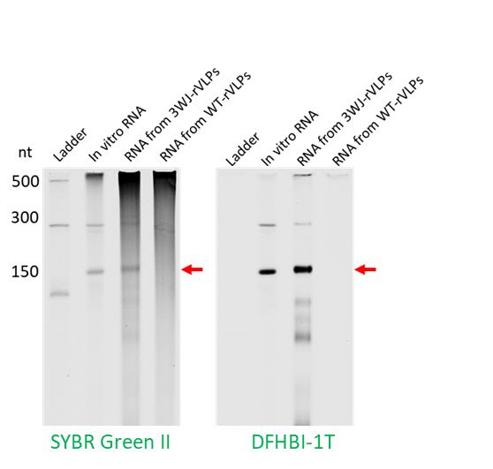
Results: traceable RNAs
Fluorescent RNA scaffold
Quantifiable auto-packaging
A
B

Slide 12
Results: Real time RNA tracing
Traditional Northern blotting
Real-time imaging

Slide 13
Results: Real time RNA tracing
Traditional Northern blotting
Real-time imaging
L: low range ssRNA ladder
1: in vitro RNA
2: blank
3: WT-VLPs
4: 3WJ-VLPs (24h)
5: 3WJ-VLPs (24+2h)
6: 3WJ-VLPs (48h)
7: 3WJ-VLPs (72h)

Slide 14
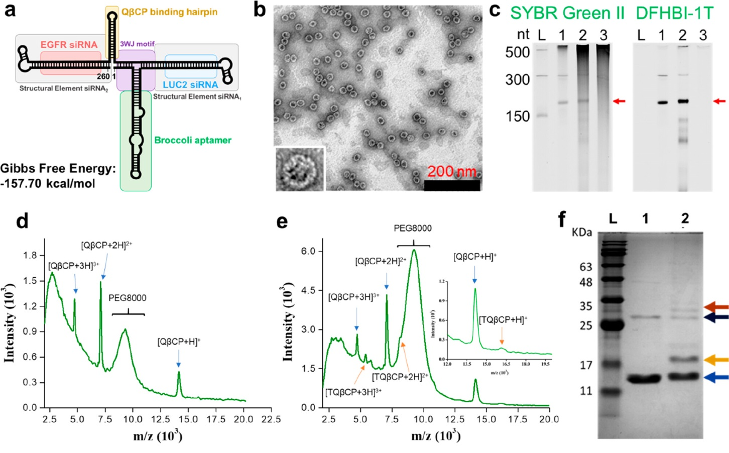
Results: TAT modification for update enhancement

Slide 15
Results: 3D tumor model tumor penetration

Slide 16
RNA scaffold for siEGFR and let-7-g co-delivery
Stage 2: RNAi scaffold therapy version
Goal:
siEGFR and let-7g co-delivery for NFκB inhibition
In vitro and in vivo tumor inhibition
RT resistance down regulation

Slide 17
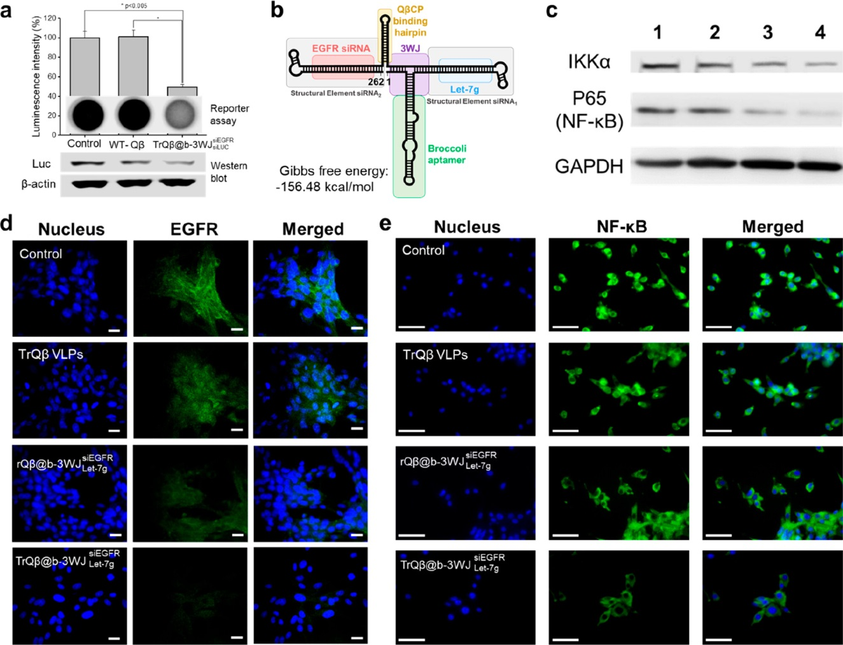
Results: multi-gene silencing

Slide 18
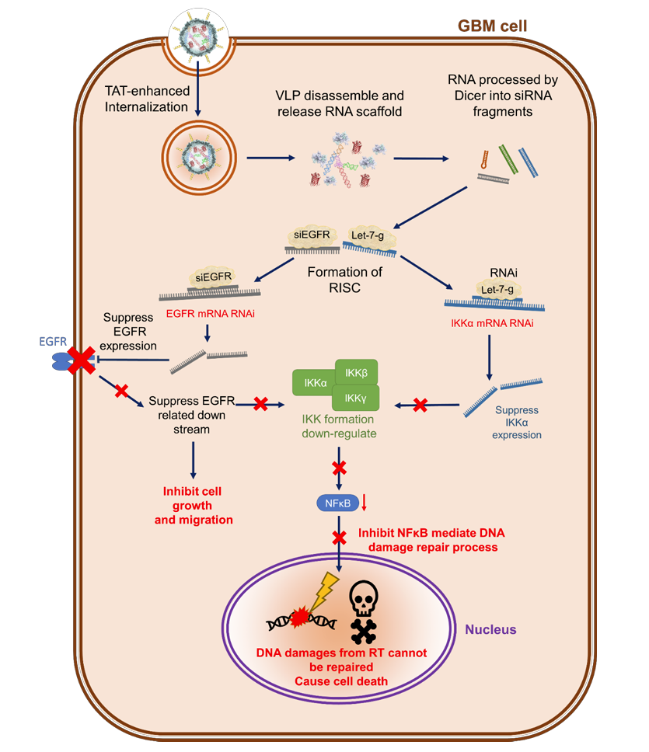
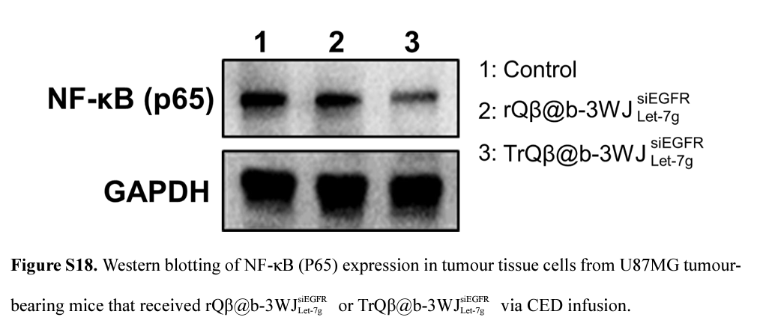
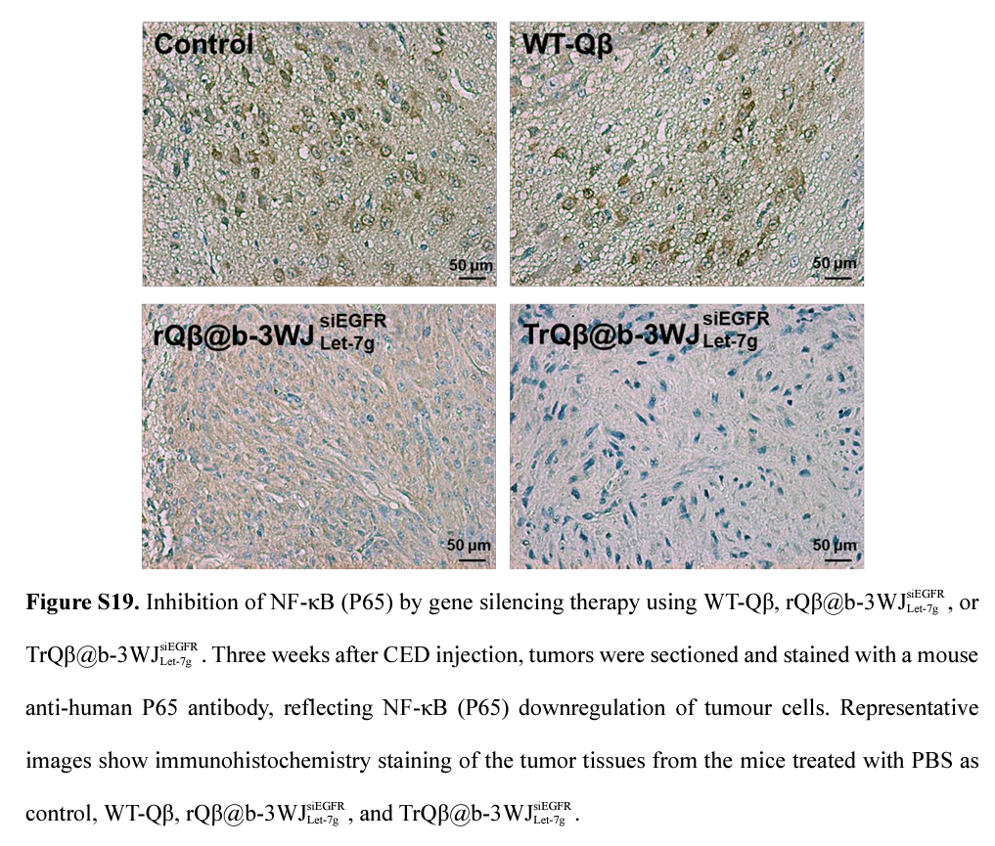
Results: Dual gene silencing pathway model

Slide 19
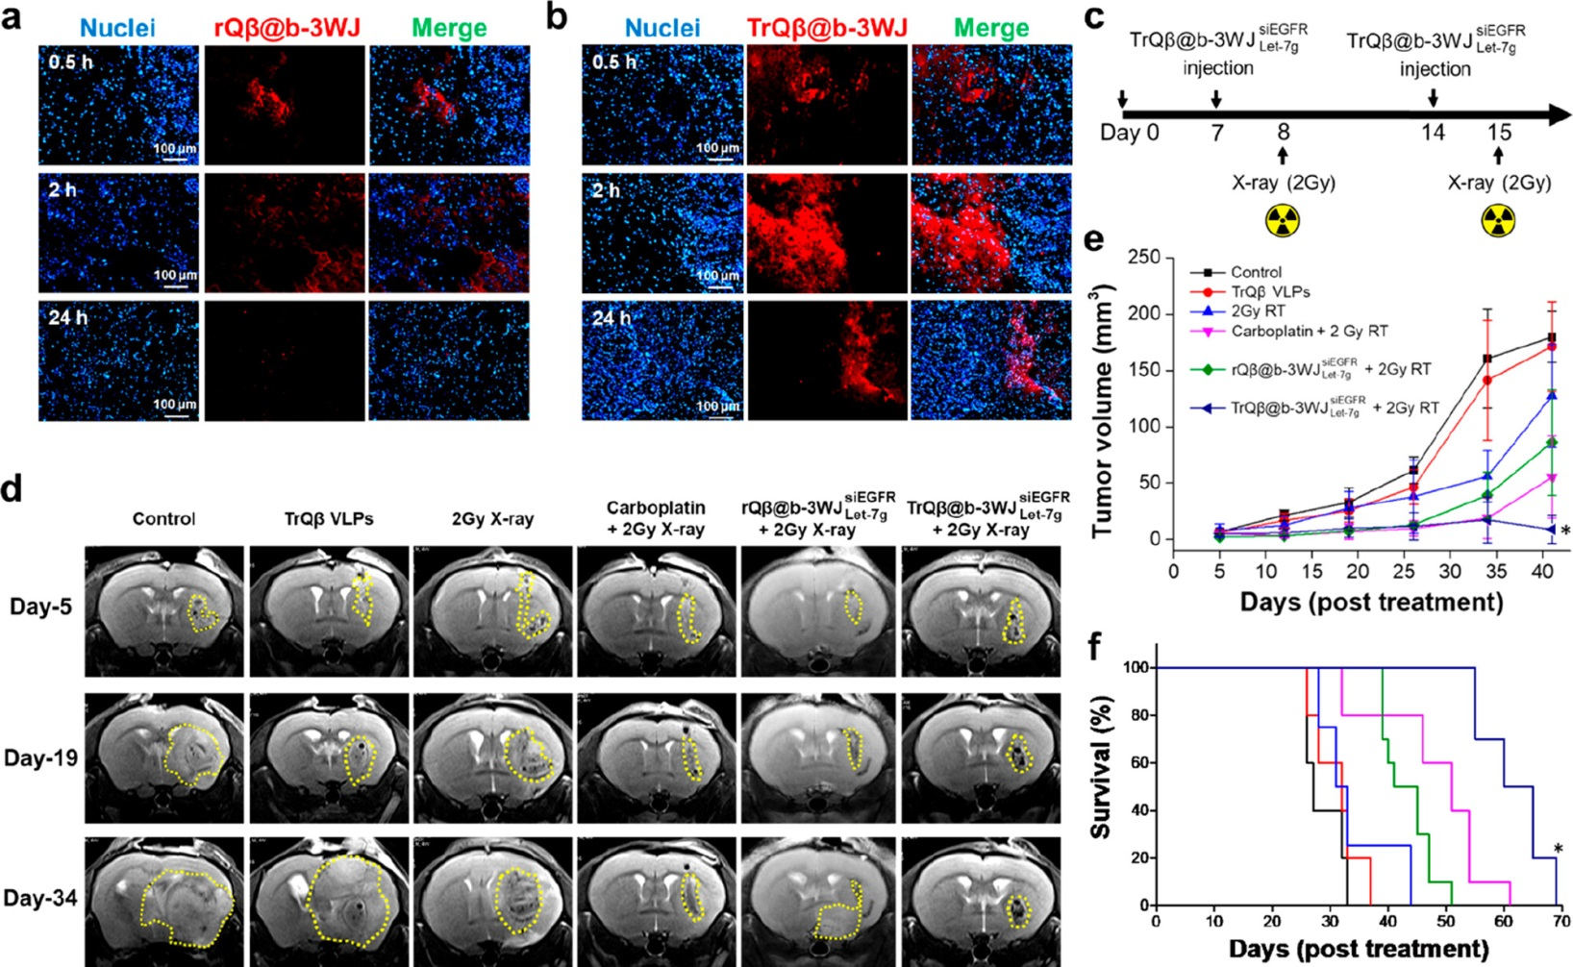
Results: Synergic therapy with RT

Slide 20
Conclusions
Real-time traceable RNA delivery
Multi RNAi delivery simultaneously
Modular scaffold design that can replace with any functions of siRNAs or aptamers
Enhance the efficiency of RT and prolong the survival time within CED injection combination therapy

Slide 21
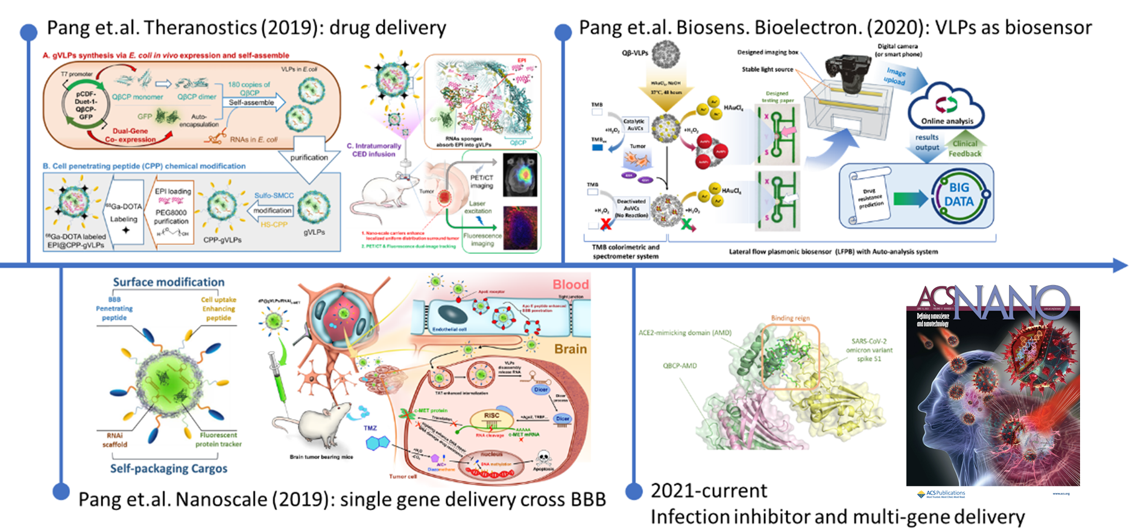
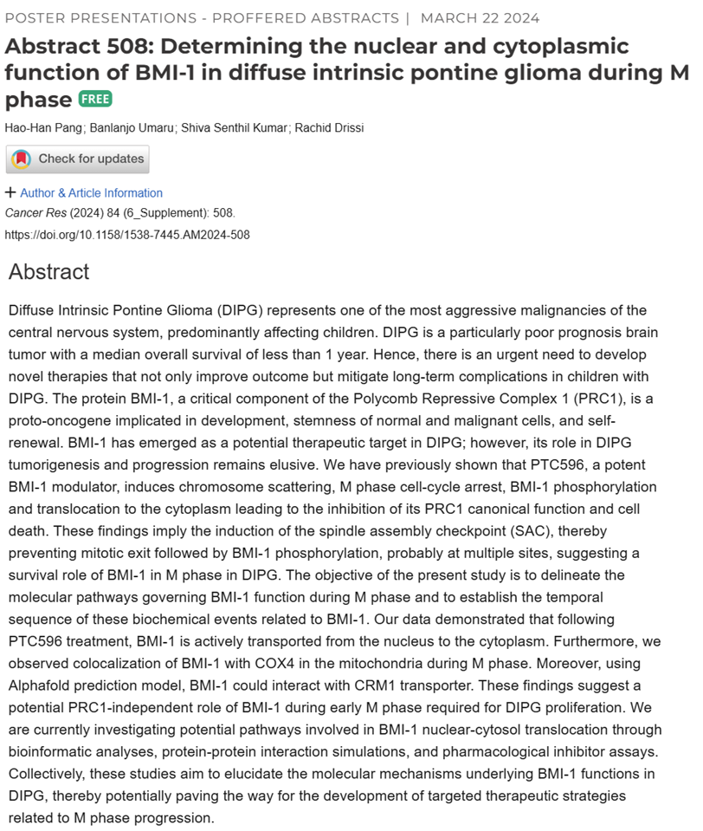
The journey with brain tumor therapy studies
2024
Target discovery for pediatric brain tumor

Slide 22
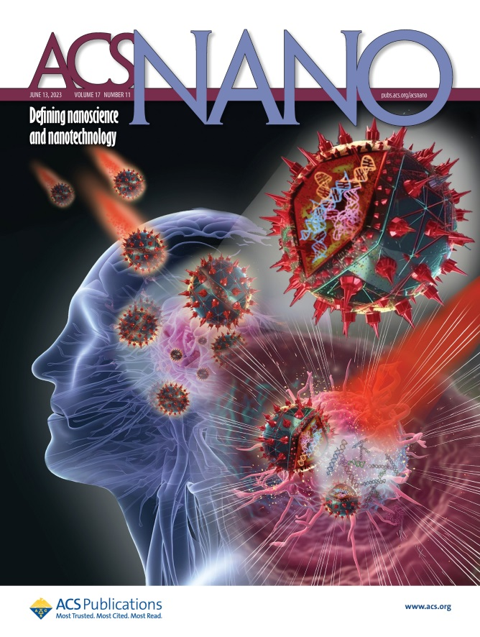
Current Stage
Apply patent (international)
Pharmaceutical company apply for collaboration and authorization of the technology. Planning to enter pre-clinical trial.
Currently doing research , for potential therapy target of diffuse intrinsic pontine glioma (DIPG) at Center for Childhood Cancer, Nationwide Children’s Hospital, USA.

Slide 23
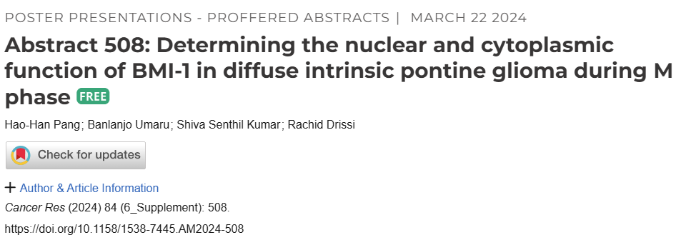
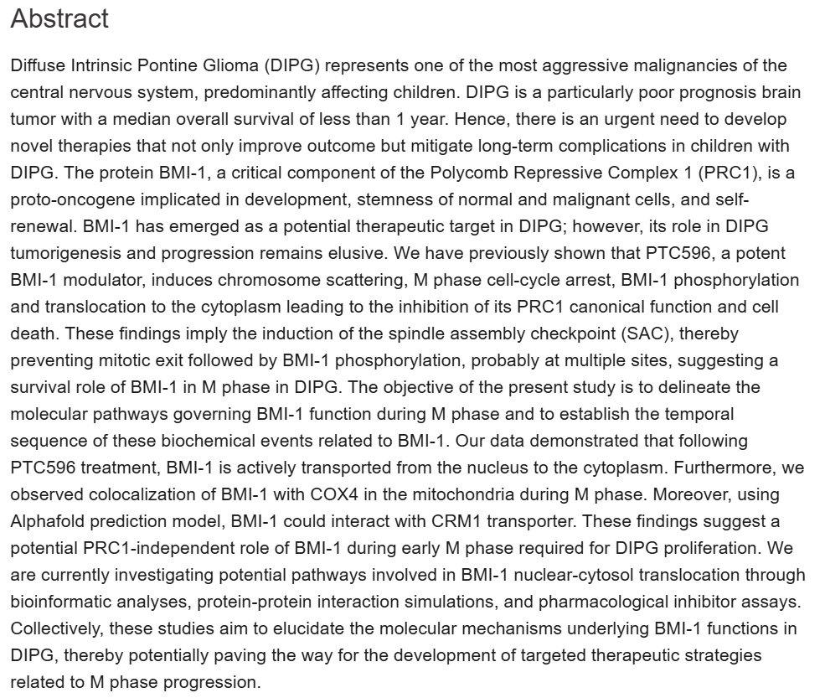
Current Stage
Apply patent (international)
Pharmaceutical company apply for collaboration and authorization of the technology. Planning to enter pre-clinical trial.
Currently doing research , for potential therapy target of diffuse intrinsic pontine glioma (DIPG) at Center for Childhood Cancer, Nationwide Children’s Hospital, USA.

Slide 24
Future scope
Find the
therapeutic target
Development of
therapy method
Functional and
safety issues
Collaboration
and commercialization
Find why, develop cure.

Slide 25
Thank you for your attention!
For more our studies:
Acknowledgement:
Department of Neurosurgery, Chang Gung Memorial Hospital, Linkou for in vivo animal model experiments support
Lab of
Nano-Biomaterials
Applications
Nationwide Children’s Hospital
Drissi Lab

Slide 26
Supporting info
Dicer processing assay

Slide 27
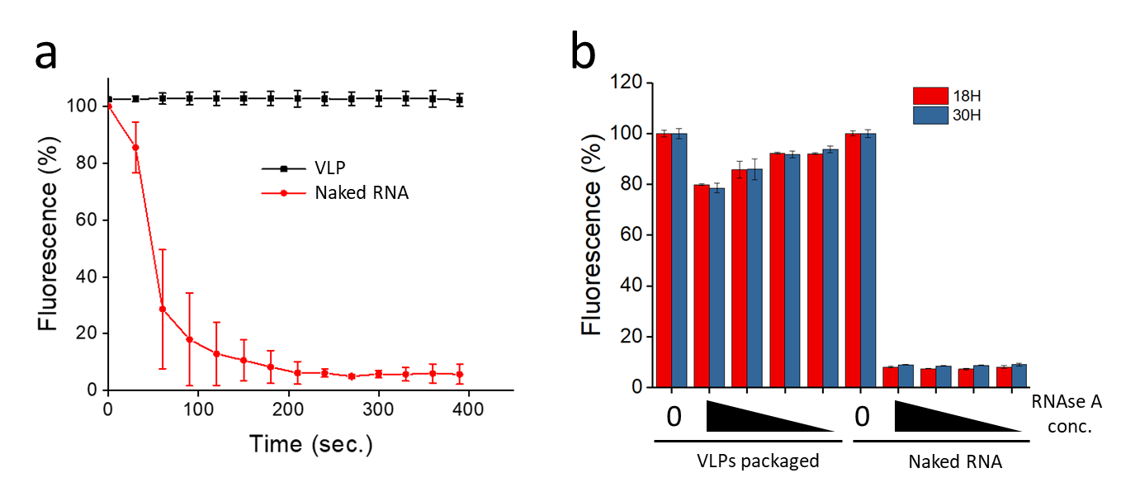
Supporting info
Stability assay

