Slide 1
臺大醫院 影像醫學部
王郁棻 醫師
Notes:
彭信逢老師指導的論文 關於Primary intracranial germ cell tumor 可否藉由一些影像的特徵來分辨germ cell tumor 的subgroup 以及判斷它的prognosis

Slide 2
Purpose of our study
To identify the image feature that can help to differentiate germinoma and NGGCTs (even between subgroups)
To D/D germinoma from NGGCTs on MRI
Diagnostic value varies in prior literatures
intra-tumoral cysts
hemorrhage
calcification
apparent diffusion coefficient (ADC) values
To identify imaging features can help in predicting the prognosis at the time of the initial image diagnosis
Notes:
*哪些影像特徵可以幫助分辨germinoma 跟NGGCT 甚至是NGGCT裡的subgroup
*在病人初次診斷的影像裡哪些image feature是跟prognosis 有關的

Slide 3
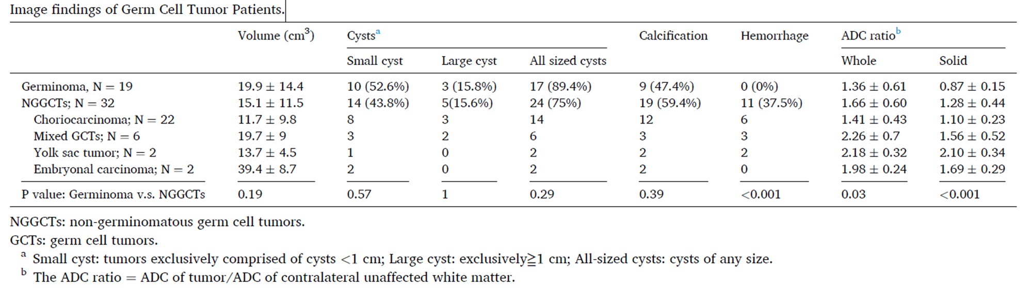
Our study- selection criteria
Retrospective study
2006.01 ~ 2023.03
Have both pre-treatment MRI and surgical biopsy at our hospital
From the hospital’s electronic medical records:
age, sex, tumor marker levels, and pathology reports
Notes:
收集了2006.01-2023.3 在臺大醫院接受腫瘤切片並有合適mri 影像序列可以分析的病患

Slide 4
Survival
Germinoma:
In the cohort of 19 patients with germinoma
without any recorded deaths
15 individuals had completed follow-up of over 5 years
4 patients are yet to complete 5 years of follow-up.
NGGCTs:
comprised 32 patients
28 patients were still alive,
17 of them having survived for more than 5 years.
4 death
In 2nd month, 2nd year, 4th year, and 4th year of follow-up, respectively.
The first three patients had concomitant tumor bleeding at the time of diagnosis.
5-year survival rate (P=0.12), overall survival rate (P=0.28)

Slide 5
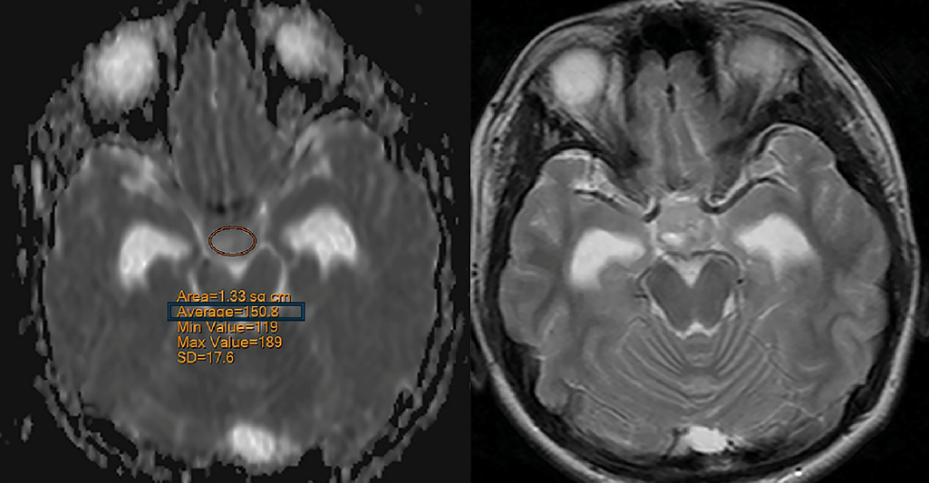
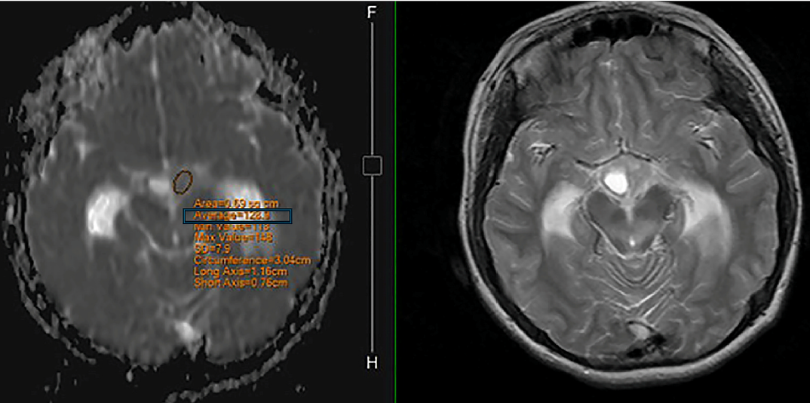
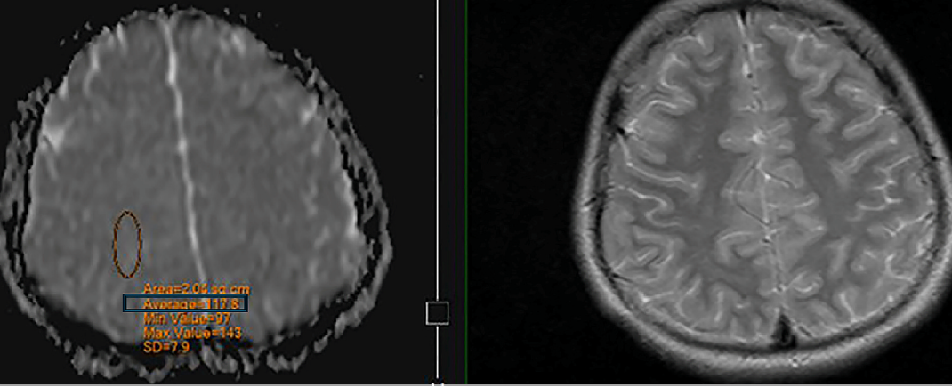
Our study- MRI measurement
ADC ratio: target ADC/ contralateral white matter ADC
Target:
whole tumor
solid component
Notes:
在mri 的adc map 上我們量測腫瘤的adc 數值 以及對側正常腦部白質的adc value, 相除成為adc ratio
* adc ration 有計算兩個地方, 一個是一整塊tumor 的 以及只有實心部分的

Slide 6
Conclusion -Hemorrhage
higher incidence of hemorrhagic events in NGGCTs compared to germinoma (P<0.001) - in consistent with prior study
Tumors containing choriocarcinoma or yolk sac tumor components are more prone to hemorrhage (P=0.003). -No prior study
choriocarcinomas and yolk sac tumors are prone to bleeding due to their abundant or fragile blood supply and tendency to erode blood vessels

Slide 7
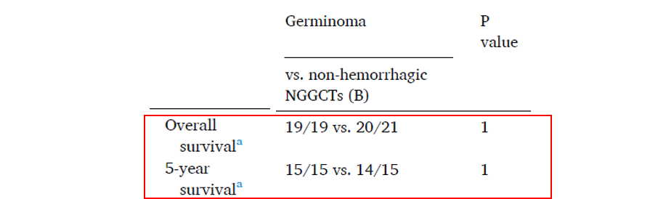
Conclusion -Survival
Patients with hemorrhage had lower overall (P=0.03) and 5-year survival rates (P=0.01) . -in consistent with prior study
Hemorrhage was the only factor that affected survival in this study.

Slide 8
Conclusion –ADC value
ADC ratios can help in distinguishing between germinomas and NGGCTs
in consistent with prior study
lower ADC ratios in germinomas than NGGCTs, in both the overall tumors (P = 0.03) and only the solid portion (P < 0.001).
related to lymphocyte infiltration resulting in high cellularity in germinomas, which in turn results in low ADC
Both the ADC ratio of the whole tumor and only the solid part were significantly lower in choriocarcinomas than in mixed GCTs
No prior study.
choriocarcinomas have significantly lower ADC ratios than mixed GCTs, both in the overall tumor (P = 0.01) and only in their solid parts (P = 0.02).
Patient number too small for embryonal carcinoma/Yolk sac tumor

Slide 9
Thank you!
Future evaluations would benefit from a larger patient cohort.

