Slide 1
2025年”伴汝慢飛”共融分享會與 科學論壇
馬偕兒童醫院 兒童神經科
黃佳雲醫師

Slide 2
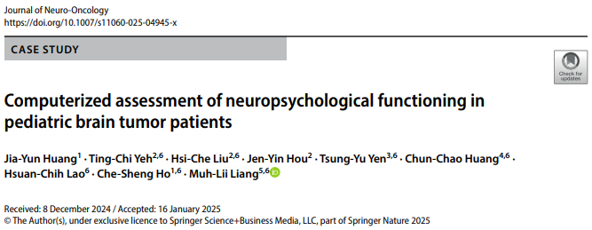

Slide 3
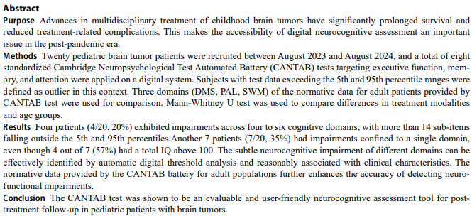

Slide 4
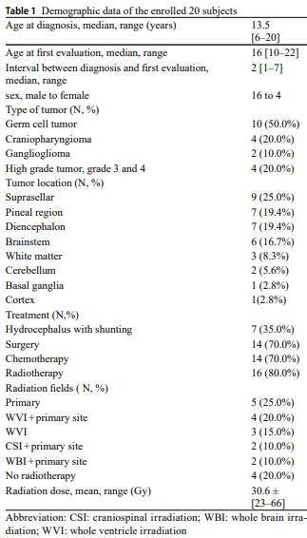
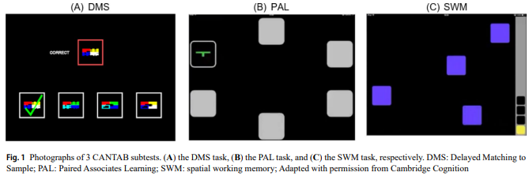

Slide 5
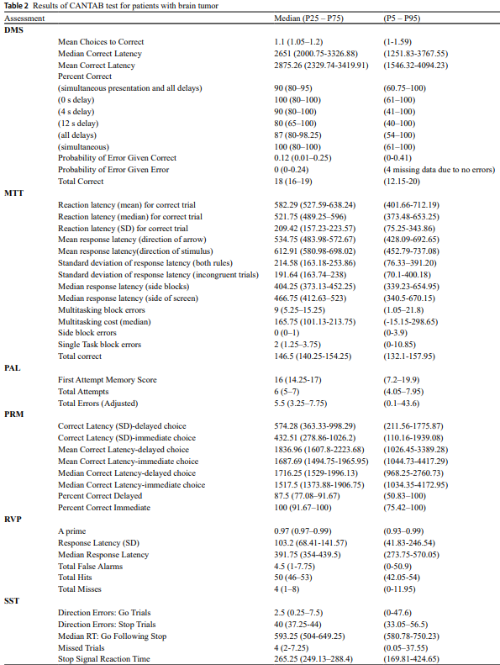
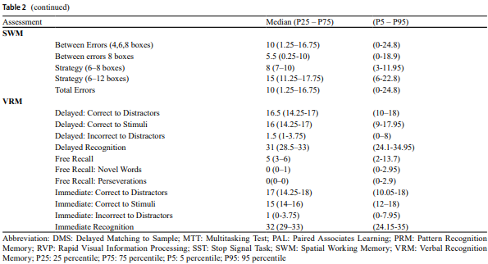

Slide 6
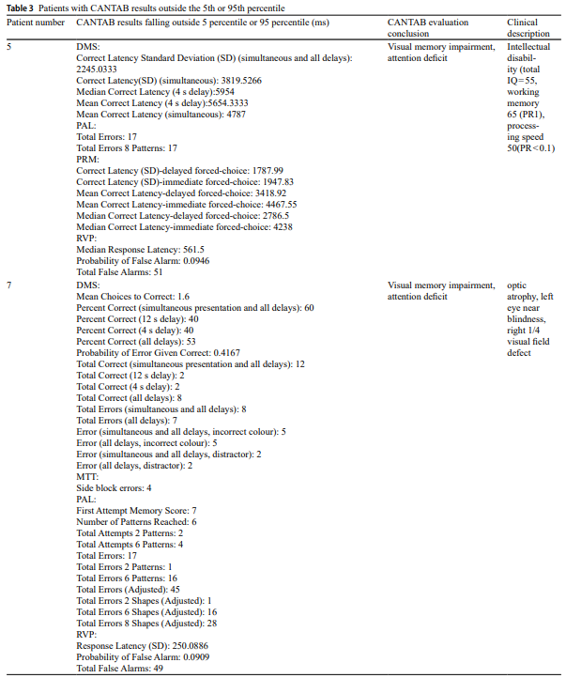
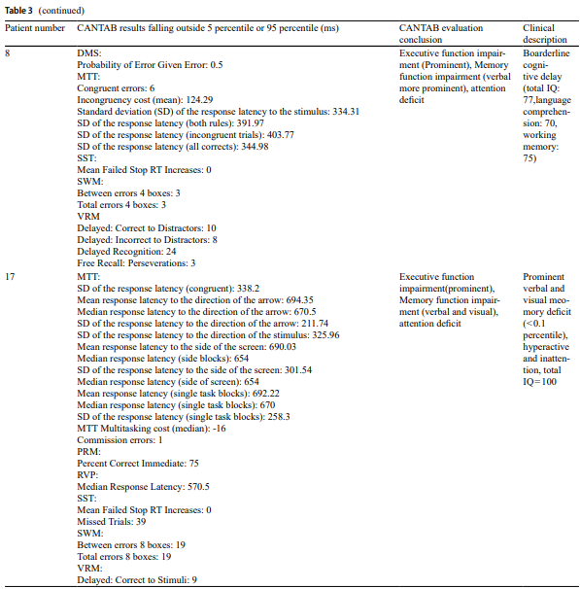

Slide 7
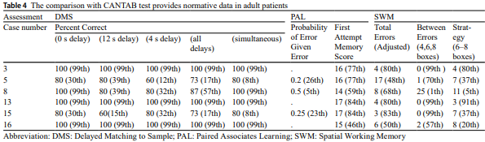

Slide 8
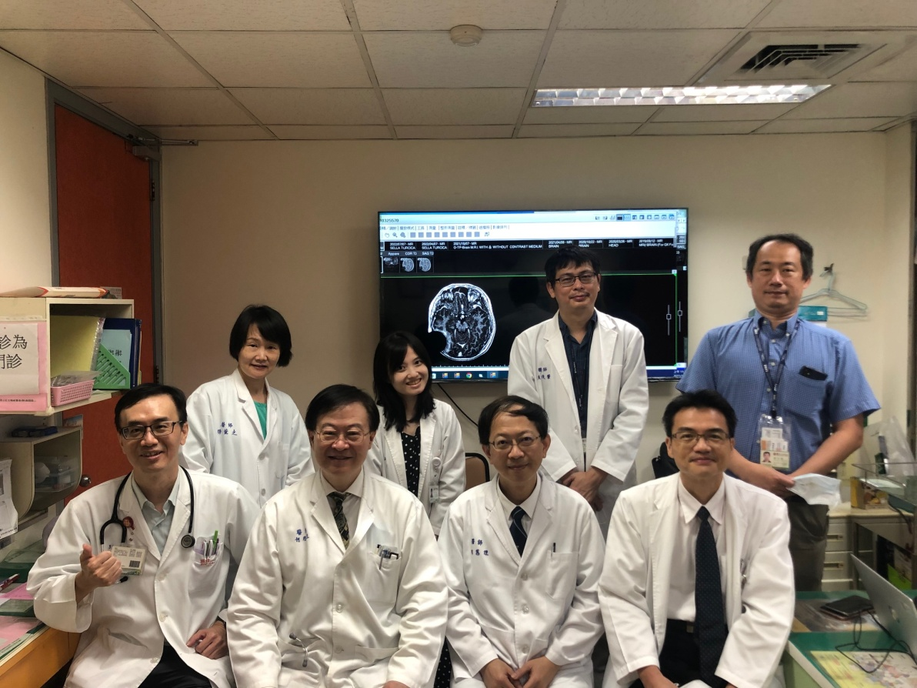

THANK YOU FOR ATTENTION !
In conclusion, this study represents our experience of utilizing the CANTAB computerized assessments to evaluate attention, memory, and executive functioning in pediatric brain tumor survivors. With high acceptance rates and valid clinical data, the CANTAB test proves to be an evaluable and highly accessible neurocognitive assessment tool for post-treatment follow-up in this population.

