Slide 1


Reduced cerebellar rhythm by climbing fiber denervation is linked to motor rhythm deficits in mice and ataxia severity in patients
Speaker : Ke-Chu Fang(方科筑)
Advisor : Ming-Kai Pan, MD. PhD.(潘明楷 教授)

Slide 2

Involuntary movements
Loss of motor precision and rhythm
Unmet medical need
U.S. FDA accelerated tracks

Slide 3

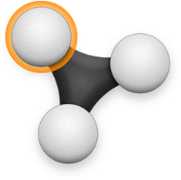
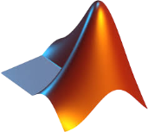
Importance
Climbing fiber dependent cerebellar rhythm loss occurs across different types of cerebellar ataxia.
This paper presents a potential therapy for ataxic mice.
A major breakthrough linking digital technology and medicine.
Optitrack
Data Analyzed by MATLAB

Slide 4
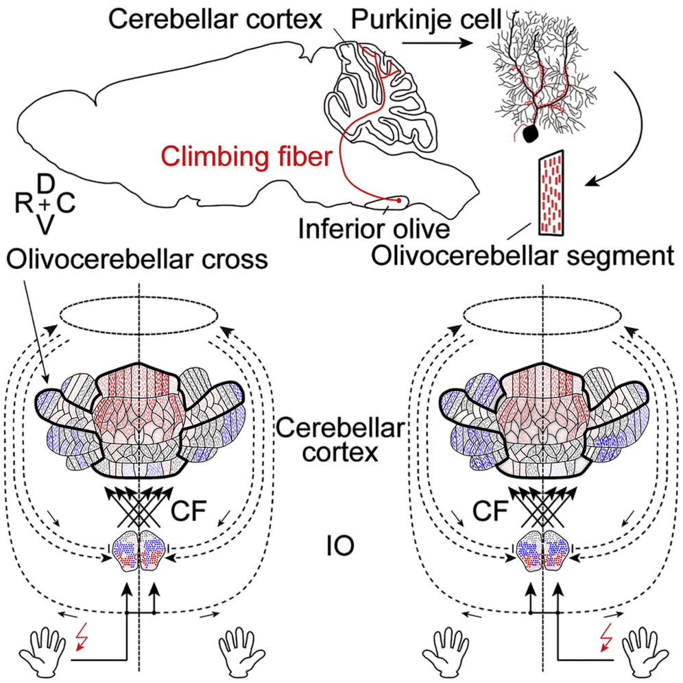
Cell Rep. 2021 Nov 9;37(6):109966.

Slide 5
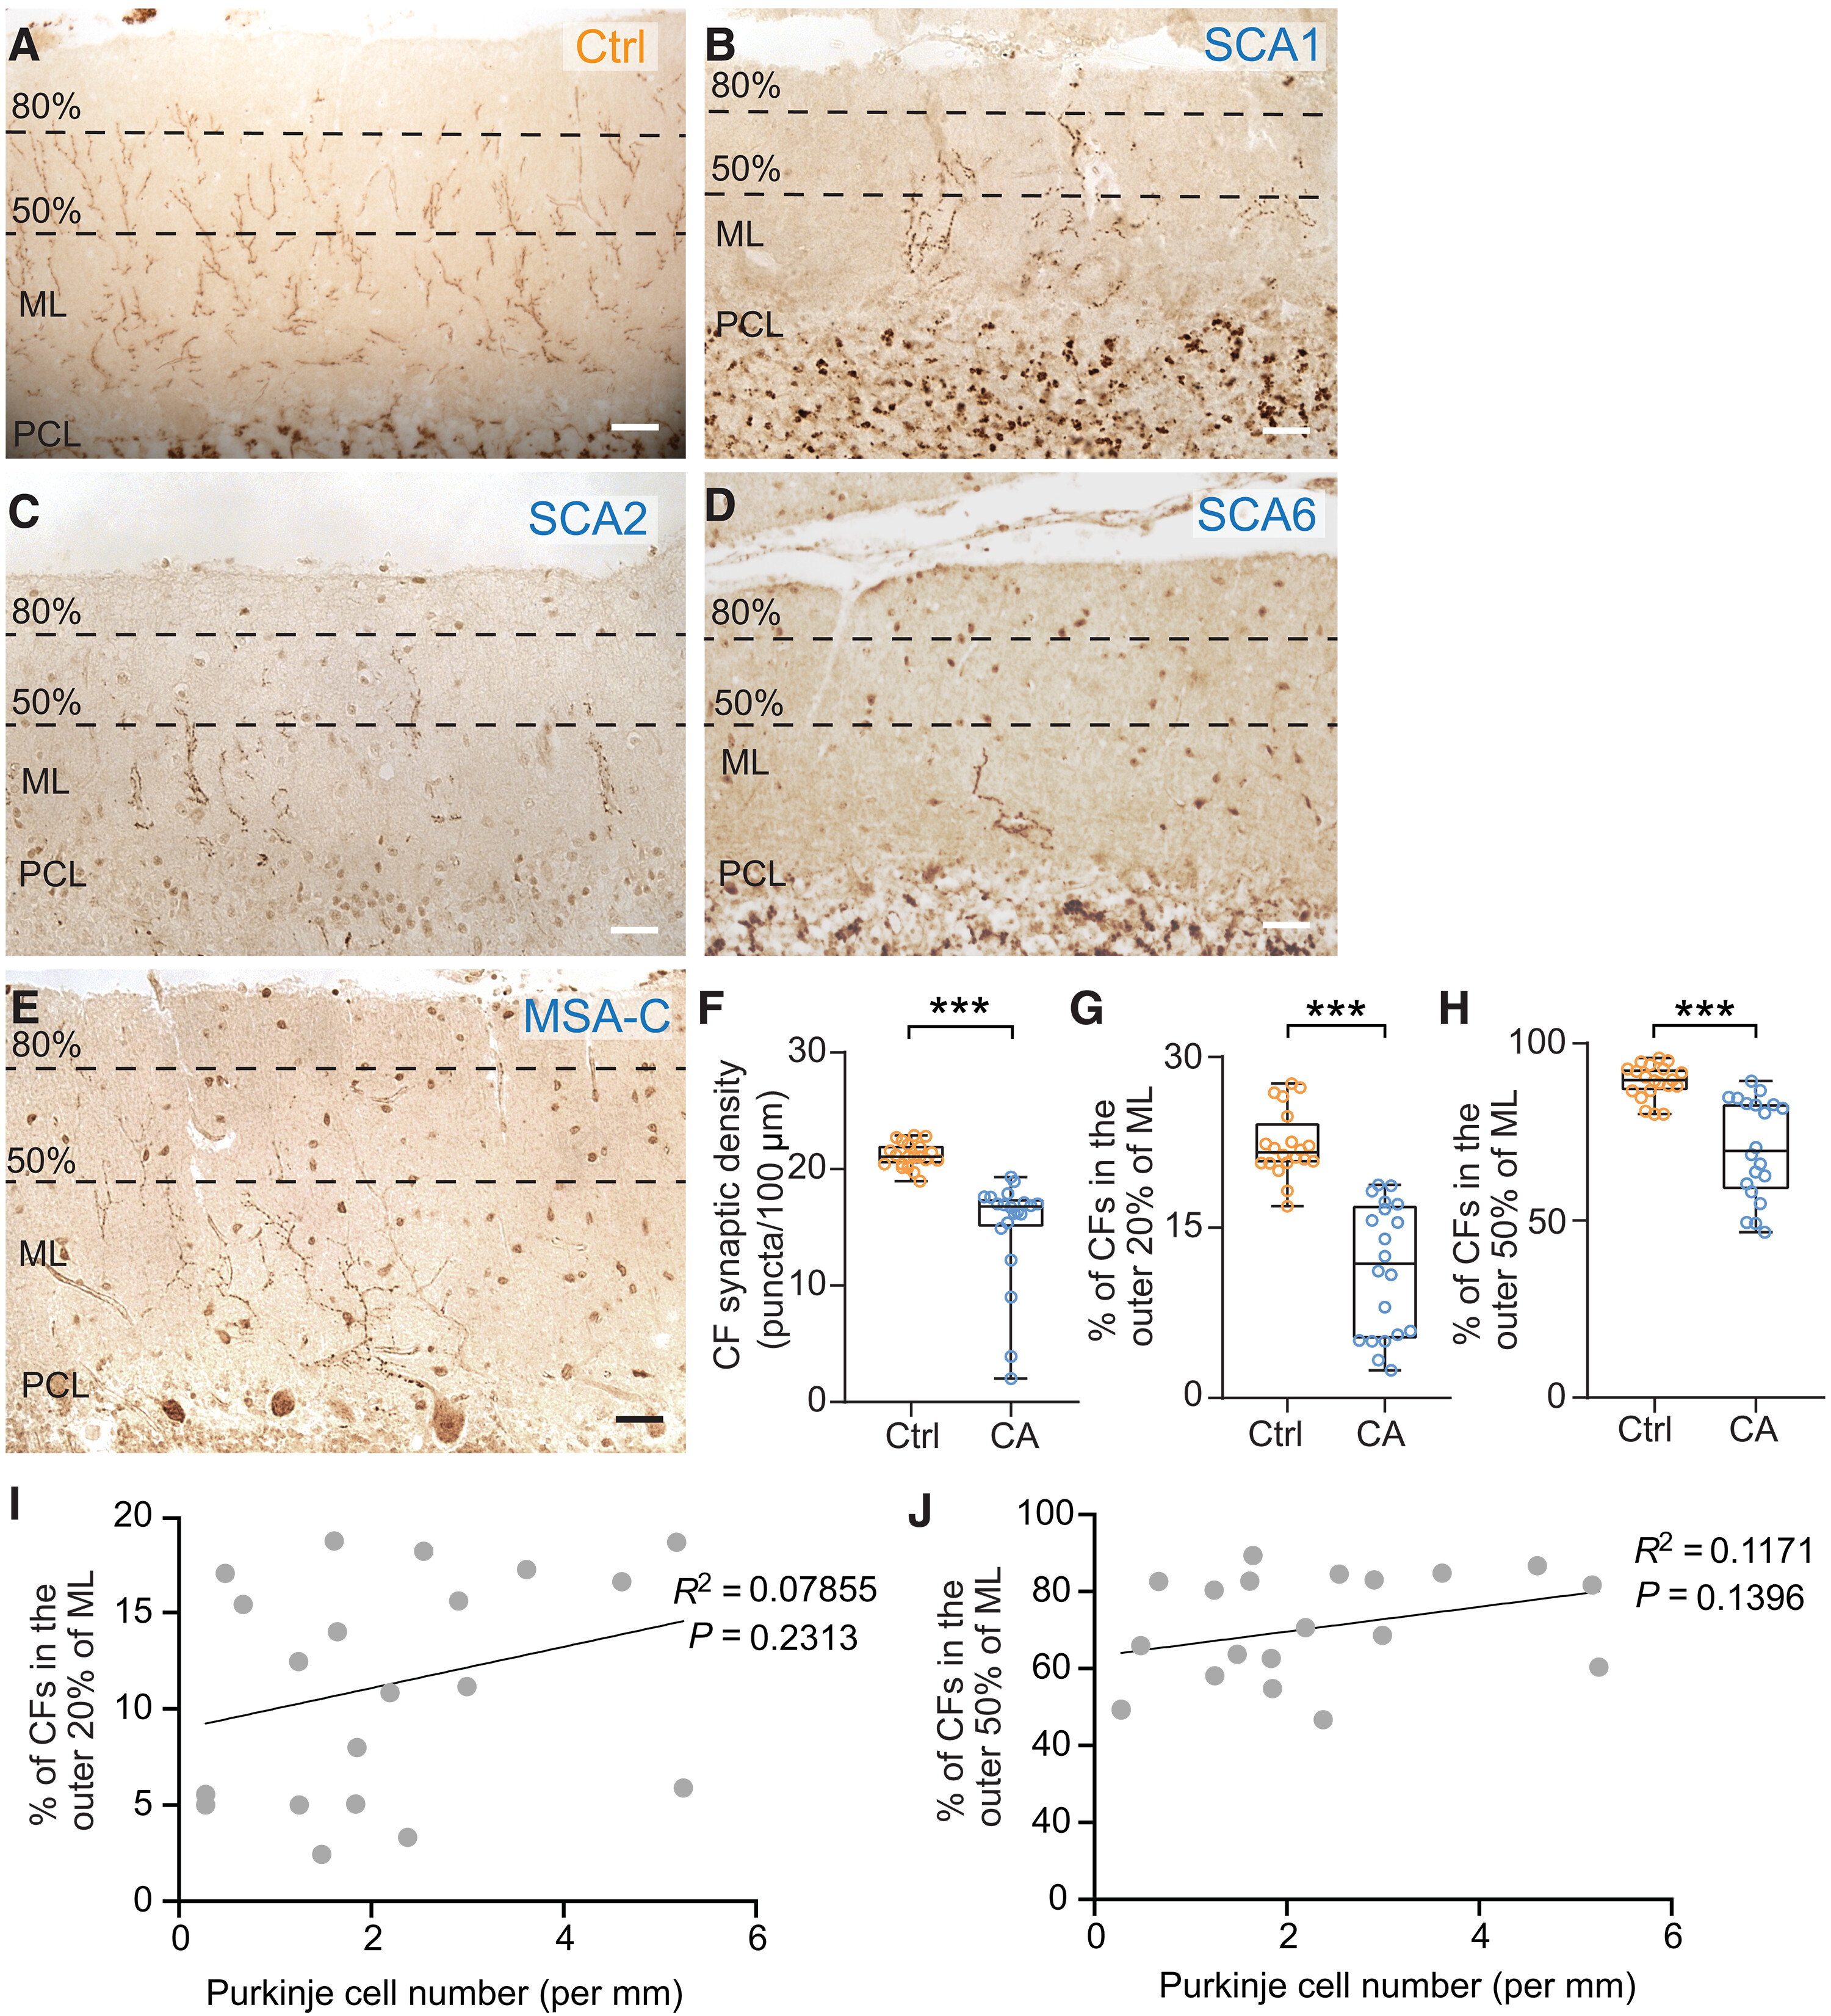
Pathological features in the cerebella of patients
Control
MSA-C ：multiple system atrophy Cerebellar Type
SCA：Spinocerebellar Ataxia

Slide 6
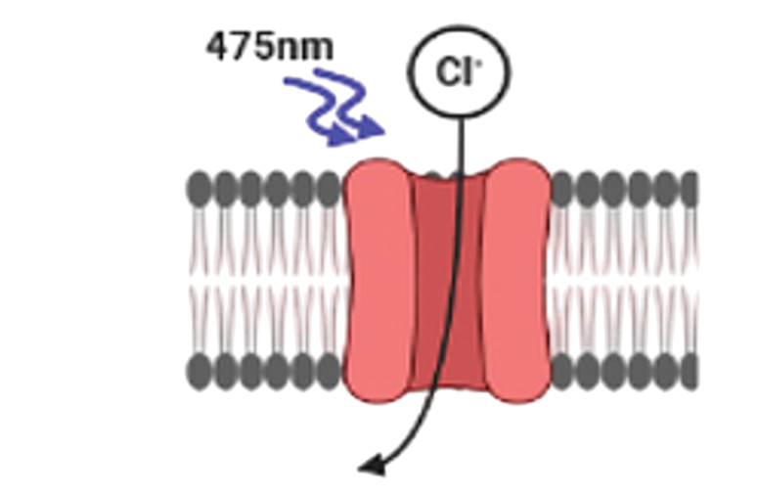
Climbing fiber inhibition reduces cerebellar and motor activity
Light on
Cl⁻
Neuron activity
Climbing fiber activity

Slide 7
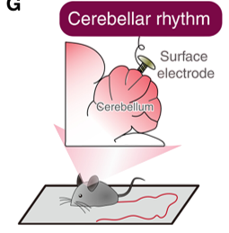
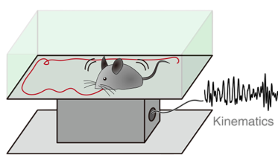
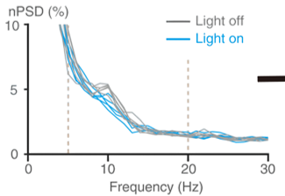
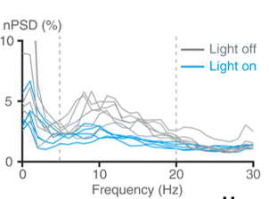

Climbing fiber inhibition reduces cerebellar and motor activity
Light on
Cerebellar rhythm
Motor rhythm
Surface
electrode
Cl⁻
Kinematics
nPSD(%)
Light off
nPSD(%)
10
Light on
10
Light off
Neuron activity
Light on
5
5
Climbing fiber activity
0
0
0
10
20
30
0
10
20
30
0
Frequency
Frequency
nPSD：normalized Power Spectral Density
Data Analyzed by MATLAB

Slide 8
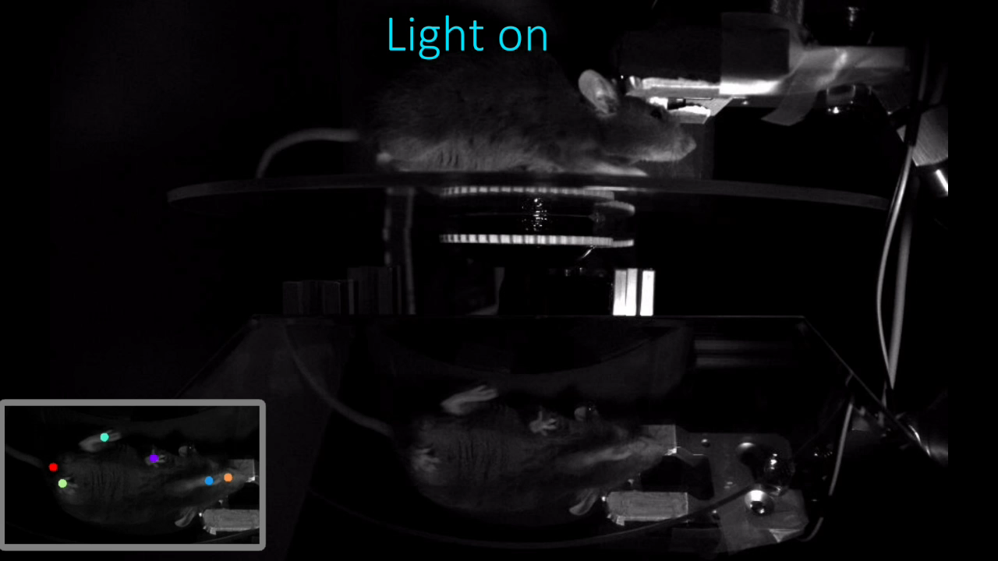
Silencing of climbing fiber activity results in motor deficits in mice
Data Analyzed by MATLAB

Slide 9
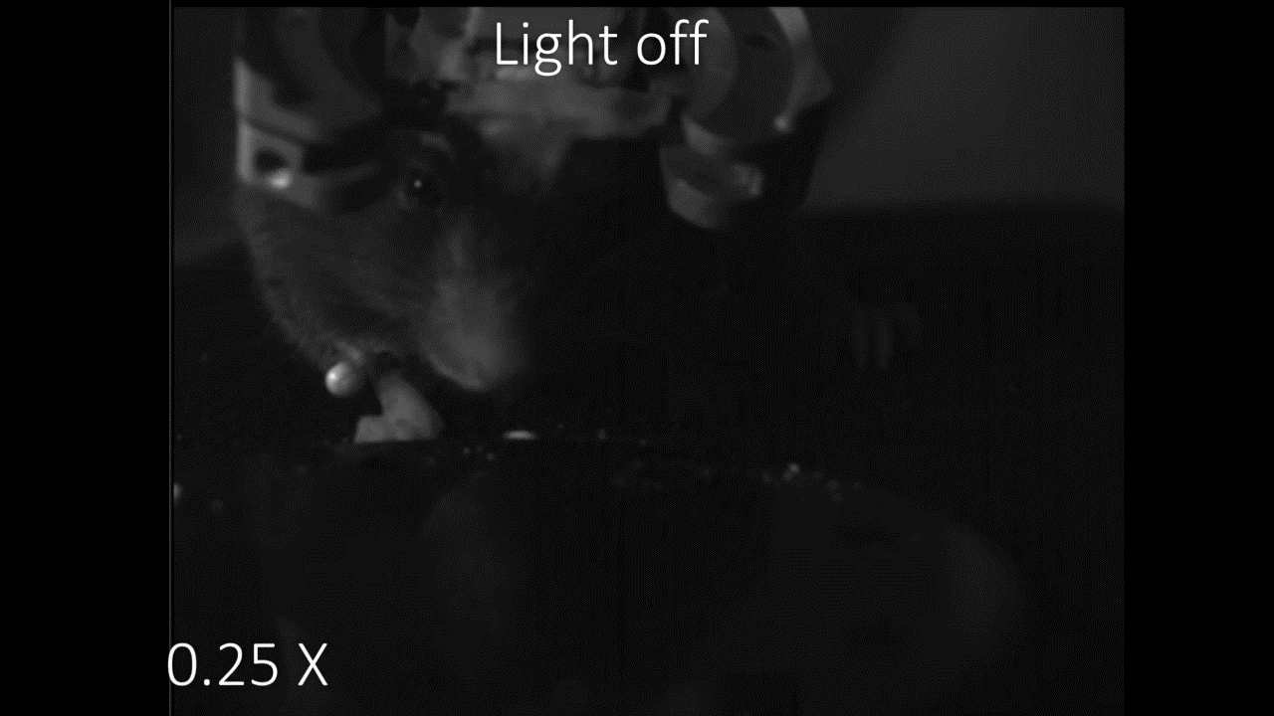

Silencing of climbing fiber activity disrupts motor precision in mice
Data Analyzed by MATLAB
Optitrack

Slide 10
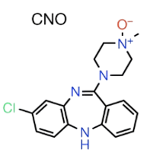
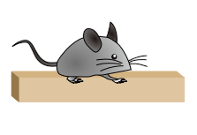
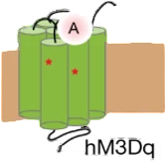
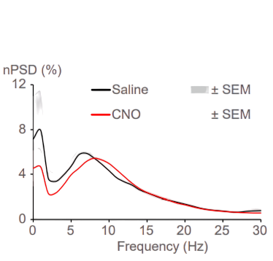
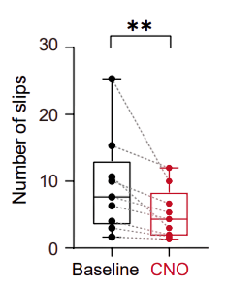
Activation of climbing fibers improves motor function in ataxic mice
CNO
Motor rhythm
Motor behavior
hM3D
Gq protein
nPSD(%)
30
Number of slips
12
Saline
Excites Neuron
CNO
20
Climbing fiber activity
8
4
10
0
0
0
10
20
30
Baseline
CNO
Frequency
CNO：clozapine N-oxide

Slide 11
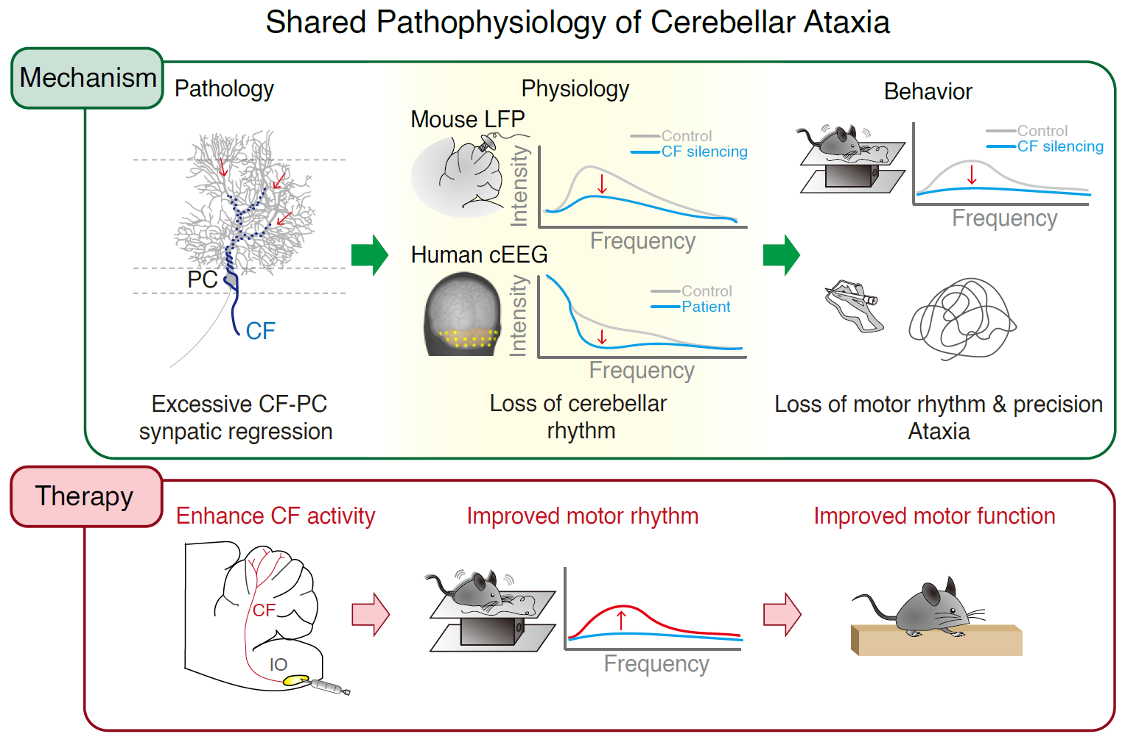

Slide 12


Slide 13
Thank you for your attention

Slide 14

Featured article in Science Translational Medicine

Slide 15
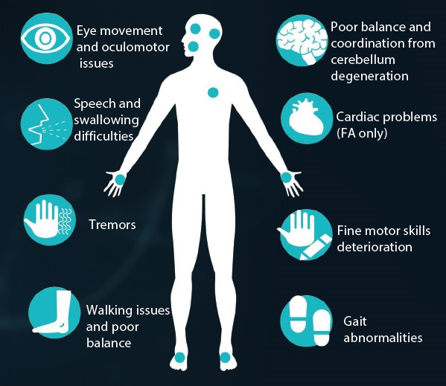
Introduction
The worldwide prevalence of spinocerebellar ataxias is 3 to 5.6 cases per 100,000 individuals.
StatPearls Publishing; 2025 Jan
Currently, there are no FDA-approved treatments and no cure for SCA.
Biohaven
Ataxia Canada
The FDA has also granted the program Fast Track designation in the U.S. for SCA.
SCA：Spinocerebellar Ataxia

Slide 16
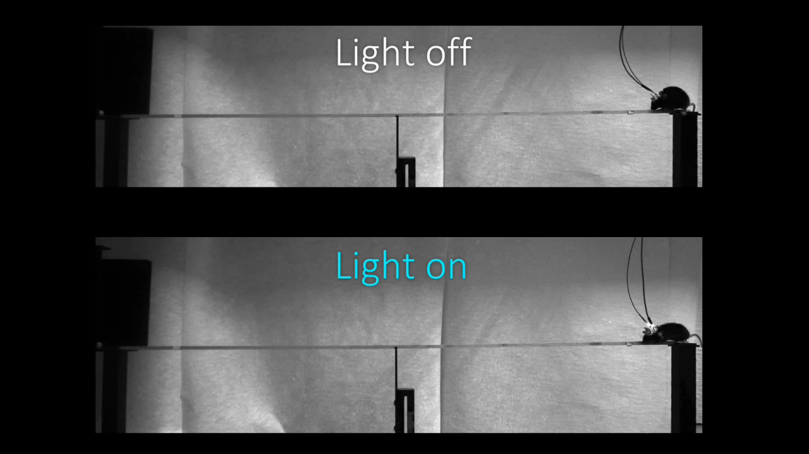
Silencing of climbing fiber activity results in motor deficits in mice

Slide 17
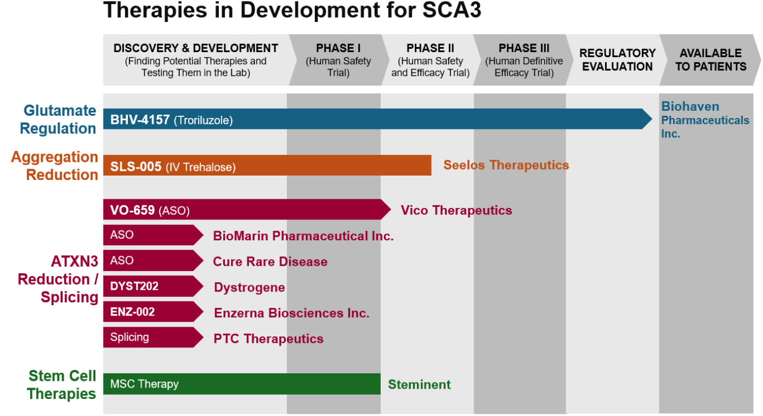
National Ataxia Foundation

Slide 18
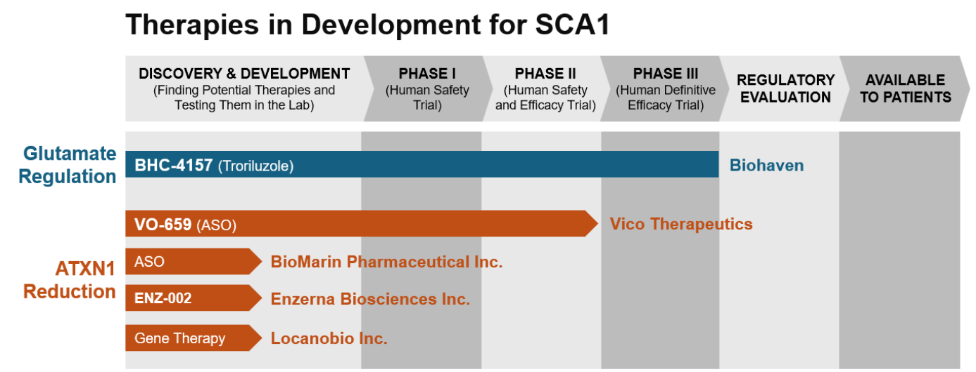
National Ataxia Foundation

