Slide 1
Machine Learning Quantitative Analysis of FDG PET Images of Medial Temporal Lobe Epilepsy Patients
施彥丞
臺北榮民總醫院 神經醫學中心 癲癇科
國立陽明交通大學 神經科學研究所
2025.10.25

Slide 2
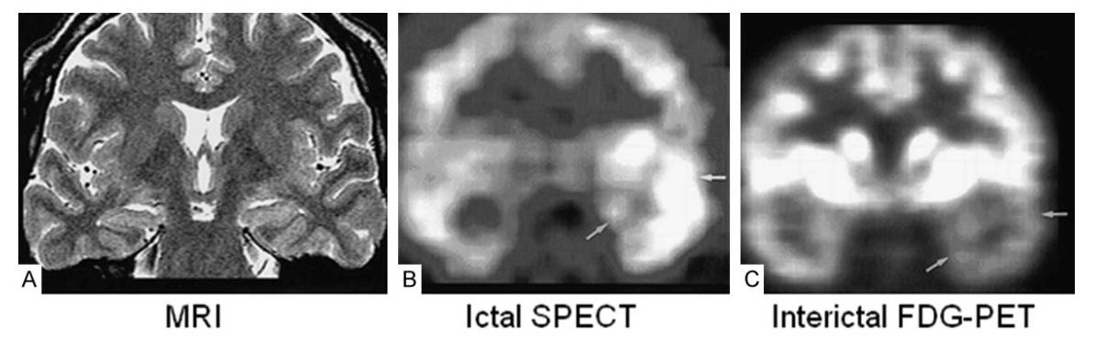
Positron Emission Tomography (PET) in Epilepsy Surgery
18F-FDG PET was used for epilepsy surgery assessments for a long time.
Regional cerebral hypometabolism:
Neuronal loss, diaschisis, reduction in synaptic activity
Represent both the focus and projection areas of seizure activity.
FDG-PET is helpful in lateralizing the side of epileptogenesis.
Kumar A, et al. J Nucl Med 2013;5410:1775–1781
Rathore C, et al. Epilepsy Res. 2014;108:1306-1314.
Theodore WH, et al. Ann Neurol. 1992;32:789-794
Willmann O, et al. Seizure. 2007;16:509-520.

Slide 3
Clinical FDG-PET interpretation
Sensitivity of FDG-PET
Temporal lobe epilepsy : 84 ~ 90 %
Extra-temporal lobe epilepsy : 33 ~ 55 %
Interpreted by visual inspection
Inter-personal and intra-personal variability
The accuracy of overall intractable epilepsy: 85%
Patients with good outcome: 86%
Patients needs invasive studies: 58%
Medial temporal lobe epilepsy: 64%
Spencer SS. Epilepsia 1994; 35: S72-S89.
Won HJ, et al. AJNR Am J Neuroradiol. 1999;20:593-599. Peter J, et al. Nucl Med Commun. 2016;37:882-887

Slide 4
The disadvantage of PET
Visual assessment → Relatively unreliable
High inter-observer variability
High intra-observer variability
In patients with unilateral MTS
7.8%: normal metabolisms or hypermetabolisms
10-30%: bilateral hypometabolisms
Classic quantitative analysis (Absolute glucose metabolism)
Frequent blood sampling
Talanow R, et al. Clinical Nuclear Medicine. 2009;34:670-674.
Kim MA, et al. Seizure. 2006;15:56-63. Tepmongkol S, et al. Epilepsy and Behavior. 2013;29:386-389.

Slide 5
Quantitative PET
Quantitative measures in PET
Higher sensitivity and specificity
SPM method for PET in temporal lobe epilepsy
Accuracy of the epileptogenic side: 76%
Sensitivity 89%; Specificity 91%
Compared Visual assessment and
Visual assessment: 7/11 (64%)
Global quantitative assessment: 10/11 (91%)
Intra-observer consistency : 92~95%
Peter J, et al. Nucl Med Commun. 2016;37:882-887.
Van Bogaert P, et al. NeuroImage. 2000;12:129-138.
Mayoral M, et al. Epilepsia. 2016;57:1236-1244
Kim YK, et al. J Nucl Med. 2003;44:1006-1012.
J. Peter et al. Nucl Med Commun. 2016 Aug;37(8):882-7.

Slide 6
Segmentation
Manual segmentation is the gold standard.
Repetitive tasks
Time consuming
Experience of the physicians
Automated segmentation
Various accuracy (0.68-0.94)
Manual segmentation vs Automatic segmentation
High correlation in hippocampus
Pearson’s correlation coefficients: 0.58–0.76
VBM8 vs FreeSurfer
Comparable performance
Carmichael OT, et al. Neuroimage. 2005;27:979-990.
Dill V, et al. Neuroinformatics. 2015;13:133-150.
Grimm O, et al. J Neurosci Methods. 2015;253:254-261.

Slide 7
AI-Assisted Quantitative Analysis

Slide 8
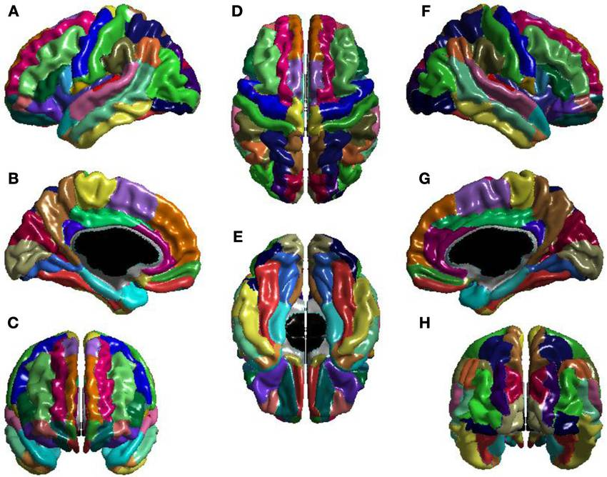
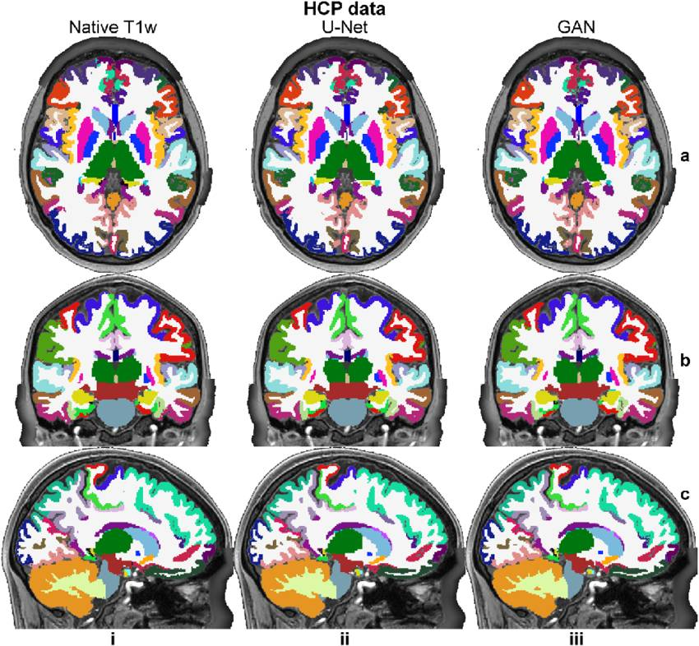
Parcellation methods
Automated anatomical labeling(AAL) atlas using DARTEL
aparc+aseg atlas from freeSurfer
Lewis JD, et al. Front Hum Neurosci. 2013 Dec 10;7:845.
Li Z, et al. Med Image Anal. 2023 May;86:102744.

Slide 9
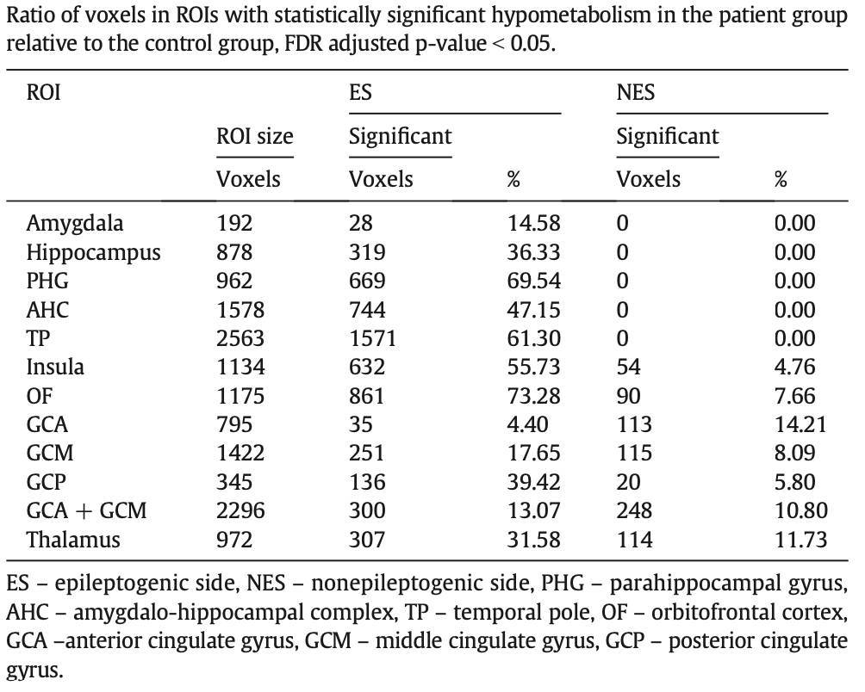
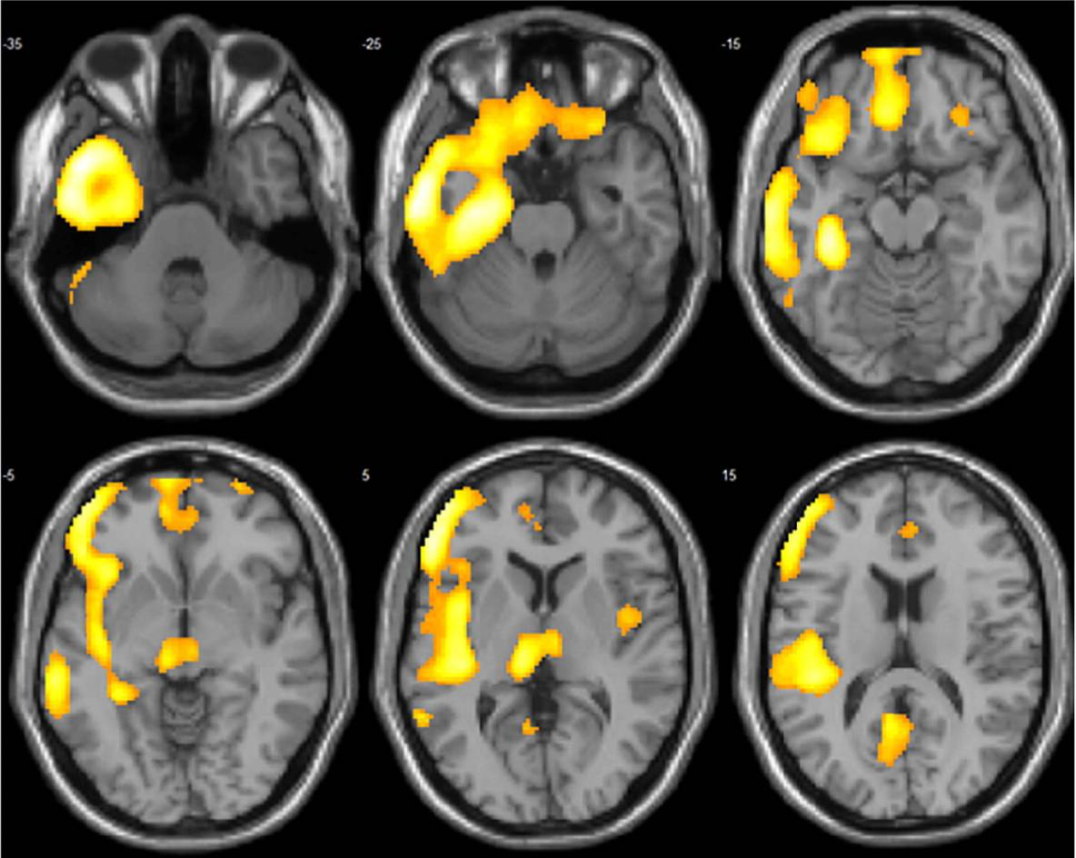
Determined the ROI
Medial temporal lobe epilepsy related region with glucose hypometabolisms
Kojan M, et al. Epilepsy Behav. 2018;79:46-52.

Slide 10
Subjects
93 patients enrolled for model training
Drug-resistant MTLE
Receiving anterior temporal lobectomy (ATL) or selective amygdalohippocampectomy (SAH).
2008/7 ~ 2019/6
Pathological diagnosis: mesial temporal sclerosis
11 patients enrolled for established model test
Stereotactic-EEG (sEEG) study
Received ATL or SAH beyond the period from July 2008 to June 2019
Post-surgical outcome
Engel classification I (86%) and II (14%)

Slide 11
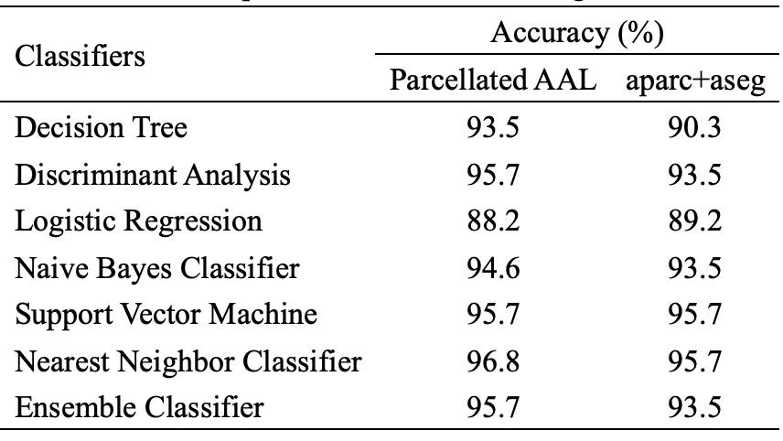
Results
2 clinical neurologists and
1 nuclear medicine physician
Hit rate of lateralization
75.3% in the training set
72.7% in the test set
V.S.
Model evaluation in the test set: 100.00%
23 patients failed lateralization by visual analysis
AAL atlas: 100%
aparc+aseg atlas: 82.6%

Slide 12
Conclusion
AI-assisted lateralization epileptogenic foci interpretation method has good results in the medial temporal lobe epilepsy
High accuracy : 96.0%
Readily available

Slide 13

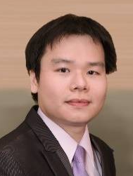
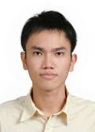




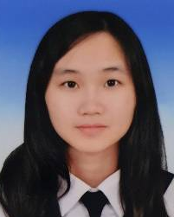
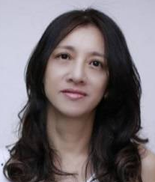
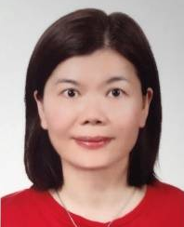
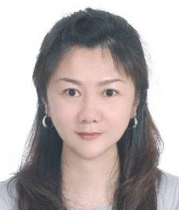
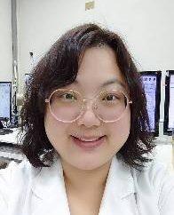
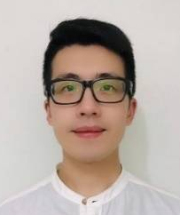
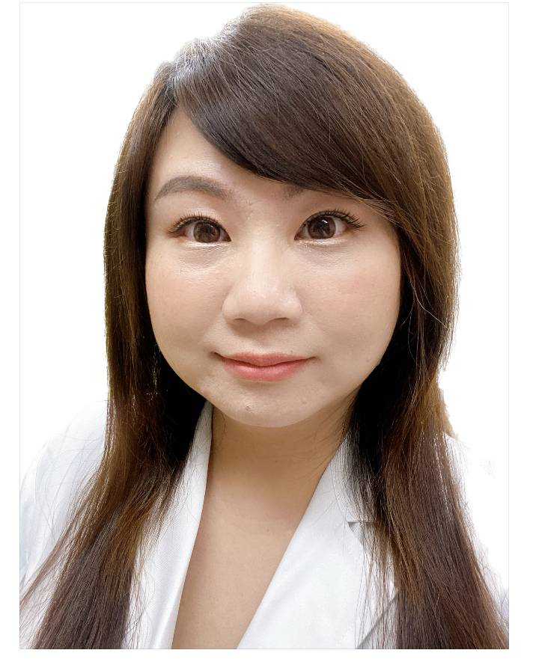
Thank you for your attention !
Acknowledgement
Yu Hsiang-Yu
Peng Syu-Jyun
Lee Tse-Hao
Lin Chun-Fu
Lee Cheng-Chia
Chou Chien-Chen
Lin Po-Tso
Chen Yi-Hsiu
Wang Hui-Tzu
Lu Chih-Wen
Chou Yi-Chun
Huang Jr-Lan
Kuo Yi-Feng
Lee Ma Ya-Hsin

