Slide 1



Tailoring the therapeutic potential of stem cell spheroid-derived decellularized ECM through post-decellularization BDNF incorporation to enhance brain repair
Speaker: Pei-Ching Yang
Advisor: Chieh-Cheng Huang, Ph.D
Date: Oct 25, 2025
Kao YC, Yang PC, Lin YP, Chen GH, Liu SW, Ho CH, Huang SC, Lee PY, Chen L, Huang CC.
Biomaterials, vol. 321, pp. 123332, 2025.
https://doi.org/10.1016/j.biomaterials.2025.123332

Slide 2
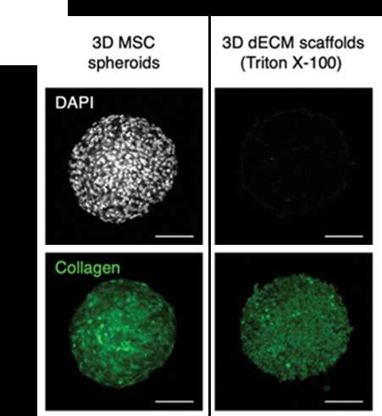
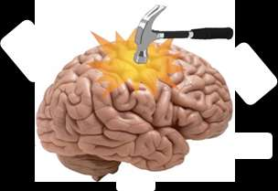
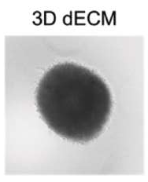
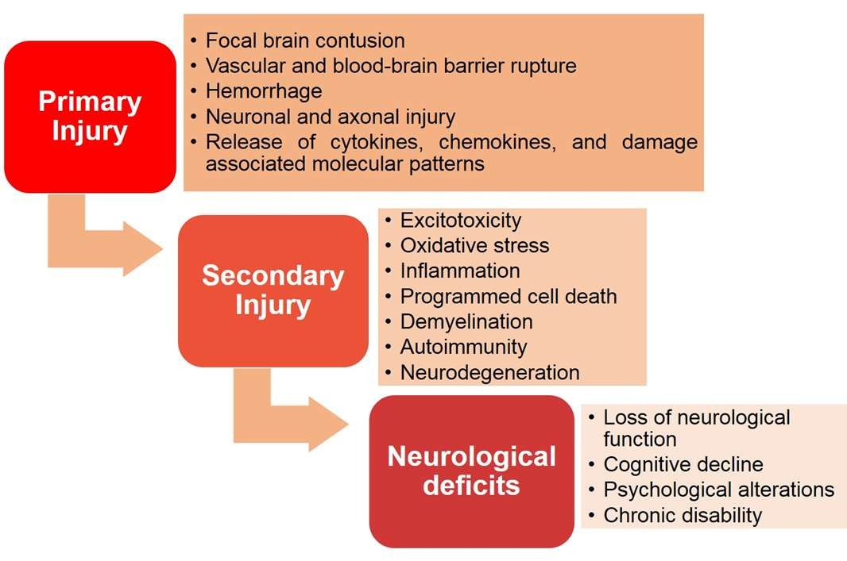
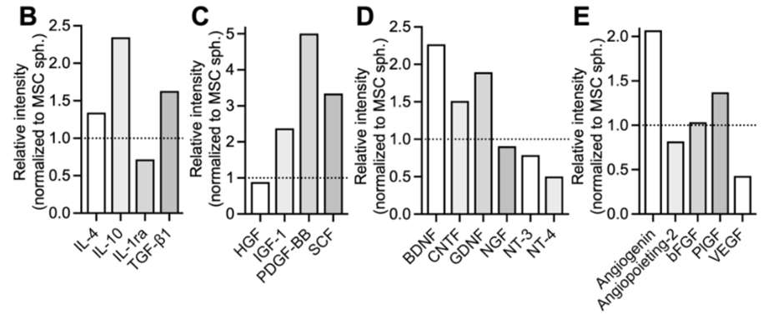
Introduction
Immunomodulation / anti-apoptosis / neurotrophin / proangiogenesis
Zhang, X., et al. (2022). Decellularized extracellular matrix scaffolds: Recent trends and emerging strategies in tissue engineering. Bioactive Materials, 10, 15-31.
Chen GH, et al. (2025). Implantation of MSC spheroid-derived 3D decellularized ECM enriched with the MSC secretome ameliorates traumatic brain injury and promotes brain repair.” Biomaterials, vol. 315, pp. 122941.
Jarrahi, A., et al. (2020). Revisiting Traumatic Brain Injury: From Molecular Mechanisms to Therapeutic Interventions. Biomedicines, 8(10), 389.

Slide 3
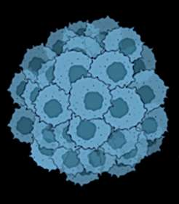
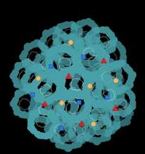
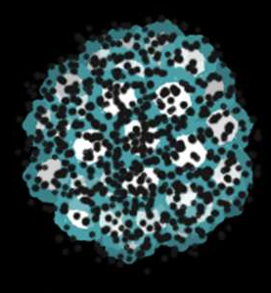
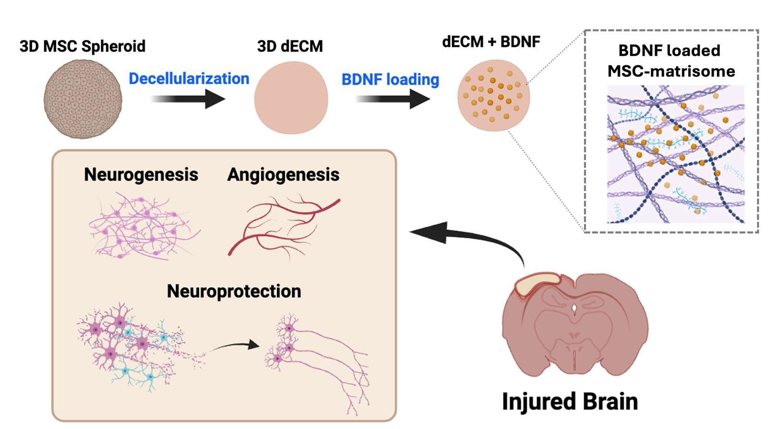
Abstract
3D MSC spheroid
3D dECM
BDNF-decorated 3D dECM
Stem cell
secretome
Decellularization
BDNF
decoration
1
2
3

Slide 4
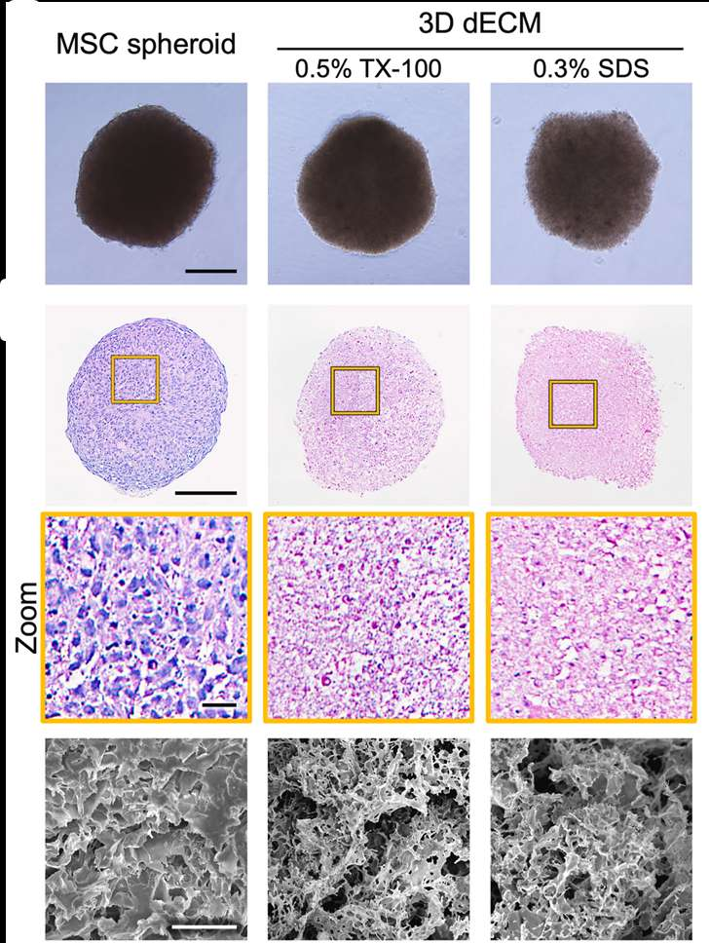
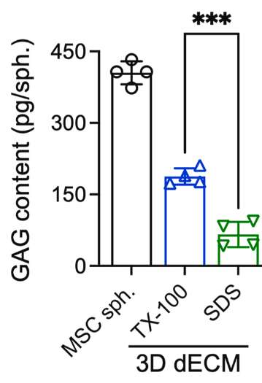
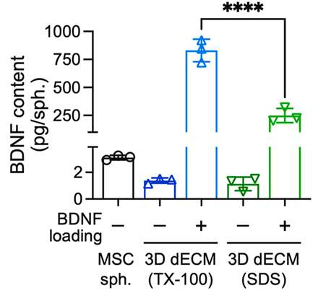
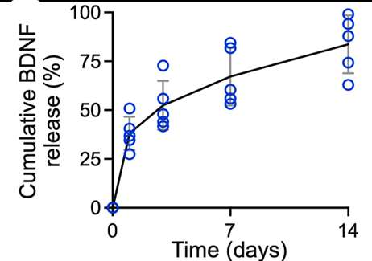
3D dECM-BDNF material preparation
Decellularized by TX-100 is better than SDS

Slide 5
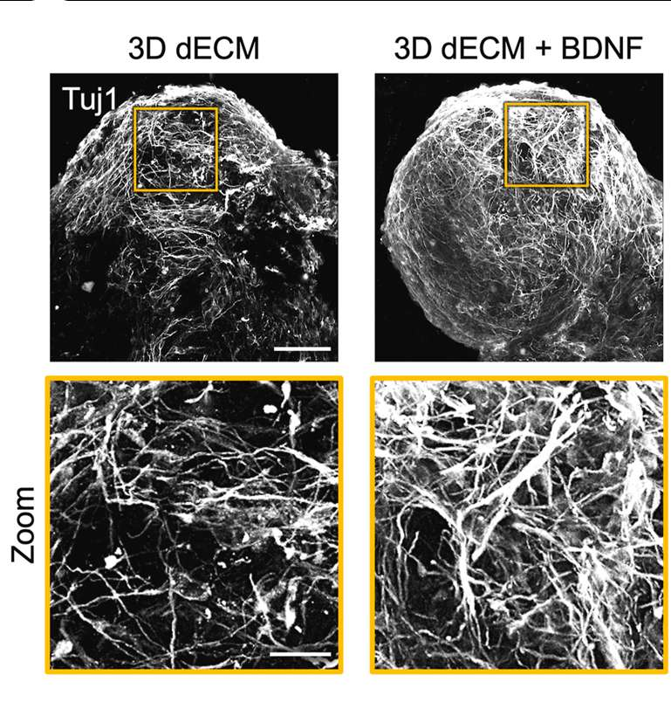
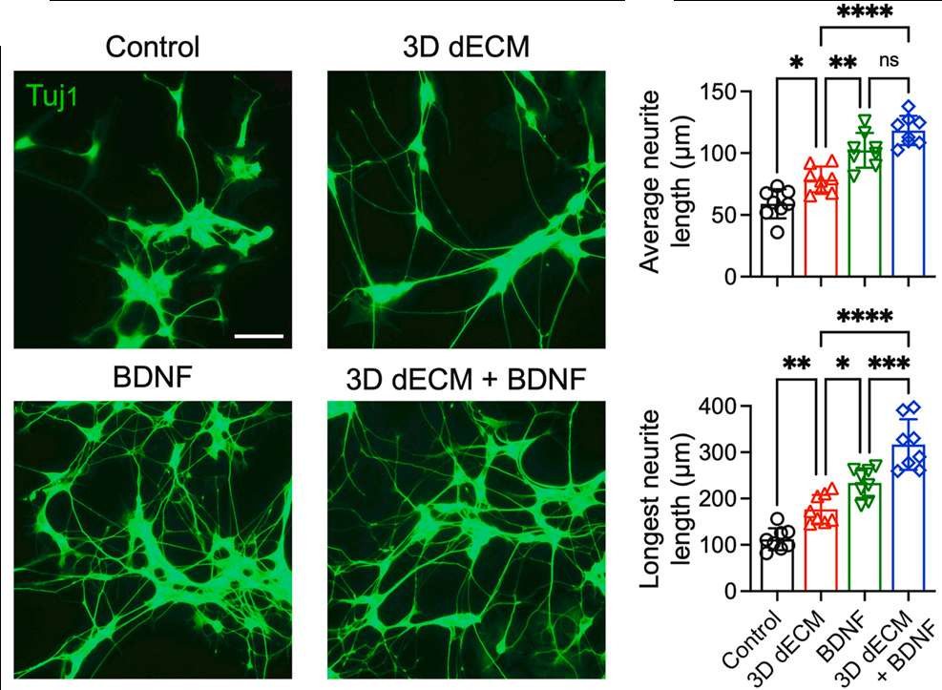
BDNF loading enhances the properties of 3D dECM
1
Neurogenesis
Releasing the inherent MSC secretome and loaded BDNF
Functionalized scaffold

Slide 6
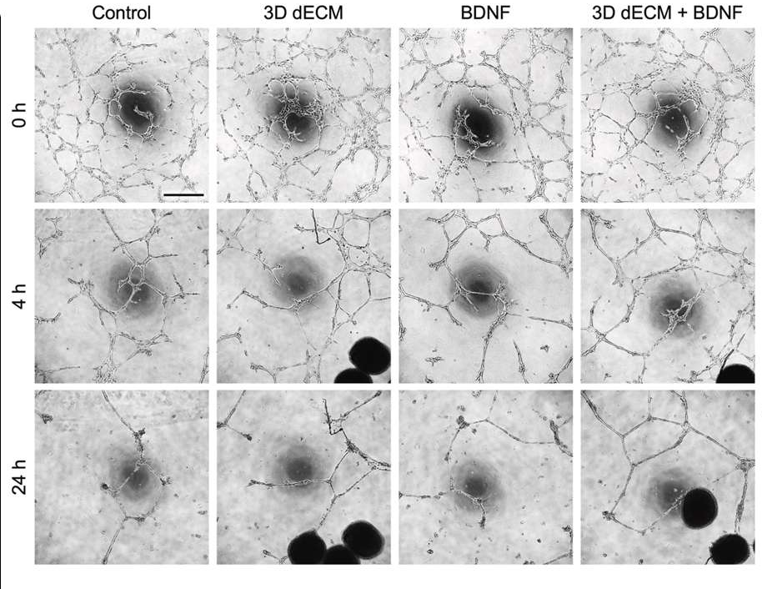
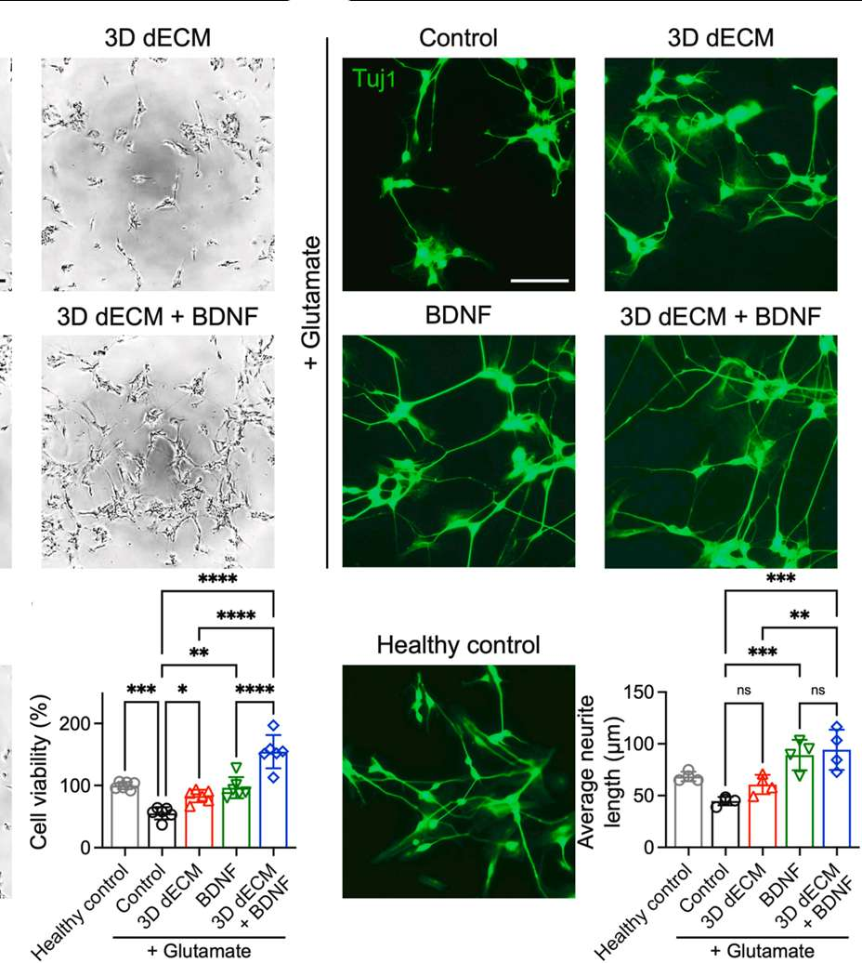
BDNF loading enhances the properties of 3D dECM
2
Angiogenesis
3
Neuroprotection

Slide 7
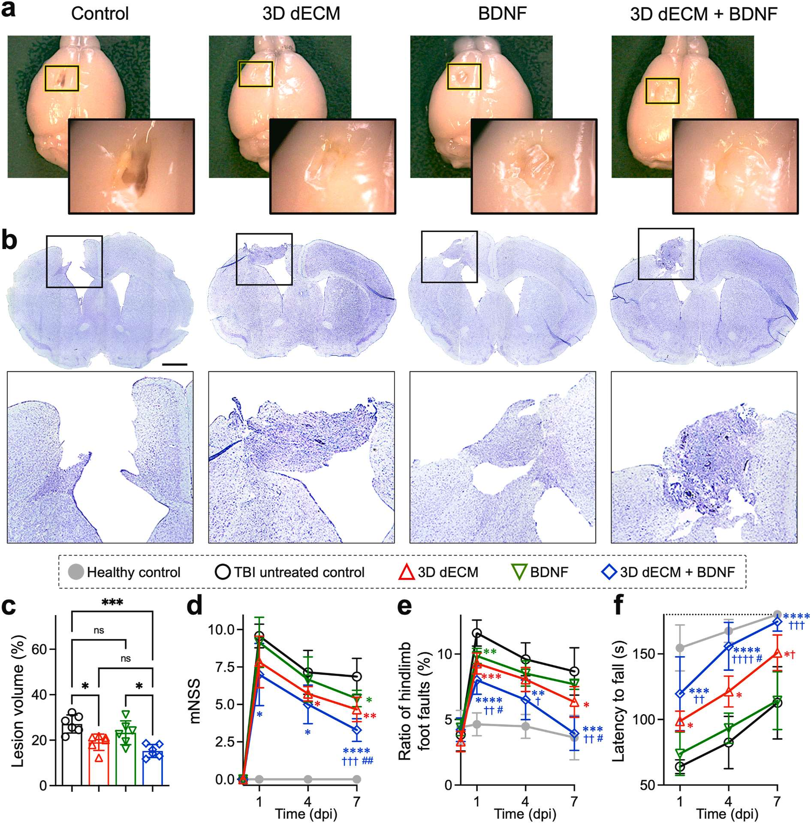
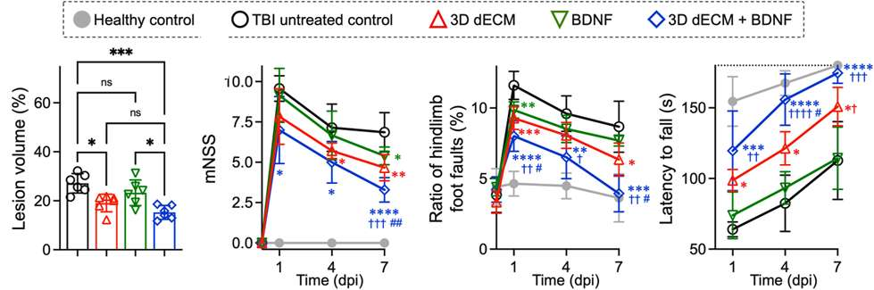
3D dECM+BDNF mitigating brain injury and improving motor function in TBI mice

Slide 8
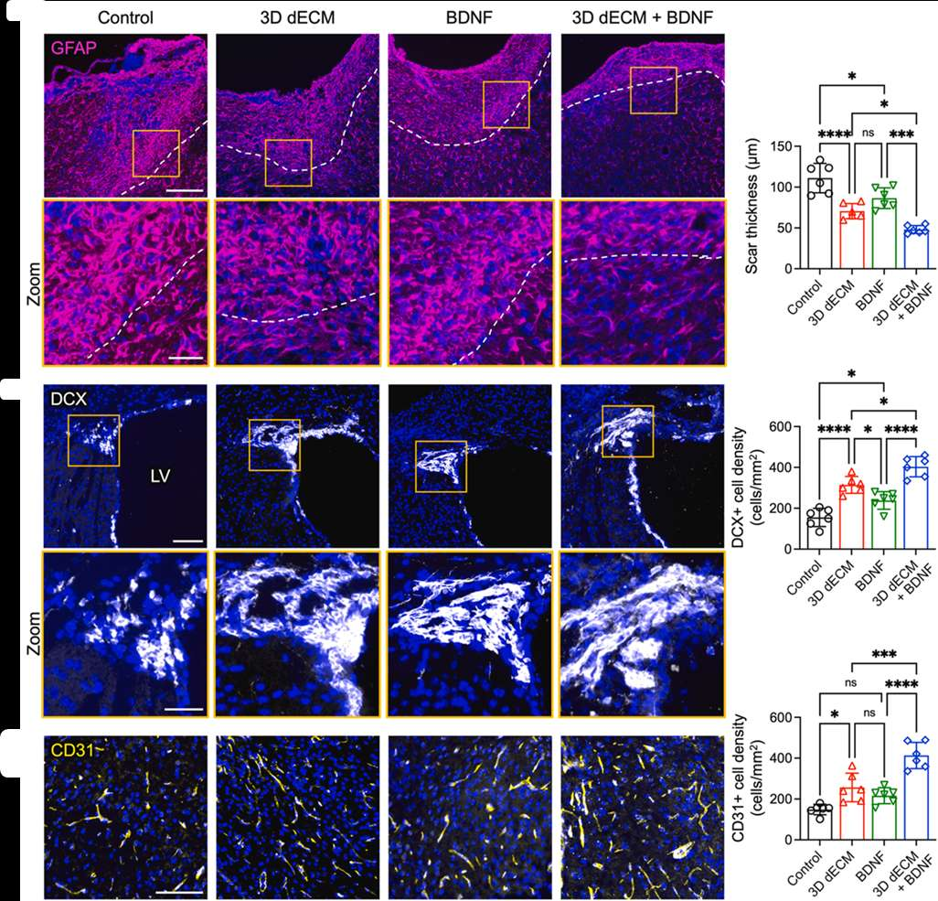
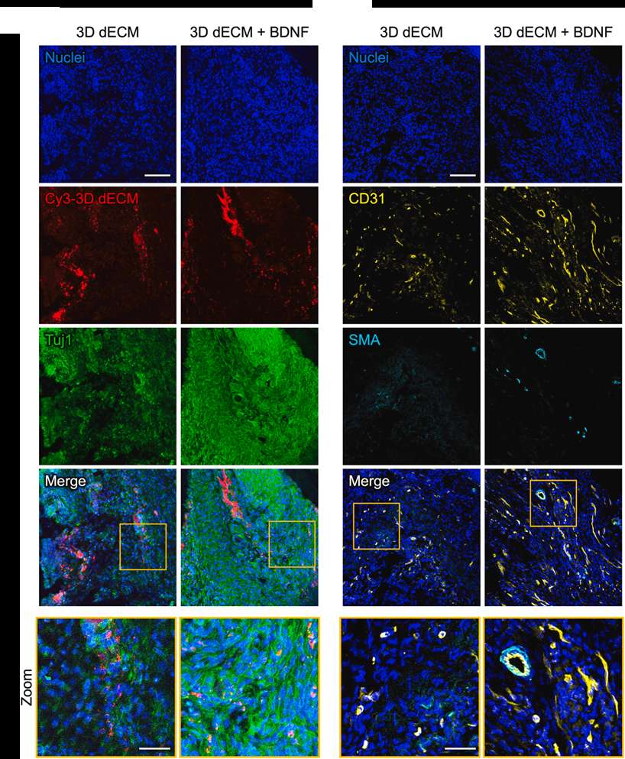
3D dECM+BDNF promotes tissue-level repair following brain injury
Preserve vascularized nerve tissue at the cortical lesion site
Alleviate glial scarring
Activate neuroblasts
Induce angiogenesis

Slide 9

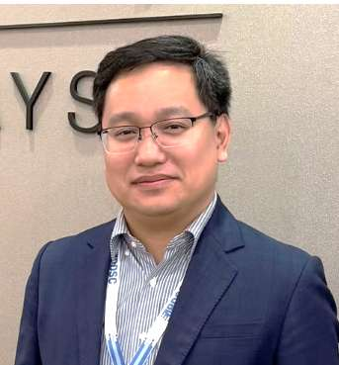
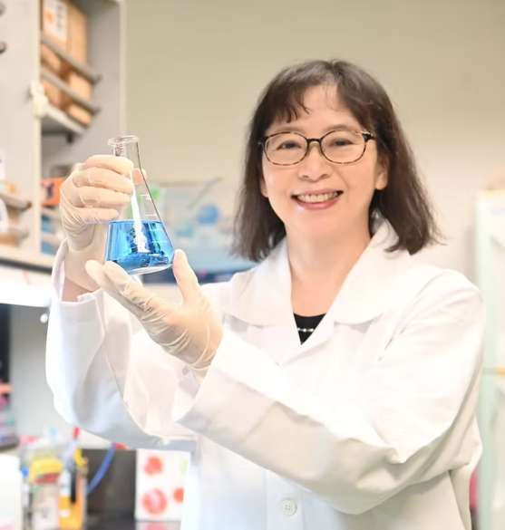



Acknowledgement
Chieh-Cheng Huang
Lin-yi Chen
Ying-Chi Kao
Our lab
My linkedin
Other information
“Polydopamine nanoparticle-enhanced stem cell spheroid-derived decellularized extracellular matrix with antioxidant and tissue-adhesive properties for brain repair.” Biomaterials, 2026.
“Implantation of MSC spheroid-derived 3D decellularized ECM enriched with the MSC secretome ameliorates
traumatic brain injury and promotes brain repair,” Biomaterials, 2025.

