Slide 1
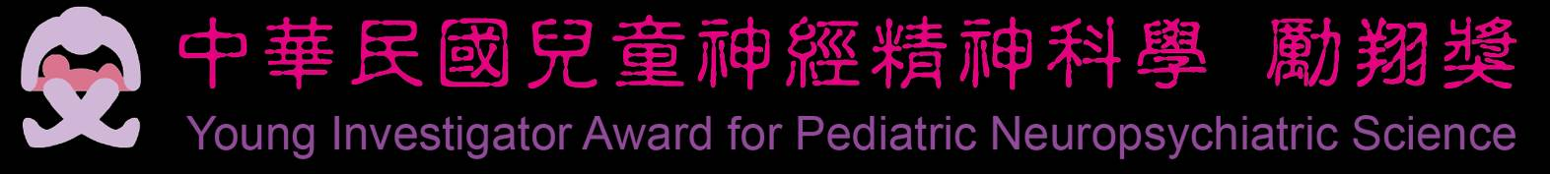


Modulation of GABAergic neurons in acute epilepsy using sonogenetics
Thi-Nhan Phan, Ching-Hsiang Fan, Hsien-Chu Wang, Hao-Li Liu, Yu-Chun Lin, and Chih-Kuang Yeh
Department of Biomedical Engineering and Environmental Sciences,
National Tsing Hua University, Hsinchu, Taiwan.
Department of Biomedical Engineering, National Cheng Kung University, Taiwan.
Department of Electrical Engineering, National Taiwan University, Taipei, 10617, Taiwan
Institute of Molecular Medicine, National Tsing Hua University, Hsinchu, Taiwan.
2025.10.25
Notes:
Hello everybody, my name is Phan Thi Nhan.
Thank you very much to give me a chance to be here introducing my research topic to you.
My topic is using US stimulates sonogenetic to treat epilepsy seizures.

Slide 2
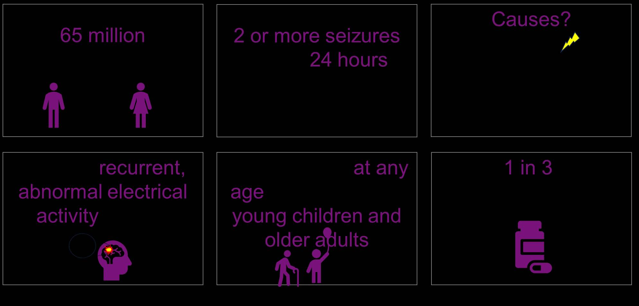
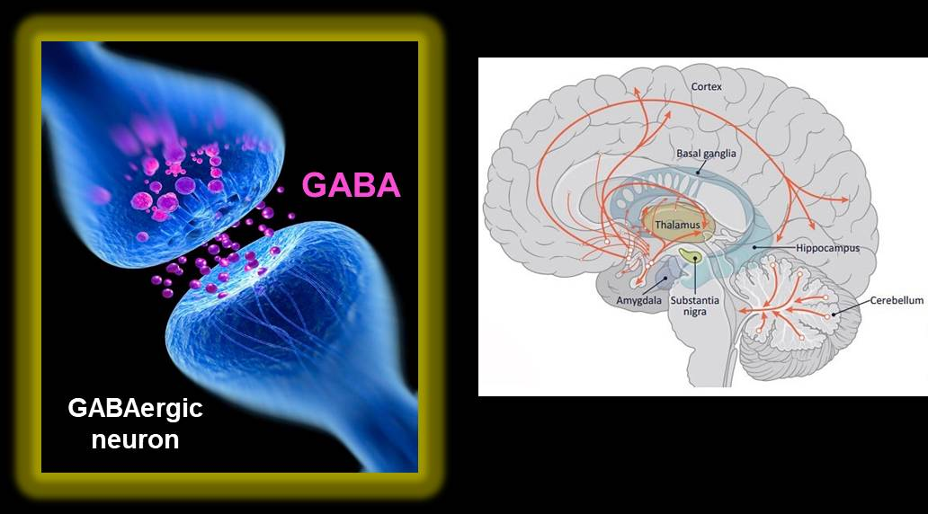
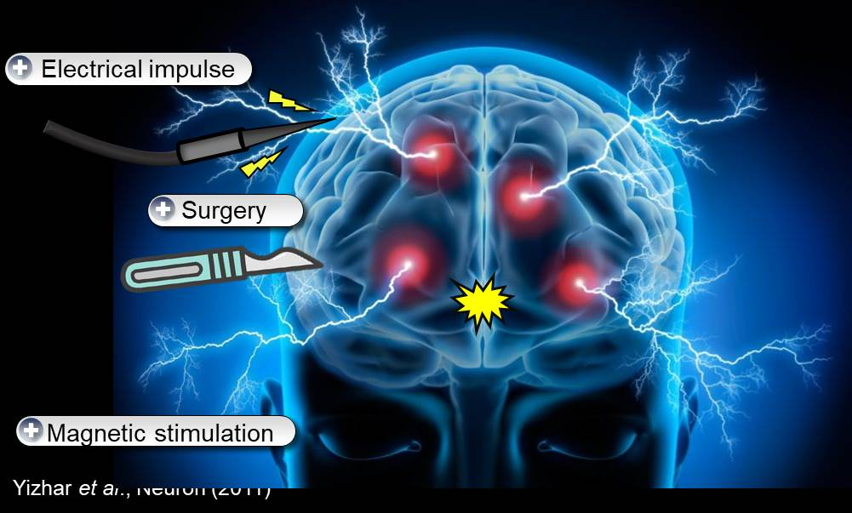
Introduction
Notes:
Epilepsy is a central nervous system disorder that affects around 65 million people in the world, with one-third being drug-resistant patients.
There are many causes of epilepsy, such as genetic factors, brain injury, and strokes.
And the most important cause is the imbalance between excitation and inhibition mechanisms in GABA neurons. Groups of neurons become hyperexcitable, leading to a state of recurrent and spontaneous seizures.
However, the common methods to treat epilepsy, such as medicine, surgery, or electrical implant, cannot stop the disease progression, with 30% of drug-resistant patients or damage to healthy brain regions.
Therefore, it’s necessary to find a breakthrough method to treat epilepsy.

Slide 3

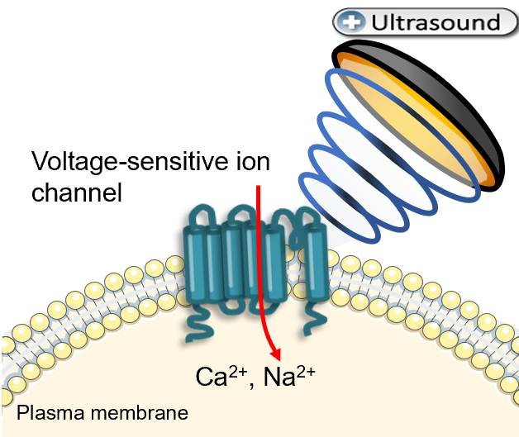
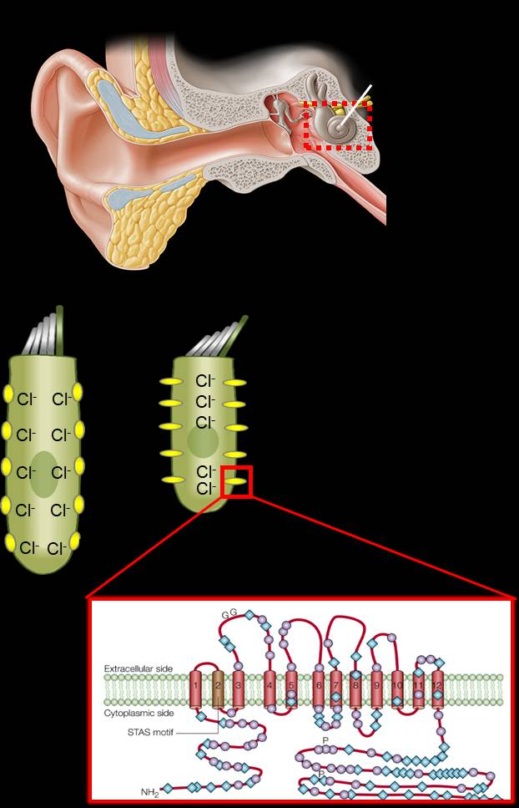
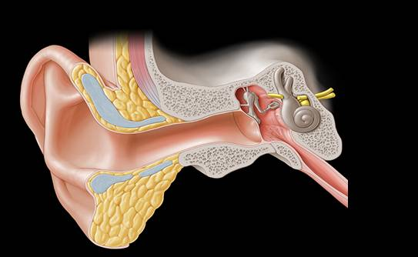
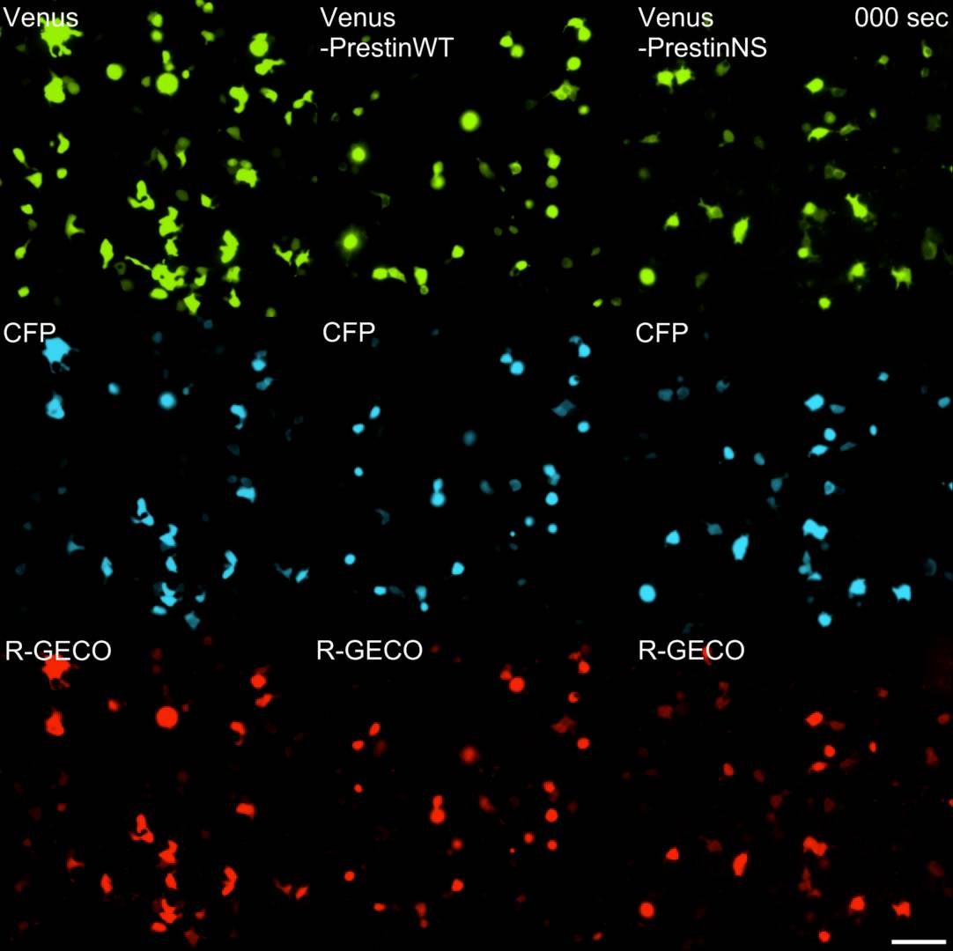
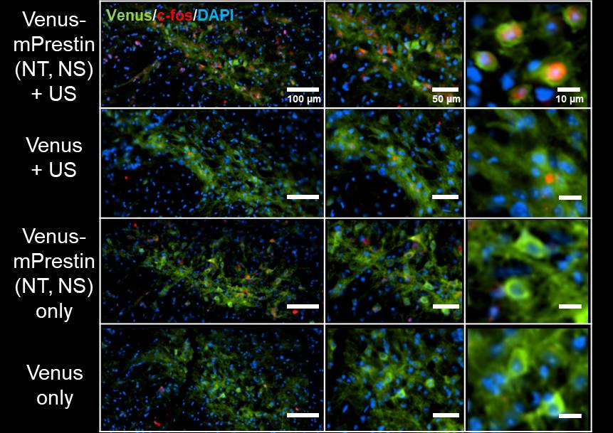
Ultrasound-based neurostimulation for inhibiting epilepsy
Great depth penetration
Non-invasive
Localized stimulation
Sub-milimeter spatial resolution
Neuronal cells are insensitive to ultrasound
Control
mPrestin (WT)
mPrestin (NT, NS)
Venus-mPrestin
(NT, NS) + US
Venus + US
Venus-mPrestin
(NT, NS) only
Venus only
Prestin structure
Tyler et al., Plos One (2008)
Fan et al., Nano Letters (2021)
Notes:
Recently, focused ultrasound seems a novel and promising method for neural disorders.
Focused ultrasound has some major potential benefits compared to other non-invasive techniques. It allows the targeting stimulation of deeper brain areas without damaging surrounding non-target tissues. Besides, ultrasound stimulation can modulate the transmembrane influx and outflux of ions by opening the ion channels on the cell membrane, including Calcium and sodium ions. They are the most important ions related to the neuromodulation process in the neuron cells.
Due to its high potential, FUS is currently extensively researched as a treatment for other neurological and non-neurological disorders, including epilepsy.
Ultrasound was used in both preclinical trials and clinical trials to treat epilepsy.
For example, in 2020, Chen and his group used a 0.5 MHz transducer to suppress in rats with the successful rate is around 32-88 % epilepsy spikes reduced. While around 62 % epilepsy seizures were suppressed after sonicating by a 1.7 MHz transducer, 800 Hz acoustic pressure for 15 minutes. Or a stimulation during 30 minutes by a 0.35 MHz transducer, the number of epilepsy spikes during 16 hours in monkeys was reduced to 61%.
However, an important challenge in neurobiology and neural disorder treatment is to stimulate a single neuron, especially in deep areas of the brain which is an unmet issue if the treatment therapy for neural disorders is using only ultrasound.

Slide 4
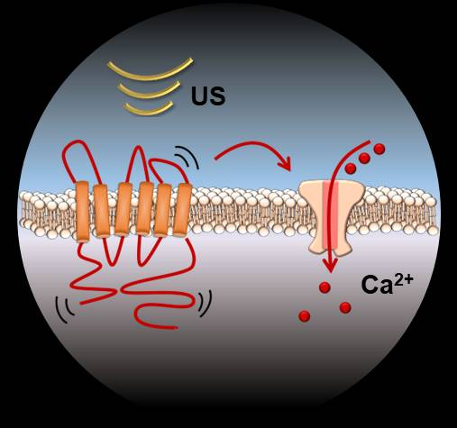
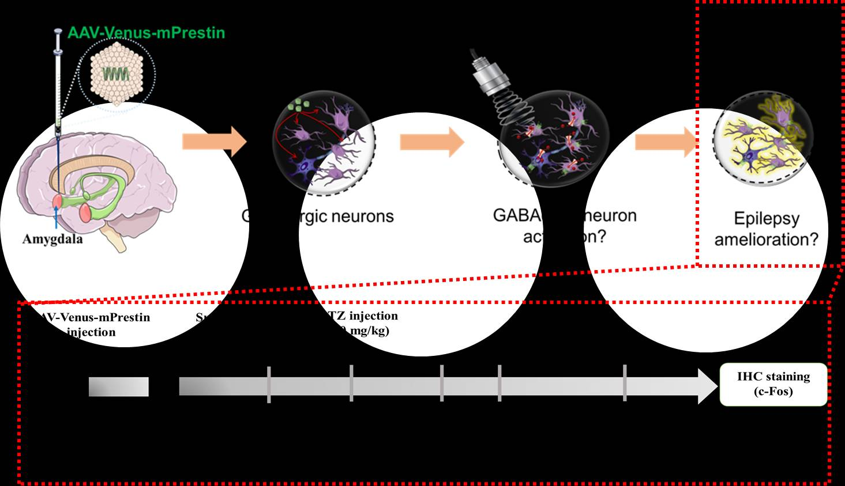
Activating GABAergic neurons to suppress epilepsy by sonogenetics
Notes:
An ideal strategy for epilepsy treatment is the delivery of genetically encoded ultrasound-sensing proteins to enhance the ultrasound sensitivity into targeted cells - GABA neurons.
After that, we will use focused ultrasound to stimulate the GABA neurons active and modulate the activation of GABA neurons by enhancing the delivery of calcium ions into the cells.
From that, this process will motivate the release of GABA transmitters in GABA neurons, which will rebalance the excitation and inhibition mechanisms in the GABA neurons. It may be the key point to suppress epilepsy.

Slide 5
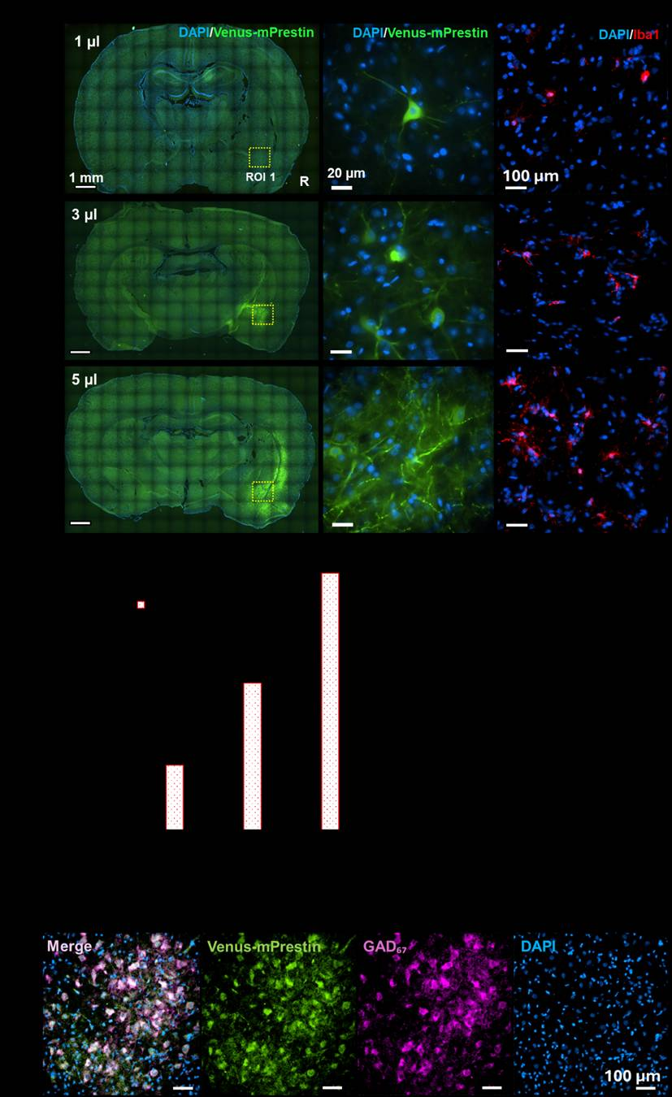
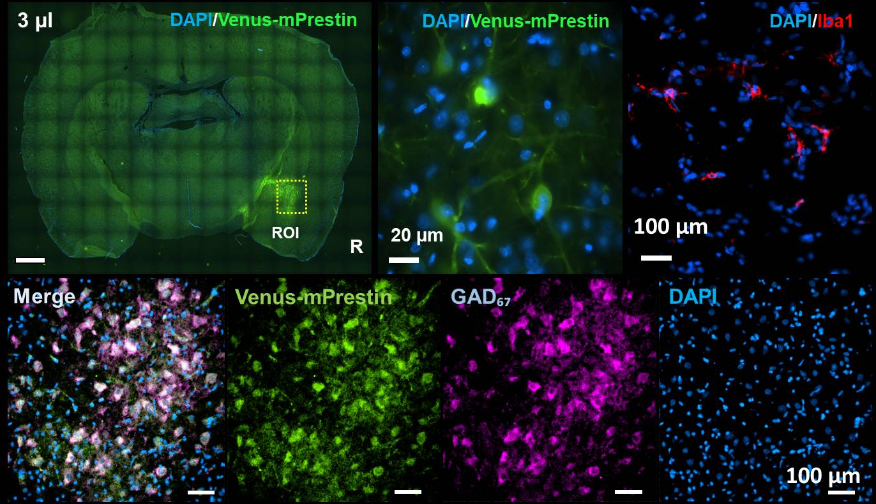

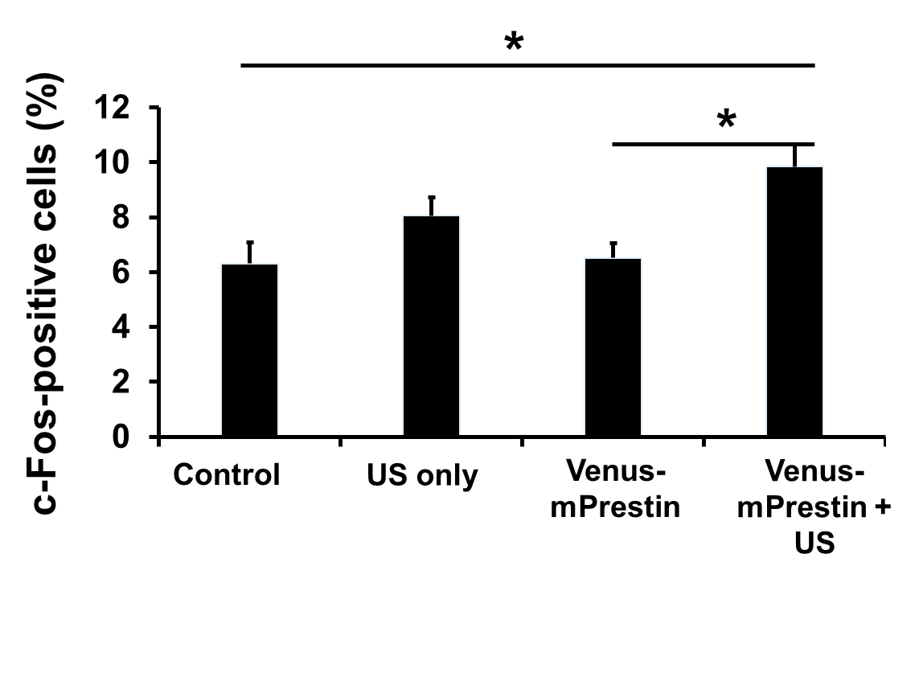
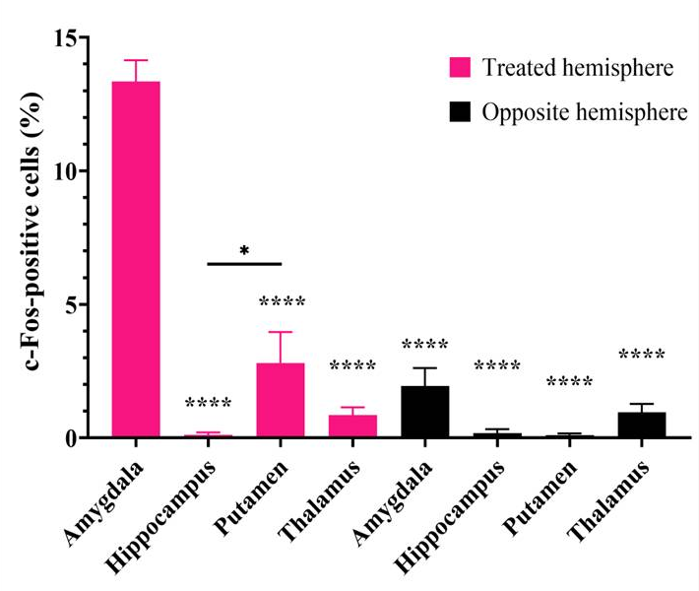
Transcranial ultrasound stimulation of cells in Amydala via mPrestin(NT, NS) expression in vivo
90% of GABAergic neurons in the Amygdala area expressed Venus-mPrestin

Slide 6
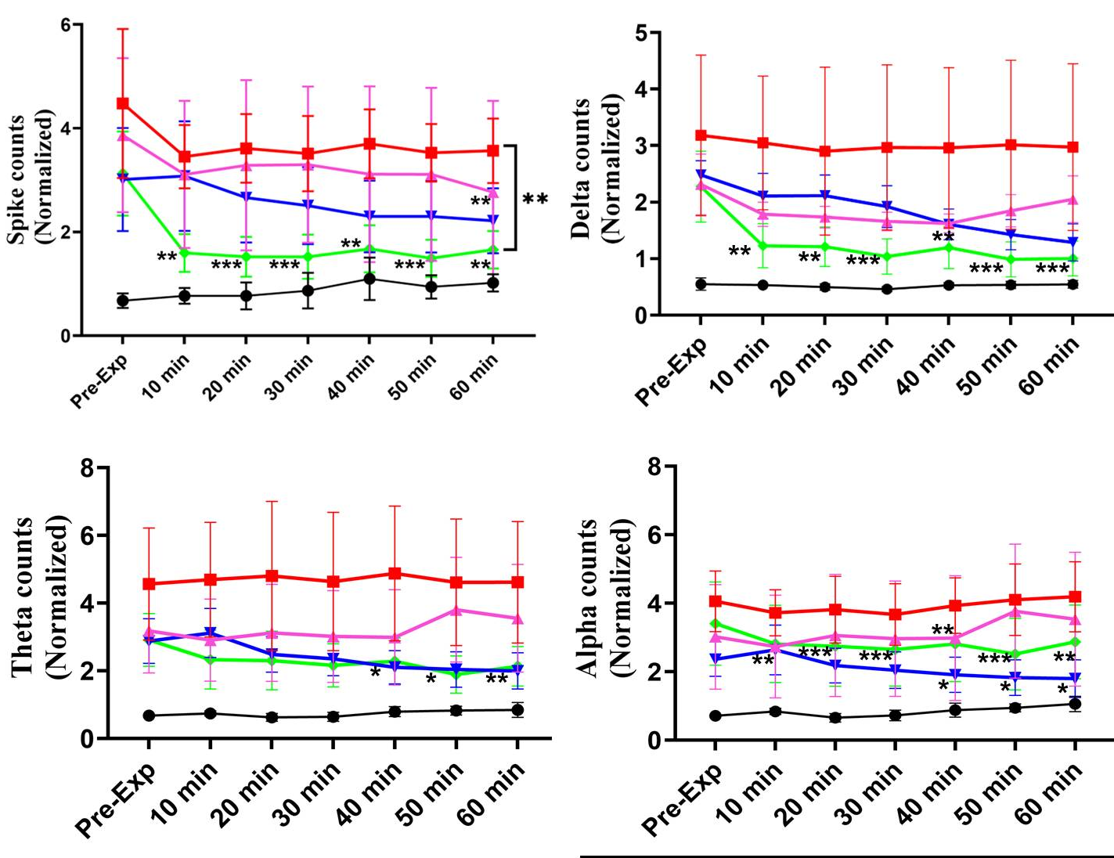
Targeted stimulation of the GABAergic neurons using sonogenetics can suppress acute epilepsy seizures
After US stimulation, the number of spikes will dramatically decrease (-50%)

Slide 7
Summary
Venus-mPrestin can successfully express on the GABAergic neurons.
Venus-mPrestin expression enhances the ultrasound to specifically activate the Amygdala and interfere with neuronal connections in vivo.
Venus-mPrestin and US (500 kHz, 0.5 MPa, DC: 10%, PRF: 10 Hz, MI: 0.71, duration treatment: 5 min) can suppress 50% of the epilepsy spikes.
Future works:
Include evaluating the GABA transmitter concentration before and after US stimulation
Understanding the mechanisms of mPrestin (NT, NS)
Verifying the long-term effects of animals.

Slide 8




Acknowledgment
Funded by:
Thank you!!
Notes:
This is my presentation
Welcome to question.

