Slide 1
Imaging Features of Pediatric Optic Pathway Glioma
Hwang Zhen An 范貞安
Department of Radiology, Wan Fang Hospital, Taipei Medical University
25th October 2025

Slide 2


Outline
Introduction of Optic Pathway Glioma (OPG)
MRI findings
LeptoMeningeal Dissemination (LMD)

Slide 3
Introduction
Optic pathway glioma (OPG) accounts for 3 to 5% of pediatric intracranial tumor.
Most common primary optic nerve and pathway tumor ~ 66%.
Most common CNS tumor for Neurofibromatosis 1 (NF-1)
Prevalence: 20-40%
15% of NF-1 develop an OPG
Often grow to involve optic chiasm/hypothalamus → undetermined primary origin
Journal of Child Neurology. 2003;18(7):471-478.
Pediatr Blood Cancer. 2006;46(5):586-596.
Surv Ophthalmol. 1994;38(5):427-452.
CNS Oncol. 2013;2(2):143-159.
Notes:
Several tumors can arise in the optic pathway, the most common being optic pathway gliomas (OPGs) that represent 66% of all primary optic nerve and pathway tumors [1].
It is well-known for the most common CNS tumor for neurofibromatosis 1 (NF-1) with he mean age at presentation is 8.8 years, and about 90% of cases aged before 19 .
Twenty to 50% of OPGs occur in the setting of neurofibromatosis type 1 (NF1) and, in turn, 15% of NF1 patients will develop an OPG. 20-50% OPG 是NF-1。在所有NF-1病人大概有15%會有OPG

Slide 4
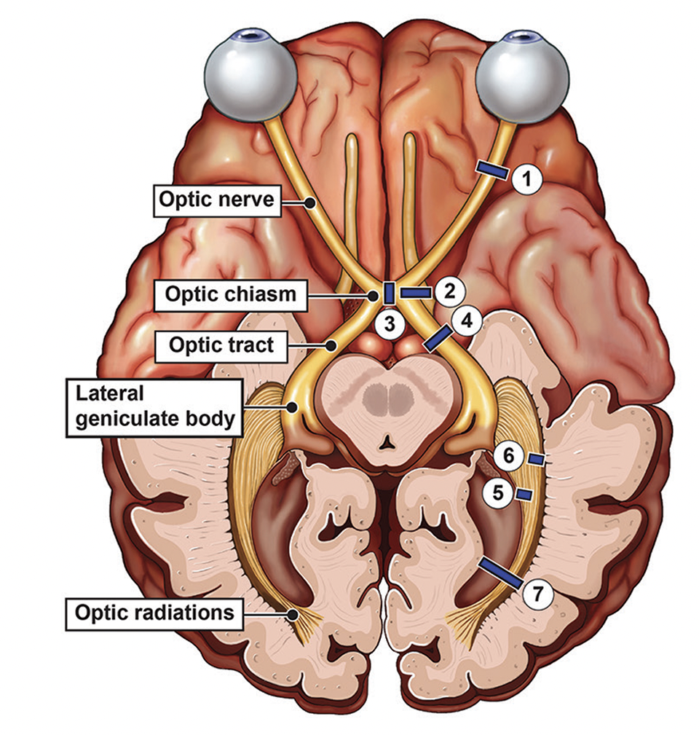
Location
Arise anywhere along the visual pathway.
Anterior pathway: orbital, intracranalicular, prechiasmatic of optic nerve
NF-1
Posterior pathway: optic chiasm, optic tract, optic radiation, primary visual cortex
Sporadic type

Slide 5
MRI Features
T1W: iso-low signal intensity (SI)
T2W: hyperintense SI
T1W C+: variable enhancement
DWI/ADC: no restricted diffusion
Primary Tumor Location
Chiasmatic/Hypothalamic
Optic Nerve

Slide 6
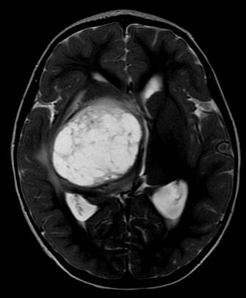

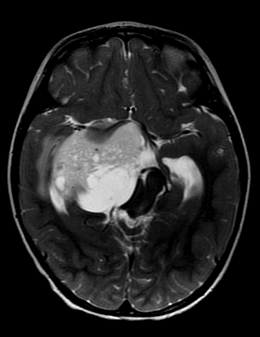
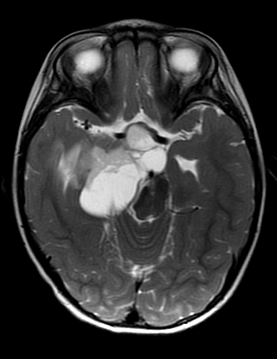
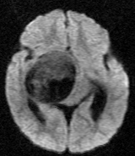
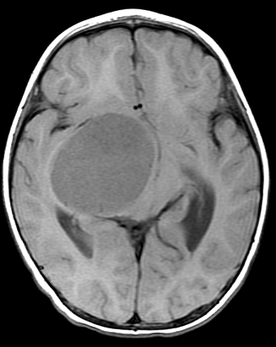
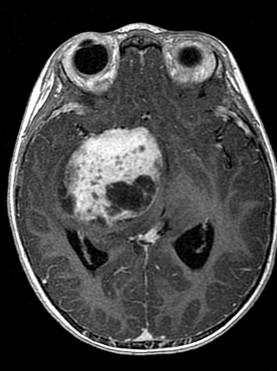
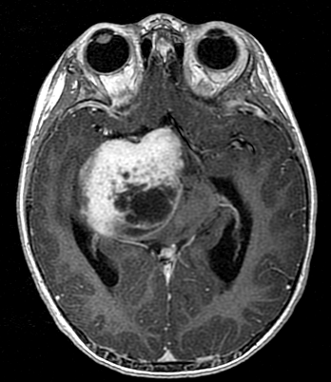
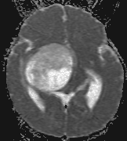
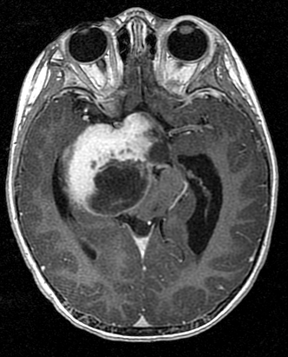
Our Case: A 2 y/o boy with PA
DWI
T2W
ADC
T1W
T1W C+
Notes:
36641971

Slide 7
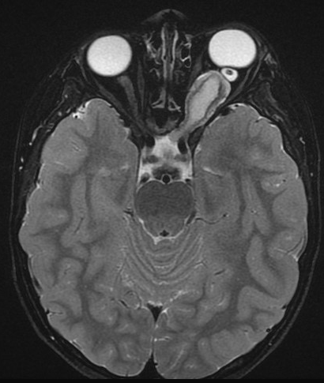
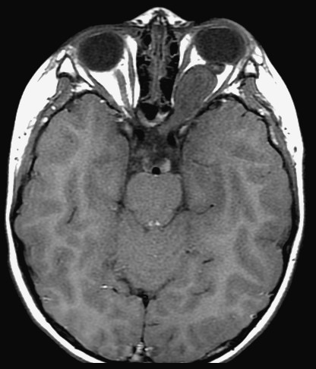
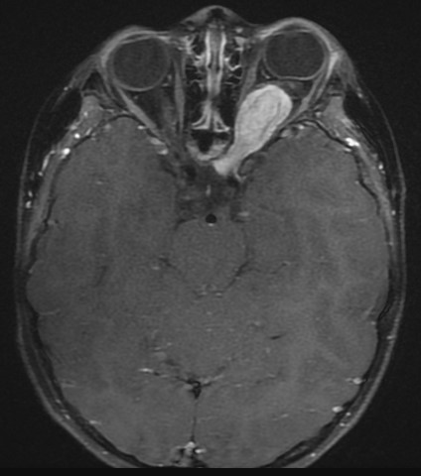
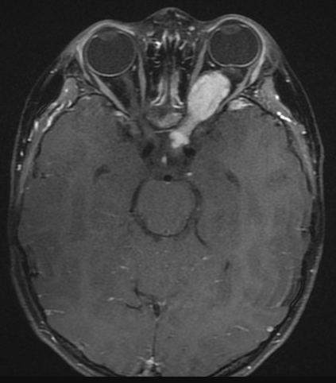
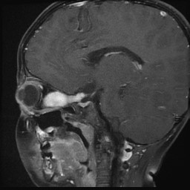
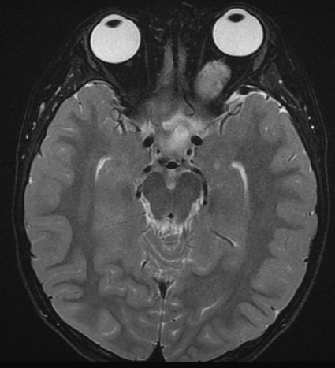
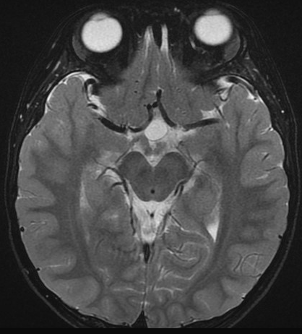
Our Case: A 4 y/o boy with Lt OPG
T2W
T1W
T1W C+
Notes:
48216688

Slide 8
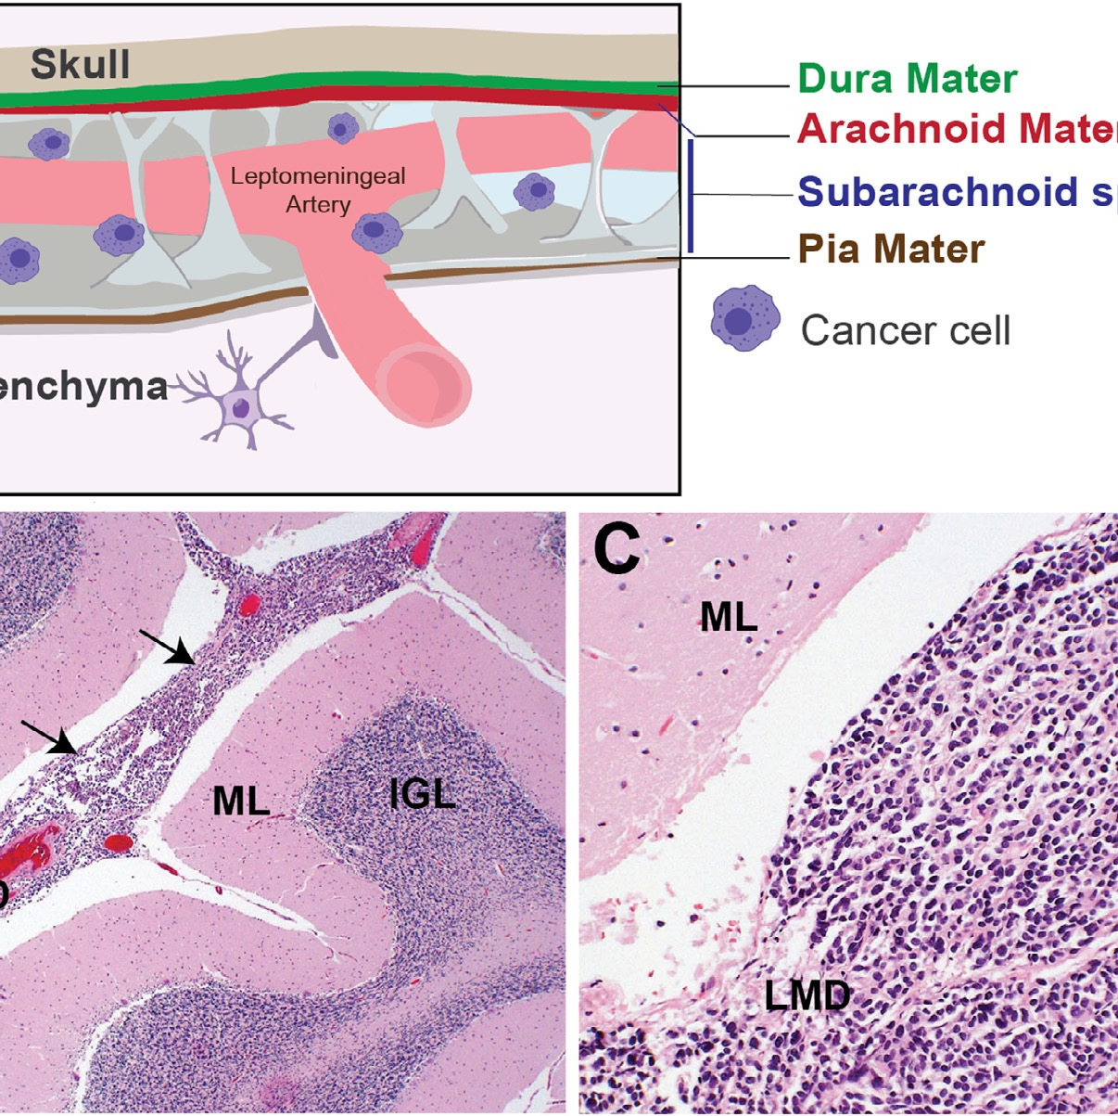
Leptomeningeal dissemination (LMD)
Seldom encountered in low grade glioma(LGG)
incidence at initial dx is 2.6-7%
5-12% for the follow-up
Worrisome for LMD → hallmark of malignancy.
How about OPG with initial LMD ??
Pediatr Blood Cancer. 2016;63(1):62-70.
J Neurosurg. 1994;81(1):24-30.
Cancer. 1994;73(11):2869-2878.
J Neurosurg. 1995;83(1):67-71.

Slide 9
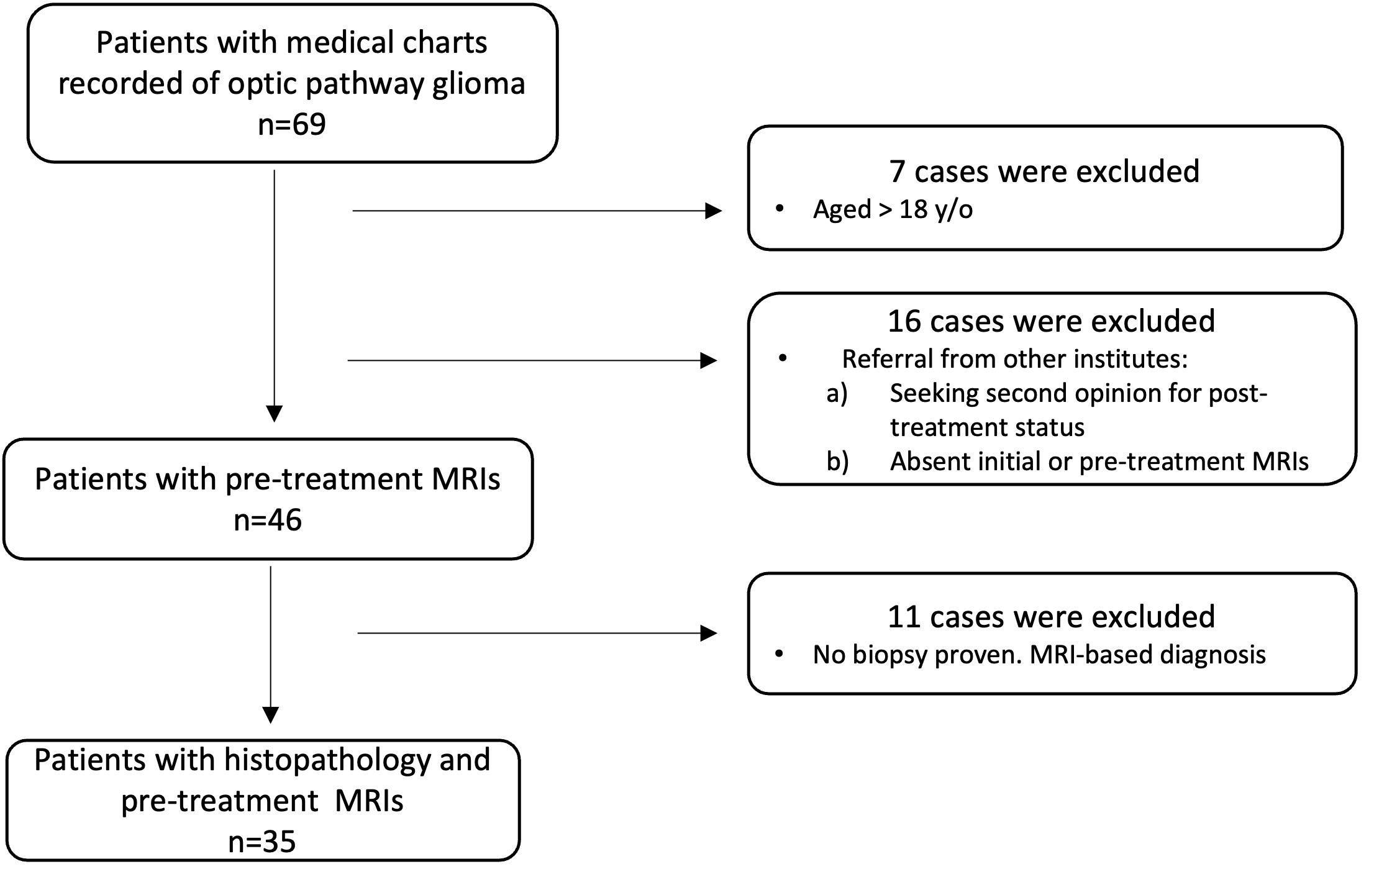
Our Experiences 8 cases of OPG with initial LMD 27 cases of OPG without LMD
OPG between 2000 and 2022

Slide 10
Data Analysis (LMD vs Non-LMD)
Demographics/Clinical Outcome
MRI Features
Location of primary tumor
> 50% asymmetrically solid part
> 50% midline solid part
Morphology of primary tumor
size, shape, border, T2 SI, enhance
ADC values
Adjacent structures involvement
perifocal edema, CSF trapping,
anterior commissure, encasement of arteries
hydrocephalus
Age, sex
Symptoms/signs
Histopathology
Initial surgical treatment
Follow up months
Outcome
recurrence/progression, stability, regression
Survival

Slide 11
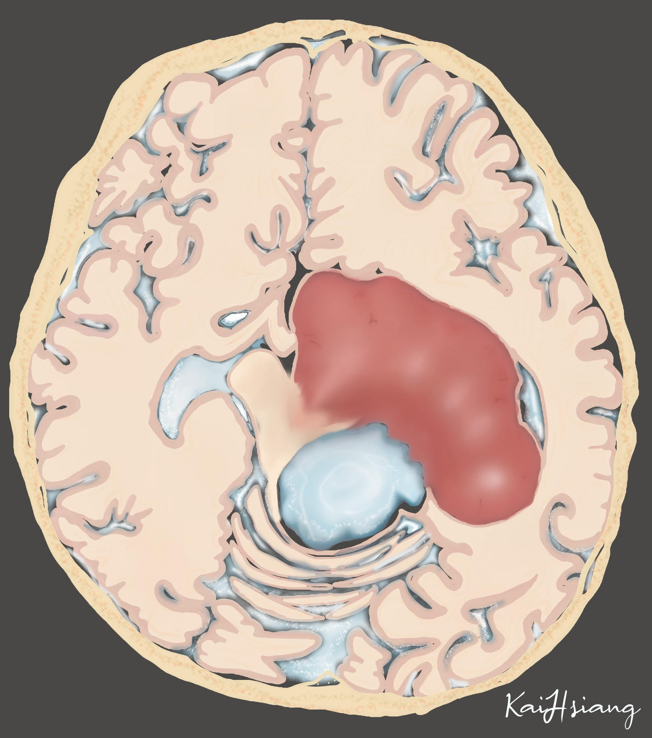
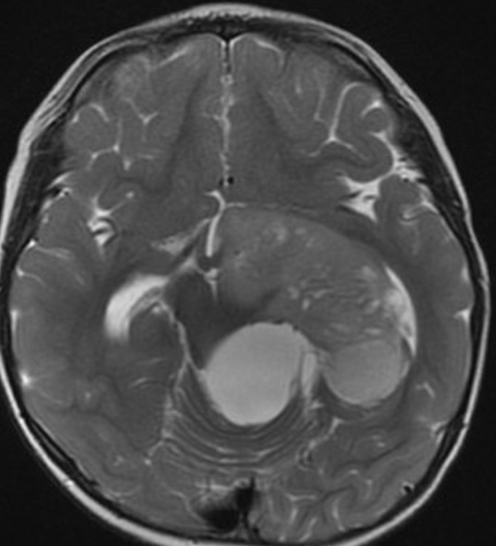
Our MRI Analysis: Location of primary tumor
> 50% solid part asymmetrically positioned/off-midline

Slide 12
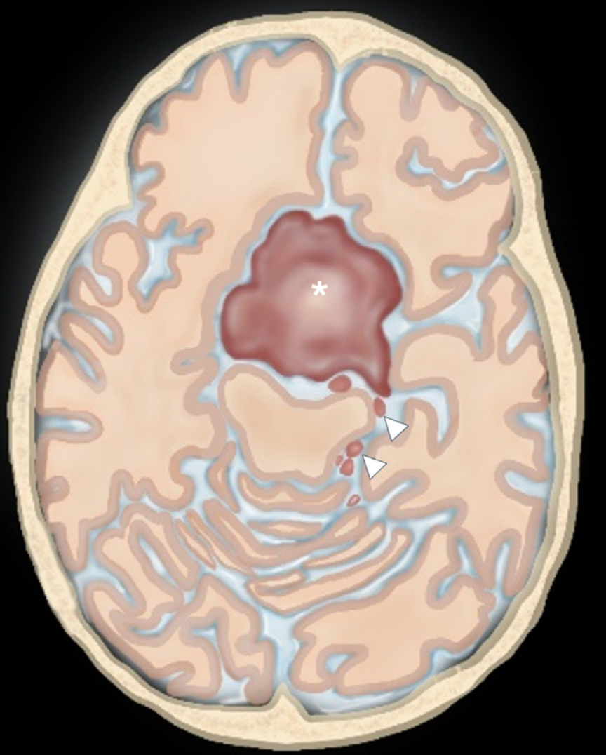
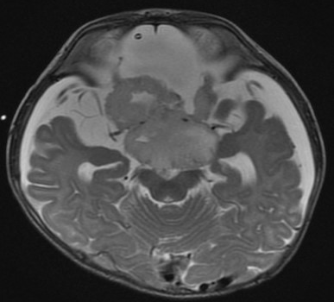
Our MRI Analysis: Location of primary tumor
> 50% solid part in the midline

Slide 13
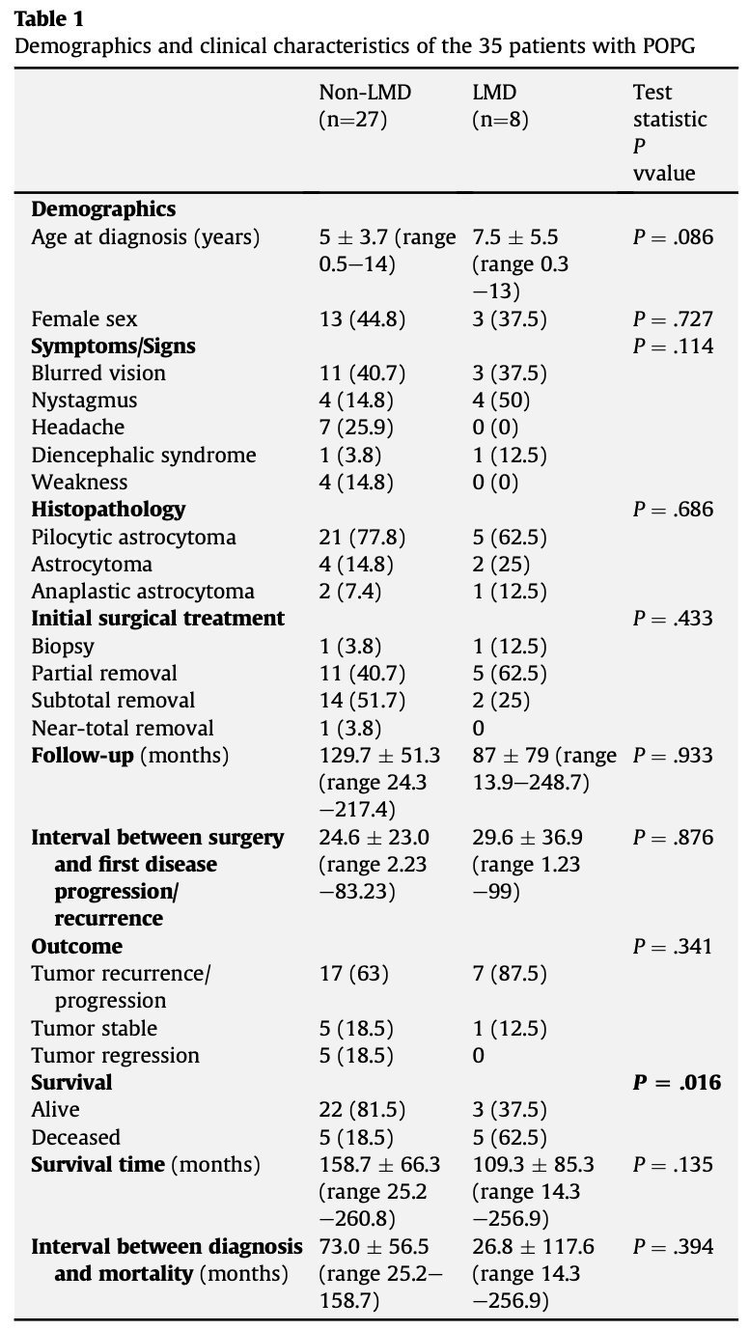
The mortality rate was higher in the LMD group than in the non-LMD group

Slide 14
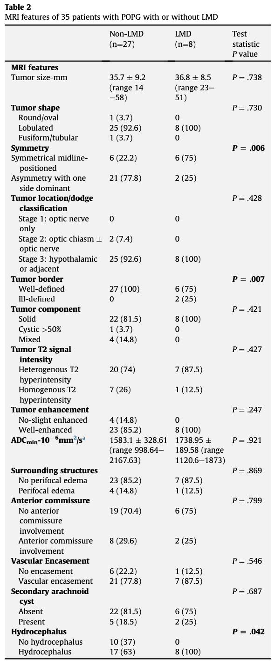

Slide 15
Our Result-MRI Features
LMD group tends to be more midline-located compared to those non-LMD.
LMD group presented with more ill-defined tumor border.
LMD group was more likely to develop hydrocephalus.
No significantly lower ADC values was depicted among LMD group.

Slide 16
Higher mortality in the LMD group
Hydrocephalus usually requires shunting treatment
high failure rate
development of ascites owing to protein secretion by OPG
Currently, the mainstay chemotherapy is vincristine and carboplatin
No standardized treatment guidelines for LMD
alternative therapy is individually variable: vincristine/cisplatin/cyclophosphamide, monotherapy with vinblastine, irinotecan/bevacizumab, thioguanine/procarbazine/cisplatin/vincristine
toxicity
The indolent behavior of POPG might cause a delay in diagnosis
Notes:
development of ascites owing to protein secretion by OPG.8,44,45
(2) Currently, the mainstay chemotherapy for POPG is vincristine and carboplatin,47 and no standardized treatment guidelines have established effective therapies for LMD. Alternative therapy is individually variable with vincristine/cisplatin/cyclophosphamide, monotherapy with vinblastine, irinotecan/bevacizumab, thioguanine/procar- bazine/cisplatin/vincristine.47 Adverse effects such as toxicity derived from this therapy might be inevitable. Our findings are comparable with those of a study evaluating sporadic OPG outcomes, which indicated a poor prognosis for children with LMD regardless of therapy.48
(3) The indolent behavior of POPG might cause a delay in diagnosis from the onset of symptoms and possibly impact the inferior outcome.

Slide 17
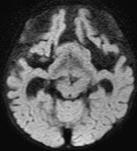
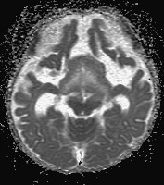
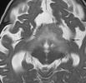
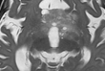
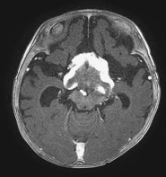
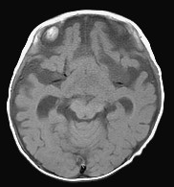
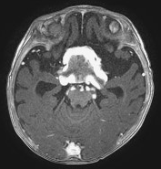
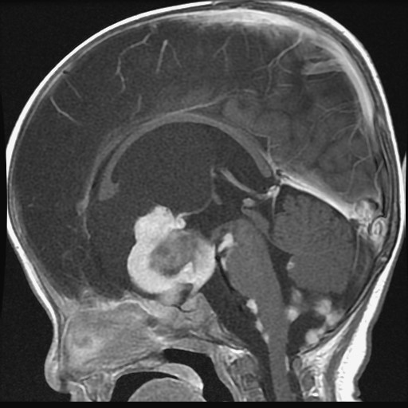
Our Case: A 6 m/o boy with Astrocytoma and initial LMD
ADC
T2W
DWI
T1W
T1W + C
Notes:
41088522

Slide 18
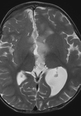
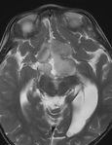
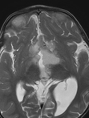
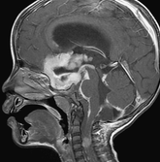
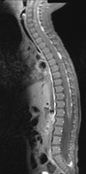
Our Case: A 2 y/o boy with Astrocytoma and initial LMD

Slide 19
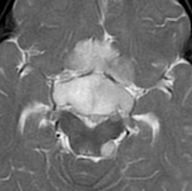
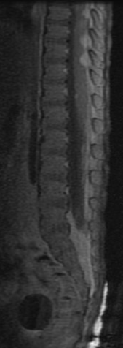
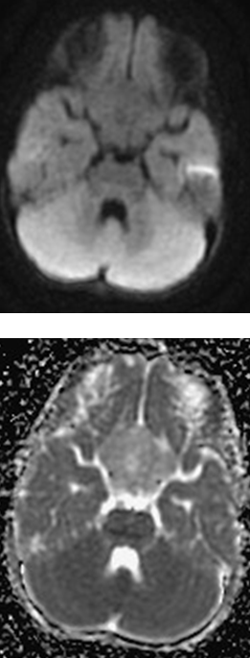
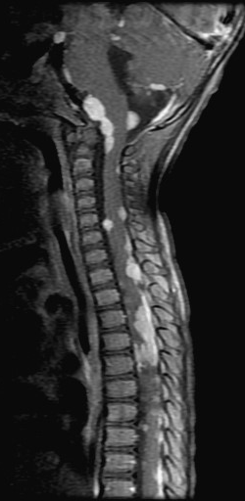
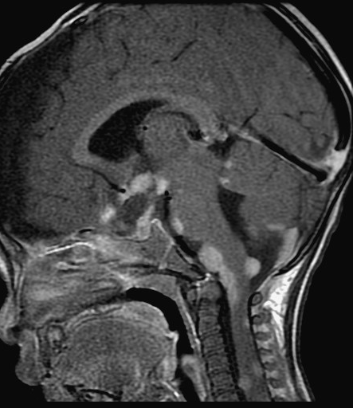
Our Case: A 10 m/o girl with PA and initial LMD
DWI
ADC
Notes:
43673252

Slide 20
Proposed Factors for LMD
Location of primary tumors
Mamelak et al. study: incidence of 30% in hypothalamic PA.
Close proximity to the subarachnoid space, 3rd ventricle, high likelihood of being only subtotally resected.
Midline structure → greater CSF exposure and contact
Non-LMD group → less CSF exposure, more confined/enveloped
Ill-defined tumor border → potential BBB disruption
Hydrocephalus → CSF stasis → enhanced LMD

Slide 21
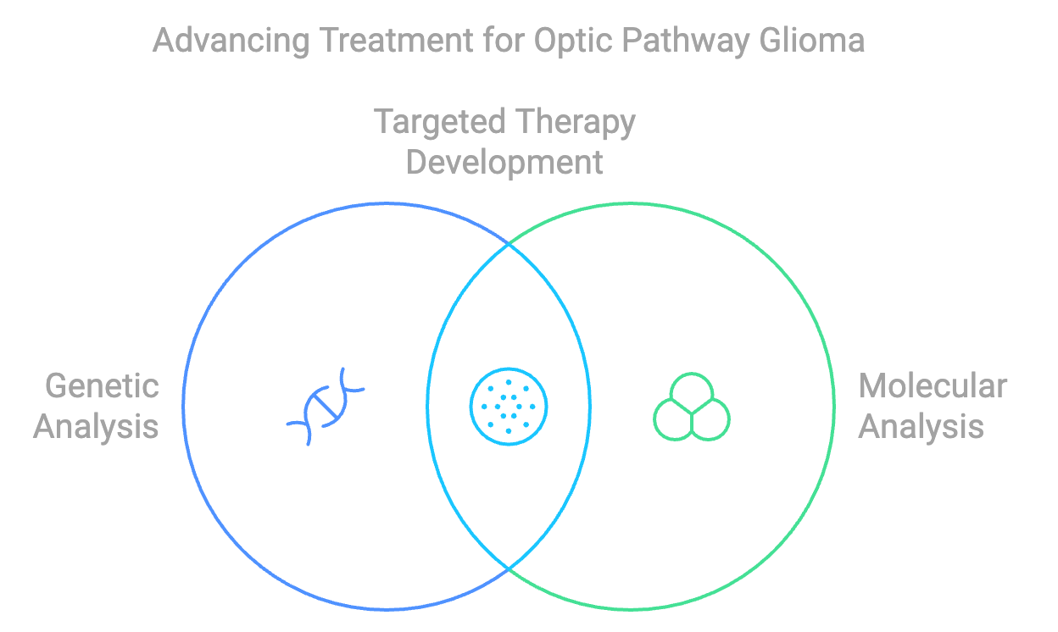
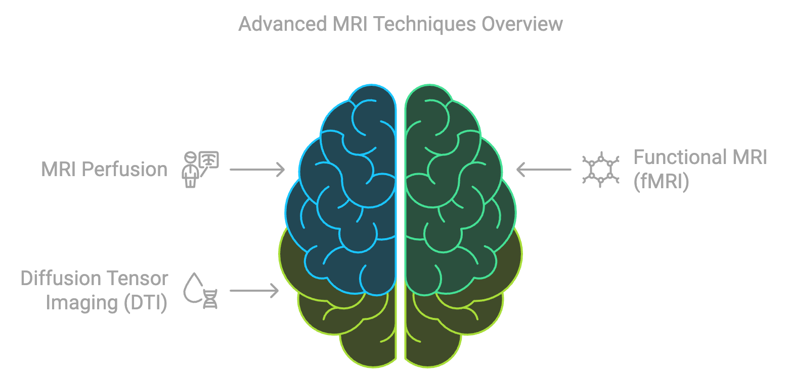
Limitations
Retrospective study, single center cohort study
Disease rarity, small case numbers
Lack of molecular/genetic testings, advanced MRI: MR perfusion
Still, largest case numbers regarding OPG with initial LMD to date

Slide 22
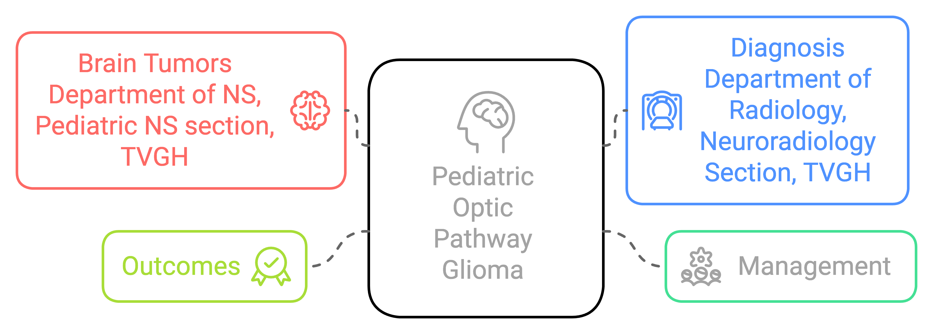
Special Thanks to

