Slide 1
Sertm2 is a Conserved Micropeptide that Modulates GDNF-mediated Motor Neuron Subtype Specification
Fang-Yu Hsu
Advisor: Dr. Jun-An Chen
October 25th, 2025
2025 Young Investigator Awards for Pediatric Neuroscience

Slide 2
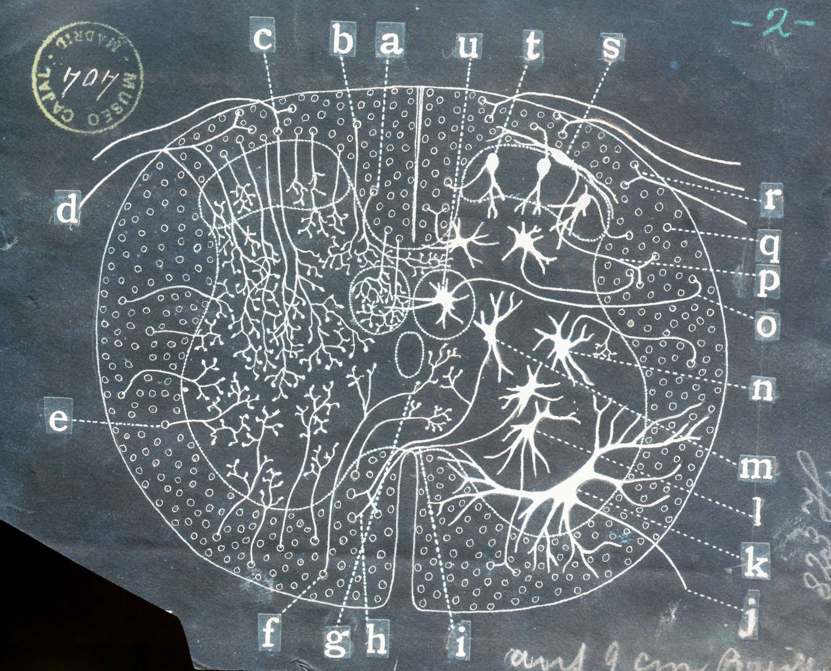
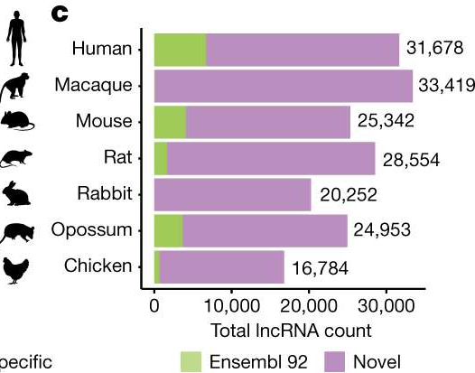

The neuron diversity in the spinal cord
Santiago Ramón y Cajal, 1852~1934
How is motor neuron diversity established?
Transcription factors
Non-coding RNAs
Epigenetic Modifications
Number of neurons
Human spinal cord ~ 1 billion
Mouse spinal cord ~ 1 million
(Kalat, J.W., Biological Psychology, 1998)
(Sarropoulos et al., Nature, 2019)

Slide 3
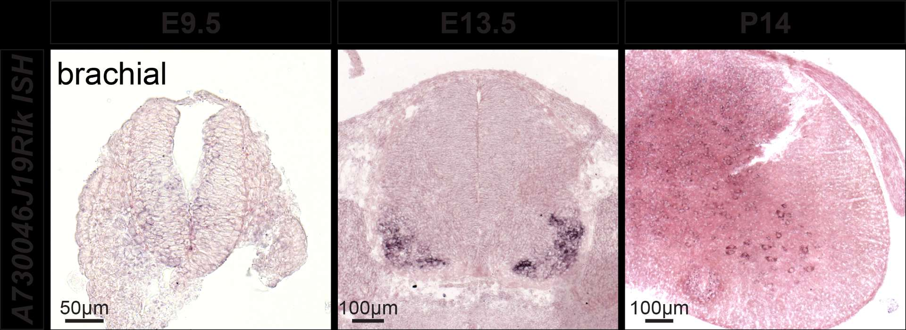
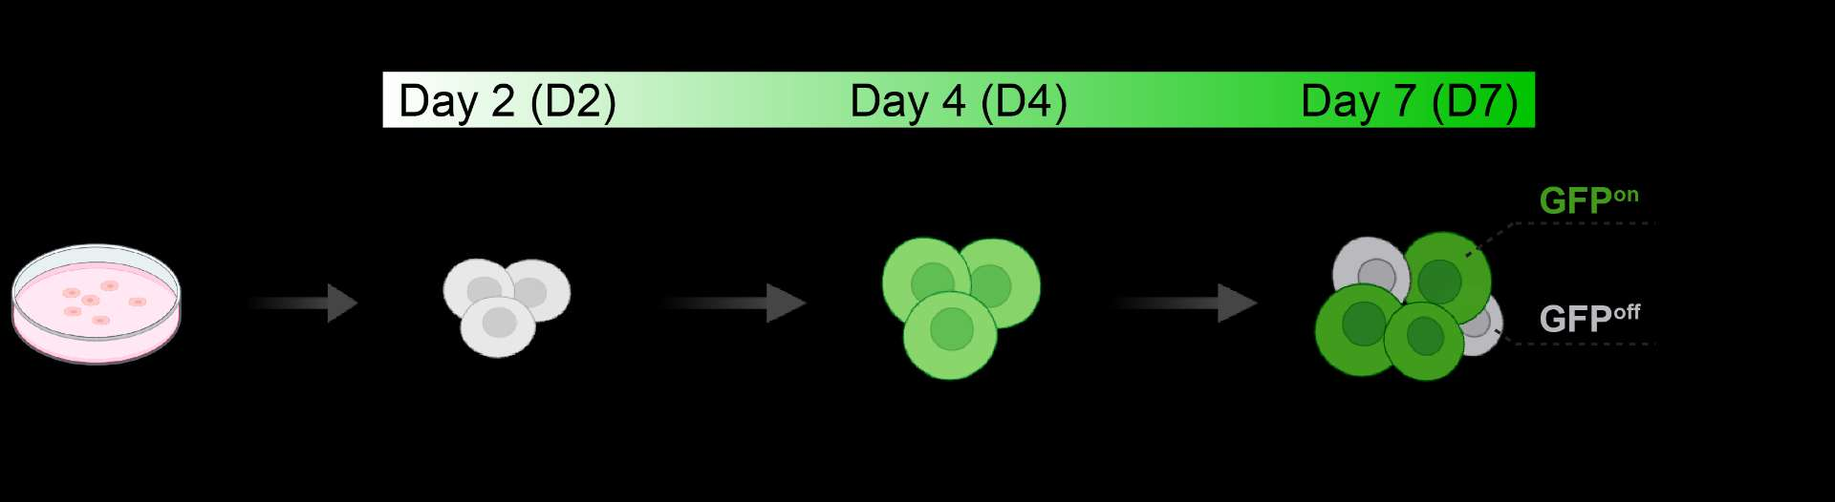
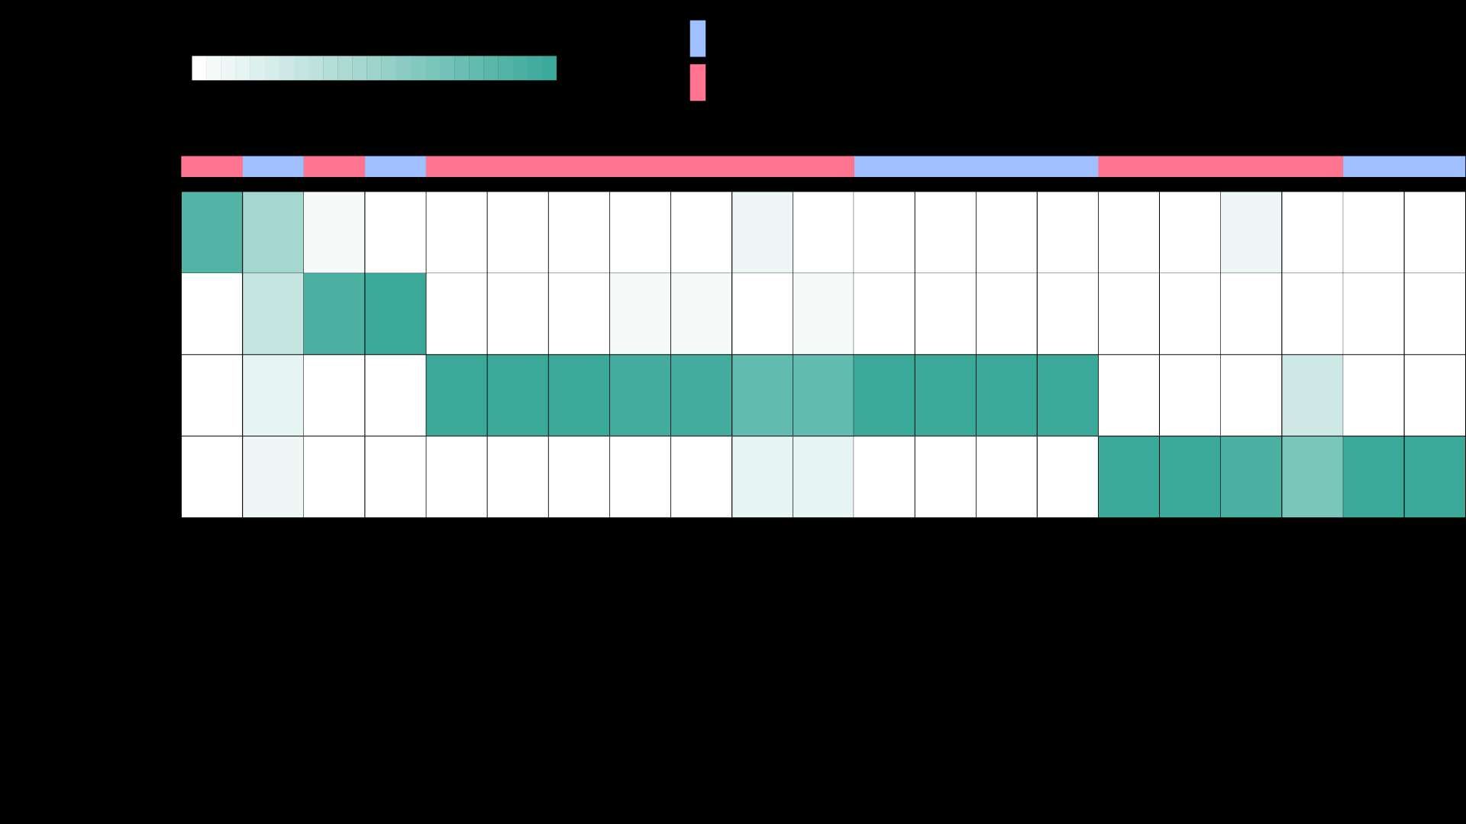
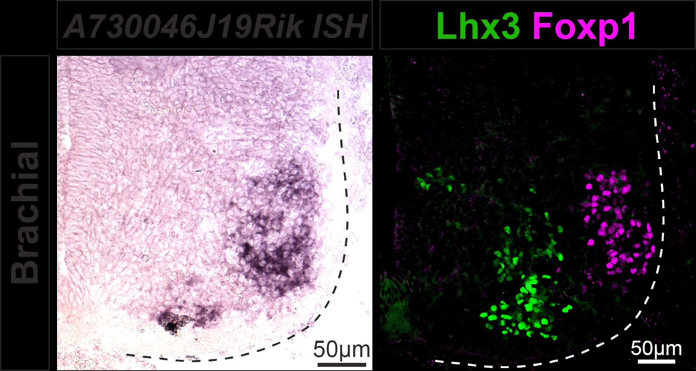

Identifications of lncRNAs in spinal MNs
Mouse ESC~MNs
E13.5
A730046J19Rik manifests strong expression in motor neurons (MNs)
(Yen et al., eLife, 2018)

Slide 4
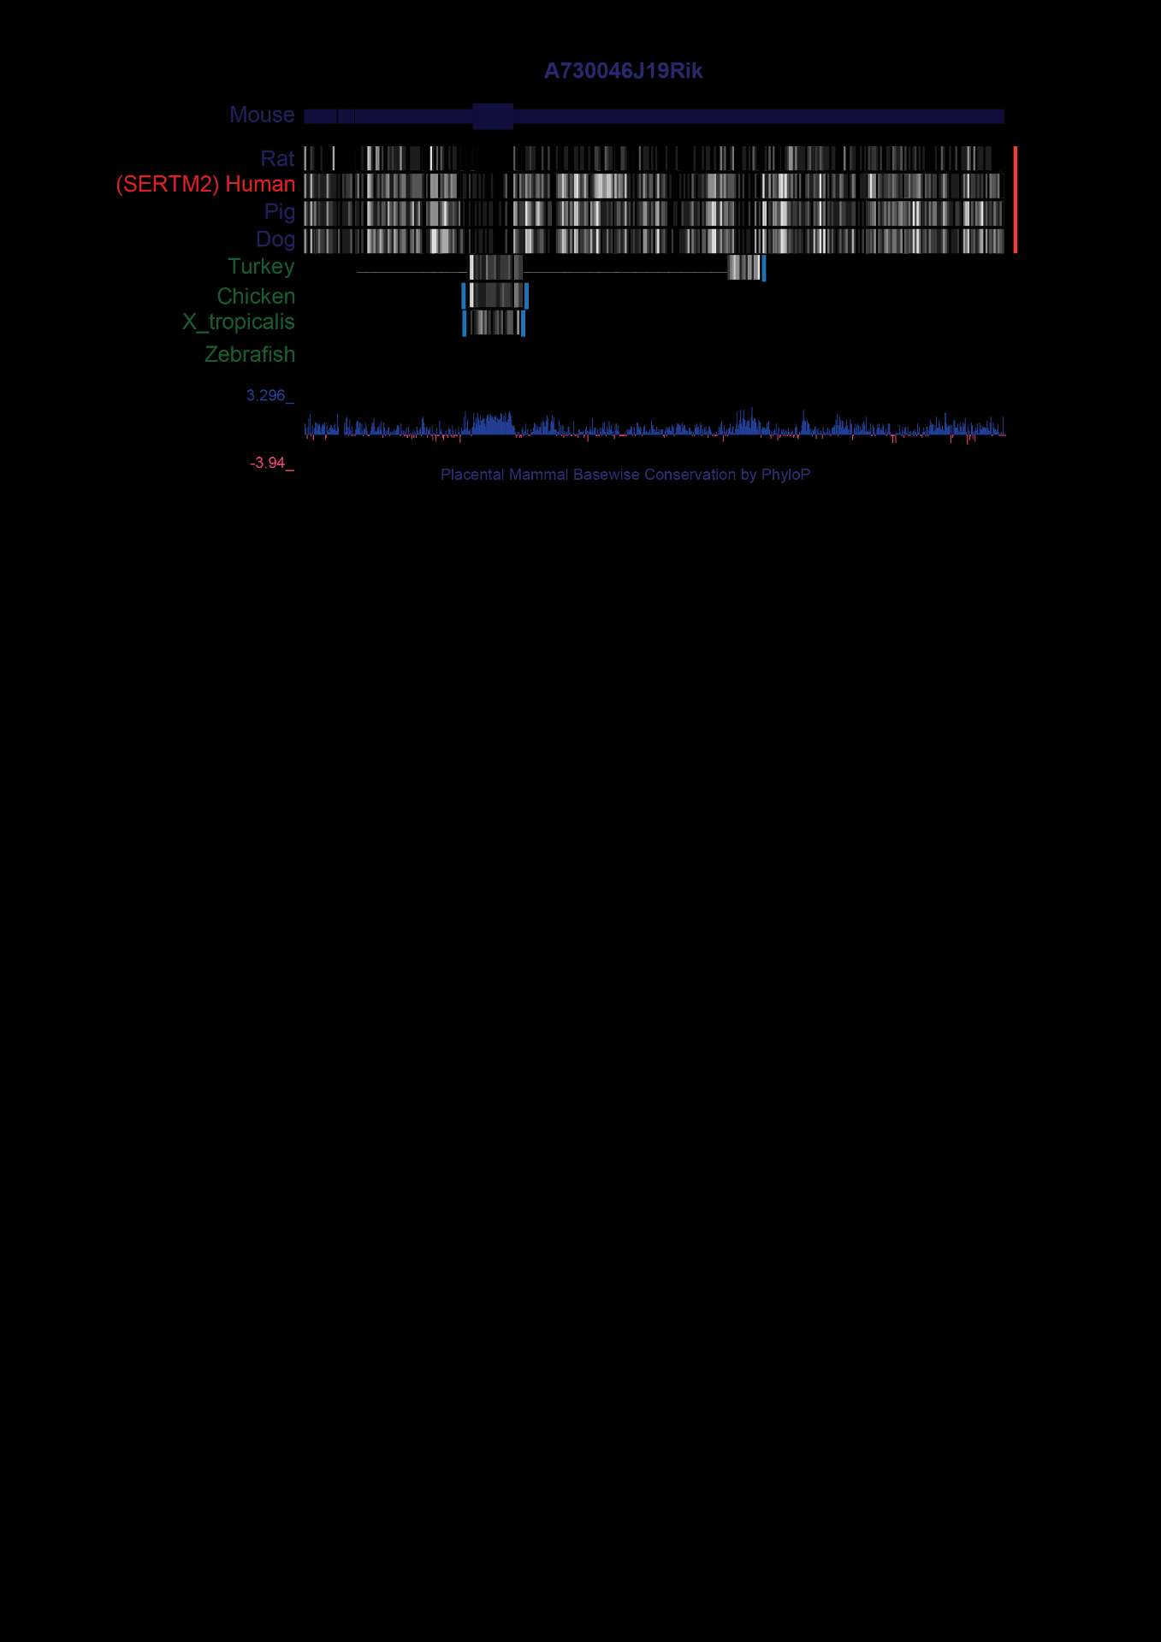
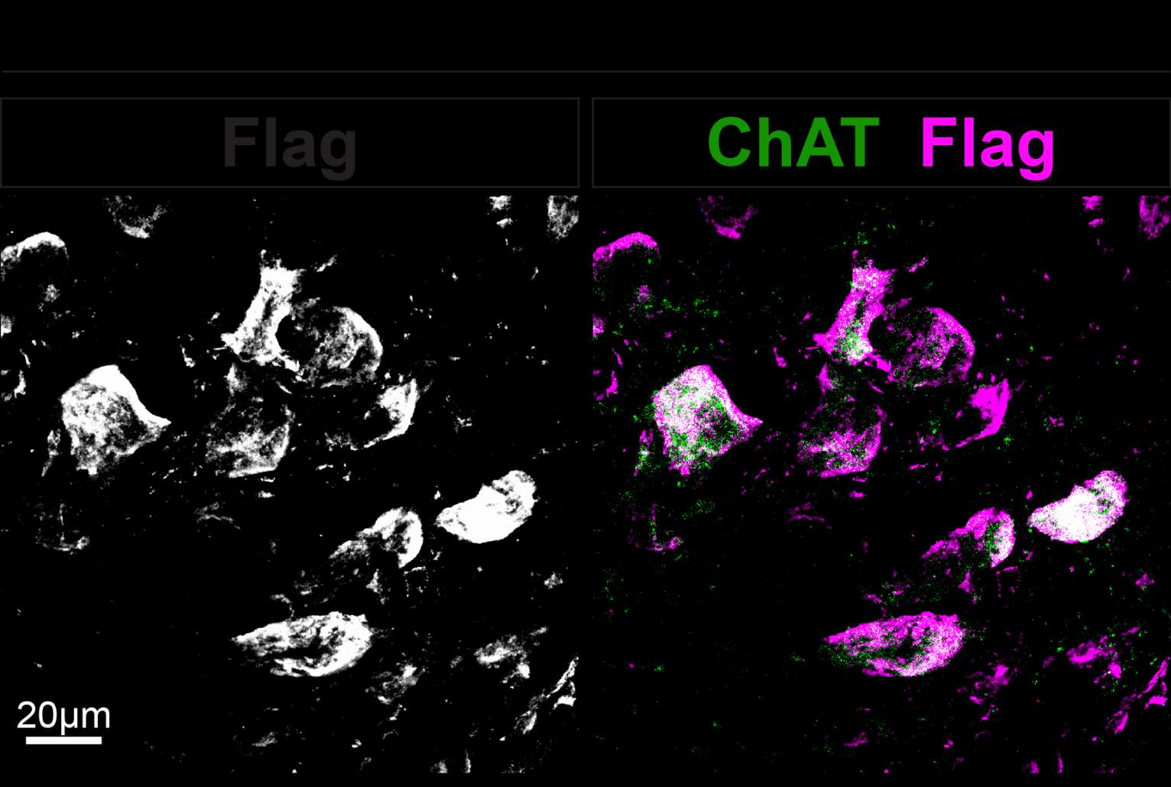
Understanding the evolutionary conservation of A730046J19Rik
1
The sequence and position of A730046J19Rik are conserved between mice and humans
Small ORFs (sORFs) are often overlooked in genomes
micropeptide: 10–100 codons
Low translation efficiency
Conservation across species
2
A730046J19Rik may encode a putative micropeptide Sertm2
5’UTR
sORF
3’UTR
In vitro verification
A730046J19Rik
In vivo verification
(LINC00890)
Human LINC00890 has been reannotated as “SERTM2”

Slide 5
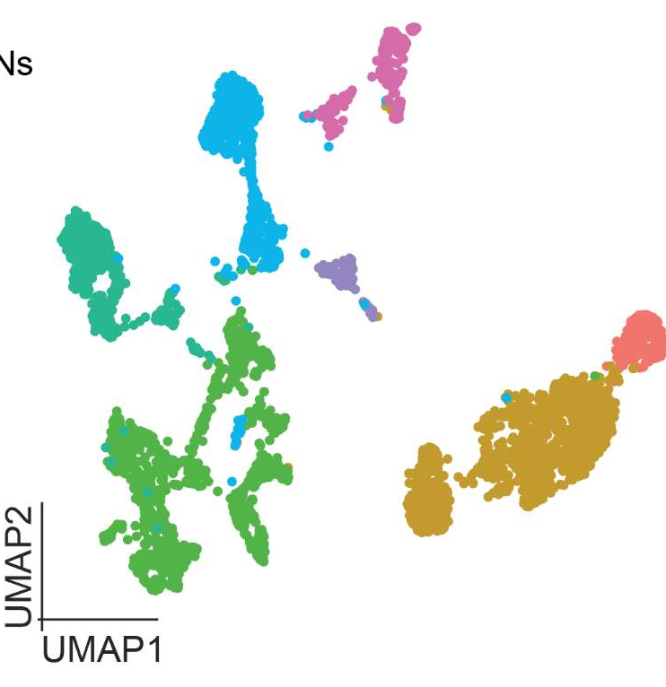
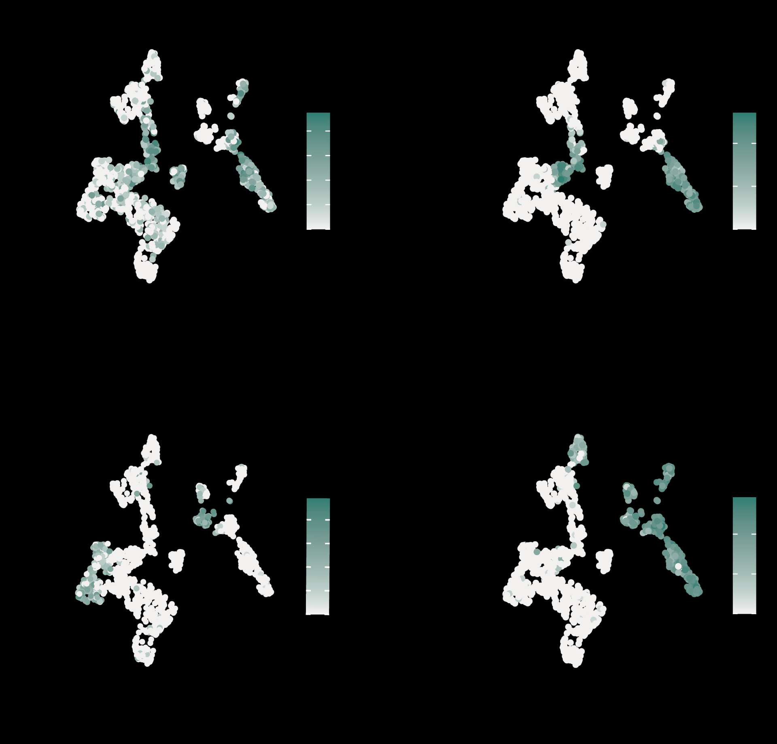
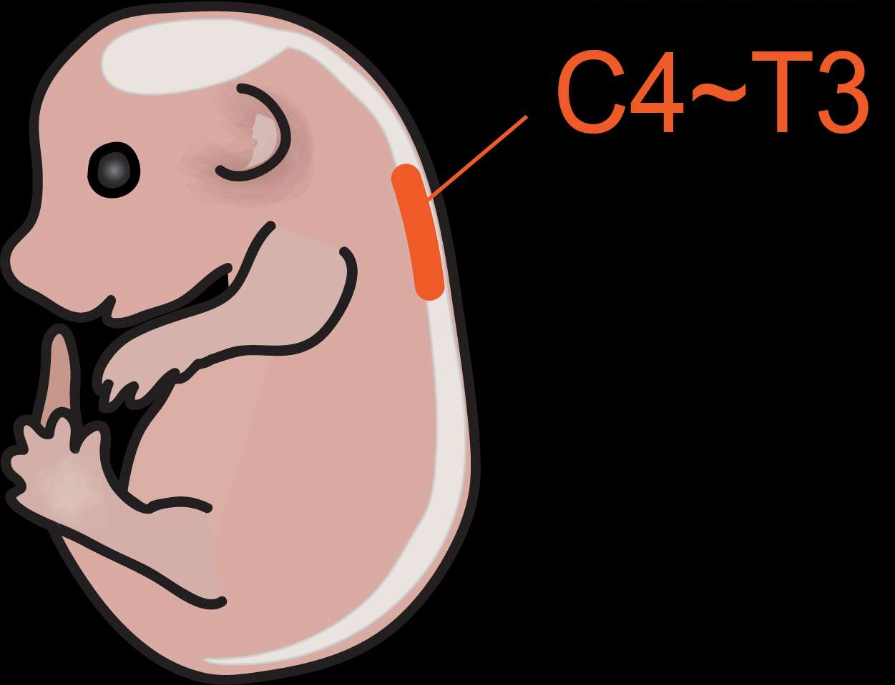
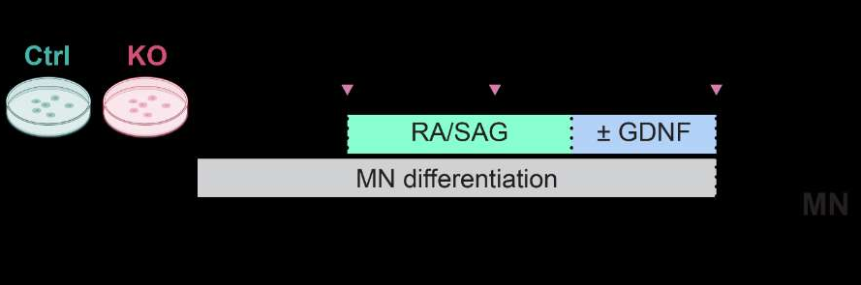


Profile the expression of Sertm2 in MN subtypes
Etv4
Sertm2
Brachial
E13.5
Mnx1-GFP
LMC
scRNA-seq
Trunk MNs
Limb MNs
(Liau et al., Nat. Commun., 2023)
Generic MN
Etv4⁺ MNs
Sertm2 Fold change
Sertm2 is enriched in post-mitotic MNs, particularly in Etv4⁺ motor pools
Etv4

Slide 6
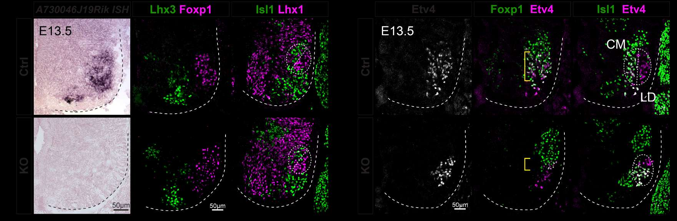
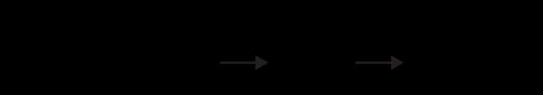
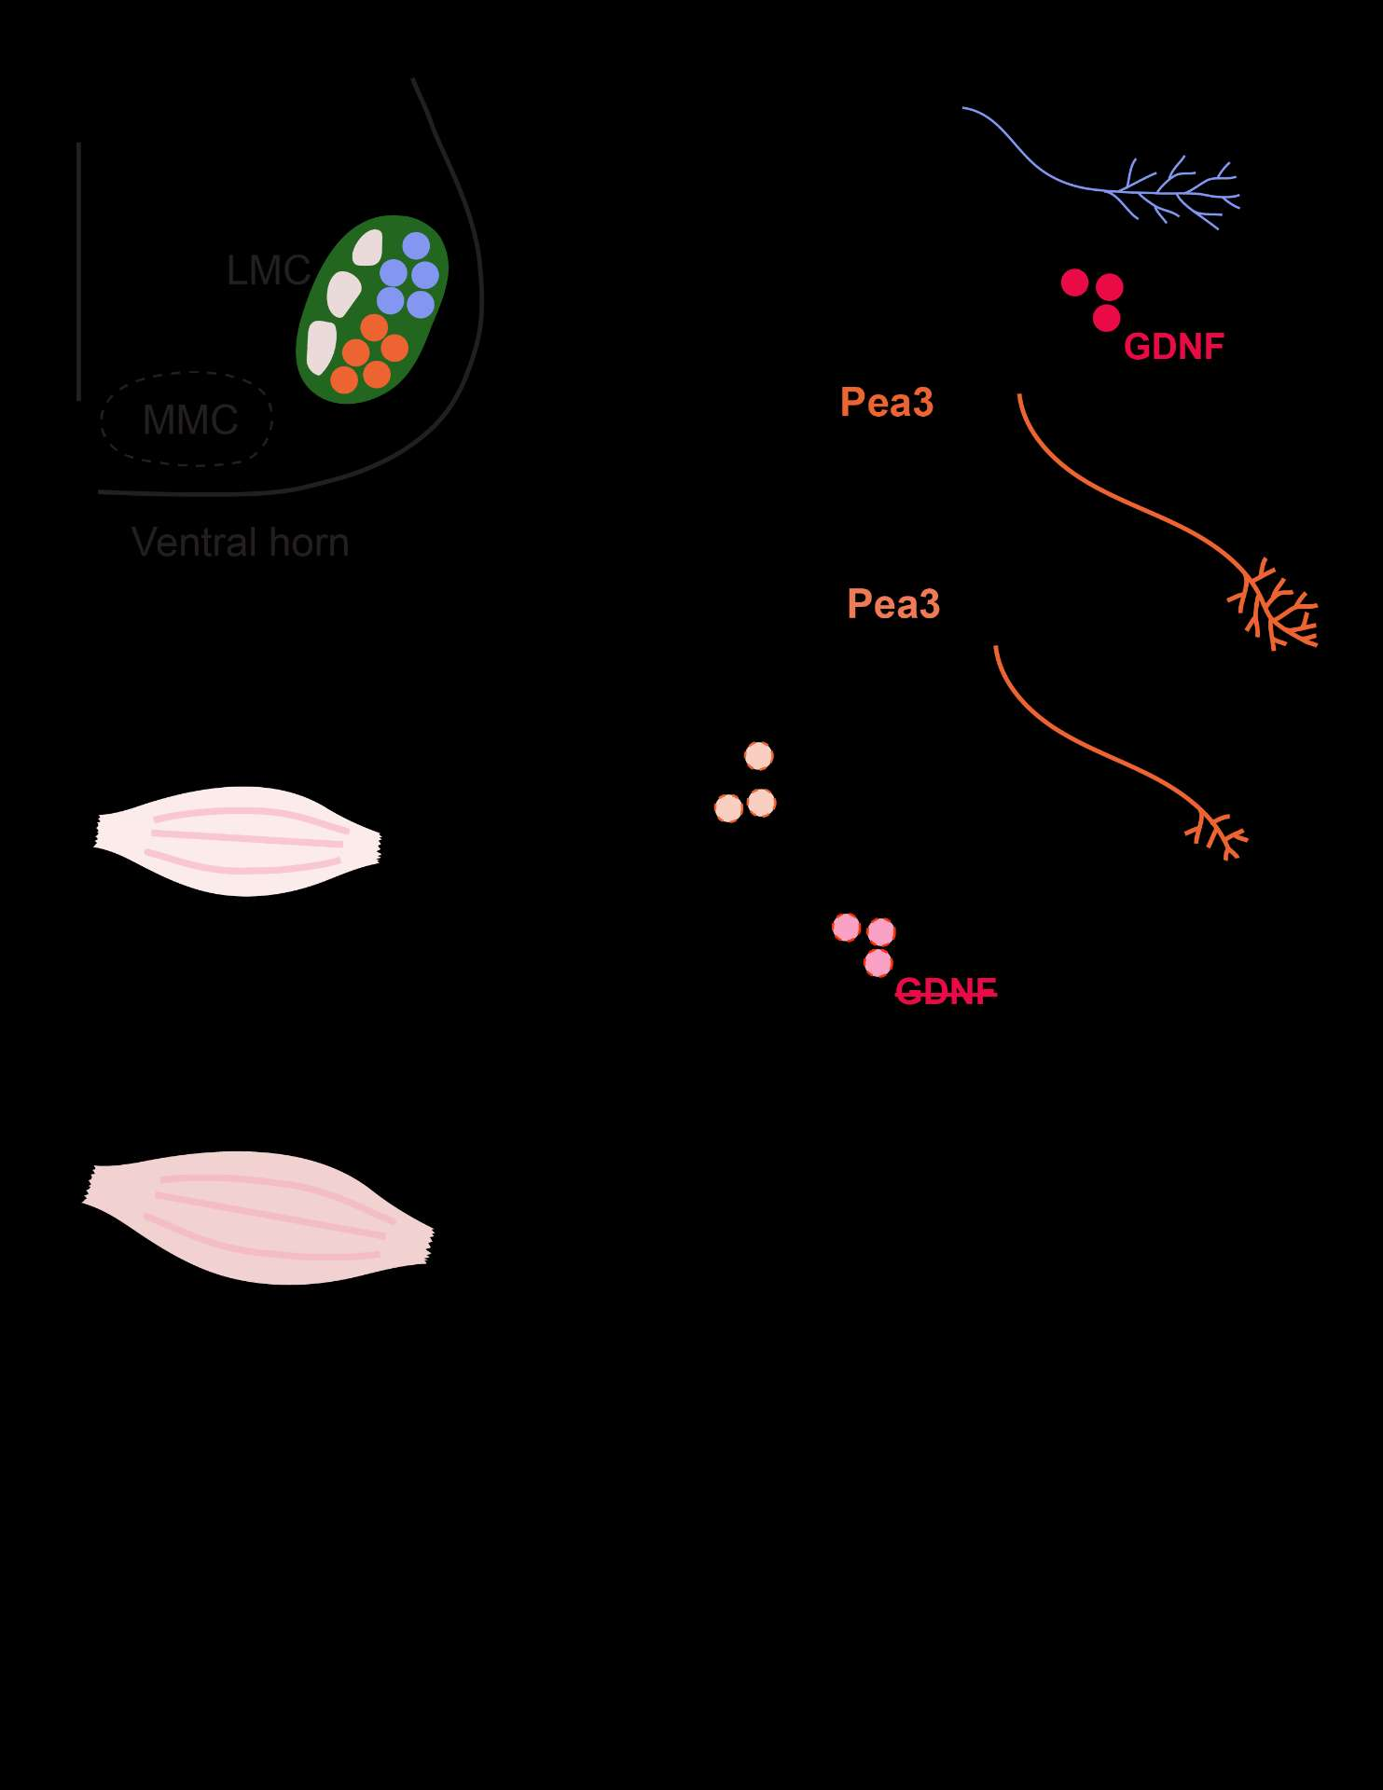
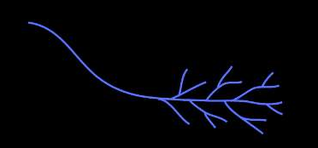
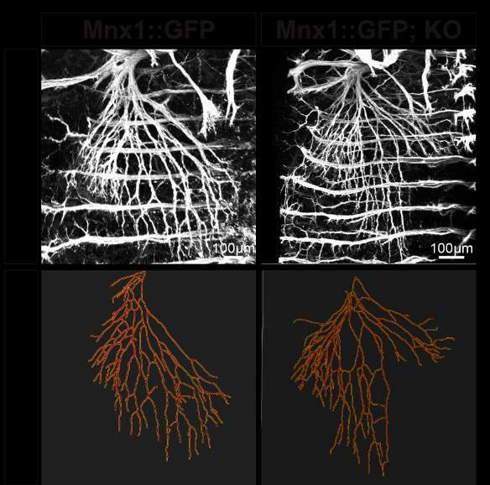
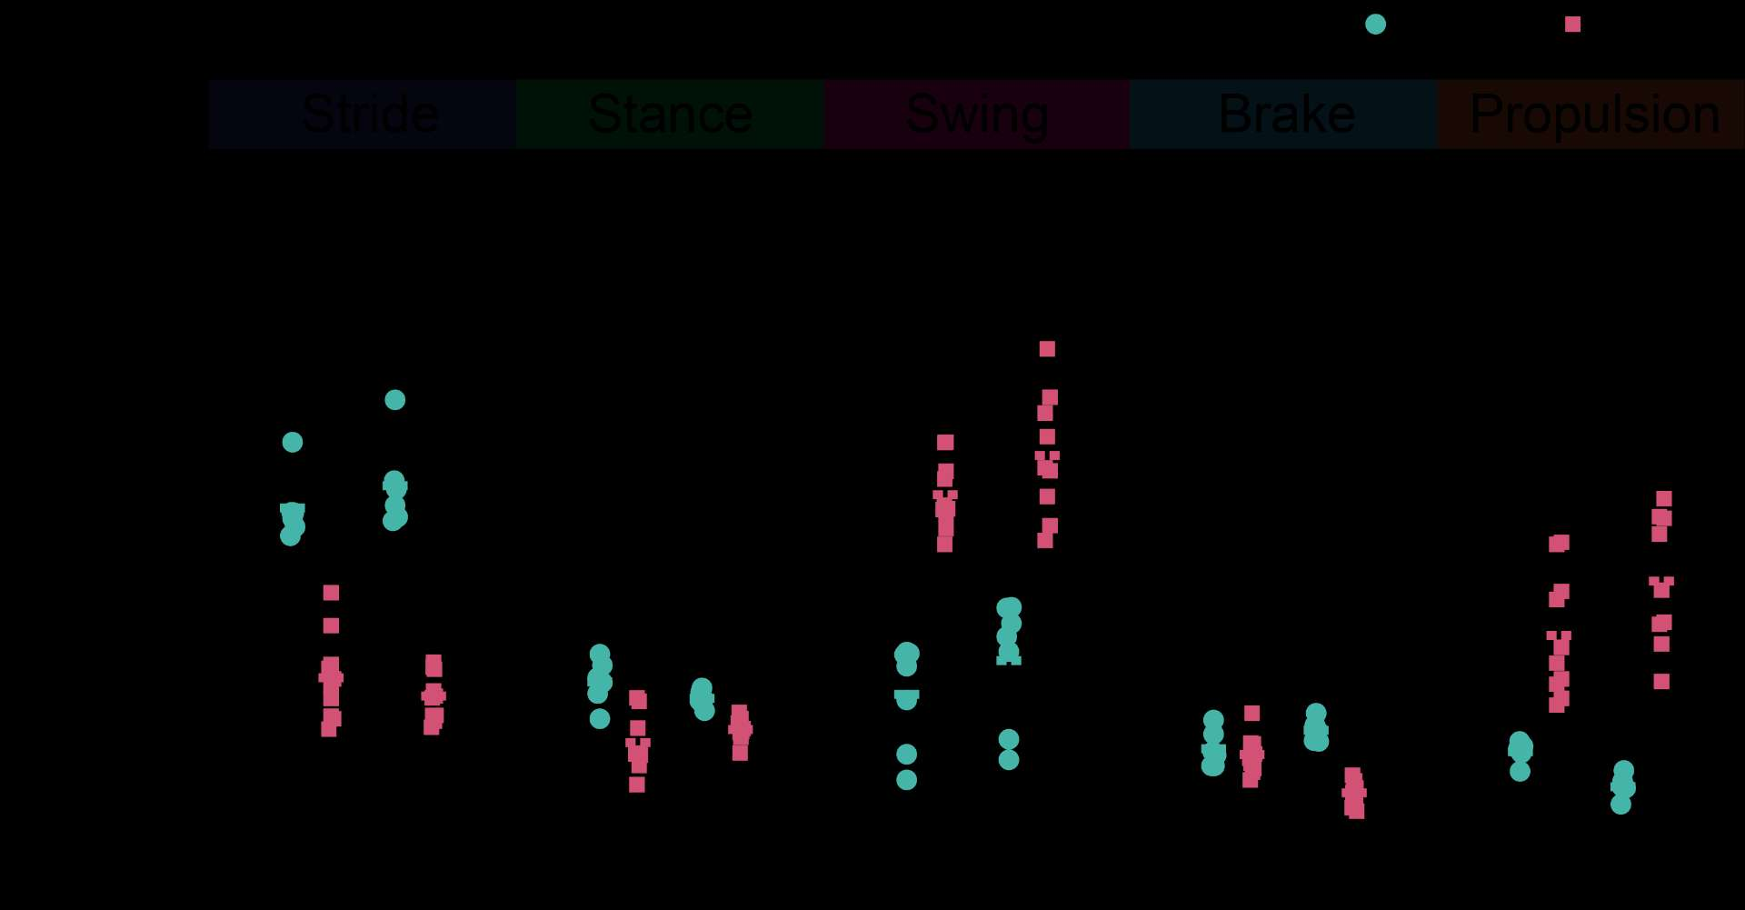
Explore the role of Sertm2 during MN development in vivo
1
Generic MNs
Columnar MNs
Etv4⁺ MNs
Sertm2 ISH
Sertm2
Etv4
2
Cutaneous maximus
3
Latissimus dorsi (LD)
Terminal arborization
Cutaneous maximus (CM)
Etv4-expressing MN subtypes and physiological function might be altered in Sertm2 mutant spinal cords
Lateral motor column (LMC)
Medial motor column (MMC)

Slide 7
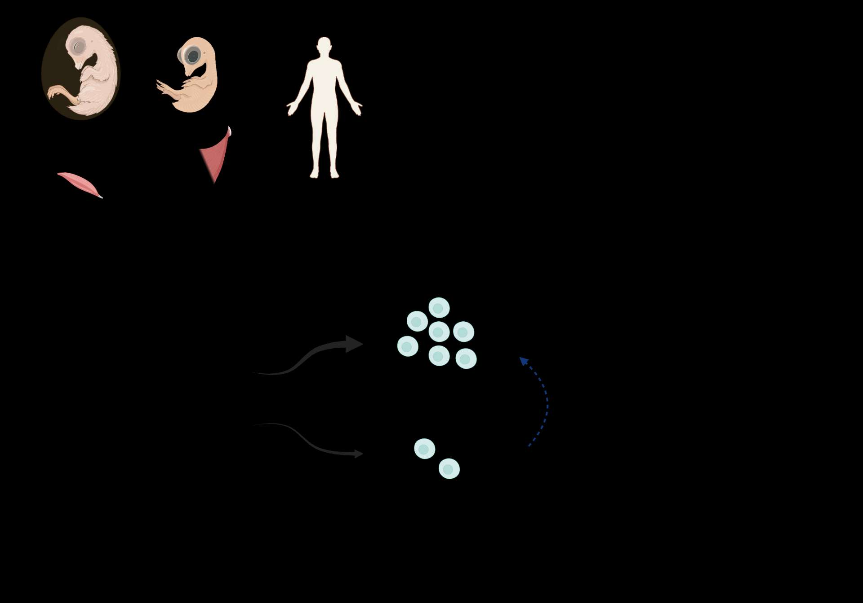

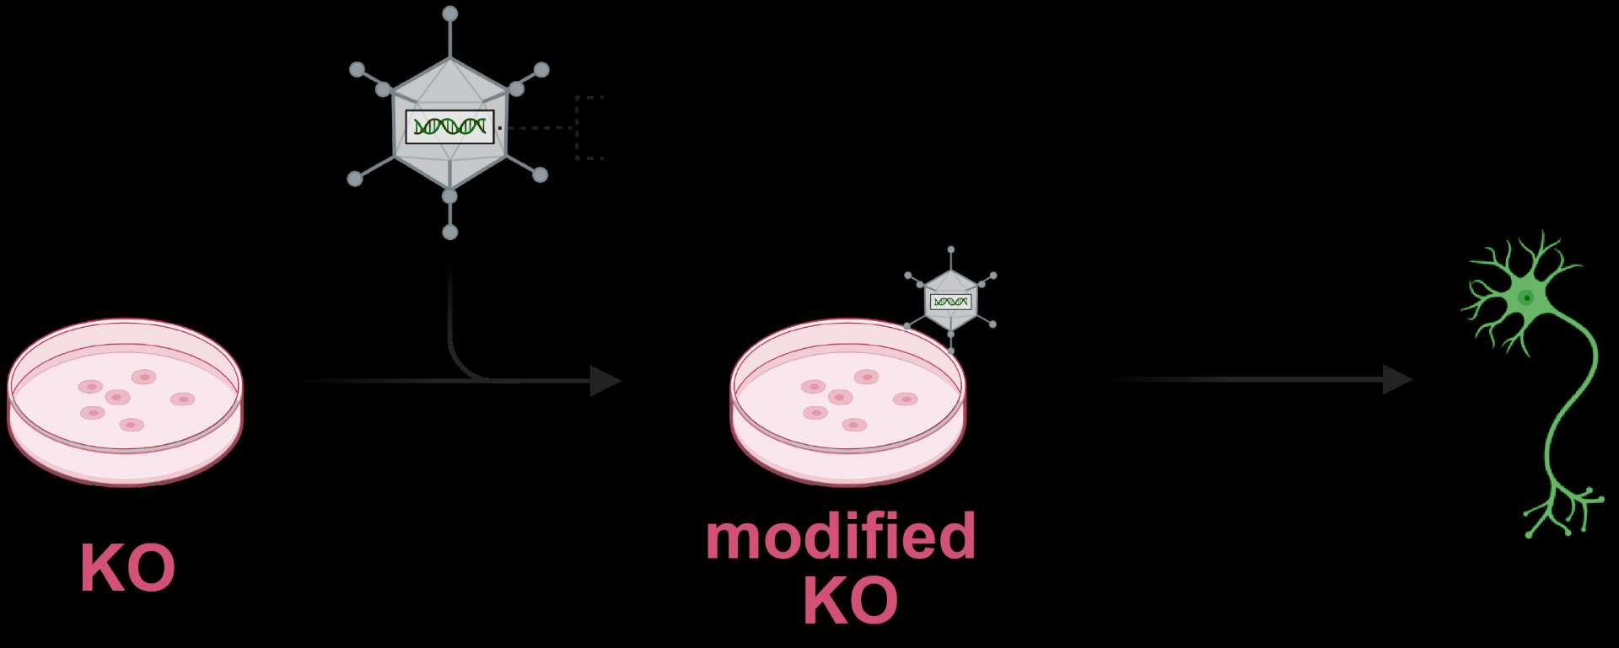

How does Sertm2 regulate Etv4 expression during MN differentiation?
Sertm2 FL
?
Micropeptide: Sertm2
Etv4
Sertm2^{KO}
Sertm2 protein administration rescues Etv4 downregulation in Sertm2 KO ESC-derived MNs

Slide 8
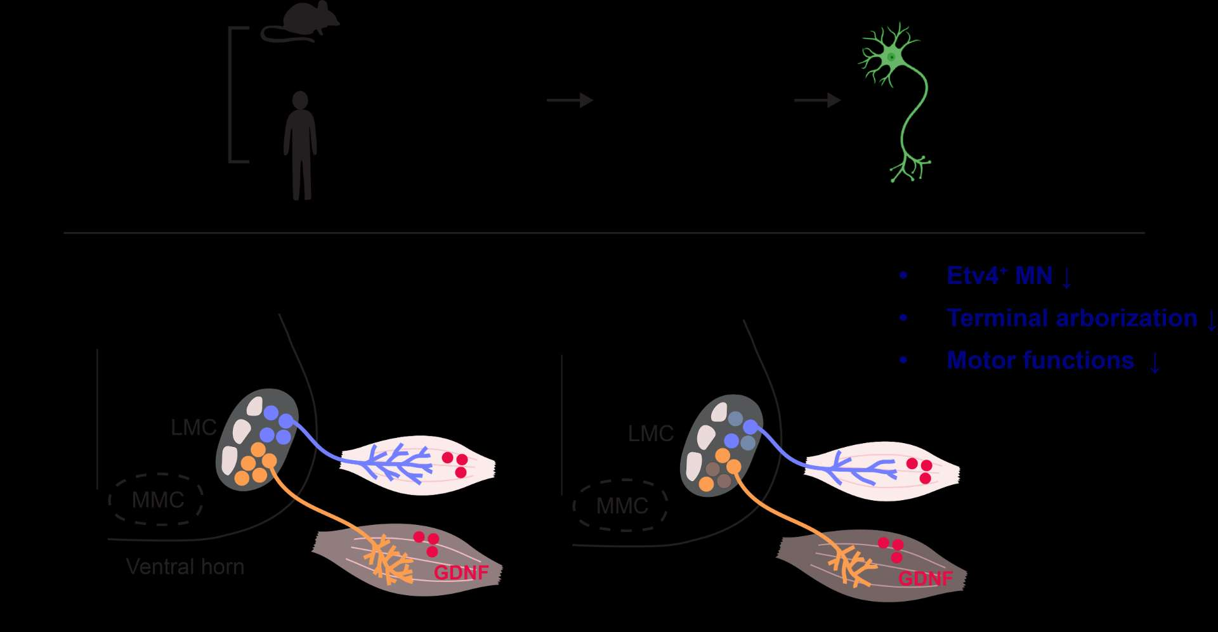
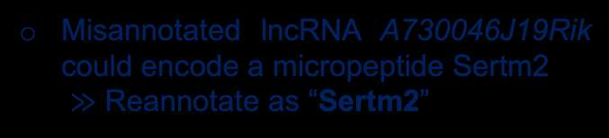
Summary
Misannotated lncRNA A730046J19Rik could encode a micropeptide Sertm2
$≫$ Reannotate as “Sertm2”
Sertm2 is a putative transmembrane protein expressed abundantly in postmitotic MNs
Sertm2 KO
Sertm2 may be a novel regulator to modulate the GDNF-Etv4 signaling pathway during MN differentiation
Sequence and functional conservation of Sertm2 between mouse and human

Slide 9


Acknowledgments
The JAC lab
Dr. Jun-An Chen
Dr. Ya-Ping Yen
Dr. Yu-Fu Wu
Dr. Ji-Dung Luo
Dr. Yu-Ying Chao
Xin Le Yap
Meng-Ting Tsai
Mien Chang
Yi-Ching Su
Ting-Hsiang Lung
Chuan-Che Wu
Guan-Lin Huang
Hung-Chi Fan
Yan-Cheng Lu
Ming-Chia Tsai
The JAC Lab
Academia Sinica/ Institute of Molecular Biology
Genomics Facility
Animal Facility
RNAi Core
Confocal Microscope Facility
Transgenic Core Facility
Lab website
Instagram
Notes:
Next, I would like to express my heartfelt gratitude to my colleagues, whose unwavering support has made this journey possible.
Working alongside such dedicated and inspiring individuals has truly been a privilege.
Thank you for your patience, insights, encouragement, and for always being there when I needed advice or a fresh perspective. I couldn’t have come this far without each of you.
I would like to give special thanks to Ho-Chiang for mentoring me when I first joined the lab, and to YP and Mien for your strong support in both my experiments and daily life from day one until now. A heartfelt thank you to Hung-Chi for collaborating with me over the past six months; your input has truly helped me think more deeply and learn so much.
I also want to extend my gratitude to the core facilities at IMB for facilitating the progress of my experiments.

