Slide 1

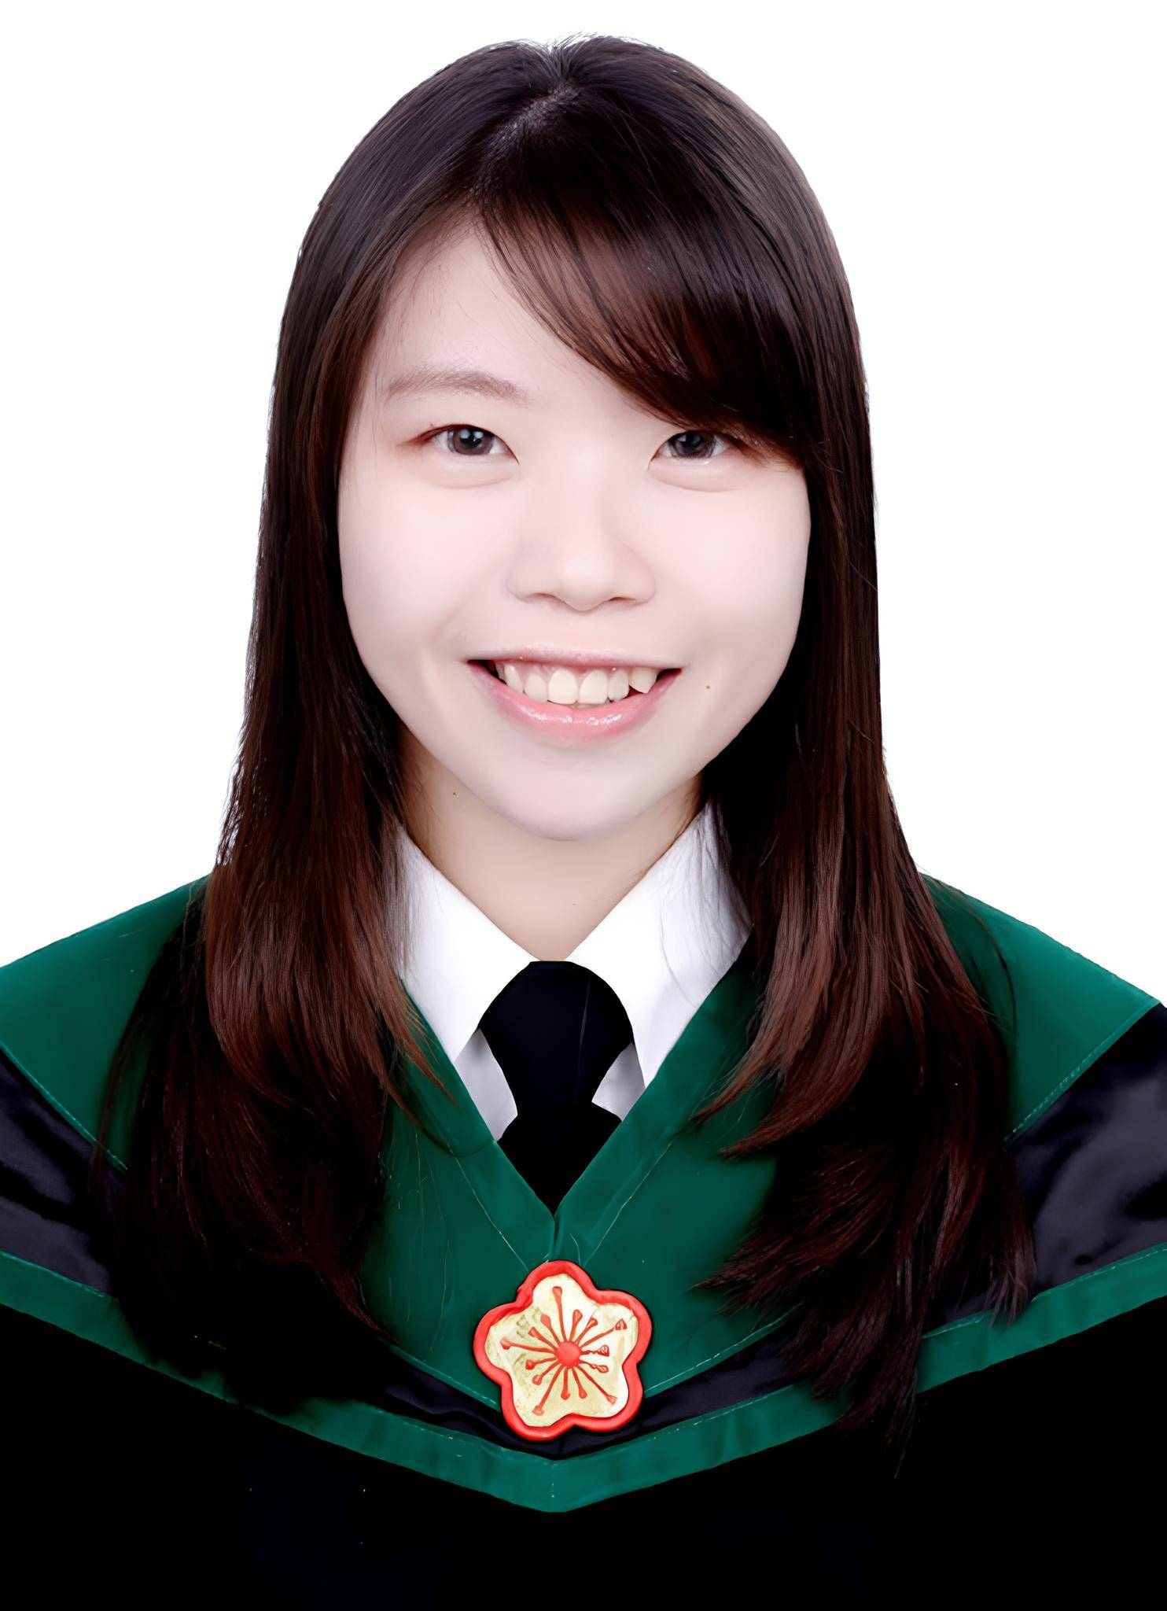

腸道菌透過迷走神經依賴胰高血糖素樣肽-1訊號途徑調節運動行為
The gut microbiota modulate locomotion via vagus-dependent glucagon-like peptide-1 signaling.
npj Biofilms and Microbiomes 10, 2 (2024).
入選者 賴姿廷
國立成功大學 醫學院
基礎醫學研究所

Slide 2

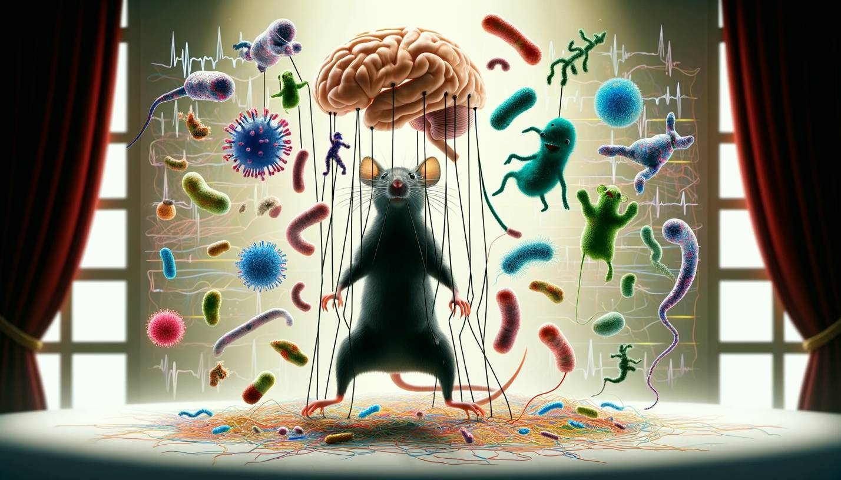


Wu’s lab Focus
Locomotion
…………..
Brain
HPA
Microbes
Anxiety
ANS
Immune
Hormone
Social behavior
ENS
Neuroactive
Gut
Gut dysmotility
Metabolite
Defensive behavior
Image was created with generated AI
HPA: hypothalamic-pituitary-adrenal axis
ENS: enteric nervous system
ANS: automatic nervous system

Slide 3
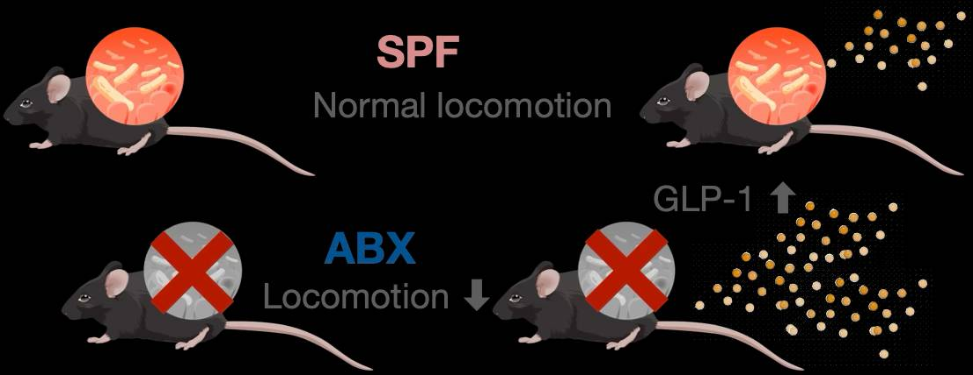
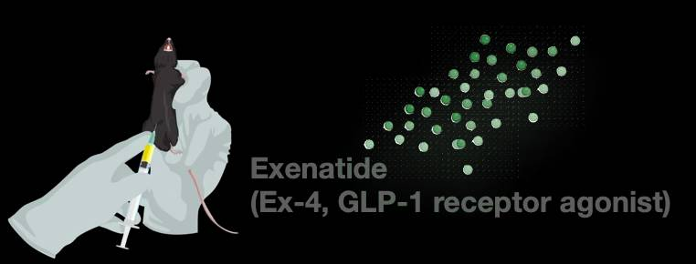
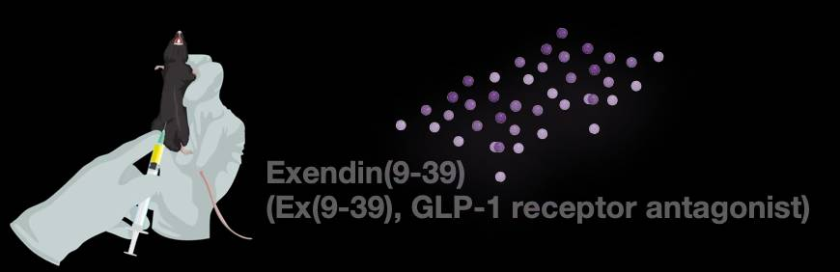

Depletion of gut microbiota by broad-spectrum antibiotic cocktail (ABX) causes hypolocomotion via GLP-1 signaling in mice
ABX
Board-spectrum antibiotics cocktail
Ampicillin, Vancomycin,
Metronidazole, Neomycin
Open-field test (OFT)
GLP-1: glucagon-like peptide-1
SPF: specific-pathogen-free

Slide 4
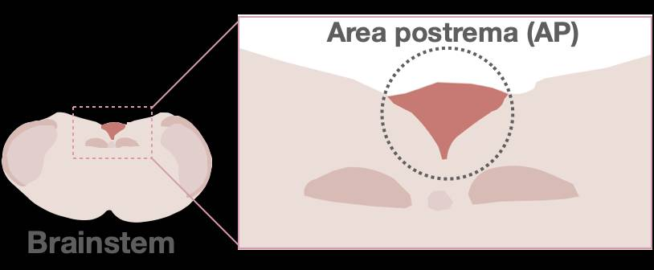
Higher numbers of c-Fos+ cells were detected in vagal ascending brain regions in ABX mice after OFT
OFT: open-field test
NTS: nucleus of the solitary tract
DMV: dorsal motor nucleus of vagus nerve
Ex-4: exenatide, GLP-1 receptor agonist
Ex 9-39: exendin(9-39), GLP-1 receptor antagonist

Slide 5
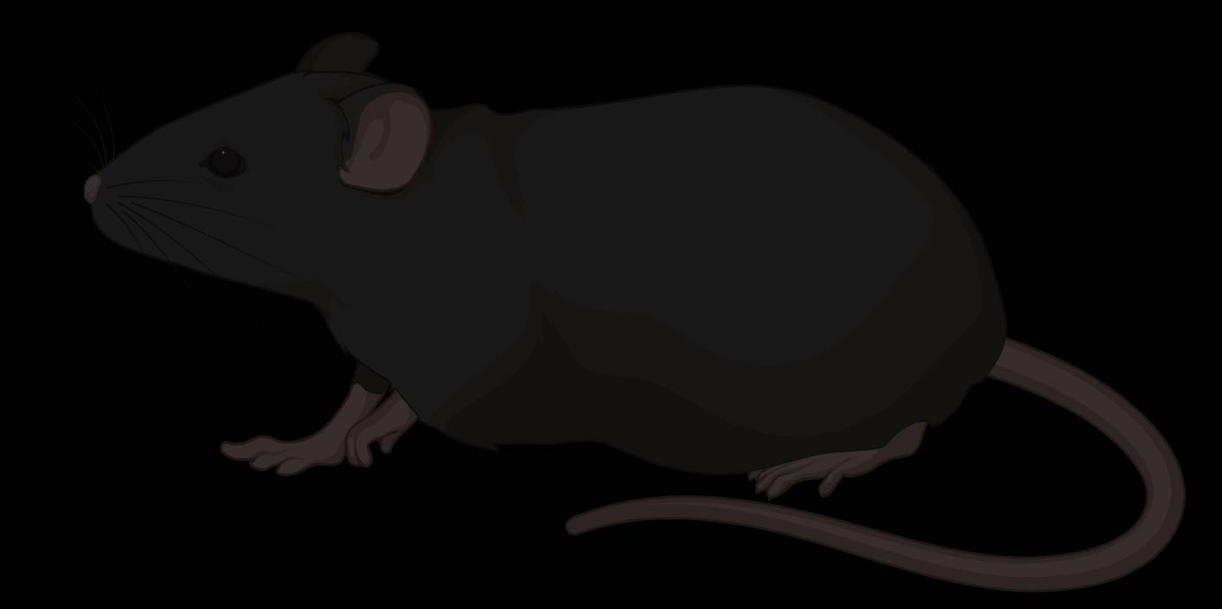
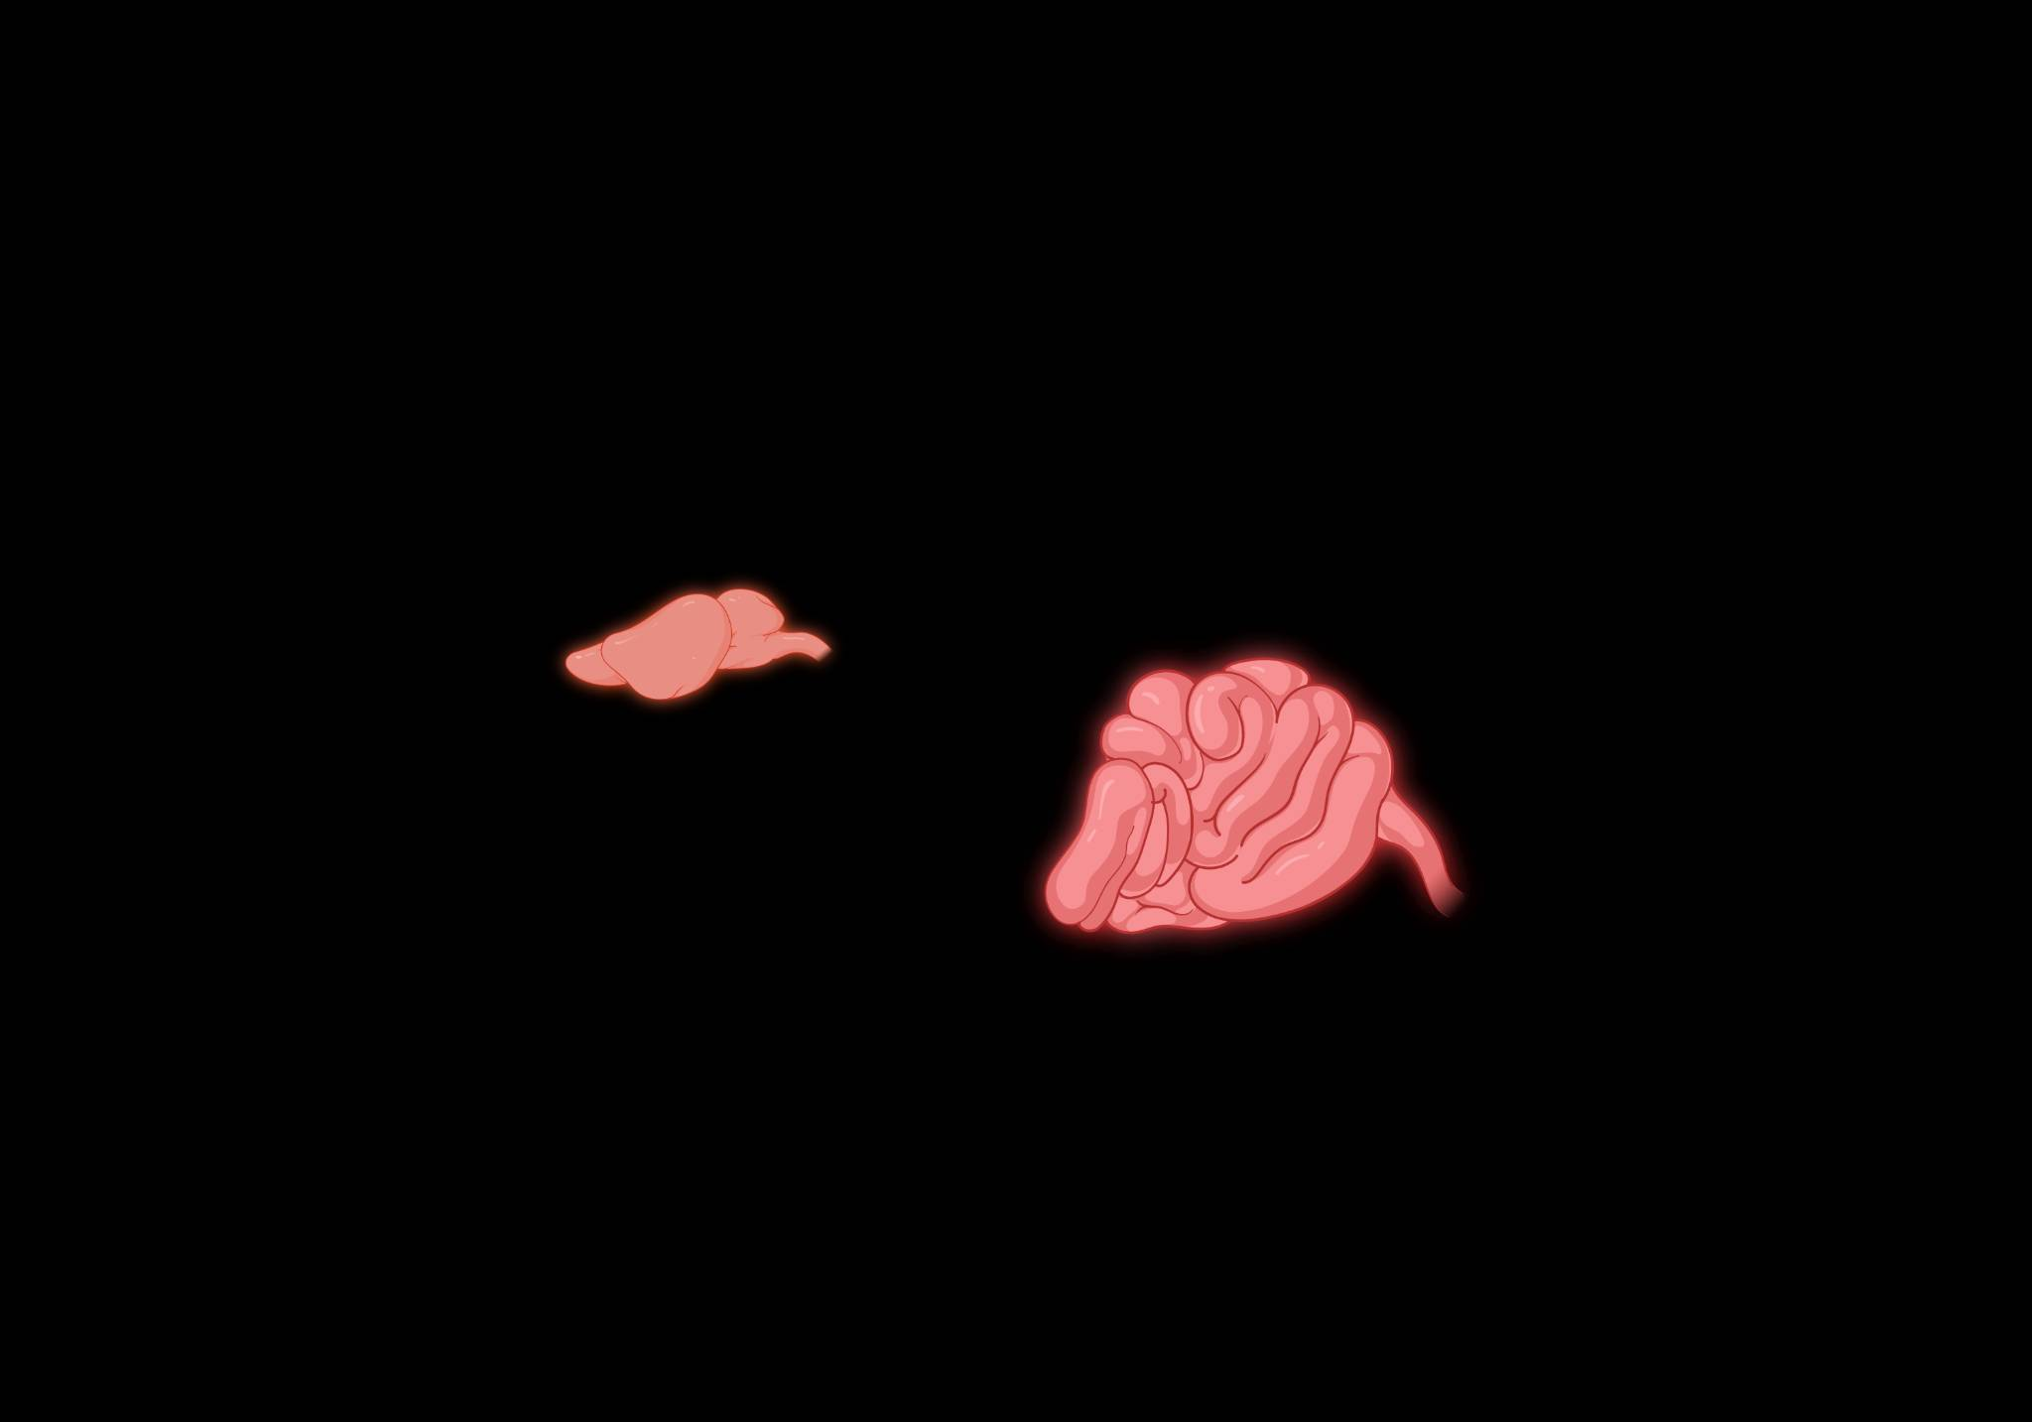
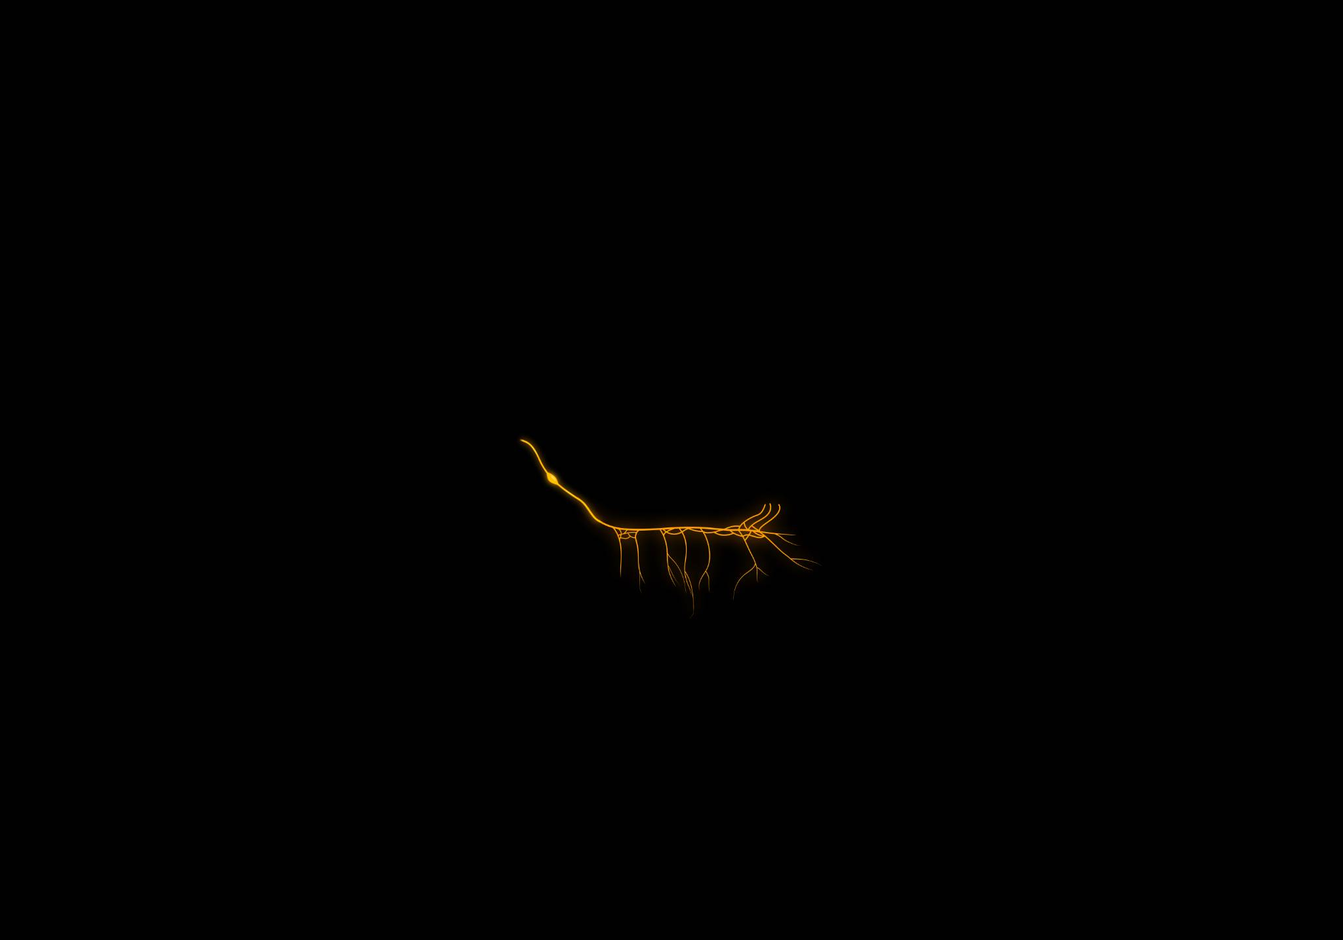

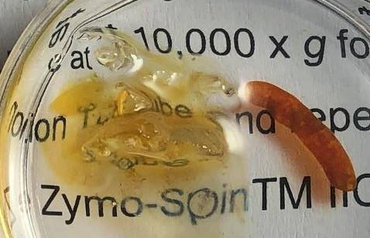
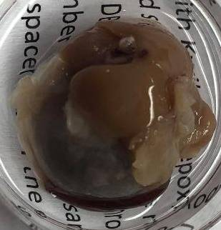
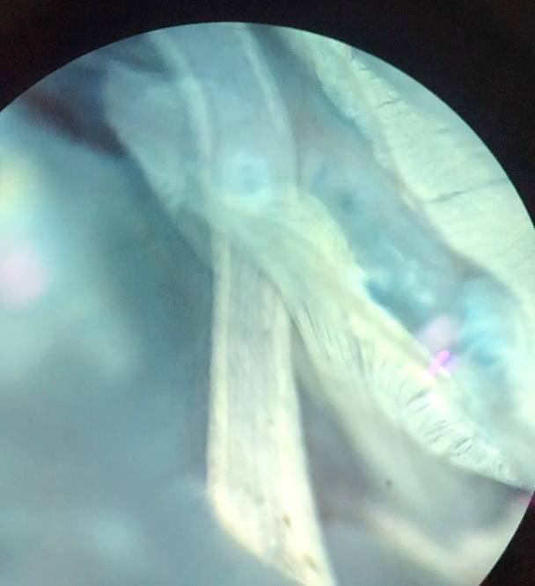
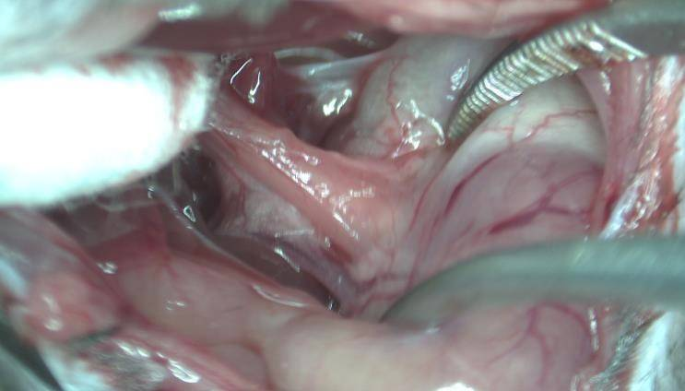
The subdiaphragmatic vagotomy (SDV) procedure restores hypolocomotion in ABX mice
Esophagus
Vagus nerve
Stomach
Subdiaphragmatic vagotomy (SDV)

Slide 6
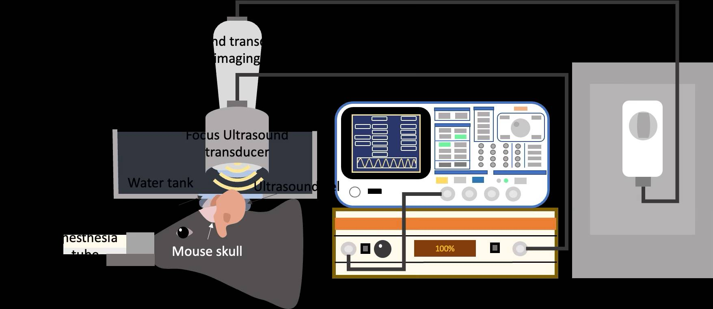
Focused ultrasound stimulation (FUS) on the brainstem of SPF mice induces the hypolocomotion phenotype
SPF
Focused ultrasound stimulation (FUS)
Sham
FUS
SPF: specific-pathogen-free
ChAT: choline acetyltransferase

Slide 7



Selective antibiotic treatment alters GLP-1 levels and gut microbiome in mice
Weighted UniFrac
GLP-1
Locomotion
……….
Unweighted UniFrac
Lactobacillus reuteri
Bacteroides thetaiotaomicron

Slide 8
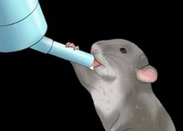
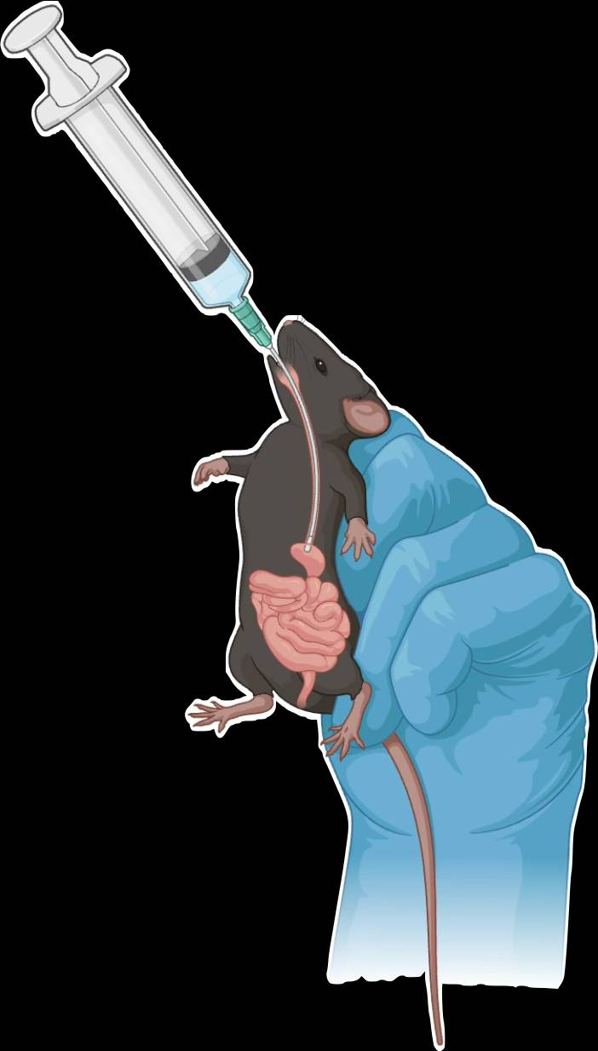
L. reuteri and B. thetaiotaomicron suppress GLP-1 levels and promote locomotion
Ampicillin-treated (Amp) mice
Germ-free (GF) mice
Lactobacillus reuteri
Lactobacillus reuteri
Bacteroides thetaiotaomicron

Slide 9
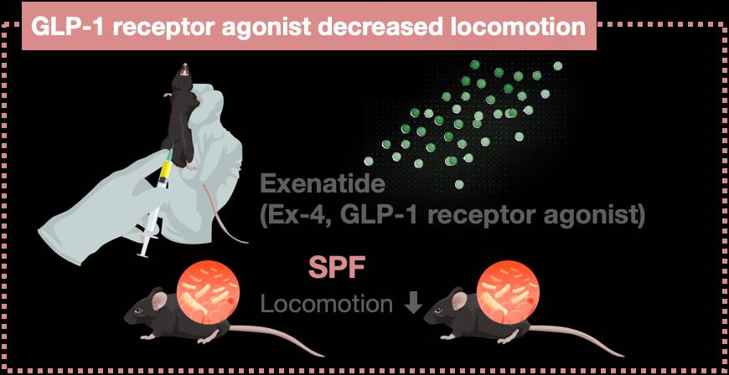
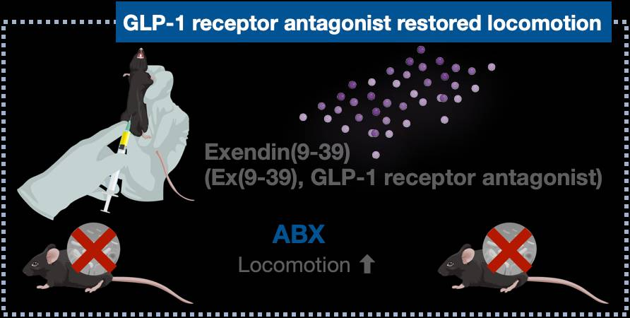
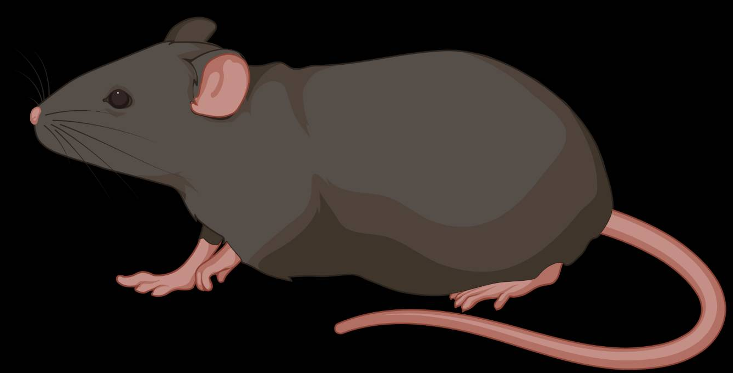
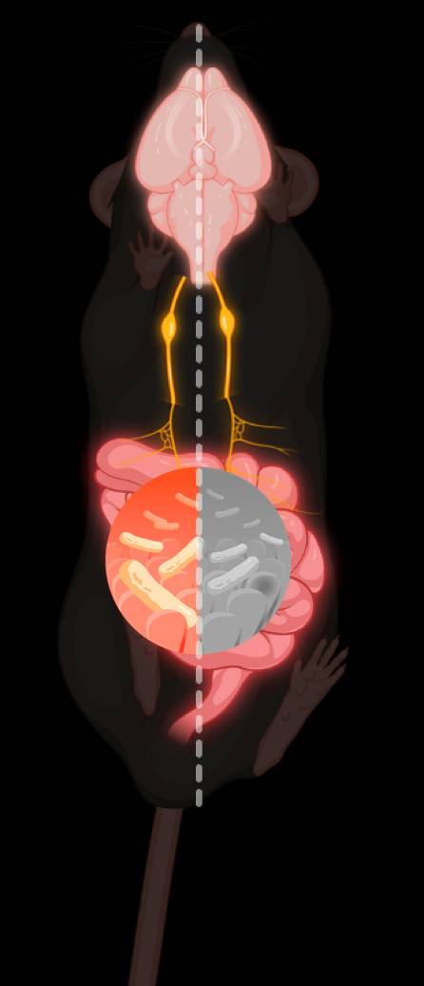

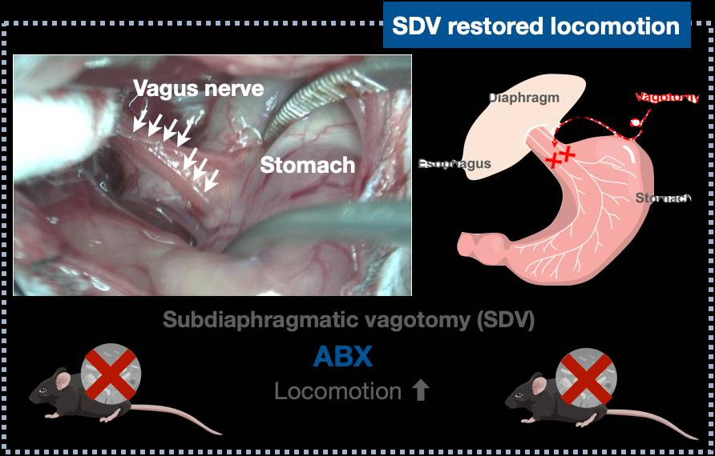
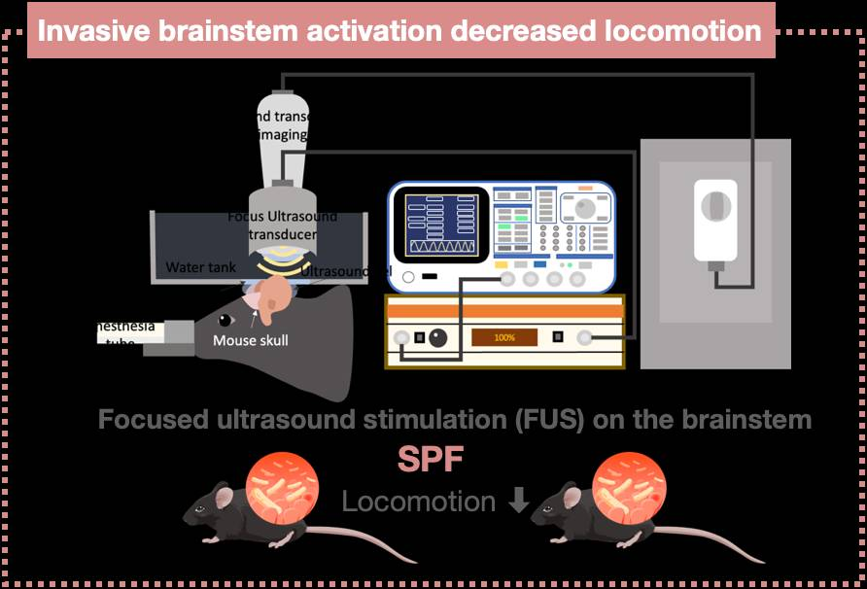
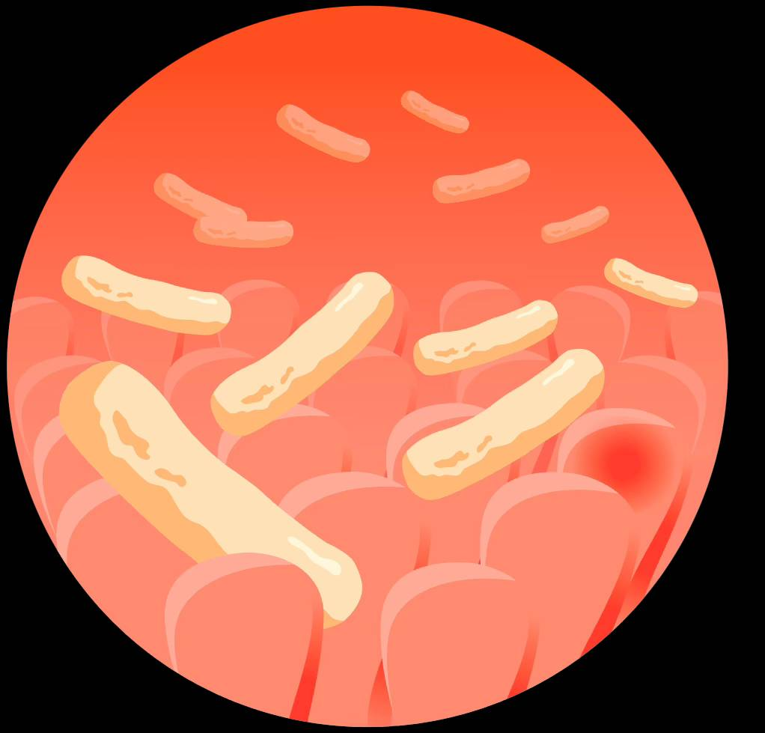
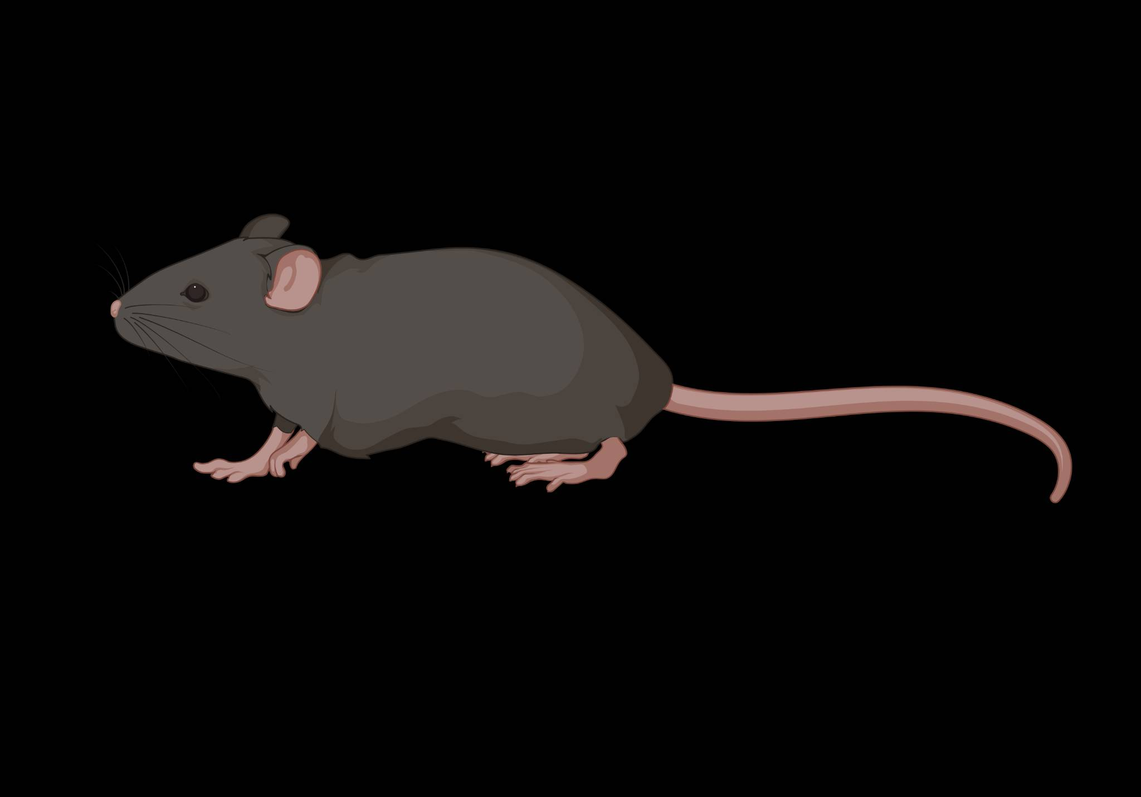
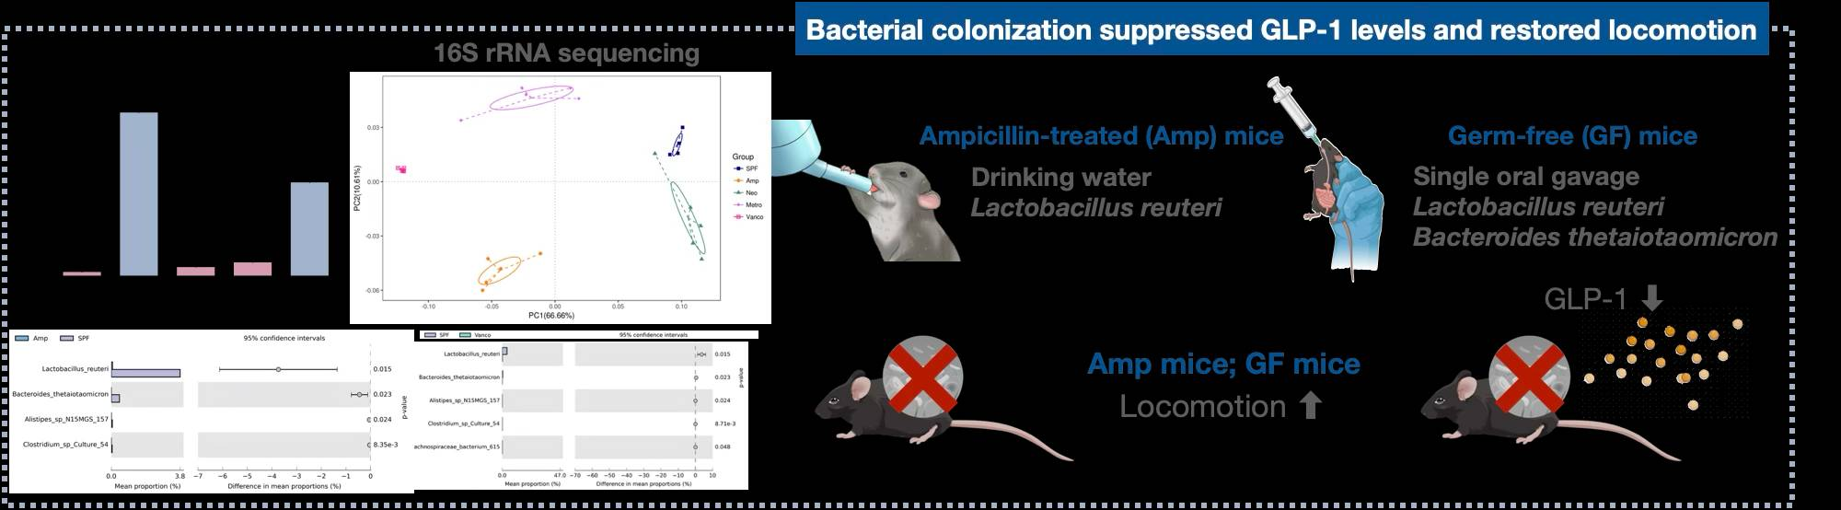
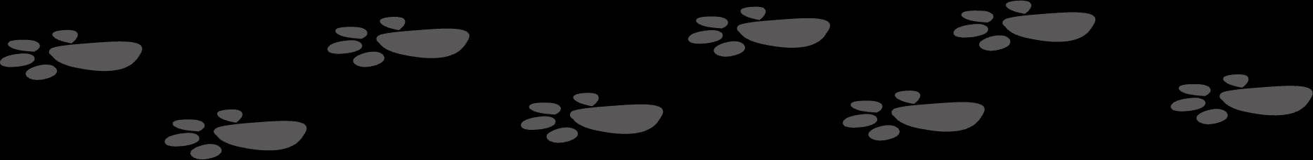
Gut microbial-mediated GLP-1 signaling regulates locomotor activity via vagal-dependent pathway
SPF
ABX
GLP-1
Vagus nerve
Locomotor activity
Gut microbiota

Slide 10
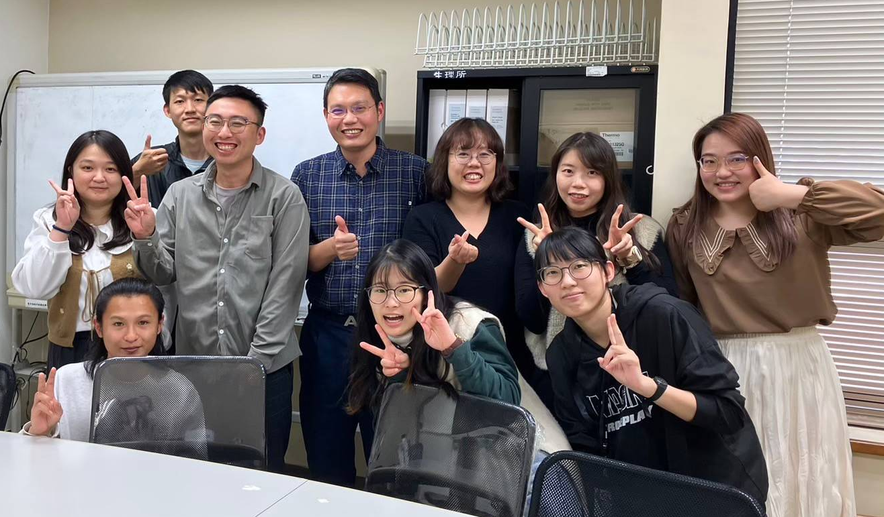
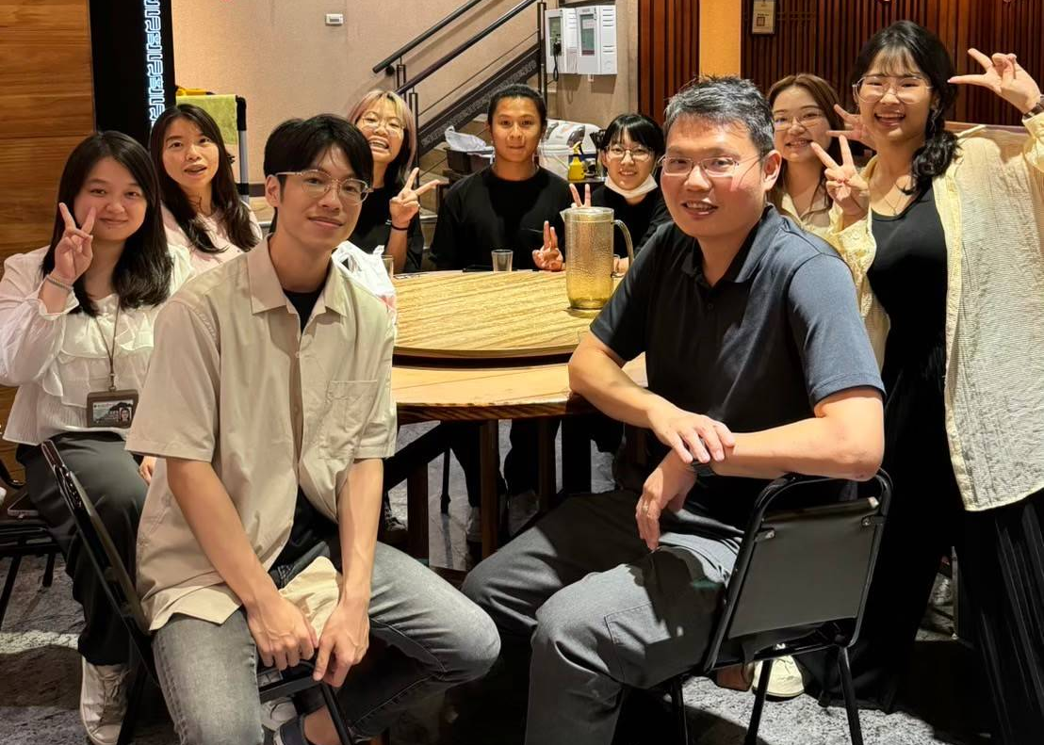






Acknowledgments
Advisor
Lab alumni
Collaboration
Prof. Wei-Li Wu
Chia-Wei Liou (PhD)
Jo-Ting Wu (MS)
Yuan-Yuan Lin (MS)
Jia-Ying Xue (MS)
Tzu-Hsuan Yao (MS)
Shin-Mei Wen (MS)
Kuan-Min Wu (BS)
Ying-Chia He (BS)
Chau Chuen (BS)
Ying-Lung Chen (BS)
Dong-Ting Ke (BS)
Focus ultrasound stimulation
Chin-Hsiang Fan (NCKU)
Yu-Tian Hou (NCKU)
Wu Lab
Yu-Hsuan Tsai (PhD)
Ju-Ching Cheng (MS)
Wei-Chen Chen (MS)
Yu-Chia Yu (BS)
Germ-free mice
Hsiao-Li Chuang (NLAC)
Service
Germ-free mice
NLAC
吳偉立
Animals obtain
武若庭
姚子宣
蔡于宣
NCKU LAC
Colon IHC
Omics Bio
劉嘉瑋
16S rRNA analysis
陳緯宸
BIOTOOLS Co., Ltd
鄭如晴
游昱嘉
文心玫

