Slide 1
什麼是兒童心智最早的功能性預測因子? What is the earliest functional predictor of mental function in child?
郭煌宗 ¹、陳妍廷 ²、翁岳塘 ³、林秀縵 ¹、蔡明倫 ⁴、吳亞倫 ³、葉宸妤 ³、 王韋竣 ³、劉書岑 ¹
¹ 中國醫藥大學兒童醫院兒少發展暨心智行為科 親職及兒童發展研究小組
² 馬偕基督教紀念醫院 ³ 中國醫藥大學附設醫院AI中心 ⁴ 中國醫藥大學兒童醫院 新生兒科
民國113年4月20日(星期六)
臺灣兒科醫學會第六十五屆年會暨第二五八屆學術演講會

Slide 2
Background
Problem
Developmental delay system in Taiwan helped 6% children,
but very limited patients are normalized
Early detection enables early intervention
Which functional predictor is earliest and most important?

Slide 3
Background
Known Facts
Significant correlated to future cognition
Hand’s manipulation by 8-10 m/o
Aberrant general movement by 2-4 m/o
Andrea Frick et al. J Exp Child Psychol. 2013. 115(4):708-20
C Peyton et al. AJNR Am J Neuroradiol. 2017 38(1):162-169.

Slide 4
Study Aim
Realize the correlation of development at four different ages, 6, 12, 24, 60 months, and to know the earliest prediction domain of future mental function
Build regression model via regularization with the biological and socioeconomic data

Slide 5
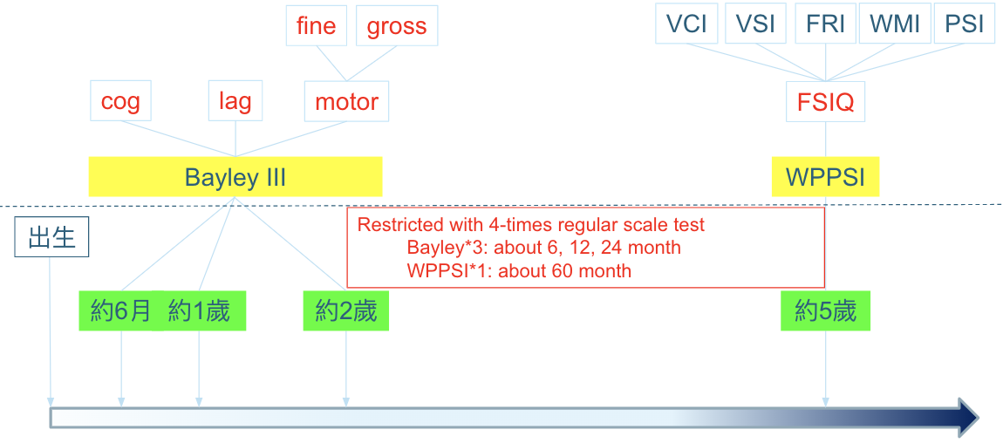
Method Flowchart
Pearson Correlation
384 VLBW preterm (2010-2021 CMUH)

Slide 6
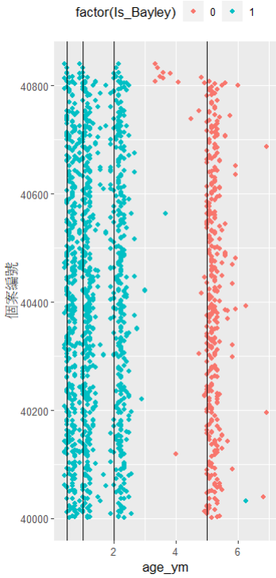
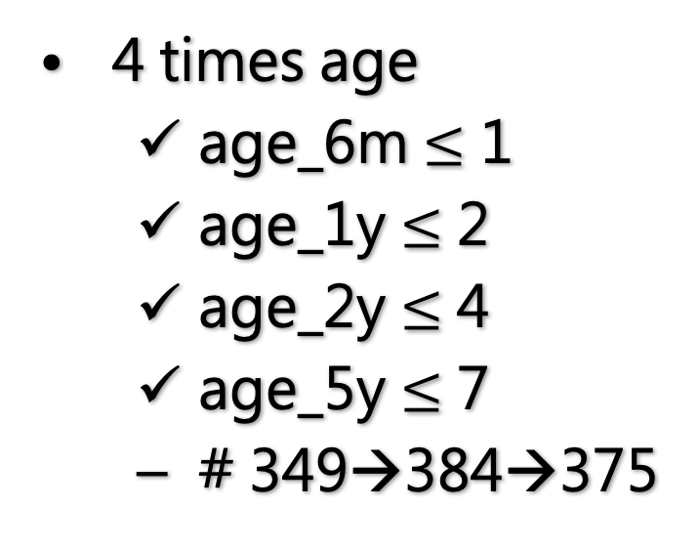
Data Mapping and Screening

Slide 7
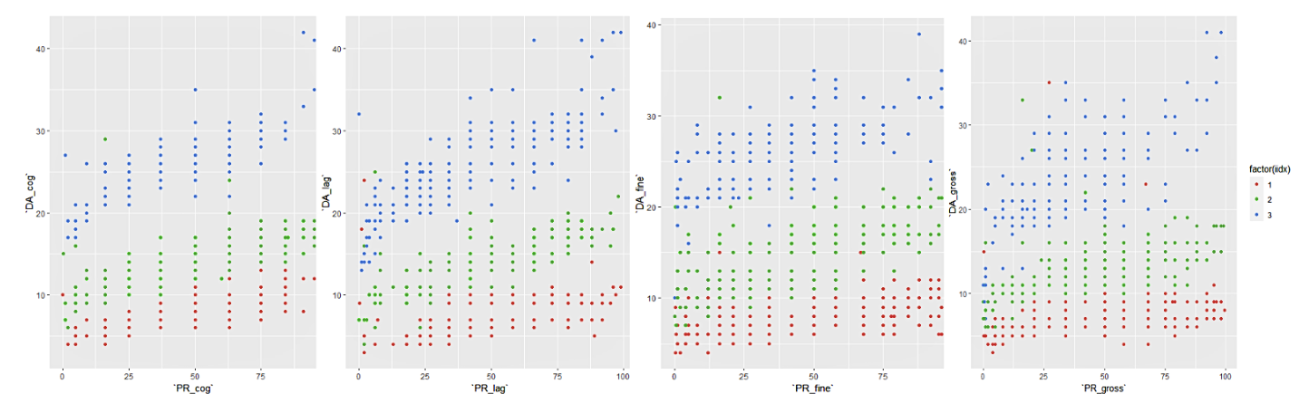
PR v.s DA
Cognition
Language
Fine Motor
Gross Motor

Slide 8
Variables
Basic Data
Biological
Neurodevelopment
Gestational age
Birth weight
Multiple Birth
Sex
Gravidity / Parity
CLD
Sepsis
Ventriculomegaly
Apgar at 1 / 5min
5 years old WPSSI
FSIQ
6, 12, 24 months Bayley
Cognitive
Motor
Language
Socio-economic
Maternal & Paternal Age/Job/Education

Slide 9
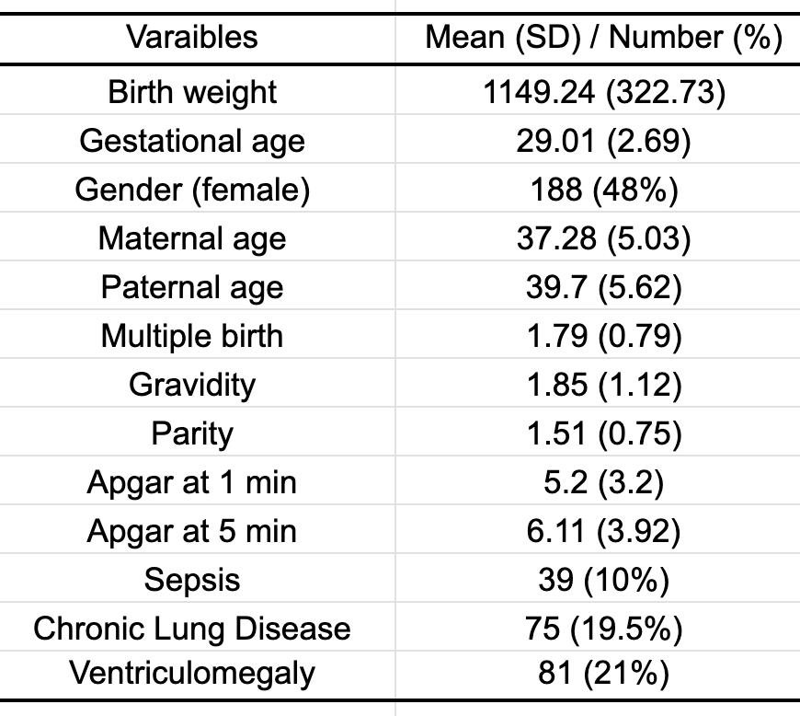
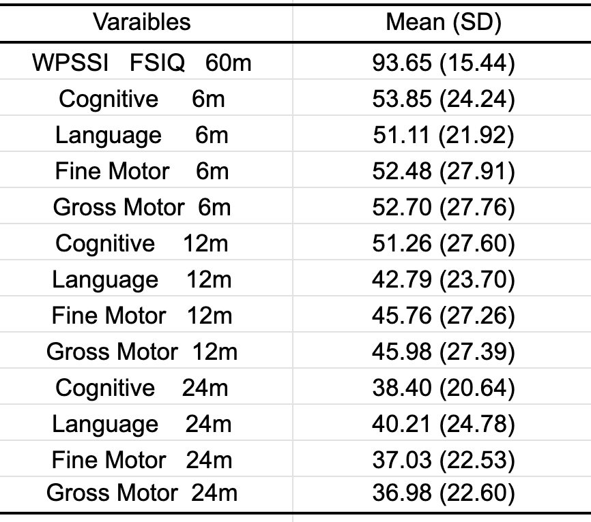
Demographic Data

Slide 10
Results
Correlation Between Bayley and FSIQ
 | Cognitive | Language | Motor
6 m/o | 0.289*** | 0.004 | 0.308***
1 y/o | 0.468*** | 0.429*** | 0.377***
2 y/o | 0.61*** | 0.602*** | 0.464***
P-value * ∈(0.01, 0.05] ** ∈(0.001, 0.01] *** ∈[0, 0.001]

Slide 11
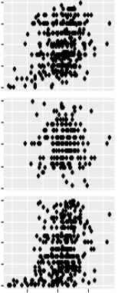
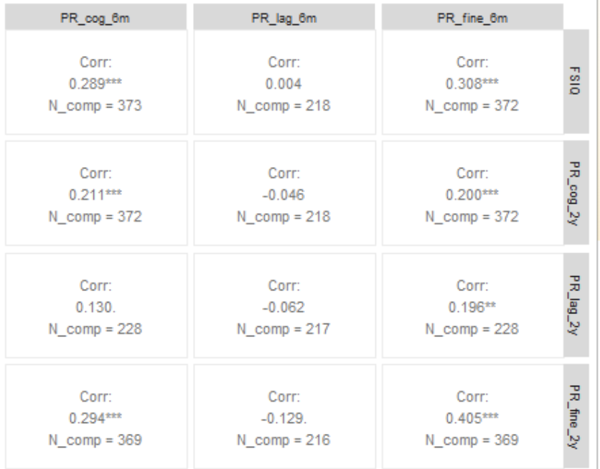
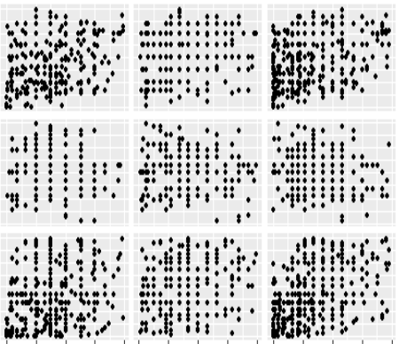
Results
cog_6m
lag_6m
motor_6m
0.289***
0.004
0.308***
FSIQ
0.211***
-0.046
0.200***
cog_2y
0.130
-0.062
0.196**
lag_2y
0.294***
-0.129
0.405***
motor2y

Slide 12
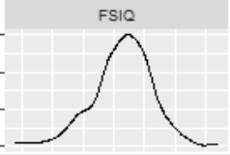
Results
cog_1y
lag_1y
motor_1y
0.468***
0.429***
0.377***
FSIQ
FSIQ
0.407***
0.331***
0.313***
cog_2y
0.418***
0.495***
0.347***
lag_2y
0.405***
0.290***
0.475***
motor2y

Slide 13
Results
The age closer to 5 y/o, the higher power of consistency. The strongest correlated factor changed by time.
At 6 m/o, motor is the strongest correlated factor with future cognitive.
The correlation of motor at 6, 12, 24 m/o to cognitive function at 5 y/o are positive and consistent.

Slide 14
Conclusions
In the past, we used deficit compensation philosophy among early intervention, but not inter-domain regulation.
In the present study, we can predict cognitive outcome through motor function in early age.
Future study with intervention-based research was suggested, to validate the correlation between early motor training at 6 months of age, and improving cognitive function.

